Slide 1
Dublin Economics Workshop Conference on Irish Economic Policy
Croke Park Conference Centre, Dublin
27th January 2012
“Well-being and Economic Conditions in Ireland “
Brendan Walsh
Professor Emeritus
School of Economics, University College, Dublin
E-mail: Brendan.m.walsh@ucd.ie

Slide 2
Earlier version available as a
UCD School of Economics
Working Paper:
http://www.ucd.ie/t4cms/WP11_27.pdf

Slide 3
My interest in this topic was sparked by the spate of commentaries in the Irish papers to the effect that the country’s mental health and well-being have declined dramatically during the current economic crisis.
Well-publicised claims have been made that indicators of stress and illness have soared, including:
  The suicide rate
  The rate of psychiatric illness
  Alcoholism

Slide 4
Closer examination shows that the evidence for some of these claims is weak.
For example, the association between the unemployment and suicide rates is weak.

Slide 5
Suicide Rate, Population 14+
Three-year moving average
Suicide Rate, Males aged 25-34
Three-year Moving Average

Slide 6
A lot of evidence about the level of subjective well-being (SWB) in Ireland is now available from a burgeoning range of survey results.
This evidence suggests that the Irish population rates its SWB high by international standards.

Slide 7
Gallup World Poll:
  In 2010 Ireland ranked tenth out of forty advanced countries in terms of ‘Life Satisfaction’ and twelfth in terms of day-to-day happiness as measured by ‘Positive Affect Balance’.
Survey on Income and Living Conditions (SILC):
  In 2010 79 per cent of the Irish population aged 18 and over perceived themselves to have been happy all or most of the time over the four weeks prior to the interview.

Slide 8
Self-perceived health status:
  In both the 2007 and 2010 SILCs, 87 per cent of the Irish population aged 18 and over reported that their health was either ‘very good’ or ‘good’
Eurobarometer question on life satisfaction:
  In 2011 Ireland ranked eight out of the 27 EU countries

Slide 10
The Eurobarometer results provide the only reasonably long time series available on Irish SWB.
Here’s Ireland’s average yearly scores over the period 1975-2011 and a comparison with the EU average.

Slide 11
Eurobarometer Index of Life Satisfaction
Ireland’s Annual Average Score

Slide 13
With the exception of 1987-88, Ireland has been consistently above the EU average on this measure
There is no long-run trend in this score even though real per capita income rose more than three-fold over these years and many other indicators relevant to life satisfaction, such as educational attainment and life expectancy, also improved markedly.

Slide 14
Ireland’s score has been relatively stable, with a coefficient of variation of 4 per cent, compared with 48 per cent for the unemployment rate.
Ireland’s score fell during the deep recession of the 1980s to a low point in 1987 but rebounded as the economy recovered and reached a peak in 1997 that was only narrowly surpassed in 2004.
Compared with other PIIGS, we seem to be weathering the crisis well.

Slide 15
Weathering the Crisis

Slide 16
Explaining variations in SWB
The level and / or growth of real income is expected to measure long-run trends in welfare.
  Easterlin Hypothesis and its critics
Textbooks typically specify a short-run social welfare function in inflation and unemployment
I have used a simple regression model with the life satisfaction score as dependent variable and the unemployment rate, the inflation rate, and the level and growth rate of real per capita Gross National Income (GNI) as explanatory variables.

Slide 17
 | Life Satisfaction Regression Results Dependent variable = Ireland’s Average score on Eurobarometer Index of Life Satisfaction Absolute values of t-ratios in parentheses
 | Equat-ion no. | Intercept | UR | INF | lnGNI | GNI g.r. | R² | Durbin-Watson Statistic
 | Sample period: 1975-2011 Exact ML estimates assuming AR(1) residuals
 | 1 | 2.15 (6.7)*** | -0.88 (1.6) | -0.06 (0.1) | 0.04 (0.5) |  | 0.50 | 2.11
 | 2 | 2.29 (46.9)*** | -1.04 (3.0)** | -0.18 (0.7) |  | 0.31 (1.0) | 0.51 | 2.10
 | 3 | 2.31 (49.6)*** | -1.09 (3.1)** | -0.27 (0.9) |  |  | 0.51 | 2.11
 | Sample period 1975-1993 Ordinary least squares
 | 4 | 1.40 (2.3)* | -2.48 (2.8)* | -0.34 (0.6) | 0.39 (2.0) |  | 0.50 | 1.69
 | 5 | 2.56 (11.8)*** | -2.76 (2.4)* | -0.88 (1.2) |  | 0.019 (0.0) | 0.36 | 1.45
 | 6 | 2.56 (15.2)*** | -2.78 (2.9)* | -0.89 (1.6) |  |  | 0.40 | 1.45
 | Sample period 1994-2011 Ordinary least squares
 | 7 | 2.77 (10.1)*** | -1.17 (2.7)* | -1.55 (1.8) | -0.12 (1.8) |  | 0.20 | 1.92
 | 8 | 2.31 (65.2)*** | -0.83 (2.9)* | -1.79 (2.5)* |  | 0.64 (2.9)* | 0.38 | 2.17
 | 9 | 2.29 (53.9)*** | -0.63 (1.9) | -0.82 (1.0) |  |  | 0.08 | 1.55
*p < .05 **p < .01 ***p < .001

Slide 18
Summary of Irish regressions for
Life Satisfaction (LS)
Unemployment reduces LS
  Level and significance of this effect greater in earlier than in later years
Inflation reduces LS
  Coefficients generally not statistically significant
National Income raises LS
  Level significant in earlier years, growth rate in later years

Slide 19
Why has the current crisis has a smaller impact on Irish SWB than that of the 1980s?
Despite the crisis, real per capita income is more than double what is was in the 1980s.
  So too are social welfare payments.
Even though the unemployment rate has soared, the employment rate among the working-age population is higher than it was a generation ago
Housing standards are vastly higher now

Slide 20
Regressions with pooled Eurobarometer data
The 27 countries of the enlarged EU
Eight years 2004-2011
Inflation, Unemployment, GDP
  GDP = per cent of EU average in PPP
With and without fixed effects for years and countries

Slide 21
 | Life Satisfaction Regression Results Dependent variable = Average score on Eurobarometer Index of Life Satisfaction Absolute values of t-ratios in parentheses Twenty seven EU countries, 2004-2011 (n=216)
 | Equation no. | Intercept | UN | INF | lnGNI | R²_
 | No fixed effects
 | 1 | 0.35 (1.4) | -2.25 (4.7)*** | -2.75 (3.6)*** | 0.57 (12.1)*** | 0.67
 | Fixed effects for years
 | 2 | -0.33 (1.2) | -2.16 (4.2)*** | -3.22 (3.6)*** | 0.56 (11.4)*** | 0.67
 | Fixed effects for years and countries
 | 3 | 0.88 (1.7) | -1.34 (5.4)*** | -0.47 (1.4) | 0.29 (2.4)* | 0.97
*p < .05 **p < .01 ***p < .001 UN = Unemployment rate INF = HICP inflation rate GDP = GDP per capita in PPS (index EU-27 = 100)

Slide 22
Summary of results for EU27
Higher unemployment reduces LS
  Coefficients significant statistically in all three equations
Higher inflation reduces LS
  Two of the three coefficients are statistically significant
Higher income is consistently associated with higher LS
  Coefficients statistically significant in all three equations
  Logarithmic specification better

Slide 23
Fixed effects or not?
If country fixed effects are included it is difficult to assess the effect of GDP because it exhibits relatively little within-country variation over the eight years.
  The average coefficient of variation of the GDP variable across of the 27 countries over the eight-year period was only 6 per cent compared 23 per cent for the unemployment rate and 54 per cent for the inflation rate.
This makes it likely that the country fixed effects are partly capturing the GDP effect and hence that the coefficient in equation 2 understates this effect.
Nonetheless, it remains significant.

Slide 24
Is Ireland an Outlier?
At first sight Ireland’s consistently LS score, and its modest decline over the past five years suggest that Ireland ‘overachieves’ on LS.
But a more rigorous test requires us to control for unemployment, income and inflation.
Here are the coefficients of the country intercept-shift variables in equation (3).

Slide 26
Recession and the Birth Rate
A significant link between cyclical economic conditions and the short-run behaviour of the birth rate has been found in many countries.
Rising unemployment Reduced LS
Reduced LS Postponed child-bearing
Perhaps also permanent reduction in family size.

Slide 27
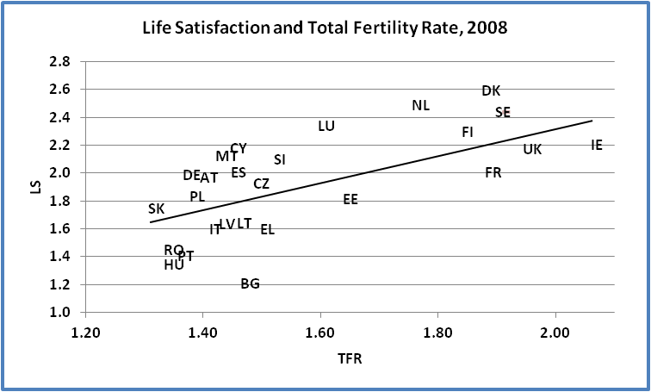
y = 0.9838x + 0.3712
R² = 0.40

Slide 28
So far the effect of the recession on the Irish birth rate has been negligible, in stark contrast to what happened during the recession of the 1980s.
[Granted, the starting point was a lower birth rate than in 1980, but still the highest in the EU.]

Slide 29
Births and Unemployment

Slide 30
The recent stability of the birth rate is all the more surprising in view of the high net emigration estimates that have been floating round.
Prediction: continued high levels of unemployment will lead to a marked fall in the birth rate.

