Slide 1
The Commercial Interest in Third Level Education
Jeffrey Egan

Slide 2
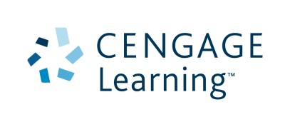
The Landscape
Increasing partnerships between commercial companies and the university
Commercial involvement noticeable at all levels of the university
Many new commercial players have entered the Higher Education Industry outside of traditional publishing
Is the commercial opportunity growing in the third level sector

Slide 3
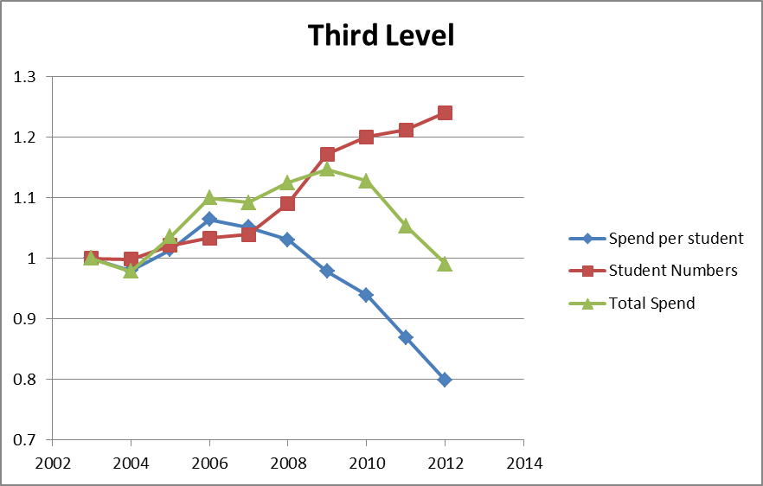
The Landscape
The following is a guide to the cost of living for a student in Ireland for 2013/14 | Students living away from home Annual (€) | Students living at home Annual (€)
Rent (National guide) | 2601 | 0
Utilities | 297 | 297
Food | 1548 | 585
Travel | 972 | 972
Books & materials | 639 | 477
Clothes/Medical | 405 | 405
Mobile | 288 | 288
Social life/Misc | 1152 | 1152
Total | 7902 | 4176

Slide 4
The Author/The Book
The role of the textbook as a teaching tool is changing
The traditional publishers role in the higher education sector today
Subject matter experts, the new authors of our digital age
Where and how do learners seek knowledge?

Slide 5
The changing conversation

Slide 6
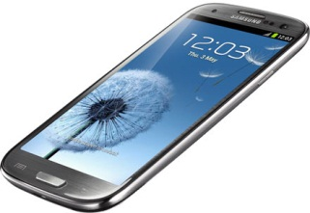
The changing conversation
Instantaneous Feedback
Teaching and learning platforms
Formative and summative assessment
Reporting structures
Learning objectives
Adaptive personalised learning
Student engagement
Lecture vs. Tutor

Slide 7
Conclusion
Universities and commercial companies are partnering together at many levels in the third level system
How students seek information and learn in a digital age is creating a very different learning environment
Corporations will increasingly focus on re-imagining learning using digital tools in an effort to enhance the student learning and lecture teaching experience as the clear pathway to innovate their offerings

