Slide 1
Social ties and the labour market integration of Polish migrants in Ireland and Germany
Peter Mühlau & Diana Schacht
Trinity College Dublin University of Bamberg

Slide 2
PPSN issued to Polish migrants

Slide 3
Area of origin SCIP Wave 1 (Lubbers & Kaliszewska 2013)

Slide 4
Descriptives SCIP Wave 1 Luthra et al. 2013

Slide 5
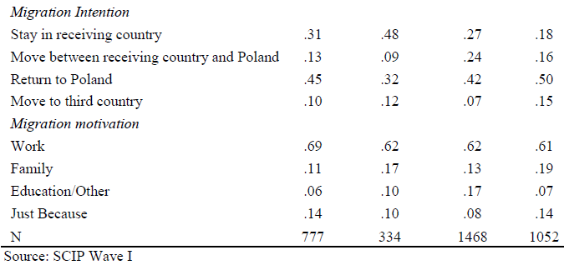
Descriptives SCIP Wave 1

Slide 6
Social ties and labour market integration
What do social ties do?
Provide you with information about jobs
Provide you with information/training/support in how to operate on the labour market
May recommend you to an employer (referral)
Provide you directly with an employment opportunity
Share resources of all sorts

Slide 7
Immigrants and ‘social capital’
Newcomer on a labour market
Language
Familiarity
Credential
High dependence on ‘social capital’, compensating for lack of destination-specific human and cultural capital
Does (co-ethnic) social capital really facilitate the labour market integration of recent migrants?
Social capital: Pre-migration ties (immigrant knew people in destination country before migration)
How exactly does it work?
Information model
Channelling model
Search subsidy model

Slide 8
‘Information model’
Social ties transmit information about job opportunities
Frequency of ‘job offers’ depend on extent of network
Having pre-migration ties gives you an advantage
Migrants with pre-migration ties find faster a job
Anticipating incoming ‘job offers’ raises expectation regarding acceptable job (job quality, reservation wage)
Migrants with pre-migration ties find a better job

Slide 9
‘Channelling model’
Network segmentation
Where are the people you know positioned in the labour market?
Information/knowledge/referral
Labour market segmentation
Informal v. formal job search strategies
Migrants with pre-migration ties find faster a poor job (weak channelling)
Strong channelling: diminishes also your chances of finding a good job
Path-dependencies in network development
Availability of informal search strategies distracts from investing in formal search strategies
Migrants with pre-migration ties take longer to find a good job

Slide 10
‘Search subsidy model’
Migrants are severely resource constrained
‘Sub-optimal job search’
Social ties share resources (& knowledge)
Enables longer, more intense job search for better job
Strong v. weak ties
Migrants with social ties commit less likely to a low quality job
Migrants with pre-migration ties take less quickly a poor job
Migrants with pre-migration ties find faster a good job

Slide 11
Comparative: Ireland v. Germany
Channelling
Germany (+)
Stronger concentration of previous cohort in bad jobs
Strong vocational/occupational structures
‘right credentials’
‘Job search culture’ segmented & more dissimilar from Polish ‘culture’
Search subsidy
Ireland (+)
Low frequency of job openings

Slide 12
Ireland v. Germany

Slide 13
Sample
Polish migrants in metropolitan centres
Ireland: Dublin
Germany: Berlin, Bremen, Cologne, Hamburg, Munich
Age: 18-60
Interviews: between 3 and 18 months after arrival
Sampling
Ireland: Multiple sampling methods
Germany: Based on municipal population registers
Sample size
Ireland 947/1052
Germany 1082/1468
Missing values
Model based Multiple Imputation

Slide 14
How long does it take to find the first job?
Quality of the first job (ISEI)?

Slide 15
Overview Hypothesis: Effect of pre-migration ties
 | Risk finding any job | Quality first job | Risk getting Poor Job | Risk getting Better Job
 | Proportional Hazard (Cox) | Linear | Competing risks (Proportional Sub-hazards)
Information | + | + | + | +
Channelling | + | -- | + | --/0
Search Subsidy | -- | + | -- | +
Germany v Ireland | + | -- | + | --

Slide 18
Pre-migration ties and ‘how find job’
Competing risks | Ireland |  | Germany
 | Worse Jobs | Better Jobs | Worse Jobs | Better Jobs
Reference: No Ties/Formal
No ties/informal channel | -0.03 | -0.08 | 0.31 | -0.17
Pre-migration ties/formal channel | -0.36 | 0.43 | 0.02 | 0.06
Pre-migration ties/informal channel | -0.12 | 0.16 | 0.54 | -0.61

