Slide 1
House Price Expectations: From Bust to Boom?
Ronan Lyons, Trinity College Dublin
Irish Economic Policy Conference
Institute of Bankers, January 2014

Slide 2
Overview
I will present evidence on house price expectations across the various regions of Ireland…
…using data from three years of a large-scale annual national survey…
…that includes information on their characteristics and circumstances that can give insight into how expectations are formed…
…which can inform public policy in this area

Slide 3
Outline
About the survey
Headline findings
Understanding expectations
Policy implications

Slide 4
Three-part survey
First part: information about respondent
  Age, income, education, marital status, employment status, sector, region, current property market status (2014: year of purchase)
  Do they read the Daft.ie Report?
Second part: their perceptions of the market
  Nationally/own region: fall from peak, good value currently, price change in next 12 months/5 years (2014: assessment of risk)
  Ranking of three most important factors affecting house prices (choice of nine)
Third part: their intentions and preferences
  Intention to purchase (and if so when), property type/size/location and prices
  Ranking of reasons for deferring purchase and of amenities

Slide 5
Survey summary statistics
Category | Year | 2012 | 2013 | 2014
 | Sample size (full answers) | 2,106 | 2,058 | 1,856
Age | Under 30 | 23% | 23% | 18%
 | 30-35 | 30% | 28% | 26%
 | 35-40 | 21% | 18% | 20%
 | Over 40 | 26% | 31% | 36%
Status | Rent/parents | 65% | 58% | 49%
 | Owner (since 2004) | 18% | 17% | 21%
 | Owner (pre-2004) | 17% | 24% | 29%
 | Other | 1% | 1% | 1%
Income | <€30k | 16% | 19% | 16%
 | €30k-€50k | 27% | 27% | 24%
 | €50k-€70k | 18% | 17% | 19%
 | €70k-€100k | 21% | 21% | 22%
 | >€100k | 18% | 16% | 18%
Region | Dublin | 49% | 43% | 45%
 | Other cities | 10% | 12% | 10%
 | Leinster | 19% | 19% | 21%
 | Munster | 14% | 15% | 15%
 | Conn-Ulster | 7% | 10% | 9%

Slide 6
Outline
About the survey
Headline findings
Understanding expectations
Policy implications

Slide 7
Increasing confidence about prices

Slide 8
Supply of credit, housing top issues

Slide 9
Concerns remain about Dublin value

Slide 10
A growing fraction wants to buy soon

Slide 11
Fear of price falls no longer dominant

Slide 12
First estimates of perceived risk
The 2014 survey asked respondents about their perceptions of risk
  In general and for a particular property they are considering
  1-5 scale, where 1 is similar to savings account and 5 listed shares
Typically seen as moderately risky
No large difference between Dublin and elsewhere

Slide 13
Outline
About the survey
Headline findings
Understanding expectations
Policy implications

Slide 14
Questions about expectations
Are expectations about house prices…
  Backward-looking or forward-looking? (Adaptive vs. “rational”)
  Dependent on individual-specific factors, such as education or income?
  Dependent on circumstances, such as housing market status and negative equity?
  Driven by fear or confirmation bias?

Slide 15
More adaptive than rational
Last year’s change contains 2.5 times the “predictive power” of the actual change observed
  Analysis using 2012-2013 samples only
Nonetheless, fit is quite poor with either or both
  Between 5% and 10% of variation explained – more when 2014 included
Using months supply leads to similar results
Chart shows coefficients on lagged and future house price appreciation, for different samples

Slide 16
Allowing “longer memory” adds little
Last year’s local price change explains about 25% of current expectations
  Including 2014 sample
Adding price changes from 2, 3, 4 and 5 years ago only increases the fit to about 30%
  Typical forecast error remains large (7.1pp vs. 6.9pp)
Chart shows coefficients on lagged house price appreciation, by year, plus 95% confidence intervals

Slide 17
Why do individual expectations vary?
A spread of house price expectations exists – so what individual factors determine that variation?
  Factors could include attributes (such as income, age or education) or circumstances (such as property market status)
It is possible to model individual expectations for the year ahead as a function of:
  Education (no effect)
  Income (no effect)
  Labour market status (some effect – but not unemployment)
  Housing market status (strong effect)
Suggests the importance of reference points
  What you think will happen to house prices depends on whether you own a house (and if so for how long)

Slide 18
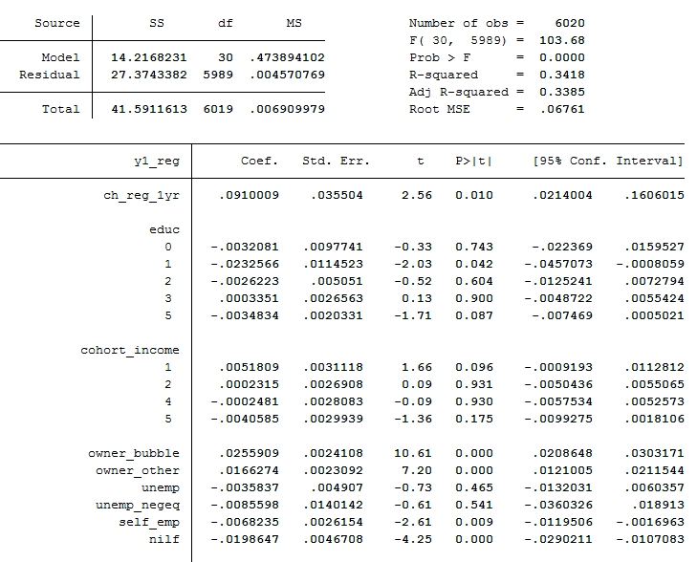
Regression output (1/2)
Fixed effects by region and year not shown

Slide 19
Behavioural aspects to expectations
The longer since your last transaction, the lower your price expectations (at a diminishing rate)
  Information on date of last purchase available for 2014 sample
This suggests a form of confirmation bias
Alternatively a form of “loss aversion” – those in negative equity convince themselves to be more optimistic
Those in negative equity appear to have a (marginally) less optimistic outlook
  Relationship between years as an owner and expectations remains
Fear of missing out important too
  Those who want to buy as soon as possible expect significantly greater house price appreciation than other groups

Slide 20
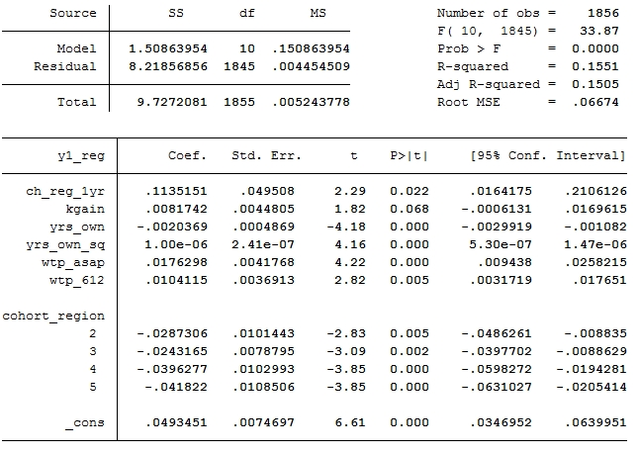
Regression output (2/2)
2014 survey respondents only

Slide 21
Outline
About the survey
Headline findings
Understanding expectations
Policy implications

Slide 22
Why do expectations matter?
House prices are determined by two sets of factors:
  Fundamentals, such as household income, the supply of housing and demographics (e.g. the ratio of persons per household)
  Asset considerations, including credit conditions (e.g. the minimum deposit required) and the user cost
The user cost is the difference between the mortgage interest rate and expected house price appreciation
  In addition to factors such as maintenance, property tax, risk…
The period 1980-2012 suggests that a fall in the user cost by one percentage point is associated with a rise in house prices by 1.5%
  The 30 percentage point rise in user cost 2006-2012 was associated with a fall in house prices of 45%

Slide 23
A significant change in expectations

Slide 24
The Dublin divide (again)
In late 2011, the average house price in Dublin was €231,000, while elsewhere it was €171,000
  Market participants expected the average price by late 2016 to be €202,000 in Dublin and €145,000 elsewhere
In late 2013, the average house price in Dublin was €251,000, while elsewhere it was €140,000
  Market participants expected the average price by late 2018 to be €290,000 in Dublin and €156,000 elsewhere
In Dublin, the expected future house price has risen almost 50% in two years
Is this a cause for concern?

Slide 25
Policy implications & next steps
The six percentage point change in expectations in the last two years may be associated with an increase in house prices of close to 10%
  This assumes no feedback within the system, e.g. bank lending becoming more generous due to house price increases
  Long-run evidence suggests house prices do no better than match inflation – role for public policy in informing consumers
Next steps…
  On-going survey of expectations – to give a quarterly picture, rather than an annual one
  More detailed one-off surveys to understand both behavioural aspects of expectations and also the “house price equation” at work in people’s minds

