Slide 1

Supplying solutions in demanding times: the effects of various fiscal measures
Institute of Bankers, Dublin, 31st January 2014
Rory O’Farrell
NERI (Nevin Economic Research Institute)
Dublin
info@NERInstitute.net

Slide 2

How has the debate changed?
French army 1914-1940
  Schooled in old tactics
    Technology had changed
  Attack until 1917
  Defend until 1940
    Again technology had changed
Intelligent people can get it wrong, for years.
Notes:
As you are all well aware I’m sure, we are approaching the 100th anniversary of the First World War.
A century ago one of the most prestigious careers for bright young men in France was to become an army officer. These intelligent people were trained in tactics that made sense given the experiences of the French army back to the days of Napoleon. The most effective way to win a war was to attack. However, by the time of the First World War defence had been mechanised while attack had not. Despite these changes in technology, for several years French army officers, who were intelligent people, continued with old tactics of attack despite huge casualties. It was not until spring of 1917 that a major rethink of strategy was undertaken. Following the offensive led by General Robert Nivelle (which was just the latest of many offensives) the French army mutinied. (The mutiny took less the form of an army mutiny, and more the form of a strike by French soldiers.) France assumed a defensive posture. By the end of the First World War roughly 20% of French men who were called up were dead, and another 50% injured. The lesson was learned that the strategy of attach was a failure. But given that France won I suppose one could claim that ‘attack worked’, and Robert Nivelle received his Grand Cross of the Legion of Honour in 1920.
By the time of the Second World War the French army relied on a strategy of defence, building the
Maginot Line. However by this time the development of tanks and aircraft made attack a more viable option. Circumstances had changed, and the Battle of France was lost. Though people can be intelligent, their patterns of thought and analysis are formed by their training and past experience.

Slide 3
Economics, 1929 to 1970s
Up to 1929 problems were largely to do with supply
  E.g. Theodore Roosevelt taking on the ‘Trusts’
1929 Wall Street Crash, deflationary spiral
  New Deal not until 1933
Demand management
1970s supply side shock (oil)
France/Denmark vs UK/US
Notes:
A similar pattern can be seen in the development of economics. Prior to the Great Depression economists were schooled that the problems of economies were problems of supply. One can think of Theodore Roosevelt breaking the anti-competitive Trusts that existed in the US. However, this led to destructive policies during the Great Depression, and in the US it was 1933, roughly four years after the Wall Street Crash, before New Deal policies were implemented.
In the decades following the Great Depression most macroeconomic problems were usually viewed as problems of demand. From the 1930s to the 1970s the prevalent ‘Keynesian’ view was that governments could effectively manipulate demand in the economy and reduce the impact of the business cycle. It was commonly accepted that government spending stimulated the economy, and taxes dampened the economy.
However, following the Oil Crisis of the 1970s, a problem of supply of energy, demand side policies continued to be used although the problem was one of supply. This led to issues of stagflation (high inflation with a stagnant economy). However, over time supply side policies were pursued, such as investment in renewable energy in Denmark and nuclear power in France (increasing supply) while in the UK and US other policies were pursued. By the time of the 2008 financial crisis economists were generally trained to see economic problems as problems of supply with supply side solutions.

Slide 4
Recent debate
Economists (again) generally view everything as a problem of supply
Expansionary Fiscal Contraction
Notes:
At the beginning of the 2008 financial crisis the more extreme notion that government cut backs and tax increases (a fiscal contraction) could be expansionary was in the public discourse. This is despite the credit crunch and banking crisis making the assumptions of perfectly efficient capital markets and access to credit highly implausible. This hypothesis has been largely discredited. Evidence from ‘VAR models’ suggests that fiscal expansion does expand the economy. These studies mainly focused on the US, however the debate was largely, not whether government spending stimulated the economy, but by how much, with authors such as Robert J. Barro and Redlick (2011) accepting that the multiplier is positive though less than one (that is, there is some crowding out). A review of the literature given by Ramey (2011) suggests that for the US multipliers are between 0.8 to 1.5 (so for the US government spending is likely to stimulate the economy). The size of multipliers depend on the structure of the economy, and the state of the economy (such as if there is a recession).

Slide 5
Recent debate
“International experience shows clearly that cuts in spending are more effective at fixing deficits and are better for growth and jobs than tax increases.”
Notes:
As pointed out by Seamus, during the crisis our options are constrained. Nevertheless the options exist.
At the beginning of the crisis it was also claimed that spending cuts were more effective than tax increases with Fine Gael (2010) stating in their pre-budget submission that “International experience shows clearly that cuts in spending are more effective at fixing deficits and are better for growth and jobs than tax increases.” Within academia these notion was promoted by Alesina and Ardagna (2009). Their approach rested on an analysis of past data, which gives the average effect over a given period of time. Despite how this topic is often presented in the media, there is no consensus as to which is more effective, with models used by agencies such as central banks, the IMF, and European Commission showing that tax increases are generally less damaging to the economy than spending cuts (Coenen et al., 2012; Veld, 2013), with the effectiveness of spending cuts being particularly weak when interest rates are particularly low (Erceg & Lindé, 2013).

Slide 6
Some research on tax
Coenen et. Al (2012) – a review of different models
Notes:
It is worth looking at some of the evidence. Here is a review of several models used by agencies such as the IMF, ECB and EU. No evidence is given that cut’s are a better option than taxes.

Slide 7
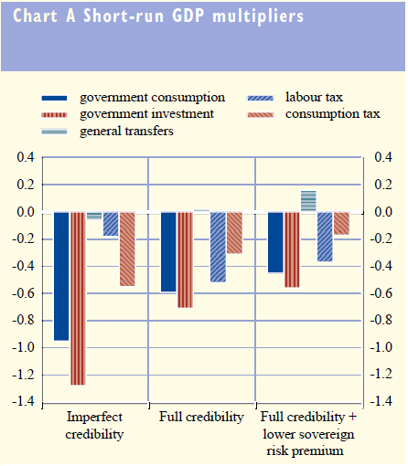
Some research on tax
ECB– recent debate triggered by IMF
Notes:
Short run – ECB – cuts to Govt consumption and investment is worst choice

Slide 8
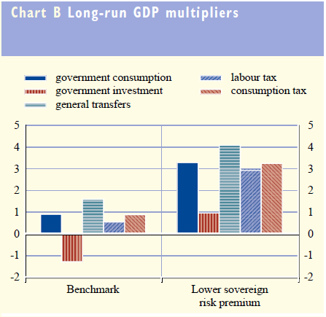
Some research on tax
ECB– recent debate triggered by IMF
Notes:
The debate reached its peak in the winter of 2012 with the ‘Battle of the Boxes’. In an information box in a regular report the IMF suggested that various agencies had underestimated the negative effects of austerity The European Commission and European Central Bank rejected some of the IMF’s criticisms. However, the consensus is that fiscal expansion is expansionary, with the notion of expansionary fiscal contraction being largely discredited.
Though consensus has not been achieved on the effects of government spending, it is generally accepted that in small open economies effects of government spending are smaller than in large closed economies (as some of the effects leak out due to imports), and it is also (now) generally accepted that in a recession fiscal policy has a greater effect than during a boom.

Slide 9
Research applicable to Ireland
A lot on spending (e.g. Benetrix and Lane)
  Only look at spending
Corsetti, Meier, and Müller (2012)
Beetsma and Giuliodori (2011)
Ilzetzki, Mendoza, and Végh (2013)
ESRI research on spending and taxes (2013)
Notes:
Though the literature for the US is quite rich, as is to be expected the current literature for Ireland is limited to a smaller number of researchers. Several studies (which make use of the VAR methodology that examines past performance), include Ireland in a sample of countries that are examined. However, what they imply for Ireland’s situation today is somewhat contradictory. Corsetti, Meier, and Müller (2012) find that multipliers are ‘unusually high during times of financial crisis’, implying a large multiplier. However Beetsma and Giuliodori (2011) find that multipliers tend to be smaller for more open economies. This finding is shared by Ilzetzki, Mendoza, and Végh (2013) who also find that multipliers are smaller for countries with high debt. These both imply a smaller multiplier for Ireland. However, Ilzetzki et al. (2013) also find the multiplier to be larger for countries that are industrialised, and with a fixed exchange rate; both of which apply to Ireland. Given that Ireland is a country with a troubled financial system, is industrialised, open, has a high level of public debt, and has a fixed exchange rate (due to membership of the Euro), these findings are perhaps more likely to offer confusion than guidance as to what policy options are better for Ireland. Therefore it is necessary to look at studies that focus specifically on Ireland.

Slide 10
Research on Ireland
Bénétrix and Lane (2009)
Galstyan and Lane (2009)
Pereira and Pinho (2011).
Notes:
Continuing with the VAR approach, several studies have been conducted by Bénétrix and Lane (2009), Galstyan and Lane (2009), and Pereira and Pinho (2011). These studies focus on government spending rather than taxation. Pereira and Pinho (2011) only look at the topic of public investment, and find that it boosts the economy, and is self-financing over the long run. Galstyan and Lane (2009) find that government investment tends to boost competitiveness, and government consumption spending tends to reduce competitiveness. The results of Bénétrix and Lane (2009) vary depending on the precise specification they use but find that increases in public investment tend to boost the economy, increases in the government pay bill hinder the economy, and the effects of spending on non-wage government consumption are more ambiguous.

Slide 11
Effect of a €1bn consolidation
 |  | Bergin et al. (2013) | This study
Income Tax |  | 0.4 | 1.07
Public Sector Wage Rates |  | 0.3 | 1.35
Public Sector Employment |  | 1.2 | 1.38
Social Transfers |  | 0.4 | 1.06
Investment |  | 0.6 | 1.76
Notes:
VAR models capture averages over time. However, as shown during the First World War, general lessons can not be learned based on the past, but must be adapted to current circumstances. The HERMES model was developed by the ESRI and the Department of Finance to examine the impacts of different fiscal policies. Though similar, the HERMIN model was developed for examining the effects of European Structural Funds and Cohesion Funds, and has been used by the European Commission’s Directorate General for Regional Policy across various European countries and regions. These models, at least to some degree, take account of current economic circumstances when giving their estimates for the effect of various policies. These are the only available estimates using a structural model that are available.
I used the HERMIN model. I’d like to thank the European Commission for allowing us to use it, but they aren’t responsible for the output. It’s like they gave me the loan of a car and I’m responsible if I crash it, but they get the credit for buying the car.
I won’t go into detail into the results, only to say they are largely consistent with the work done by the ESRI. The size of multipliers reported are generally somewhat larger than those of the ESRI, but in the same direction. In no way can one conclude from this research, or the research that was put forward earlier, that a supply side policy of “cuts in spending are more effective at fixing deficits and are better for growth and jobs than tax increases”
The Irish economic crisis is fundamentally a problem of demand, and NOT a problem of supply.

Slide 12
Conclusion
The Irish economic problem is fundamentally a problem of demand, not of supply.
Up to now the focus has been on supply side solutions, which are less effective given the current circumstances.
Cuts Vs Taxes? – It’s a matter of what sort of society we want, not economic efficiency

Slide 13
www.NERInstitute.net

Slide 14
References
Bénétrix, Agustin and Philip R. Lane. 2009. "The Impact of Fiscal Shocks on the Irish Economy." The Economic and Social Review, 40(4), 407-34.
Bénétrix, Agustín and Philip Lane. 2010. "Fiscal Shocks and the Sectoral Composition of Output." Open Economies Review, 21(3), 335-50.
Bergin, Adele; Thomas Conefrey; John FitzGerald and Ide Kearney. 2010. "The Behaviour of the Irish Economy: Insights from the Hermes Macro-Economic Model." ESRI Working Paper, No. 287.
Coenen, Günter; Christopher J. Erceg; Charles Freedman; Davide Furceri; Michael Kumhof; René Lalonde; Douglas Laxton; Jesper Lindé; Annabelle Mourougane; Dirk Muir, et al. 2012. "Effects of Fiscal Stimulus in Structural Models." American Economic Journal: Macroeconomics, 4(1), 22-68.
European Central Bank. 2012. "December Monthly Bulletin," Monthly Bulletin. European Central Bank

