Slide 1

Notes:
Welcome from Dublin, Ireland

Slide 2
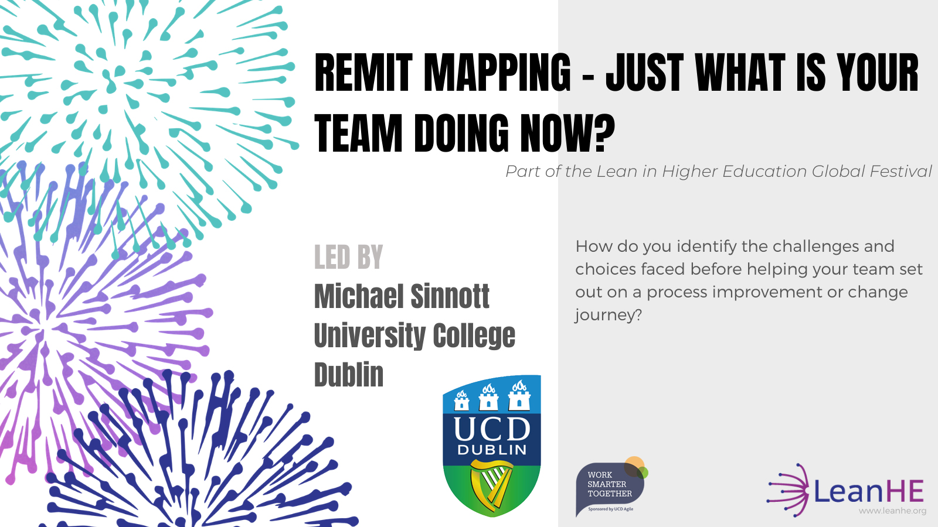
Director of UCD Agile strategic change
2.30-3.30 IST Wednesday 21 October 2020
Notes:
Led by Michael Sinnott, Director of Agile UCD
Co-host: Jeremy Britton, USM Project Manager, UCD

Slide 3

Lean in Higher Education (Lean HE) is a community of practice who:
Are committed to the continuous improvement of higher education, its people and those we serve;
Network, connect and share best practice with our local and global community;
Are led by voluntary committees who make the most of the skills of our peers and available technology to operate without a budget of our own.
We're always interested in broadening our community, hearing new voices and sharing our learning with other universities and colleges.
Notes:
My contact with Lean HE has been through attending the Lean HE conference in Ann Arbor, Michigan, in November 2019. I’d found them through Google and through meeting folks at other sessions who said ‘Lean HE will be great – be sure to come’.
I joined the European regional committee for a breakfast on one of the conference days, met the then Irish representative on Lean HE’s European committee, and was asked to take over her place on the regional grouping when she stepped down. That was in April of 2020.
In early autumn 2020 I made contacts with folks in UCC in Cork, DCU in Dublin, and Queens in Belfast – we’ll see what we can make of an Island of Ireland local group in the coming months.

Slide 4
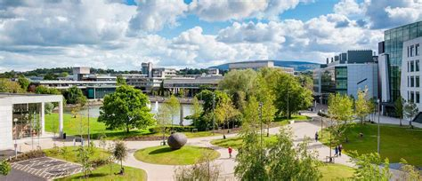
Welcome to University College Dublin Ireland
1 | Ranked within top 1% of higher education institutions world-wide
29 | Percentage of international students
30 | Percentage of international staff
32 | Percentage of undergraduate students from under represented cohorts
64 | Percentage of non-Exchequer funding
133 | Hectares making up the woodland campus
136 | Number of nationalities within the student body
520 | Million euro annual turnover
574 | Million euro won in externally funded research in last 5 years
1,611 | Number of PhD students
1,727 | Academic staff (FTEs)
1,920 | Support staff (FTEs)
1854 | Year founded by John Henry Newman
3,984 | Number of international students in overseas operations
8,428 | Number of international students on main campus
9,645 | Number of graduate students
9,763 | Number of awards conferred each year
33,285 | Total number of students (including overseas operations)
279,000 | Number of alumni across 169 countries
A parkland campus 4km from the city centre of Dublin.
UCD by Numbers
Notes:
www.ucd.ie
UCD Agile’s address
Ardmore Annex, Belfield, Dublin, D04 FX62
Plus code: 8Q5H+2V Dublin

Slide 5


The Work Smarter Together Community of Practice
Check https://worksmartertogether.ucd.ie/ for all the details
@ucdworksmart
WST provides colleagues with an opportunity to come together to share, to learn and to celebrate their creativity and successes
Work Smarter Together (WST) is focused on the broad community of those who make the operation of the University possible. WST’s roots stretch back to 2011 and from 2015 UCD Agile is sponsoring Work Smarter Together as part of Agile’s contribution to the university community.
WST in action
Three newsletters a year
Summer school each July (including 2020!)
February and October events
Biennial whole campus WST event – 2014, 2017 and 2019
Supporting communities of practice
… and more
#ucdagile
#ucdwst
Notes:
Use the link above for Work Smarter Together and explore our community of practice focused on celebrating the collaboration and creativity that powers so much of what is good in the UCD ‘support ecosystem’.

Slide 6
Today’s session
From this session you will get
The Concepts
The Tool
The Method
The Approach in Action
Objective
By the end of the session you should be happy to try out remit mapping with your own colleagues.
Just what is your team doing now?
Notes:
The goal is that this presentation give you enough of a sense of remit mapping for you to feel happy to work with a team on this.
The idea is simple – the skill is in working with a group in using it, more about your facilitation skills than understanding remit mapping.
As mentioned later – your main asset will be curiosity. Remit mapping is not about replicating a process created by someone else but about your exploring these ideas with a group of busy, active and committed people who want to take the chance to stand back and see just what they are doing now.
And the main ‘product’ of remit mapping is not so much the map, and the conversations it can underpin, but the dialogue and exploration that bringing the map causes to happen.
Remit mapping is about the people rather than the map making.

Slide 7
My two reasons for asking ‘where are we now?’
As institutions, and as managers, we can be bad at giving our colleagues and staff clarity.
We can be bad at setting out on change journeys without a clear understanding of where we are leaving from.
Notes:
Sometimes business unfolds on the basis of this year being ‘last year plus tweaks’.
“Last year worked well. If we absorb the change pressures, we can tweak last year and get a good ‘this year’. And we can keep on doing that until there is a major change or a crisis. We don’t really need to talk about what we do or why – ‘everyone knows’.”
And if we you the manager of this you know it worked last year, you know your staff are committed and dedicated, and so it is reasonable to assume it will work this year. “Who needs to think about it? Now, where is that committee meeting I’m supposed to attend…? I’ll let the folks get on with the work…”
But… “We’re making a change? I’ve no idea how all this works or what impact the change will have… Hmmm… let me just use some logic. Logic’s all you need in making changes.” (Logic, aka the last resort of the desperate person who has no experience or practical insight at their disposal).
“Eeek!! A crisis. Quick, all hands on deck. Work till you drop… we’ll deal with this!!!”
Who needs to have a clear picture of what a team is doing, why it is doing it, and how it connects with broader pictures and purposes?

Slide 8
Zoom Survey
Assuming your team itself knows what it is doing…
By those outside your team – how clearly understood is your team’s purpose and activity? All of what you do… why you do it…
By those in your team – could all members give a clear breakdown of all of what you do and why you do it?
Notes:
Check the following slides for results.

Slide 9
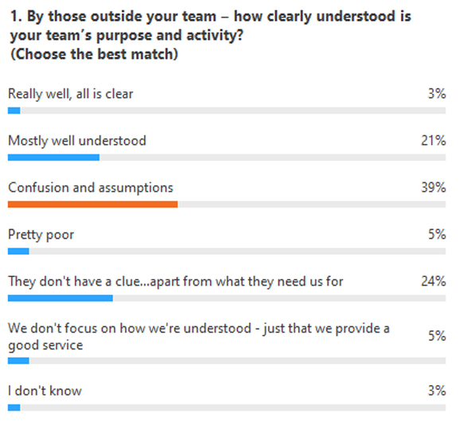
Zoom Survey results – question 1
Of note, perhaps
63% confusion and assumptions plus ‘do not have a clue’
21% well understood.
The 63% will give rise to extra time / effort / etc. for all.
Is the antidote to not being understood a focus on your ‘customers’ and the services they need / you give?
Survey carried out with participants of the webinar on 21 October 2020.
Notes:
Most teams are not understood.
Do they need to be?
5% do not focus on how they are understood as a team – they focus on the services they deliver. Who cares what your purpose and activities are, as a description, if you are reaching out with the right services and supports? Who cares? You and your team because that’s how you organise yourselves and your work. Do your ‘customers’ need to know?

Slide 10
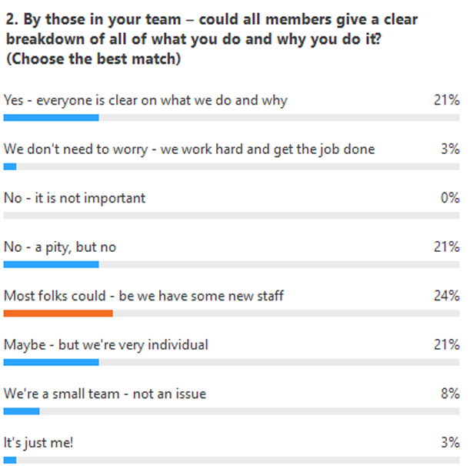
Zoom Survey results – question 2
Of note, perhaps
Clarity for over half 53% between ‘yes’ and ‘most folks could’ and ‘small team’
21% ‘no’ but wish they could
21% very individual
… and no one thinks this clarity is unimportant
Survey carried out with participants of the webinar on 21 October 2020.
Notes:
Things are better here, fortunately – teams have a better sense of themselves than their ‘customers’ do.
We have a ‘just me’ and a few ‘small teams’ – for the rest should we not all hope that ‘everyone is clear on what we do and why’? Should we not do more than hope but act to make it so?

Slide 11
Three concepts - the ideas behind remit mapping
Mastery, Autonomy and Purpose for Motivation and performance from Dan Pink linked to…
My (team’s) purpose evolves
You need to know your ‘now’ before heading on a journey
Notes:
A key point to note: ‘evolves over time’ is a really important concept as what is says is that clarity one day can be delusion a month or a year later, especially in a team with staff turnover and new staff who judge the ‘what is’ from what they see. Now you have the risk that some folks are holding onto an old clarity, some are seeing the current reality, all think they are talking about the same thing, and no one is too sure where all the confusion is coming from.
Dan Pink’s message is broad and deep but, for me as a manager, it boils down to “How to I create a working environment in which my staff can thrive and the business get done well?” High performing team, great place to work.

Slide 12
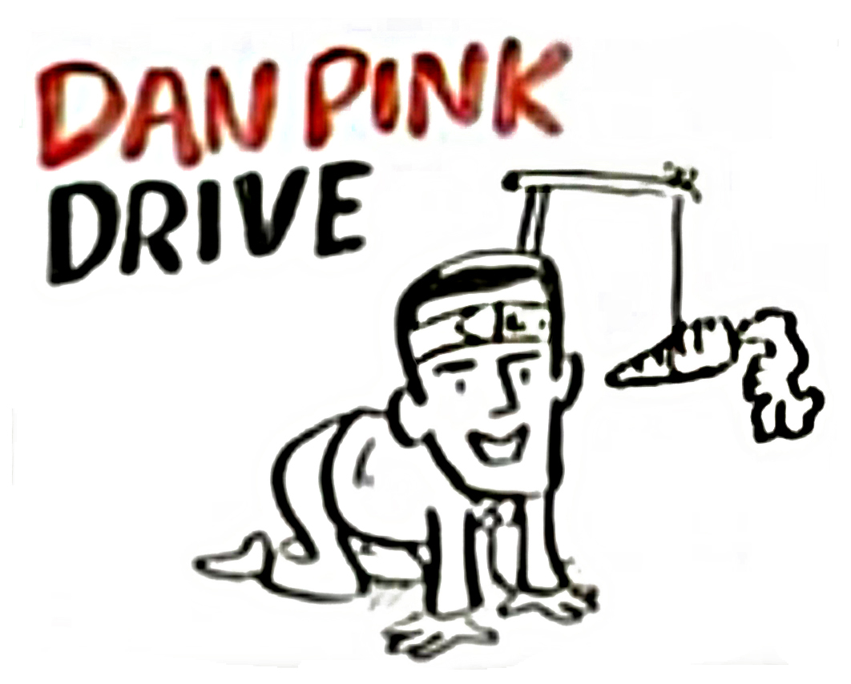
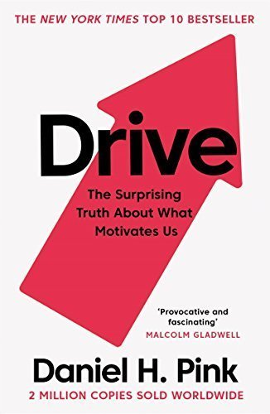
Intrinsic motivation and high performing team environments.
Watch the YouTube!
RSA Animate: Dan Pink - Drive: The Surprising Truth About What Motivates Us
https://youtu.be/y1SDV8nxypE
Notes:
Check more from Dan Pink… as per the information above.

Slide 13


The desire to improve… The journey to be better…
The opportunity to learn and practice…
An excellence you seek for its own sake…
Notes:
Check more from Dan Pink…

Slide 14

The desire to direct your own life and work…
What I do…
When I do it…
Who I do it with…
Notes:
Check more from Dan Pink…
Note, I have adopted the stereotype of a typical administrator being a balding, bearded and bespectacled male in his 50s who always wanted to drive an E-Type Jag.

Slide 15

Working towards something larger and more important than just me…
Connecting personal goals and values to the organisational…
Notes:
Check more from Dan Pink…

Slide 16
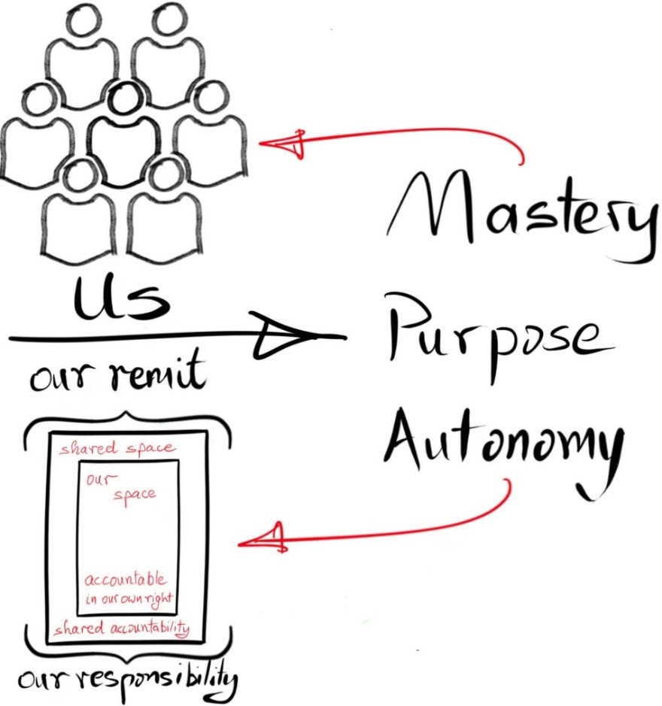
Concept 1
Notes:
Key concept – the importance of mastery, autonomy and purpose, the connection between purpose and remit, and the manager’s and team’s role in ensuring remit is clear.
If one of the foundations of Dan Pink’s thinking lies in Purpose, remit mapping is based on the idea that our remit frames our clarity of purpose, with our remit not just being a list of things for which we are responsible but also our connection with institutional purpose and goals – helping us place our work in its bigger context.
In a ‘last year plus tweaks’ environment, this can be a real challenge. As we have seen in the past in staff surveys, clarity tends to diminish the greater the organisational distance from the individual: “I know what me and my direct colleagues do, I know most of what our little team does, I’ve a fairly good idea of a lot of what our units contributes, our division seems varied and obscure, and sure isn’t the university all about teaching and learning… and research… and impact, whatever that is…” And unless you are directly involved in, or supporting, teaching or research or impact you can feel at quite a remove from a lot of this.
Just what is our purpose? What are our priorities? Just how do we prioritise and make decisions? Who is ‘we’, anyway?

Slide 17
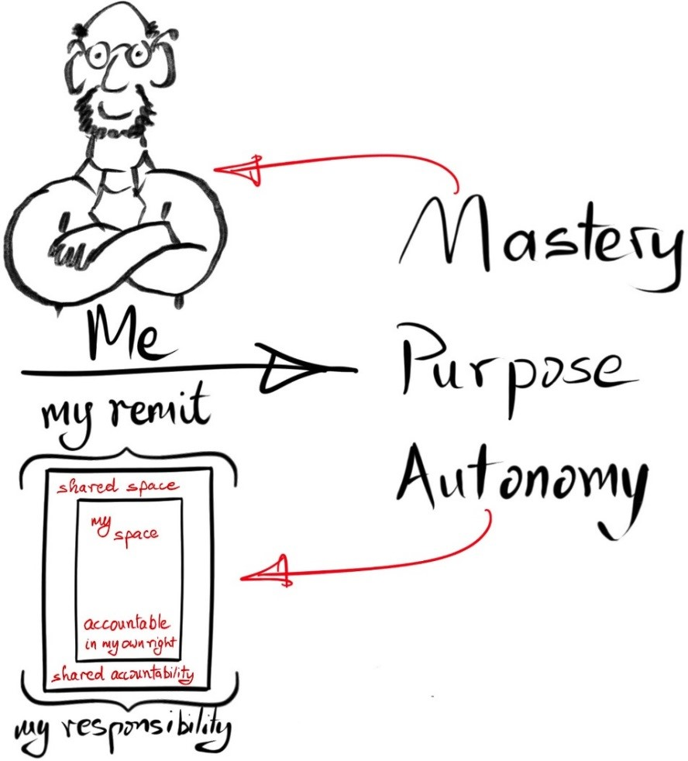
Notes:
All as true for the individual as they team.

Slide 18

Concept 2
Purpose can evolve…
under lots of influences…
… so where are we now…?
how did we get here…? where are we going…?
…
what about motivation and performance?
Notes:
Key concept – purpose evolves over time.
Remit is our main channel for framing individual, team and unit purpose. We need to be clear what our remit is now – both in theory and as seen in the practice of what we do, and as explored in the tension between formal responsibility and practical reality.

Slide 19
You are going on a journey…
‘Journey’ = some kind of change
Could be … reacting to COVID-19 pressures
… technology
… home working
… new website
… staff changes
Notes:
Any transition from some ‘now’ to some ‘to be’ is a change journey, even if the change is as seemingly small as restructuring a website or sending or on-boarding new staff.

Slide 20
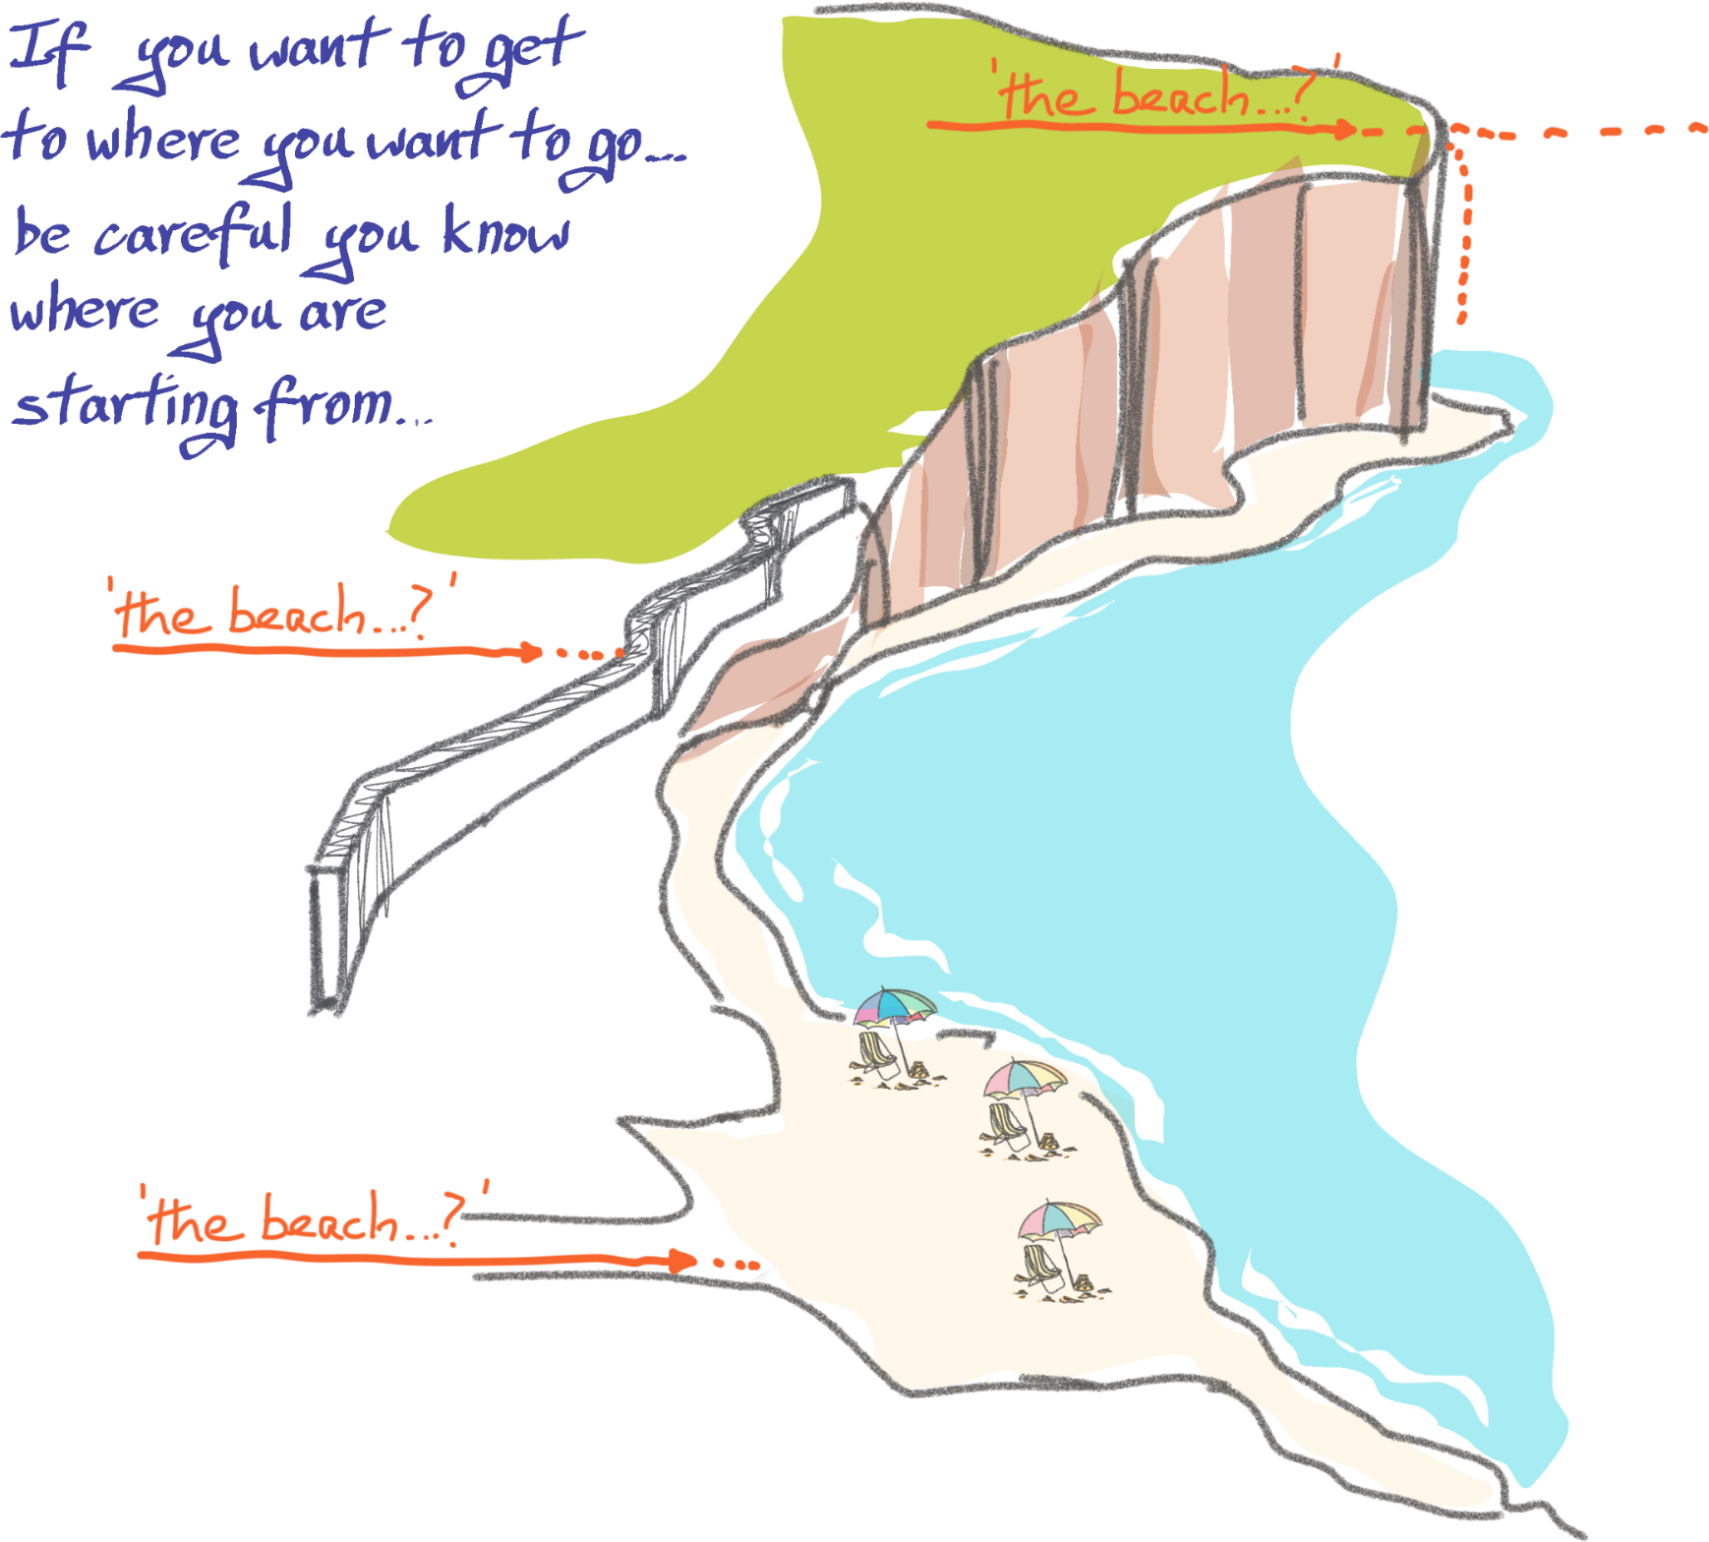
Concept 3
Where are we starting from?
Where are we trying to go?
© UCD 2019
Notes:
A good analogy when talking about this slide on a Zoom with folks joining from locations as far away as Singapore and as close as a kilometre away… Get up from your chair, leave the building you are in, go left outside the door, follow the road around for 400m, take the left at the T-junction, a right at the traffic lights, walk for 300m and… there you are, at the petrol station. No? Well, you are if you leave from where I am now…
If you do not know where you are leaving from as you set out on a change journey then you are already lost.
At some point you will need to cry for help or will need a compass and map to find out where you are… and to plot the route to where you want to go… if, that is, you have not run out of time, money, good will, commitment…
If you are not clear on where you are going you cannot plot the journey from where you are now.
How many change journeys have you seen where the ‘now’ analysis is missing or weak, or the clarity of purpose/destination is missing or weak, and all you have is the activity of ‘never mind all that… we’ve no time… follow the process’?

Slide 21
Where are we ‘now’ - two questions
As seen in what we do and don’t do how has our purpose evolved, what is it now, in practice and is our ‘what’ and ‘why’ clear?
As we head out on our ‘journey’, where are we leaving from? Have we some kind of clear analysis or assessment of our current situation?
Underpinning all – clarity and purpose

Slide 22
The tool - the elements of a remit map
The ‘remit’ concept
The evolution of remit – why you need to check what it is ‘now’
The map elements themselves

Slide 23
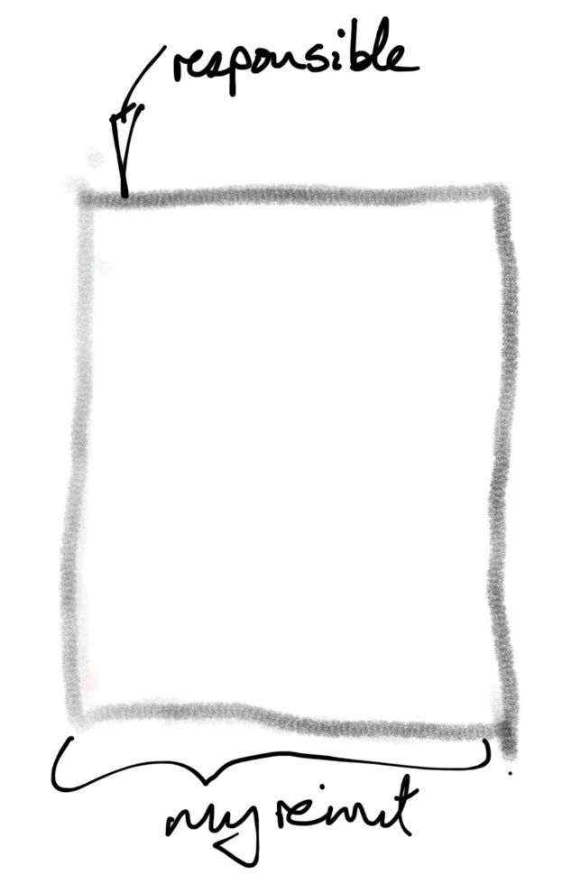
My remit
Responsibility I’ve been given
… responsibility I’ve taken
… responsibility I’ve ended up with
Notes:
This is how we are using remit – the scope of my formal responsibility, clearly stated, understood by all who need to.
The ‘boundary’ includes targets and measures – what constitutes success and how we will know we are achieving it. The SMART approach to goal setting is an example of how one might go about discussing this ‘boundary’ to the remit. No targets, no success measures, not specifics… poorly defined remit… poor purpose… reduced chance of success… reduced likelihood of happy staff performing well…
But… you can end up taking responsibility passed your way or sought out… and you can end up with responsibility you were not expecting.
Remits can become less clearly marked out, less clearly understood, less formally recognised, perhaps less supported, perhaps more than can be delivered on…

Slide 24
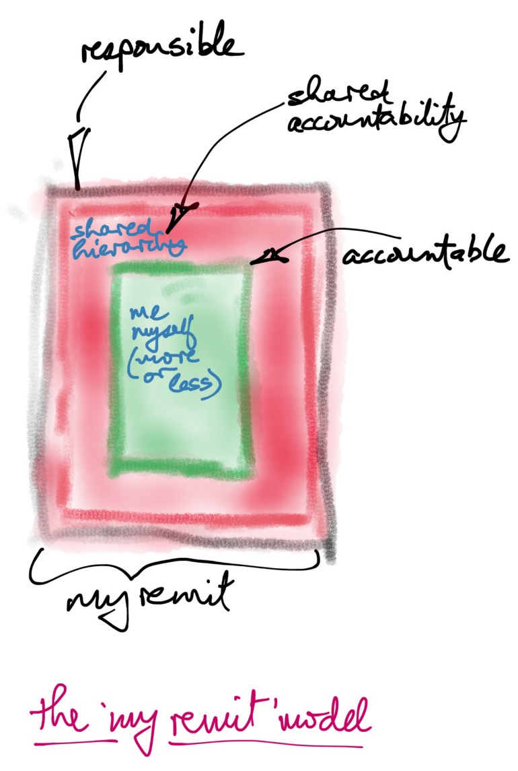
My remit is
What I am responsible for doing
Some of it I am fully accountable for
For some of it I share accountability
Clarity of purpose
“This is what I do”
… and hopefully
This is why I do it
This is how it contributes overall
Notes:
The key point in this slide is that for nearly all of us there is a zone in which we are free to get on with carrying out our responsibilities as we see fit – in green – and a zone in which we need to refer to others (a team lead, a director, a Dean…) for agreement and sign-off, or some such. – in red.
I am responsible for all of this, I am free and accountable for a lot of it, and I share accountability for some, with a need to refer on this for agreement/permission/sign-off.
If this is not clear then time and energy are going to be consumed in dealing with the lack of clarity.

Slide 25
Zoom Survey
How long is it since the last time your team’s remit was formally set / defined / named?
You may be a team of 1 – when did you last have your remit defined.
If you run a team – this is about the team your run, not the team of your management peers
Notes:
Mastery, autonomy, purpose. Purpose is brought to us through remit, in large part. If your remit is not clear your purpose may not be clear and if your purpose is unclear you have a problem with mastery, autonomy and purpose, which means you are not likely to be at top performance, creating a good environment for folks to work in.
Big danger: self-defined purpose. “No one tells me what to do… I’ve been doing it for years… I know I’m doing a good job… I’ll just get on with it…”
Do you ever – some of us do – take your hands off the steering wheel when you are travelling at 120km/hr on the motor way, just a little off the wheel, to see how your wheel tracking is doing. If it is good, the car stays in a straight line. If there’s an issue, you start veering off the road. (Only take your hands a little off the wheel when you try this!)
If remit/purpose is self-defined then all is great and good when what you have self-defined is going in the same direction as the road. If something comes up which leads to direction change, or the planning for change, both those who have set their own direction and those who are responsible for that direction (but have not been managing it) are now in trouble. If you have not had the conversation about you or your team’s remit, how do you know you are aligned? ‘Self-defined’ = ‘lots of assumptions’.
Of course, ‘self-defined’ can = ‘happy’. Why ask? Why change?

Slide 26
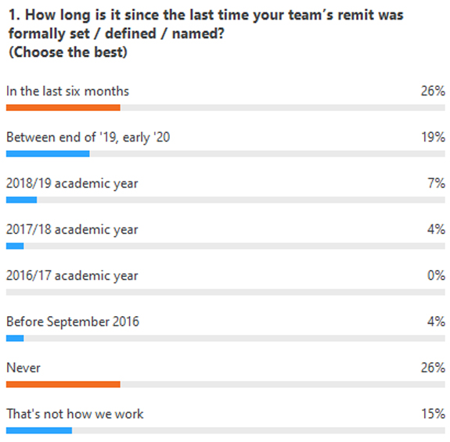
Zoom Survey results
Of note, perhaps
45% within the last year, 26% in the last six months. Has this helped navigate current challenges?
41% do not have a formally defined remit – ‘never’ + ‘not how we work’. What’s the overlap with the first survey on how you are understood?
Interesting split – ¼ in the last 6 months, ¼ never
15% prior to September 2019
It would be interesting to explore the 15% “That’s not how we work”
Survey carried out with participants of the webinar on 21 October 2020.
Notes:
What a lot of variety! And at the extremes are both very recently defined and never defined.
To recall the last slide, ‘never’ is the same as driving hands off the steering wheel… Great while the road is straight and a team’s sense of itself is aligned with the momentum of the university, a real challenge when the road starts turning or events intervene…

Slide 27
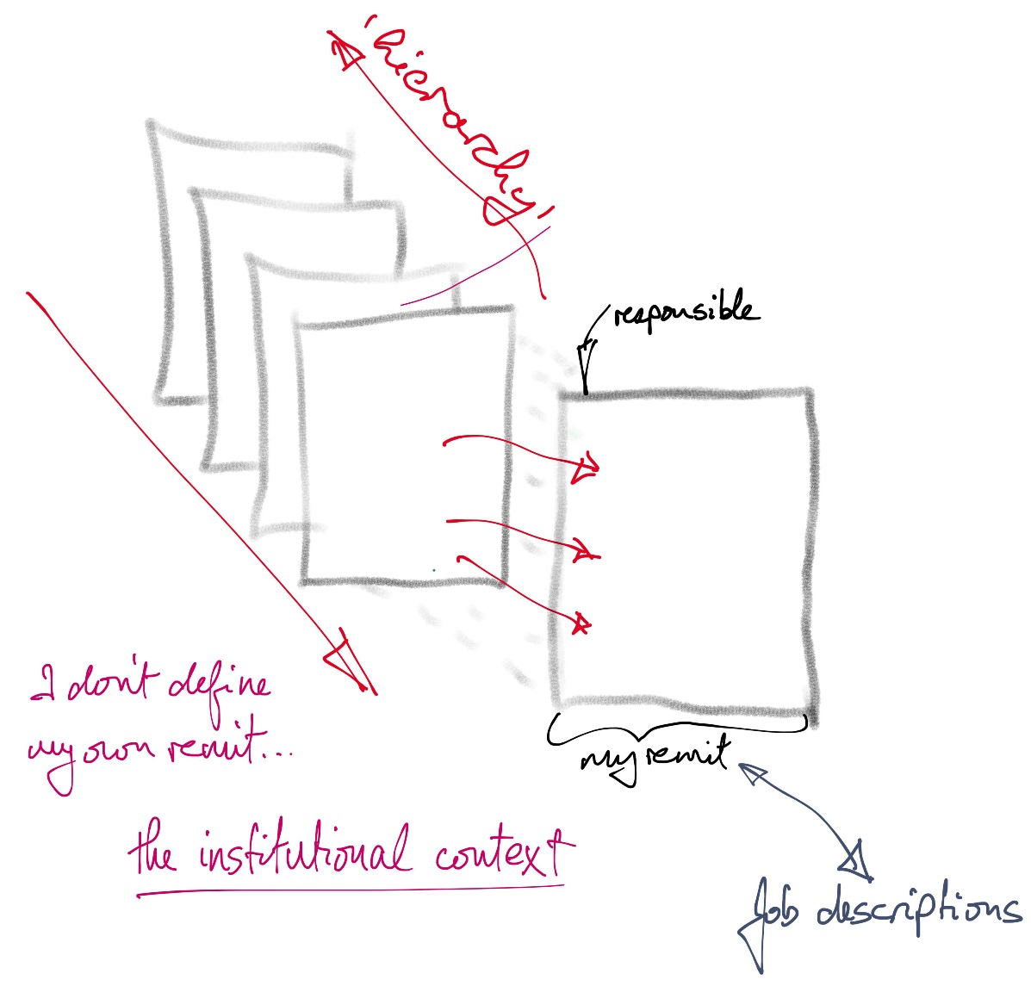
Remit - creation and evolution
Notes:
Remit comes down the hierarchy… through strategic plans, through how we are structured and organised…through how teams are defined in relation to each other… And ideally… there is some scope to feedback and influence up the hierarchy too.
Hoshin Kanri, in the Lean space, does a very systematic job of building robust version of the above.

Slide 28
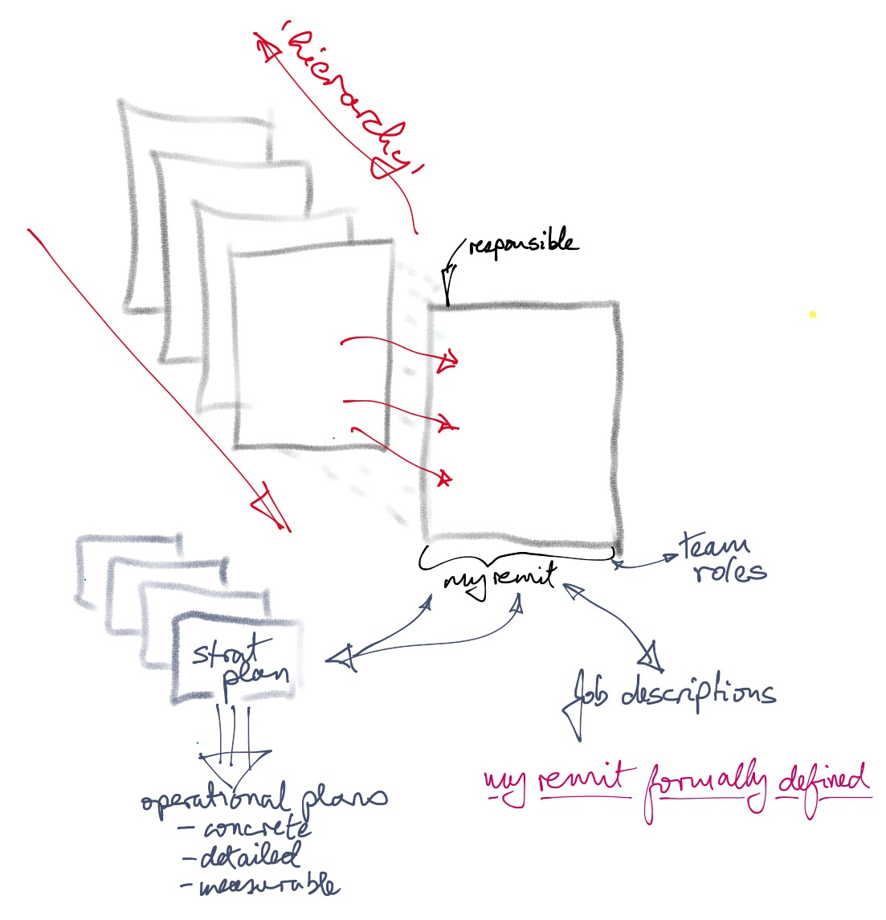

Remit - creation and evolution
Notes:
Strategy gets turned into implementation… policy becomes procedure becomes process… teams have roles assigned to them…
The bigger hierarchical picture formally gets turned into practical actions to be carried out.

Slide 29
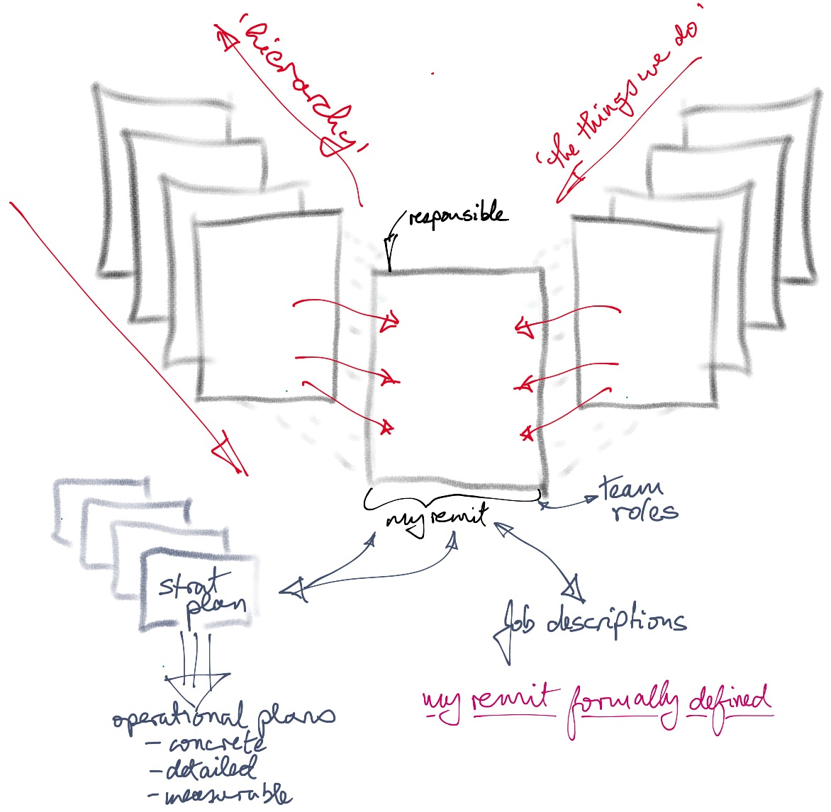
Remit - creation and evolution
Notes:
Perhaps for you the biggest shaper if remit is operational momentum – ‘the things we do’. These can often be baked into the life of a team rather than existing as a formal catalogue of SOPs and operations plans. These can often be taken as givens i.e. not part of explicit conversation except when the time of the year for doing them comes round again.
And there can be quite a tension, at times, between the implementation demand of the hierarchical side and ‘the things we do’ demands of operations cycles, especially if the operations cycles are taken as givens and management largely takes them (almost and subconsciously) for granted.

Slide 30
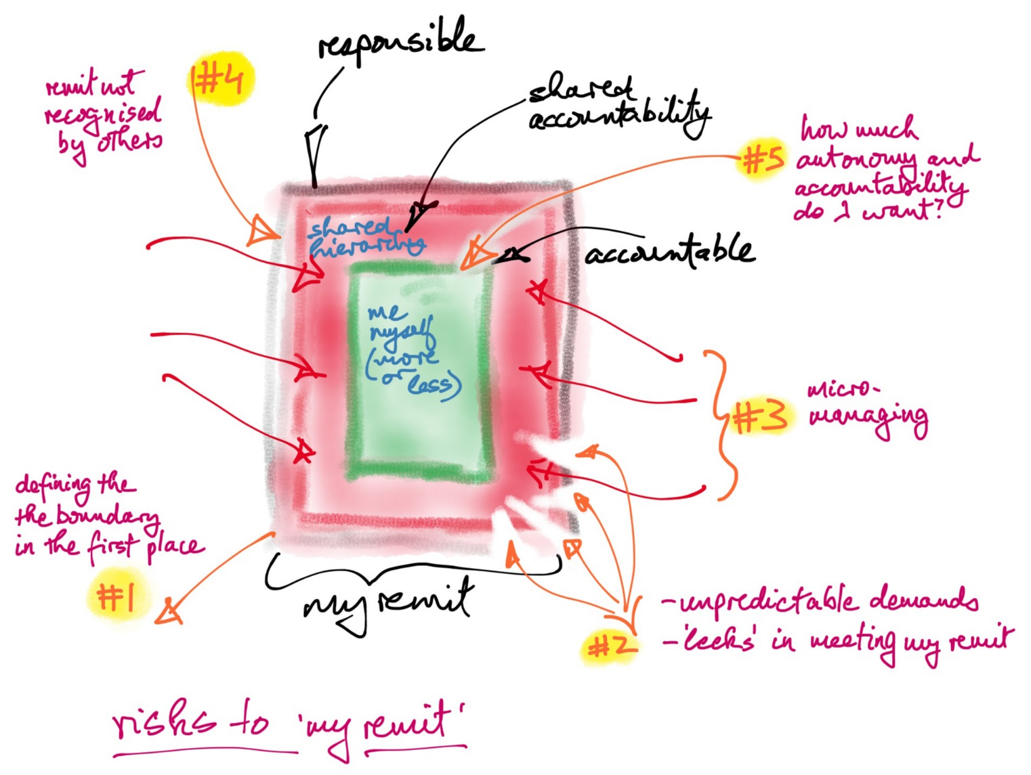
Remit - risks
Notes:
Remit can become confused in many ways. This image shows just some. Knowing remit can become confused means you should have some systematic way of checking, for an individual or team, that it is clear.
#3 is often about a manager who is not sure what they want you to do (poorly defined remit) and so they keep checking and tweaking.
#5 can be a staff members who wants more, or less, autonomy than the role requires, either of which is a challenge, though perhaps seeking less is more of a challenge.
The primary pressure of making sure remit is clear lies on the manager.

Slide 31

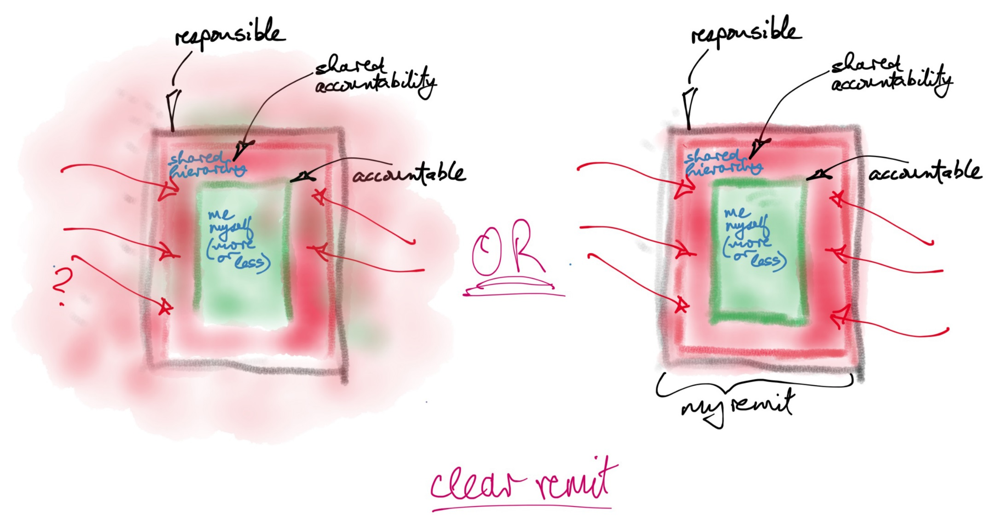



Which would you prefer?

Slide 32
The following eight slides work through the elements of a remit map. In running a workshop you start by bringing the group through these simple ideas.
When they understand the six elements, you get them to populate them using Post-its/stickies. It is not significant where an item is posted as long is it is what it is…
One point per Post-it
Must have a verb – its something that gets done. Abstract nouns no good!!
Level of detail depends on the span of the remit you are looking at…
Remit mapping describes the facts of what is – ‘where are we now?’ How things came to be this way may come up but the focus is ‘now’.
You know the map is right when the workshoppers say “Yes, that is us.” It is therefore a neutral exercise, not judging ‘why?’ or ‘why not?’, just recording.
Notes:
The essence of remit mapping is dialogue.
The use of remit mapping is in creating a work environment in which a team, or individual, can be a high performer and find professional and personal fulfilment.
That may seem a bit on the ambitious side but it follows form Dan Pink’s mastery, autonomy and purpose. Remit mapping speaks to clarity of purpose, it helps outline the ‘boundary’ around the person or team and therefore the space in which they should have autonomy, and it frames the skills and capabilities in which the person or team should be helped develop mastery.

Slide 33
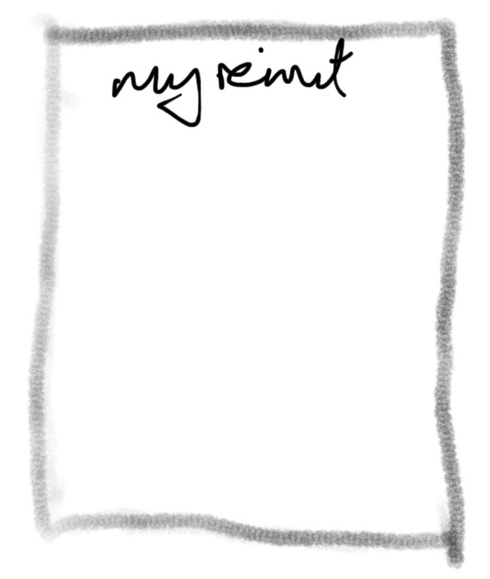
Remit - clear start
Notes:
This is the remit formally given at some start point – a last review, the creation of a team, on-boarding in a new role – and is what we are responsible for, how it connects, how it helps meet overall purposes, what our targets are, how we will measure success etc.
The dialogue around remit mapping is not about putting constraints on the person or team whose remit it is but about ensuring that all involved are clear – clear on responsibilities, expectations, targets, measures etc.
That is, remit mapping puts the pressure on the manager to ensure an effective environment more than on the person or team whose remit is being defined. It is the managers responsibility to ensure remit is clear and success enabled. It can also be a challenge to bring clarity if history and evolution has created fuzziness.

Slide 34
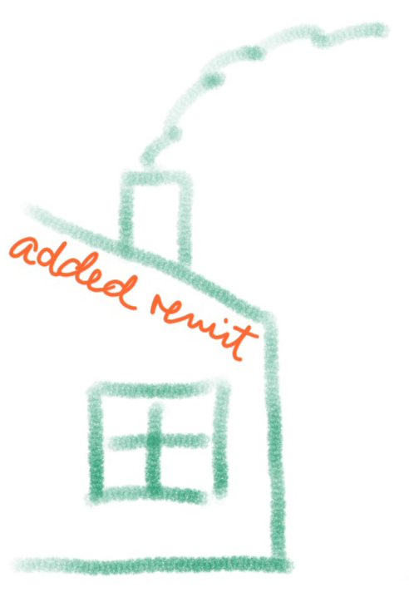
Remit - formal change
Notes:
Formal additions are made – all relevant conversations taking place when remit is added.
Indeed, remit can be formally reduced/removed too.
The point is that this is an explicit change in remit.

Slide 35
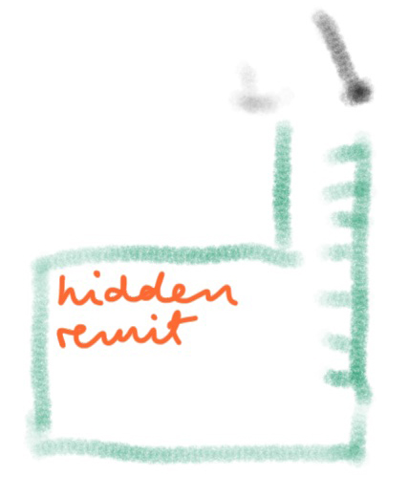
Remit - incremental pick-ups
Notes:
This is more challenging… the things that people pick up along the way that become part of what they do. This has two implications – it takes time from their working day/week/months to do it and it becomes something others expect them to do or rely on them to do. But it is not formally part of the remit.
A good example of who this can crop up is in reporting and analysis. Someone in the team may be good with your reporting tool and gets known for doing interesting reports on an aspect of the team’s business. This is very useful to another team and so your colleagues finds they are producing reports for them on a regular basis. A project starts outside your team and your colleague gets called on to help it. They need to spend half a day a week on the project. It is an important project. The team lead cannot say no. But what about their day job? Who is going to do that? It is great to be able to help… but is it undermining what we are responsible for. Is delivering on our remit taking a hit?
The worst/best aspect of this is that the individual often quite enjoys this hidden remit they have accumulated. And they are often well appreciated for it.
What are you going to do if you are such an individual, if you are the manager in such circumstances?

Slide 36
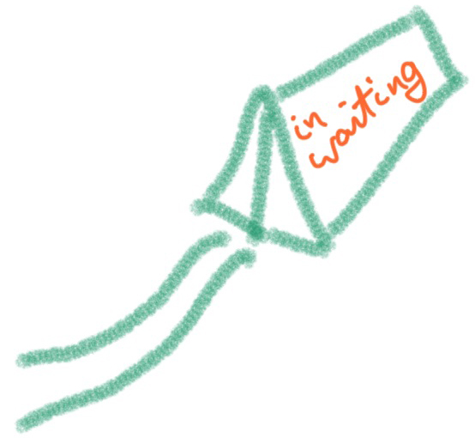
Remit - coming your way
Notes:
You know there is a new policy being launched in three months and you are going to have to operate it. You know there is a system upgrade coming in six months for which you will be responsible. You know that you will be running a new masters next September will need to prepare for it.
Remit in waiting is something you will be responsible for, which will take your time and energy, and will have to be fitted into your current responsibilities.
What are you going to do? Where will it fit or land? Is it new or an extension of something you already do?

Slide 37
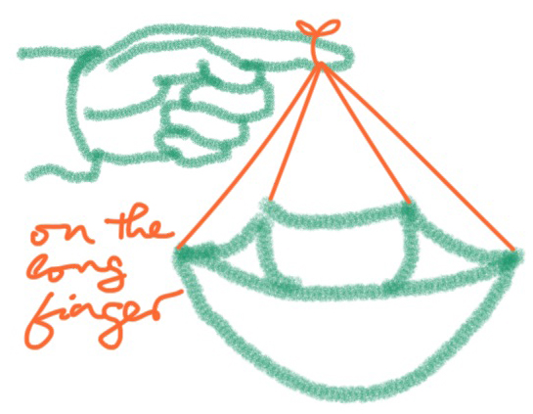
Remit - the undone ‘should’
Notes:
I was running a workshop one day when someone asked “What about the stuff we are supposed to be doing but do not get around to?”
So what about the things you know you are supposed to do but do not. Recognising they are on the long finger is a start. Then comes the question “What will we do about them…?” Actively deciding what to do about them is better than just leaving them on the long finger, important enough to be in your remit, not important enough to do.
This is about dialogue again – within the group doing their remit map, perhaps beyond that with the remit giver.
Do you bring the work on the long finger into the active part of your remit or leave them on the long finger? And if they are on the long finger is there a need to talk with the up stream folks – line manager, lead, director - about the consequences of your not being active in this area? If it should be done but is not, what are the consequences.?

Slide 38
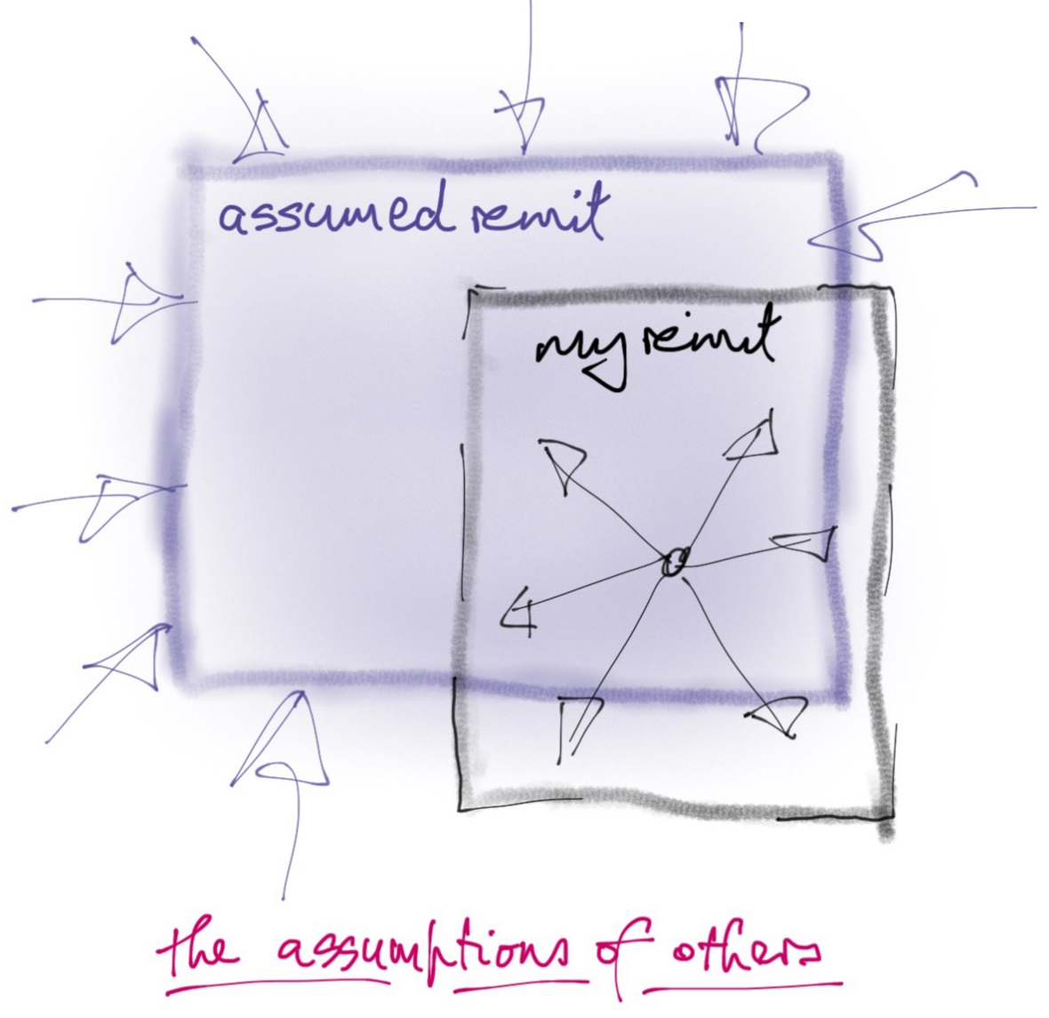
Remit - how others act
Notes:
People make assumptions about your remit. This part of the map is looking at the remit people think you have, and they act on that basis, but which is not formally your responsibility. It may also be that people act as if it is your remit because it suits them to. Or it can be a territorial thing – “this is our responsibility, not yours” or “we don’t want the responsibility and are sending it your way…” or “we are both responsible but have not figured out the dynamics of how we work together…”
You can have one or both of two problems when this business comes your way – saying “this is not our responsibility”, with the challenges that ‘no’ can bring and the time and effort to say it, and/or taking it on board and acting on the assumption.
It can be very interesting to look at the assumptions folks make. Such assumptions will always, in some way, tell you something interesting and need to be explored. Do you act to make your remit clearer to folks in order to stop this work coming your way? Do you absorb the assumptions into the detail of your remit? Do you need to talk with others to figure out what to do with what are clear needs that come your way but are not part of anyone’s remit?
Again, this is a trigger for dialogue.

Slide 39
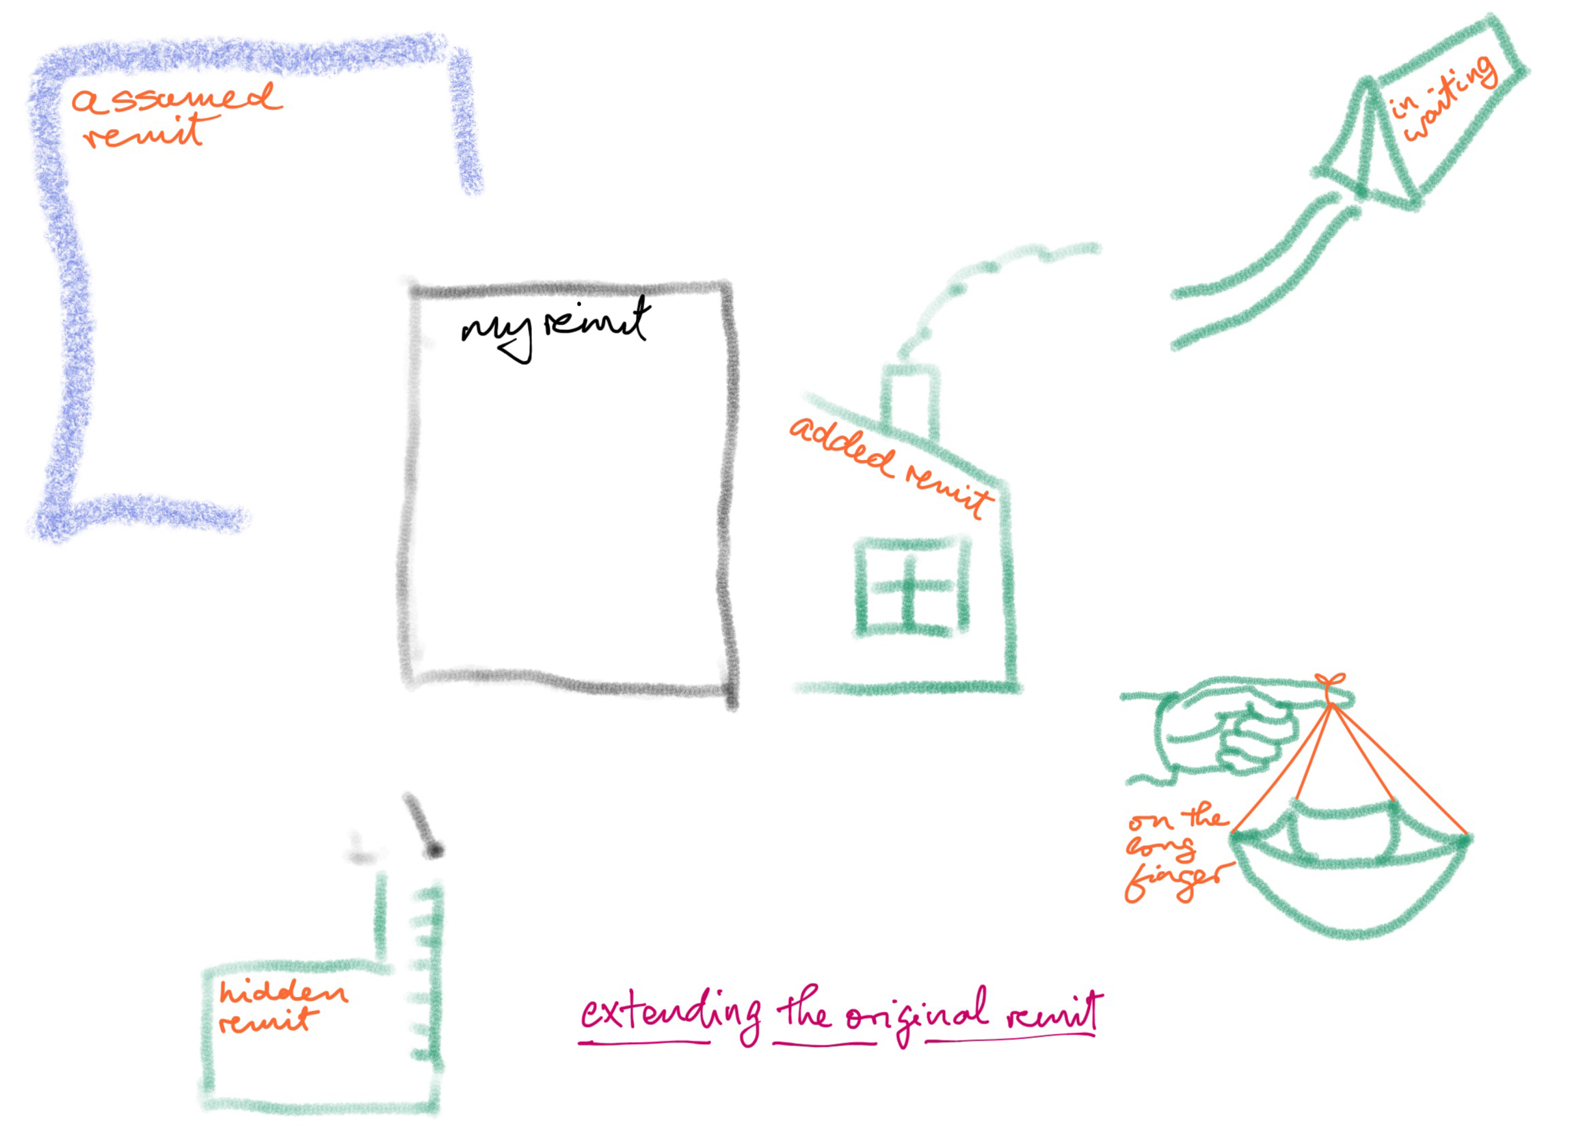
Remit - all the elements
Notes:
The six elements

Slide 40
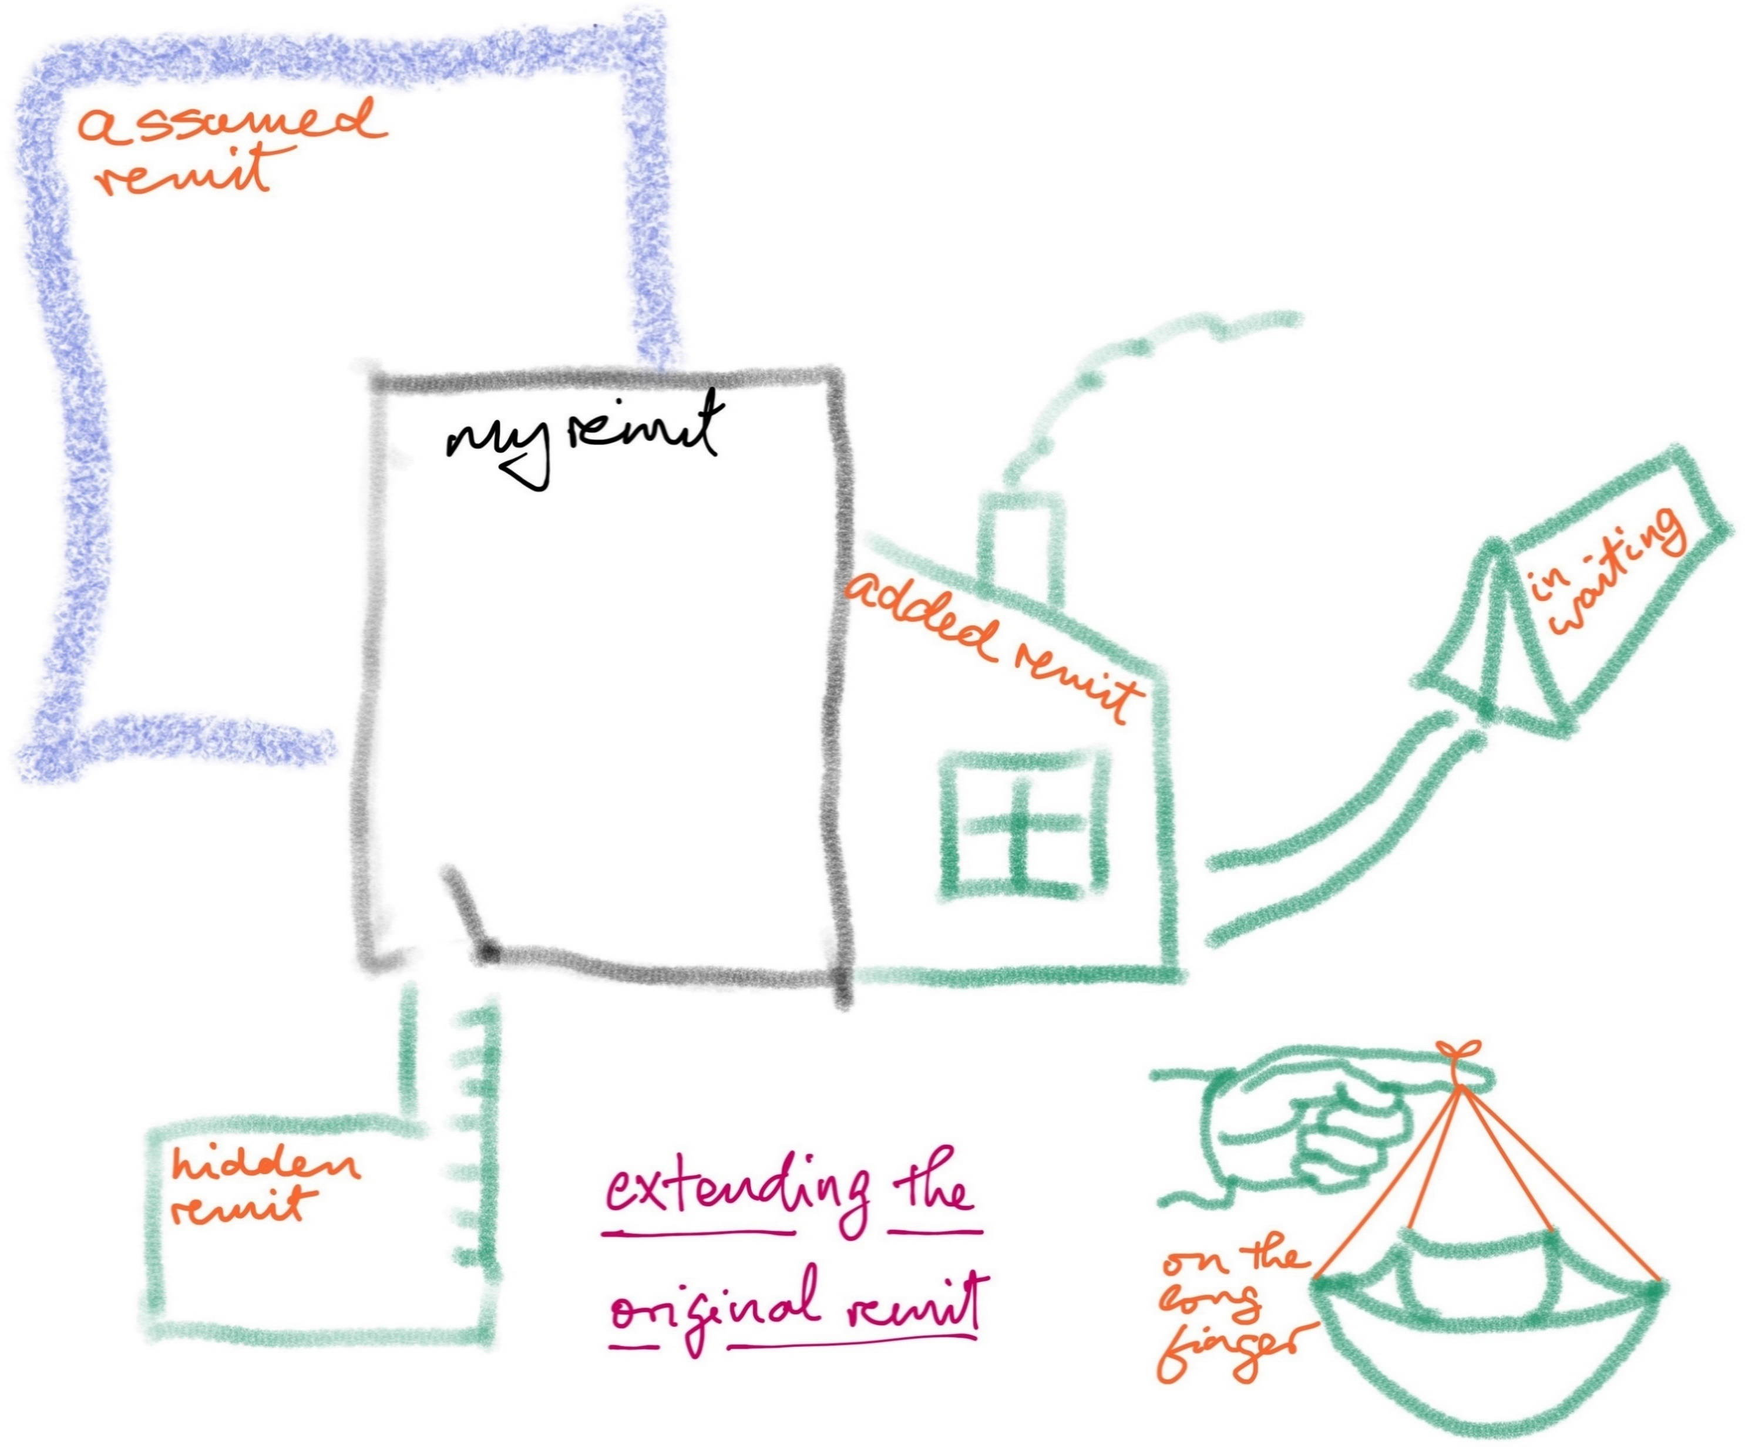
Remit - my actual remit
Notes:
The overall remit map.
When you populate the map with everything you do … that’s your remit. This is the picture of what you were formally given, what has been added, what you have picked up, what you know is coming your way, what people assume you do, and what you should be doing but are not.
Your remit, in this sense, includes the bits which have not been given to you – in ‘assumed’ and ‘hidden’.
What do you do when you see the full picture?
From my point of view it would be a rare colleague who would simply tell the team “do not do that anymore” as that could be a staff management challenge or a stakeholder management challenge. Dialogue. In running a workshop you have asked for the participants’ voice. They have filled in the details of what is the ‘now’. Whether the original intention or not, this is the span of responsibility being taken – the effective remit.
Arising from remit mapping, though rarely, it can be that a team lead needs to talk to a team member about something that cropped up in hidden remit, was precious to the person who was doing it, and they were doing it well, but which did not belong in the team’s remit. The more likely challenge will lie in dealing with assumed remit. It is also not unusual to find something which has been brought in through added remit but has grown over time – in people’s minds is ‘just an add on’ but has become a significant business.
You populate the full map and take a photograph.
Then you talk through ‘hidden’ and ‘assumed’ and ‘in waiting’ and see what is recognised as part of the team’s remit. The discussion around ‘on the long finger’ is different – however passively, the team has ‘chosen’ not to do these things even though they are formally their responsibility. What to do?

Slide 41
The Method - how to run a remit mapping workshop
It is a workshop so you need to put in all the preparations you would normally do for a workshop
Key: clarifying and working with the context in which the workshop takes place – your brief in running it, the participants’ reason for taking part
Where will you run it?
In the physical – lots of stickies and markers UCD Agile has 100m² writable walls
Online – Mural (https://www.mural.co/)
How long does a workshop take?
For a first time, 2 hours
Preparations?
None for the attendees – they are already the experts in what they do
Follow up
Photos – shots of the workings – from the session
Notes:
Three key points
The facilitator is a facilitator and so will do their very best not to bring their own agenda into play.
This can be a challenge for a team lead but is possible if they are committed and the team accepts them in this mode.
The facilitator’s goal is to create a space in which the team can work successfully in the workshop. You are looking for them to make the most of the opportunity to step back from their day to day and find the answer to ‘where are we now?’.
The essence of running a successful workshop is preparation.

Slide 42
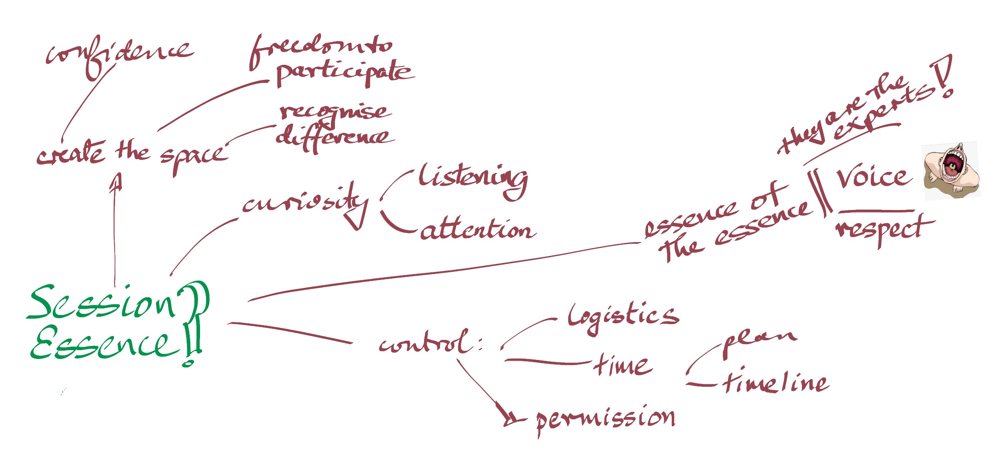

Workshop - essence
Notes:
The ‘essence of the essence’ of a successful workshop is people – giving the team its voice / giving the individual their voice. This is a significant responsibility to take on board and a beautiful opportunity.
The best thing to bring as a facilitator is curiosity – it means you will listen and pay attention. When you give folks their voice, listen.
The best thing for the team, too, is to be encouraged to be curious and to listen. For bigger teams this is not such an issue as it is likely few of them will have seen the full map of the team. With smaller teams, much of what they do may not need to be spoken, day to day, and so drawing it out here will give them a new perspective on themselves, often making explicit details they do not regularly bring to mind. This can take some drawing out.
In the end, curiosity and listening will draw the details out.
And humour.
‘Control’, above, is about the facilitator controlling the ‘space’ in a way that enables an effective workshop. That includes the permission, especially important if the facilitator is the lead or a team member, to interact with folks as a facilitator, to explore and question, to work with the map and shape it. For a lead or team member, it is especially important that they step into the facilitation role and out of their normal role, and that the participants see and feel this difference.

Slide 43
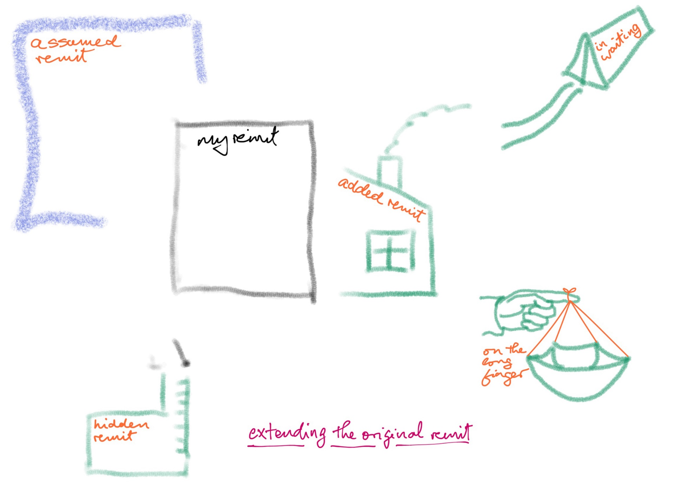
Workshop - introduce the concepts
They are the experts on what they do
The session is just about the facts of ‘now’
Notes:
1st Ideas:
You begin by talking about mastery, autonomy and purpose and why they are key to having high performing teams in which folks can thrive.
There are two messages in this – firstly, that purpose is important and that remit mapping is a practical way to explore this and, secondly and most importantly, that the team lead or line manager wants to help the team be high performing and a good place to work. In effect, remit mapping is a statement of commitment to the team.
2nd Ideas:
You then talk about what remit is (the things for which we are formally responsible) and all the influences which shape remit over time. The message here, following on from Dan Pink’s highlighting of purpose, is that it is important to take the time to stand back and see where the team’s remit is now, given all the influences which have shaped it, if you want the team to be the best it can be.
3rd Ideas:
And then you introduce them to the six elements of the remit map.
All in all, you have now given the team or individual a bunch of concepts, framed in terms of helping the team be high performing and creating a good working environment for its members. Beyond the remit mapping workshop itself, the group now has these concepts to work with.

Slide 44
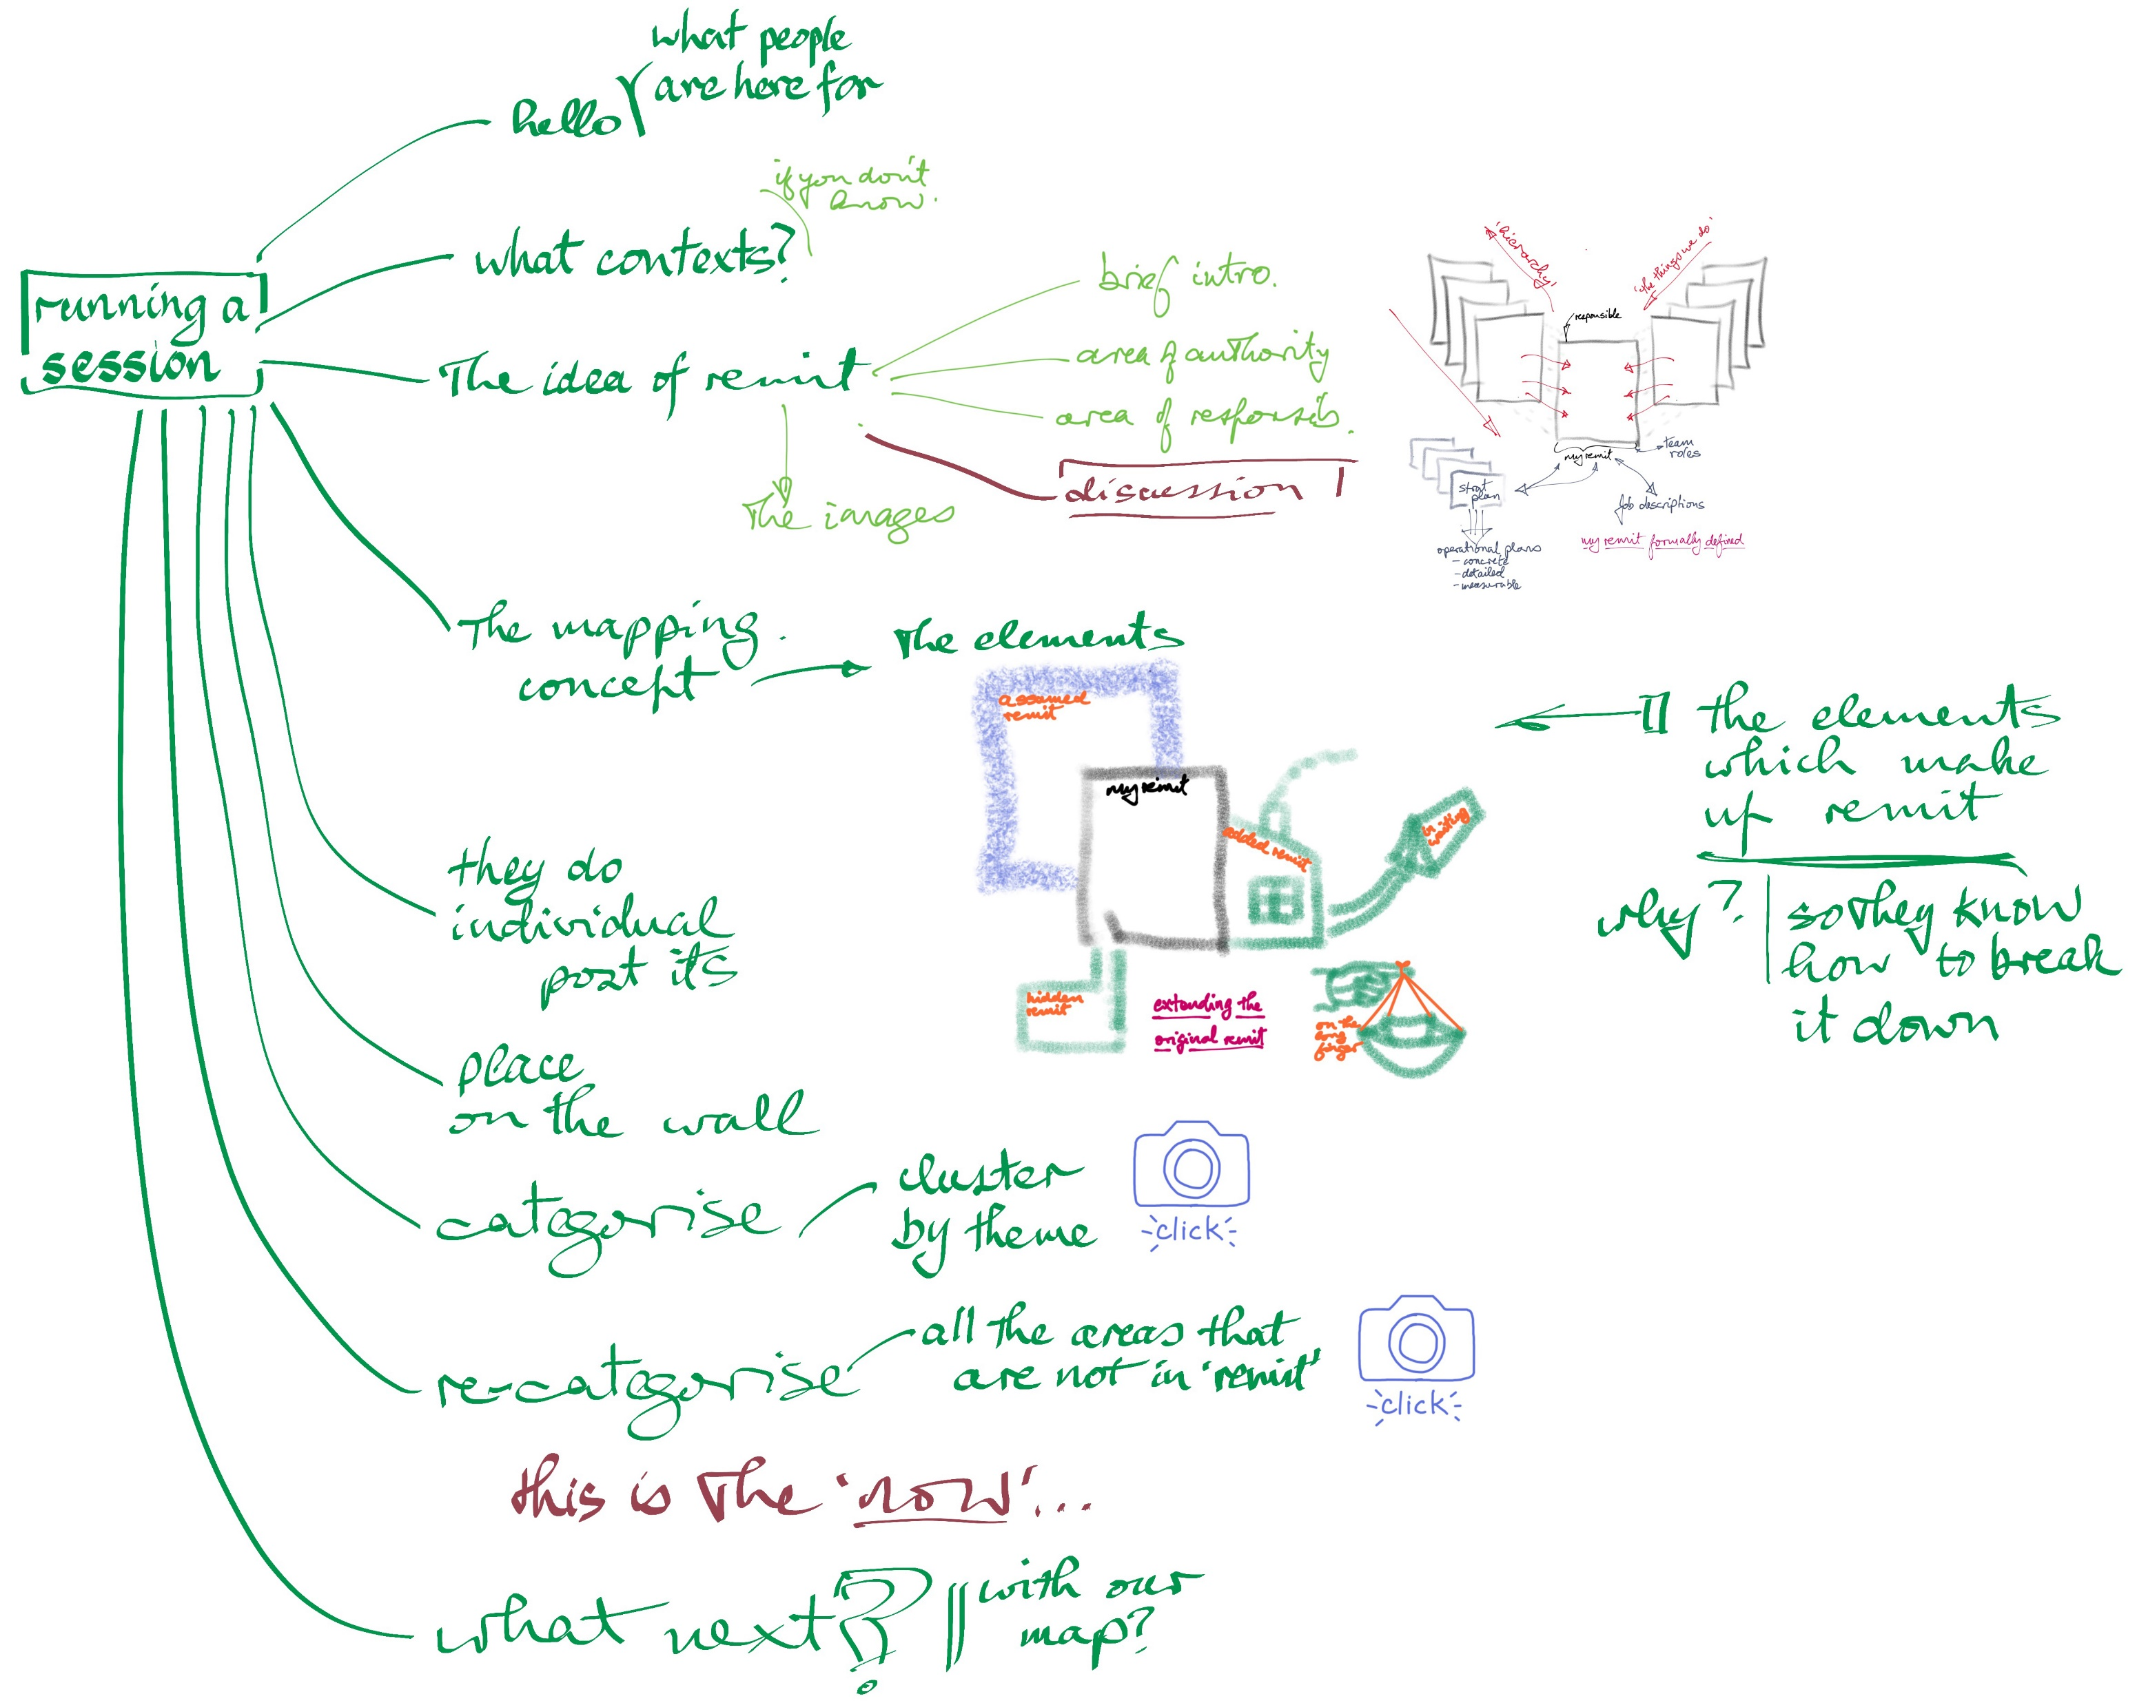
Workshop - sequence
Notes:
Zoom in on the image above and you’ll see the sequence to follow in running a workshop.
If you are already experienced in running workshops, the mechanics of the session will come to you quite quickly.
If you are new to running workshops like this, be sure to get some wisdom and insight from a veteran workshopper on the tricks of the trade in creating a effective workshop experience.

Slide 45
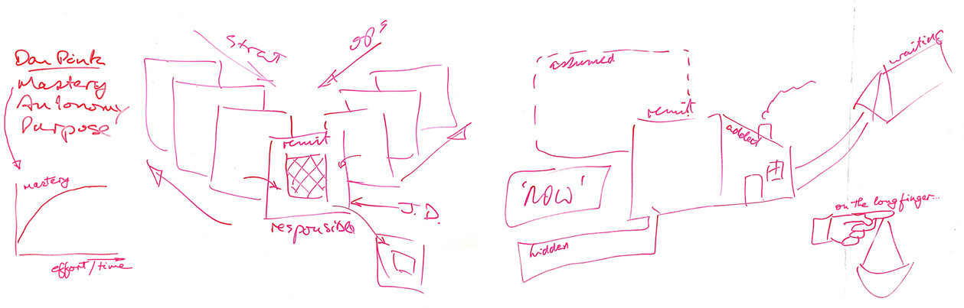
Workshop - what it looks like
Notes:
This slide, and the following two, are wall shots from UCD Agile’s great workshopping space – a 7m x 7m room of writable walls.
As a facilitator, I draw my way through the ideas, talking the participants through the concepts as the picture unfolds. You’ll see above – a wall photo from an actual session – that the images do not need to be polished – they are prompts to help you talk and to hold participants' focus.
You could use a PowerPoint presentation to bring the attendees through the ideas… but the whole feel for a workshop like this is ‘hands on’ and built on the day so try the incremental build of ideas that drawing as you go bring. The drawings are simple.
I have never found it necessary, later in a session, to go back to the theory and explore it again.
When you get to this point of your workshop – the six elements of the map explained – you ask the participants to start their own Post-its.
Watch out for the risk of one word, abstract noun, Post-its. They meaning something to the person who wrote them but are hard to work with and they tell you nothing about what doing is taking place.
- One action/activity per Post-it.
- Must have a verb.
‘Receive invoices’ makes more sense than ‘Invoices’.
While they are busy writing, you prepare for the next phase of the workshop by drawing the map they will populate on the wall.
If you do not have a wall (what’s keeping the ceiling up?) then large whiteboards or the large A0 Post-its can create a big enough space for a team to work with.

Slide 46
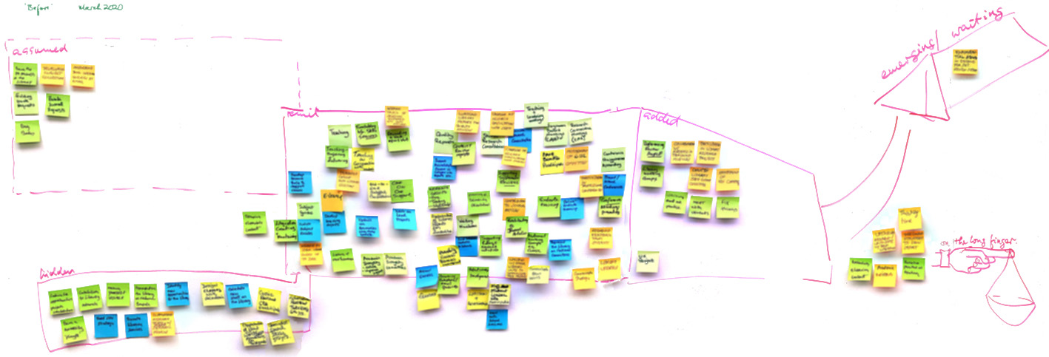
Workshop - what it looks like
Notes:
When they have done their list folks post their Post-its on the map. The above map came from eight people. The detail of every map is, of course, different. There is no example I can give of this which would mean anything – every team is unique.
Make sure the Post-its are intelligible – no one word Post-its; should have a verb.
Colour does not matter.
And the fewer rules the better – they should feel free to work with the ideas.
The level of detail on the Post-its will depend on the scope of the session. If you are working with a dozen people, covering the scope of an entire team, the actions/activities on the Post-its will be at a higher level than if you are looking at the details of one area of the team’s activity.
Note: the Post-its in the slide above have been intentionally blurred out. The details might reveal the team!

Slide 47
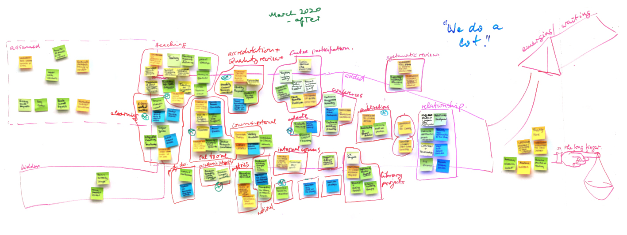
Workshop - what it looks like
Notes:
This is the map after we worked through all the areas. You can see that most of the material in ‘hidden’ was moved into the main map – the team agreed it was part of the business of the team. On the other hand, most of the ‘assumed’ stayed in ‘assumed’ – in fact, it grew. It was not seen as part of the team’s work. The issue may have been that the team had been in place for some time and its remit never quite clearly defined. Also interesting was that none of ‘on the long finger’ moved and, indeed, did not get much discussion.
You can also see how the clustering shaped the content. Lots of discussion takes place at this point – just what belongs with what, just what distinctions exist, just what the best way to describe the clusters might be.
By the time you get to the end of this phase all the folks in the room have contributed to the content of the map and to the shaping of it into its clusters. This is the part of the process where facilitation skills are most important as you are both drawing contributions from all participants and looking for meaningful patterns. It is the team’s reaction and insight which determines the accuracy of the map.
Take a photo.
Now you can go further. If you look closely at the above map you’ll see green Xs against some clusters. This was used to mark the activity clusters for which useful metrics existed. Or you might tag the map with back log hot spots or complaints or excessive workload. Folks are not getting involved in the agenda that gave rise the using the remit map to answer ‘where are we now?’

Slide 48
Workshop - follow up
The follow up all depends on the brief you took in running the session
Part of the follow up may be working at the end of the session with folks on what they will do
Minimum – the ‘wall shots’ from their work – photos of the map
Depending on the client
Work with them beforehand on how the outputs will be used
Provide a summary of the session content that fits with that intention

Slide 49
The Approach in Action - using the remit map, working with the team
Who can you use remit mapping with?
What kind of contexts can you use it in?
What lessons would we take from our experience in UCD?

Slide 50
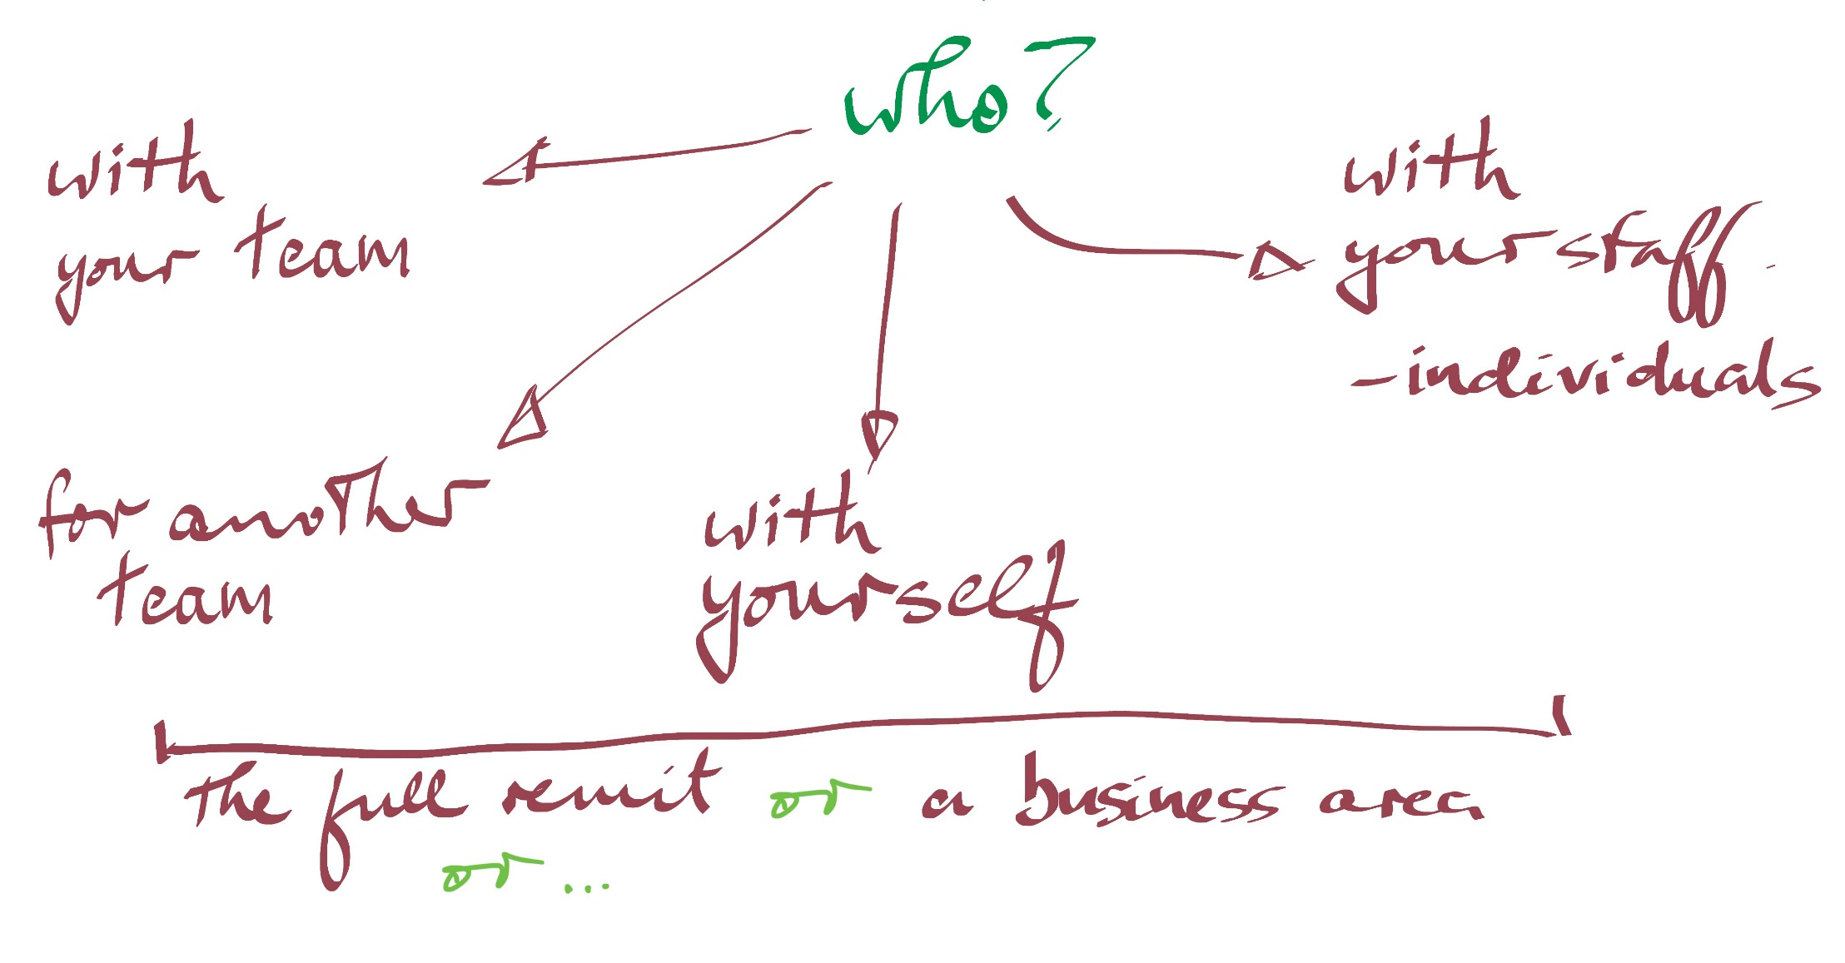
In action - with whom?
Notes:
In essence, you can run remit mapping with any individual or team. You can even run it with yourself!
And you can run it at whatever scale is useful.
We’ve not tried it for the whole university yet…

Slide 51
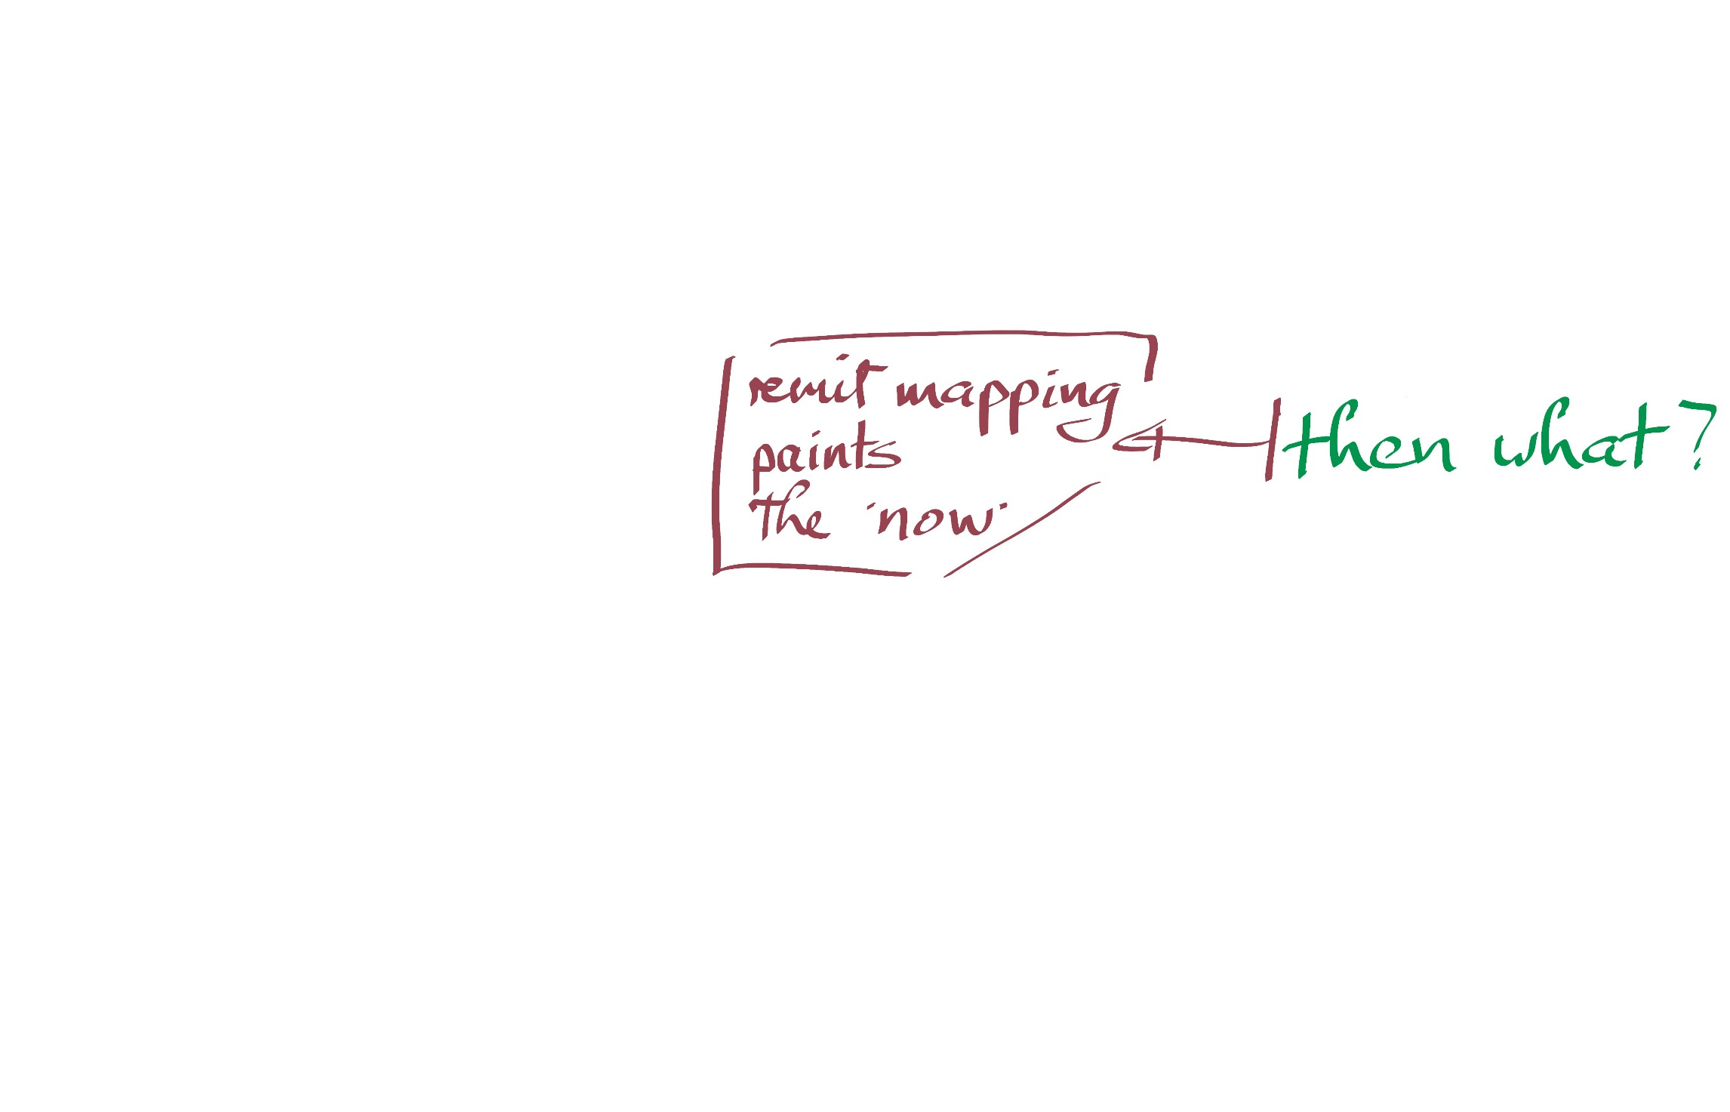
In action - why?

Slide 52
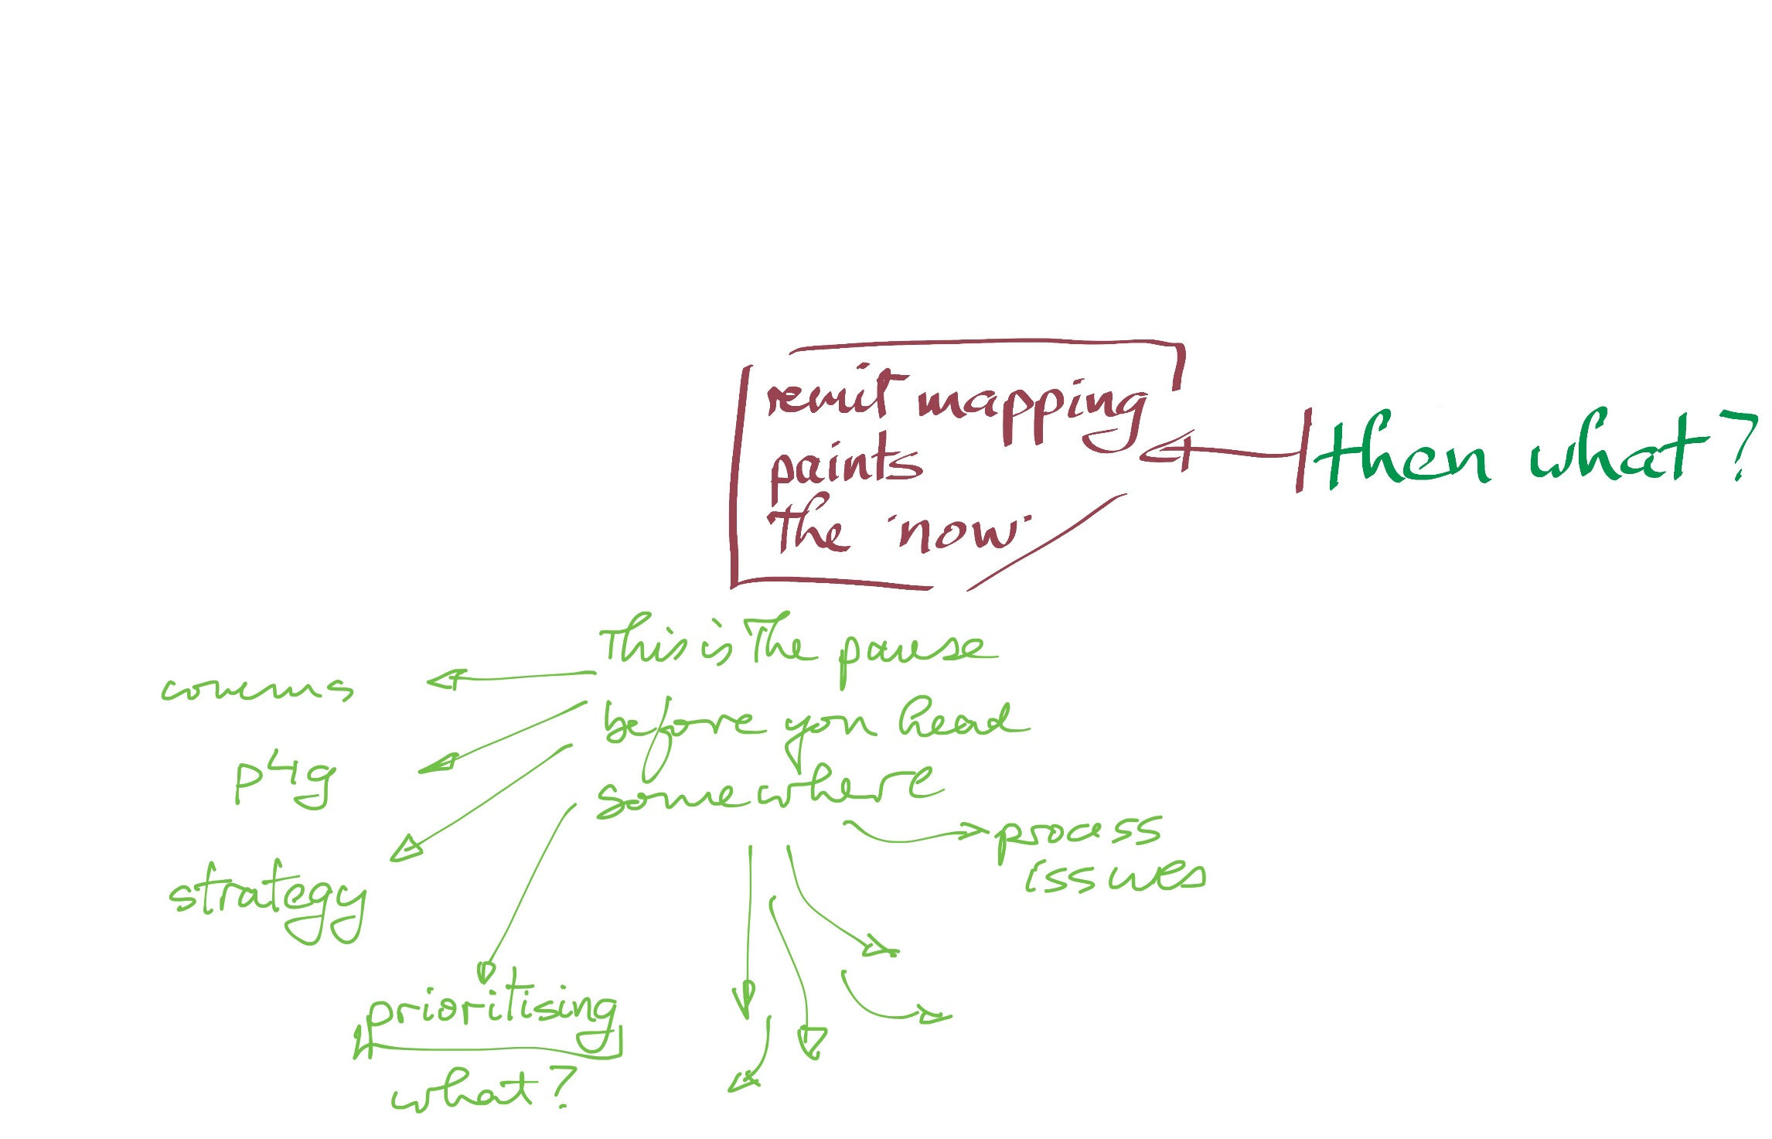
In action - why?
Notes:
When you click through this slide you will see that the first point is that remit mapping allows you take a pause before… Before heading on that journey mentioned at the start of the presentation – from some ‘now’ to some desired future state. The example above has ‘comms’, reflecting work we did with a team that wanted to completely update its website and needed a whole team perspective to ensure a comprehensive picture. ‘P4G’ is UCD’s performance management framework and remit mapping helps folks frame their thinking and discussion in term of what the team does and their contribution to it. ‘Process issues’ reflects sessions when folks know they need to deal with some process issue, workload pressures, complaints etc. but are not sure where to start. A key element of this can be helping shape a common sense of need and a shared sense of the options to pursue.

Slide 53
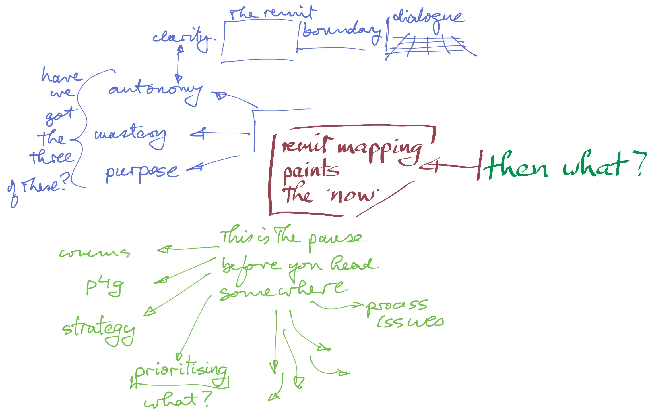
In action - why?
Notes:
This all leads into the deeper questions of mastery, autonomy and purpose, the factors which help shape high performing teams in which staff can thrive. The purpose element leads to a search for clarity as framed in remit… all of which is about creating dialogue in and around a team.
Remit mapping is about dialogue, about making clear the ‘now’ in which the team or individual works and operates. At the heart of remit mapping is bringing clarity of purpose.
If you talk about mastery, autonomy and purpose you move to clarity regarding the remit, which bring in a discussion of just what the remit is and the boundary around it, with its targets and success measures and connections to other teams or individuals, all of which creates a context for dialogue with the clear underpinning of wanting to help teams and individuals be high performing and in an environment which helps them thrive.

Slide 54
In action - lessons?
The concepts are quite simple and work well
Helping folks to think and navigate complexity
Context is all
Why is the mapping being done? What kind of ‘journey’ are they planning?
How will the insights be used? Who is going to do the work?
A great way to work with teams
Their business, their voice… their writing, their stickies…
They own the map – it is not an abstract document but a map they made… reflecting who they are and what they do…
Workshopping is teaming
If the boss is not an active part of the team, they just set the context
If this is the first time the team has done something like this…
… it will be new to the boss/lead too… and they will need help
You get good at running these sessions through practice!
Great for:
New staff
Fragmented teams
Merging teams
Disaggregating ‘we do all of this’
Starting strategy
Communications
Etc. etc.

Slide 55
Today’s session
For you and your team… …the two questions at the end of a remit mapping exercise:
Have you a clear picture of what your team is doing now?
Are you better able to talk about purpose, clarity and change?
In this session you saw
The Concepts
The Tool
The Method
The Approach in Action
Objective
By the end of the session you should be happy to try out remit mapping with your own colleagues.
Just what is your team doing now?
Notes:
Hopefully, you will have seen enough to lead you into trying remit mapping in your own environment.
The best test is to get comfortable with the thinking and then explain it to some colleagues. Explaining it to colleagues is a dry run for the theory part of a remit mapping workshop. Testing it with colleagues is not about practicing the workshop – it is about testing the ideas themselves, but in their resonance for you and in how your colleagues engage and react.
When you are happy the ideas work for you and you can ‘feel’ their flow, then you are ready for your first remit mapping workshop. It will take you a few before you are comfortable with the flow and can put most of your energy into facilitation – into the curiosity that will drive your listening and attention and which will help make the participants feel heard.
Good luck and have fun. It is a real privilege to work with a team in this way so be sure to try this out.

Slide 56
Questions / comments?
Contact
Michael Sinnott
UCD Agile
michael.sinnott@ucd.ie
Best contact: Zoom, Teams, Chat
I am the Lean HE Ireland contact
www.ucd.ie/agile
worksmartertogther.ucd.ie
https://worksmartertogether.ucd.ie/remit-mapping/

Slide 57

Notes:
SPEAKING NOTES:
Our 2021 Conference will be held in Glasgow, Scotland and we invite you to join us;
The University of Strathclyde has a long standing commitment to continuous improvement, which is underpinned by their University Values of being People-Oriented, Ambitious, Bold, Collaborative and Innovative. These values very much align with the two pillars of Lean: Respect for People and Continuous Improvement. We have no doubt that the team at the University of Strathclyde will deliver an outstanding experience for all conference delegates and we look forward to welcoming you to the wonderful city of Glasgow in October 2021.

