Slide 1



Applying for a Mortgage, key points:
Rates from 1.95% fixed/fix for up to 30 years
Exclusive Public Sector Mortgage Options
Market based advice is always best
October 2021

Slide 2


TODAY
Todays webinar should be of interest to you:
If you have or require a mortgage
If you want to pay less interest on your mortgage & save thousands over the term
If you know someone who does
www.affinityadv.ie

Slide 3

The Mortgage Process..
Arrange a mortgage consultation & understand your market based mortgage & protection options.
Submit your documents/obtain an Approval In Principle letter – enables you to view suitable properties.
Make a successful bid/go sale agreed. Pay your
booking deposit (fully refundable).
Confirm your Lender, instruct your valuation/survey
(if applicable) & receive your loan offer.
Sign contracts/pay balance of 10% (non refundable) unless the contract contains a loan/mortgage clause.
Exchange contracts, close and move into your new home!
www.affinityadv.ie

Slide 4

So how much can you borrow?
If you’re a First Time Buyer : up to 90%
A Mover or Trading Up: up to 80%
Remortgage/Switch: up to 90%
Buy To Let (Purchase or Switcher): up to 70%
Income is calculated @ 3.5 times “income”
“EXCEPTIONS” to the above are available based on Central Bank Macro Prudential Rules, HOWEVER they are not readily available due to Covid 19 impact on closings & the volume of mortgage applications which are at record levels,
BUT…there is some good news ☺
www.affinityadv.ie

Slide 5
Public Sector Mortgages
Finance Ireland & ICS offer Public Sector Mortgage options designed for First-time buyers, Second time buyers and those switching from another lender and possibly releasing equity in their home.
Product features include:
Only one applicant needs to be a public sector worker;
The applicant's basic income will be considered @ two points up their current pay scale;
Employees who are promoted within the Civil Service on a one year ‘probationary’ period will be considered;
New entrants to the Civil/ Public service who are subject to any probationary period can also be considered; and
An overpay facility – you can pay an additional 20% off the loan amount in any 12 month period without penalty whether you are on a fixed or variable rate. This will reduce your mortgage term and the amount of interest you pay.
www.affinityadv.ie

Slide 6
What The Lenders Look At…
Your Income
Stressed Repayments
Demonstrated Repayment Capacity
Employment (type & period)
Your Credit History
Your Deposit & how it is generated
www.affinityadv.ie

Slide 7

Reasons Applications Are Declined…
No evidence of repayment capacity
Bad credit rating
See www.centralcreditregister.ie
Insufficient net income
“Blips” on your current/savings account
Poorly packaged application
Unstable employment/income
www.affinityadv.ie

Slide 8

The Don’ts…
Un-paid charges on your bank account
Referral fees on your bank statements
Cash withdrawals on your credit card statement
Late payments or other penalties on your bank
credit card statement
Pay rent by cash
www.affinityadv.ie

Slide 9

DOCUMENTATION
PAYE Income
  2020 Employment Detail Summary, your last 3 months payslips, salary cert completed by your employer & if on a contract, a copy of it.
Self Employed Income (if applicable for 2nd applicant)
  Your last 3 years Financial Accounts, Form 11 and Chapter 4 receipts;
  Tax Clearance Cert & 6 months business bank statements;
  In addition to income documents above –
  Current account bank statements;
  Existing loan statements;
  Photo & Address ID e.g. Utility bills and passport or driving licence;
  Application form & Lender Declaration; &
  Any other relevant document requested by the Lender.
www.affinityadv.ie

Slide 10




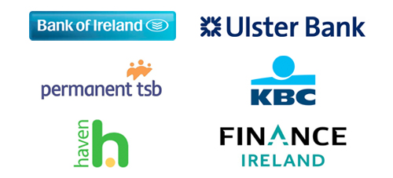


THE IRISH MORTGAGE MARKET
10 Providers offering over 170 different products!
www.affinityadv.ie

Slide 11

MORTGAGE RATES
The lowest rates available vary from Lender to Lender, are subject to criteria and are based on your loan to value, mortgage amount, ranging from (@ <60% to 90% loan to value):
Variable @ 2.45% - 4.5%
Fixed 3 years @ 1.95% - 3%
Fixed 5 years @ 1.95% - 3%
Fixed 7 years @ 1.95% - 3.15%
Fixed 10 years @ 2.1% - 3.5%
Fixed 15 years @ 2.25% - 2.95%
Fixed 20 years @ 2.45% - 2.99%
Fixed 25 years @ 2.65% - 2.99%
Fixed 30 years @ 2.85% - 3.1%
Green rates available from 2.15%
What rate do you qualify for?
www.affinityadv.ie

Slide 12

THE BEST MORTGAGE TERMS
Your own bank may offer the best terms available to you BUT you should compare the market.
This is because they are not obliged to tell you that better terms may be available elsewhere!
Q. Which mortgage most suits your unique circumstances & requirements?
Mortgage amount & term required
Capacity to overpay without penalty
Payment break option
Contribution to legal fees or/Cashback
Interest rate – fixed (long term?), variable, or a combination of both or,
“Green” for BER Cert A1 – B3
One size does not fit all, your own bank offers just 1 product!

Slide 13

Mortgage Related COSTS
Broker Fee (Affinity Advisors charge no fee for UCD employees)
Legal fees (ranging from €1,750 - €2,500 – always shop around and get a written quote including VAT)
Valuation fee (€150 plus VAT)
Surveyors’ Fee (Second homes only - circa €500 plus VAT)
Stamp Duty @ 1% (or 2% over €1million purchase price)
www.affinityadv.ie

Slide 14

WHY USE A BROKER?
Only use a Broker offering Market based advice and who engages directly with lenders;
You will save time & money;
Availability is flexible;
They should provide expert packaging, skills & knowledge;
They are not paid by the lender until your mortgage closes;
Rates the same as going to a Lender directly; &
Same commission paid by all Lenders – no product bias
www.affinityadv.ie

Slide 15
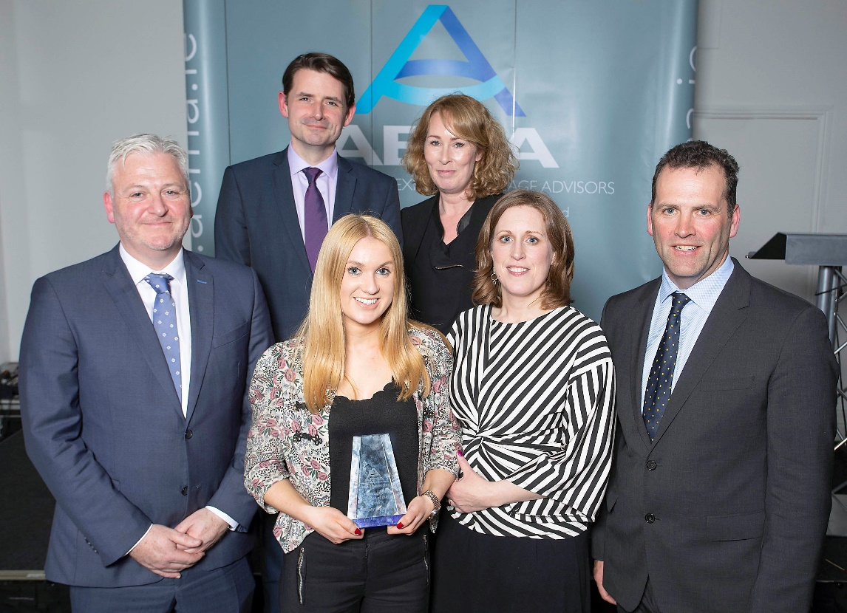
WHY AFFINITY ADVISORS?
Mortgage Broker of The Year
2018 & 2019
as voted by the Lenders
Choice - Market Based Advice
Knowledge- over 100 years combined industry experience
Ease- we coordinate the entire process from enquiry to completion
Reputation- Mortgage Broker of the Year 2018 & 2019
FREE Advisory service from qualified & dedicated personnel
FREE Customer Care programme post mortgage completion
For us, Customer Care is a Promise not a Slogan.
www.affinityadv.ie

Slide 16
Top Tips For Good Mortgage Advice!
Understand your options by obtaining market based advice. Don’t just speak with your own bank.
Shop around and get written quotes from Solicitors for conveyancing work.
Buy your mortgage protection cover from a broker providing market options.
Get an Approval In Principle letter before viewing properties.
If you are a first time buyer purchasing a new build, enquire whether you qualify for the Help to Buy Scheme in advance of your mortgage application, up to €30k available, see www.revenue.ie
www.affinityadv.ie

Slide 17

Your Next steps..
Any Questions?
Contact us for a Free, No obligation consultation
Email trevor@affinityadv.ie or call 01 6533120 / 087 2721146
Thank you for listening!
Affinity Advisors offer free mortgage & protection advisory services
to all UCD employees.
Affinity Mortgages Limited t/a Affinity Advisors is regulated by the Central Bank of Ireland. This presentation is for illustration purposes only and does not constitute individual customer advice. Individual consultations and/or a copy of our terms of business are available upon request.

