Slide 1


ARBITRATION FOR CROSS BORDER TRANSACTION IN ISLAMIC FINANCE CONTRACTS
Presented by: Farah Farina Mazlan
Islamic Finance and Law Conference 2015
Dublin, Ireland
15th May 2015

Slide 2
Motivation
The observation on the courts of the contextual aspect of Islamic Finance disputes under the purview of Islamic law in commercial disputes has not been satisfactory.
e.g. Shamil Bank of Bahrain v Beximco Pharmaceuticals Ltd
Arbitrations sensitivity to readiness in taking into consideration Islamic law as essential to Islamic finance disputes.
e.g. International Investor KCSC (Kuwait) and Sanghi Polyester Ltd (SPL)

Slide 3
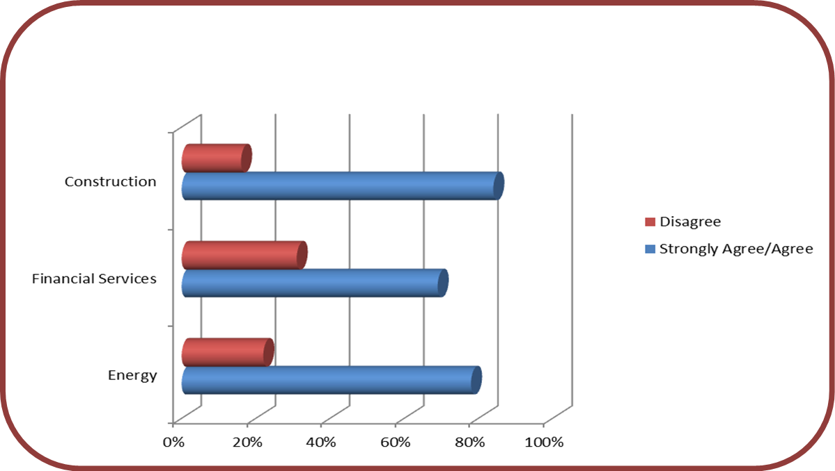
Arbitration in General
1.Survey in 2010 (Choices in International Arbitration) shows arbitration as a fast growing segment of the legal practice where both local and international arbitration service providers are reporting brisk growth, both in numbers of cases and number of venues for arbitration.
2.Survey in 2013– focus on the three main industry- Energy, Financial & Construction.
Source: 2013 International
Arbitration Survey :
Corporate choices in
International Arbitration
Industry Perspective
Queen Mary University of London, School of Arbitration & PwC

Slide 4
Arbitration in Islamic Finance
Arbitration can be seen as a preferable forum as compared to litigation that places private dispute resolution above aggressive court proceedings.
In the Islamic finance industry practice however, it has found a little place due to a number of pertinent issues, including difficulty reconciling international arbitration rules with the Sharia law.
In responding to this issue, this discussion will cover the current practice on how the modern international commercial arbitration tribunal examines the Sharia compliance of the transaction in Islamic finance disputes.
In a similar vein, the issue of how Sharia compliance transactions be viewed in the light of international conventions- Rome Convention, New York Convention and United Nations Commission on International Trade Law (UNICITRAL) Model Law on International Commercial Arbitration 1985.

Slide 5
Methodology
Comparative Analysis- focus on the main procedural rules that have or may potentially raise concerns- KLRCA i-Arbitration Rules, IICRA Arbitration Rules, AAOIFI Sharia Standard No. 32 on Arbitration and new 2012 Kingdom of Saudi Law of Arbitration and UNICITRAL Model Law.
Dynamic Convergence theory- as to find potential of this evolution may provide evidence of convergence between the modern international commercial arbitration rules and Islamic financial contracts.
It builds a preliminary overview of the context that the result of convergence may only be achieved once the exploration of the historical development in the evolution of Islamic finance disputes is thoroughly examined, especially the acceptance by the arbitrator either in international commercial arbitration or Sharia law arbitration in determining Islamic financial disputes.

Slide 6
Religious considerations can play a crucial role in the acceptance and successful functioning of commercial arbitration.
The religious variable may impact the following:
(a) The scope of arbitration (b) The nature of arbitration-arbitrability
(c) Choice of law (d) the appointment of arbitrators
(e) liability of arbitrators (g) interest
(h) public policy considerations (i) enforceability of decisions
- The potential for disagreements and differences between nations and regions in both substance and procedure is obvious as the international commercial arbitration is governed by several sources of law.

Slide 7
Historical Analysis
According to Charles Brower and Jeremy Sharpe, explanation on historical acceptance of arbitration with Islamic law are divided into three phases of development and this study will borrow from the development of oil and gas concession agreement disputes which specifically deal with Islamic law.
EVOLUTION THROUGH
TIME SCALE
END WORLD WAR II – 1970’s
alienation of Islamic Law
Cases: Trucial Coast
Ruler of Qatar v International Marine Oil
ARAMCO
1970’s – 1980’s
more confidence gained
Cases: Sapphire International Petroleum
AMINOIL Arbitration
Present
anticipation by Islamic countries

Slide 8
Analysis
Arbitrability (Subject Matter of the Dispute)
Article II (1) on the Convention the Recognition and Enforcement of Foreign Arbitral Award (New York Convention)
“Each Contracting State shall recognize an agreement in writing under which the parties undertake to submit to arbitration all or any differences which have arisen or which may arise between them in respect of a defined legal relationship, whether contractual or not, concerning a subject matter capable of settlement by arbitration”.
The highlighted wordings above indicate the arbitrability aspect in the arbitration process. The subject matter of the dispute or issues that need for an arbitrator to determine is a crucial area that needs to be explored especially compared with the nature of Islamic financial contracts.

Slide 9
Analysis
(b) AAOFI Sharia Standard No.32 on Arbitration
7. Scope of Arbitration
7/1 Arbitration is permissible in whatever a party entitled to relinquish his right in.
7/2 Arbitration is impermissible in the following cases:
(a) What constitutes a right of Allah, such as Hudood (Sharia Penalties).
(b) Cases that entail proving or disproving of a verdict that concerns a third party.
7/3 When the arbitrator issues a verdict on an issue that should not be resolved through arbitration; his verdict is null and void.
(c) A similar arrangement also found in UAE Arbitration Rules. While in Saudi Arabia, besides provisions above, a narrow view which has been taken up to the measure that all matters are pertaining to public order shall not be accepted for arbitration.

Slide 10
Analysis
Appointment of Arbitrator (Religion & Gender)
UNICITRAL or others international commercial arbitration- NO
IICRA & AAOIFI Sharia Standard – non-Muslim arbitrator may be appointed when necessary
Apparently, restrictions on gender and religion in arbitration rules will breach the international norms and may cause serious concerned in an effort of uniformity between ICA and Sharia.
Choice of Law
UNCITRAL Model Law –Article 28
ICC Rules of Arbitration
American Arbitration Association (AAA)
AAOIFI Sharia Standards –apply rulings of Islamic Sharia

Slide 11
Analysis
Permissible Limitation
- Help in placing the controversial problem arises as to which school of Fiqh in Islam may apply in arriving the finding of fact.

Slide 12
Conclusion & Contribution
This discussion has attempted to identify as to which provisions in international commercial arbitration need modification or insertion of specification to accommodate Islamic financial contracts.
The appreciation of the contextual assessment on the acceptance of international commercial arbitration as part and parcel of Islamic finance settlement dispute from national to the international level indicates a preliminary overview that the framework of dynamic convergence may work.
This contributes to the construction of an intellectual bridge between the worlds of international commercial arbitration on one part and Sharia on the other.
Nonetheless, the reflections in this discussion are not conclusive as this research will continue to study further provisions of arbitration rules that pull out a break between these two universes.
As this part focus on modern international commercial arbitration arguments, deeper discussion from an Islamic perspective needs to grasp too. It has, however laid an essential foundation for convergence to take place.

Slide 13
Thank You

