Slide 1

The 1st Islamic Finance Law Conference
Banking Law and Implementation of Islamic Banking in Kazakhstan
Alfiya Salikhova,
Association for Development of Islamic Finance in Kazakhstan

Slide 2
Issues
1. Introduction
2. Legal framework
3. Islamic Banking
4. Challenges
5. Prospects

Slide 3
1. Introduction
Islamic Finance Development Indicator, 2013
Source: https://www.zawya.com/islamic-finance-development-indicator/#

Slide 4
2. Legal framework:
Bank Law & Tax Code

Slide 5
The most important amendments to the Law “On Banks and Banking Activity”, 2009
Establishing basic requirements to Islamic bank activity based on Islamic financing principals. Deposits in Islamic banks are not guaranteed by the deposits obligatory insurance system
Prohibiting Islamic branch or window in commercial bank. Islamic bank has to operate as a full-fledged Islamic financial institution
Appointing the Council on Islamic Finance Principles by the General Shareholders Meeting of an Islamic bank, which is an analogue to Shari’ah Supervisory Boards (SBB)
Removing restrictions on the participation of Islamic banks in capital of business entities, as well as restrictions prohibiting Islamic banks to be engaged in any activity other than banking. Islamic banks are allowed to be engaged in trading activities and to share profits and losses with their clients

Slide 6
Banking transactions of Islamic Bank according to the Law
Accepting interest-free demand and investment deposits from individuals and entities, opening and maintaining their bank accounts
Bank borrowing: providing interest-free cash loans repayable within specified periods
Supporting entrepreneurial activities by: financing trading activities as a commercial agent by providing a commercial loan; and financing manufacturing and trading activities through acquiring an share in corporate equities or on partnership conditions
Investment activities on leasing/renting conditions
Agency for the Islamic Bank’s banking transactions

Slide 7
The most important amendments to the
Tax Code
Corporate income tax. The incomes obtained by an Islamic bank within the process of managing funds received in the form of investment deposits, transferred to depositors of these investment deposits and remaining there are tax exempt
Value-added tax (VAT). According to the Tax Code, the following bank transactions of Islamic banks which operate on the basis of a received license are VAT exempt:
  Acceptance of interest-free demand and investment deposits of individuals and legal persons, opening and maintenance of their bank accounts
  Banking borrowing transactions: provision by an Islamic bank of credits in cash on terms of maturity, collectability and without charging of commission

Slide 8
The most important amendments to the Tax Code (VAT)
The transfer of the property by Islamic bank shall be exempted from VAT in the part of the incomes (mark-up sum) receivable by an Islamic bank in the framework of financing trading activity as a trade mediator that offers commercial loan.
Islamic banks using proportional method to make offset have the right to apply the separate accounting method of VAT amounts on turnovers relating to acquiring and transferring property in the framework of financing trading activity as a trade mediator that offers commercial loan. This provision allows Islamic banks to avoid increasing their tax base, and as a result to decrease the amount of VAT due.

Slide 9
3. Islamic Banking
Al Hilal Bank is the first Islamic bank established in Kazakhstan and CIS countries. Al Hilal Islamic Bank is a 100% subsidiary of Al Hilal Bank of the UAE, which is the only bank fully owned by the Government of Abu Dhabi
According to the Development Strategy, the bank positions itself as a corporate financing institution, and also takes deposits from individuals. It pays special focus on governmental, quasi-governmental companies and corporate clients. The bank does not finance retail sector.
Nowadays, the bank offers to clients the following products for business financing: corporate murabahah facility, commodity murabahah facility and ijarah muntahiya bi tamlek.

Slide 10
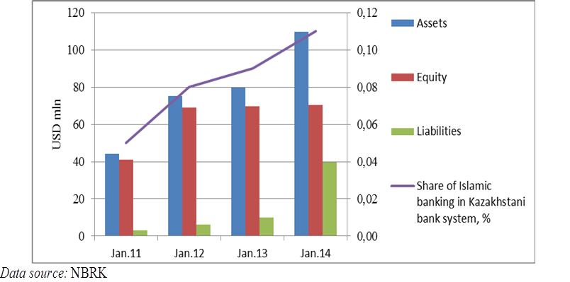
Trends in Islamic Banking

Slide 11
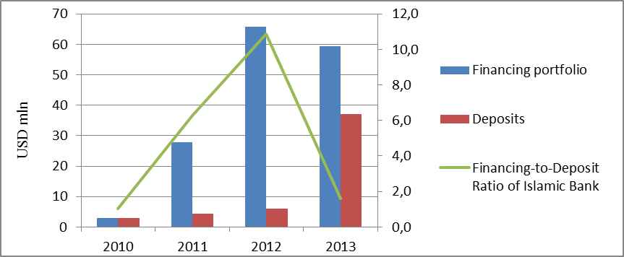
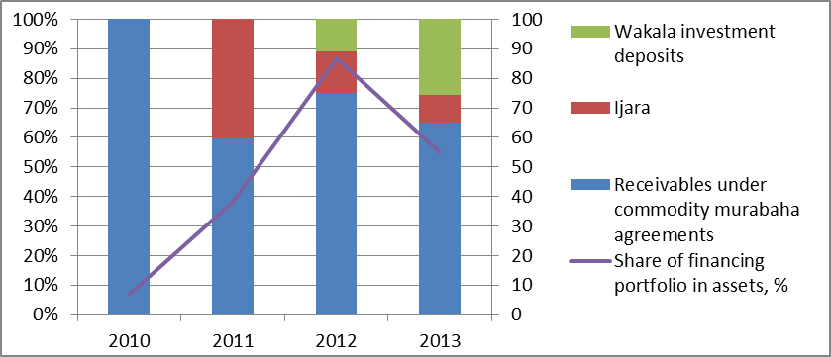
Trends in Islamic Banking
Al Hilal Bank portfolio
“We explain to our clients that they will share not only profit but and also losses on the predetermined base. After that many clients say that they need to think and they do not return to our bank. However, we have many other clients who say “Yes, I know. I was waiting for a long time and had not allocated my money on deposits in other banks. Now there is Islamic bank and I am happy to allocate my money there” (Abraham, CEO Al Hilal Bank, 2014)

Slide 12
4. Challenges
Establishment of the level playing field for Islamic banks under the secular law
Implementation of Islamic banking products

Slide 13
Establishment of the level playing field for Islamic banks under the secular law
Prohibition of opening Islamic subsidiaries in conventional banks
Licensing process
The requirement of establishing the Council on Islamic Financial Principles in each Islamic bank
Absence of any insurance system for accountholders in Islamic bank
Lack of Shari’ah compliant liquidity management instruments

Slide 14
Prohibition of opening Islamic subsidiaries in conventional banks
To ensure strong segregation of Islamic funds from conventional ones the regulator permits to offer Islamic banking services only to full-fledged Islamic banks
In the UK, the UAE, Malaysia and other countries the largest number of Islamic banking providers falls on the Islamic subsidiaries
For instance, in the UK the number of Islamic banking providers in 2013 totalled 22, and only six of them operated as full-fledged Islamic banks
Another example is Malaysia, where Islamic banking has about 25 % market share of the total retail business and 20 % out of them are held by Islamic windows and subsidiaries of conventional banks

Slide 15
Licensing process
The prohibition to open Islamic bank subsidiaries in Kazakhstan has coupled with the complex process of conversion of conventional bank into Islamic one
Since 2013, the shareholders of local bank Zaman Bank have been trying to convert it into the first retail Islamic bank. As of today, the bank has not received license from the supervisory authority so far
The existing law stipulates that conventional banks would have to shut down the activity and then reapply for licences to offer Islamic finance services. This process could take up to 3 years. It is obvious that not every financial institution can afford such luxury to close its business for such a long period

Slide 16
The requirement of establishing the Council on Islamic Financial Principles in each Islamic bank
The Bank Law stipulates that each Islamic bank should have the Council on Islamic financing principles (CIFP) which will determine the compliance of operations and transactions to Shari’ah principle. The Bank Law does not stipulate any requirements towards the number and qualification of CIFP’s members
The National Bank of Kazakhstan which is the supervisor for all Islamic financial institutions in the country in 2014 became the Observer Member of AAOIFI and the conformance of CIEP members to the requirements of AAOIFI is unequivocally a right benchmark
According to AAOIFI Governance Standards No.1, the SBB shall consist of at least three members and they should be experts in the field of Islamic financial institutions and with knowledge of Islamic commercial jurisprudence.

Slide 17
Council on Islamic financing principles (CIFP)
CIFP requires the presence of highly respected scholars in Islamic commercial jurisprudence with experience in Islamic finance and the issue here is that Kazakhstan is lack of such scholars
The first option: the invitation of eminent scholars from abroad. However, the question here is the cost of such expertise, especially when Islamic banking industry in the country is at an early stage of its development
The second option: Islamic bank being guided by the principle of dhurura (necessity) can appoint newly graduates of religious universities without relevant practical experience to be members of CIFP. However, it may cause lack of confidence in Islamic bank operations from potential customers and foreign investors

Slide 18
Absence of any insurance system for accountholders in Islamic bank
In compliance with the Bank Law, deposits in Islamic banks are not covered by the obligatory deposit insurance system. This provision is Shari’ah compliant as it prohibits any financial transactions to be involved in riba or excessive gharar
However, in some courtiers to propel the further growth for Islamic financial industry by reducing the potential outflow of deposits from Islamic banking institutions to conventional banks, many jurisdictions implement different schemes of deposit insurance or guarantee

Slide 19
Implementation of Islamic banking products
The type of law system which is utilised by the country
Limited list of Islamic banking transactions
Tax treatment of Islamic financial products

Slide 20
The limited list of banking transactions
Islamic bank can finance entrepreneurial activities through providing a commercial loan or participating in corporate equities. In this regard, financing individuals through establishing a simple partnership for acquiring, for example a property, is prohibited by the exciting legal provision. It is worth noting that Islamic home financing in the UK, the US and many Muslim countries is widely carried out by Islamic banks through partnership agreements namely diminishing musharaka.
Islamic bank can carry out investment activities on leasing (ijara) conditions. One of the types of ijara contract is forward ijara. With forward ijarah, an Islamic bank undertakes payment during the construction period, whilst customer's payment starts within a specific period after completion. However, according to the current legislation, only non-expendable items can be the subject matter of leasing (ijara) contract.

Slide 21
5. Prospects
Political backing
Demand for Shari’ah compliant financial services
Growing interest from the foreign investors

Slide 22
The most important amendments to Islamic finance legislation, 2015
Commodity murabaha will be recognized as a transaction of an Islamic bank (Bank Law)
The income from commodity murabaha transaction as a mark-up on the commodity will be exempted from VAT, and both as an Islamic bank so as its clients using proportional method to make offset have the right to apply separate accounting method of VAT for such transaction (Tax Law)
Wakala principle will be approved for accepting investment accounts by an Islamic bank (Bank Law)
Islamic ijara as a specific form of leasing will be introduced (Lease Law)
Islamic insurance as a separate type of insurance will be introduced (Insurance Law)

Slide 23
National Bank of Kazakhstan (NBK) & Islamic Finance
In 2015 the NBK has signed an agreement with International legal firm Norton Rose Fulbright to elaborate a new standalone comprehensive law on Islamic finance in the country
The NBK is working out a new concept for development of special financial zone in the country. This, as expected, will allow Kazakhstan to become a financial hub in the CIS and Central Asia

Slide 24
Demand for Shari’ah compliant financial services
According to official data, the number of Muslims in Kazakhstan exceeds 10 mln people which can be considered as potential customers under the conditions that Islamic banks would be able to offer competitive financial services
“As of today, the number of Muslims in CIS and Central Asia exceeds 75 million, and by 2030 it will increase up to 100 million. Since the Islamic finance market is equally accessible for all, irrespective of faith and confession, the demand for Islamic financial products is expected to keep growing.” (Kelimbetov, KIFC 2014).

Slide 25
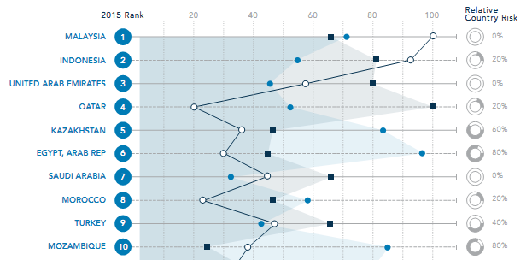

Islamic Growth Markets Investment Outlook, Thomson Routers 2015
Source: www.zawya.com/ifg-publications

Slide 26

Thank you for your attention

