Slide 1
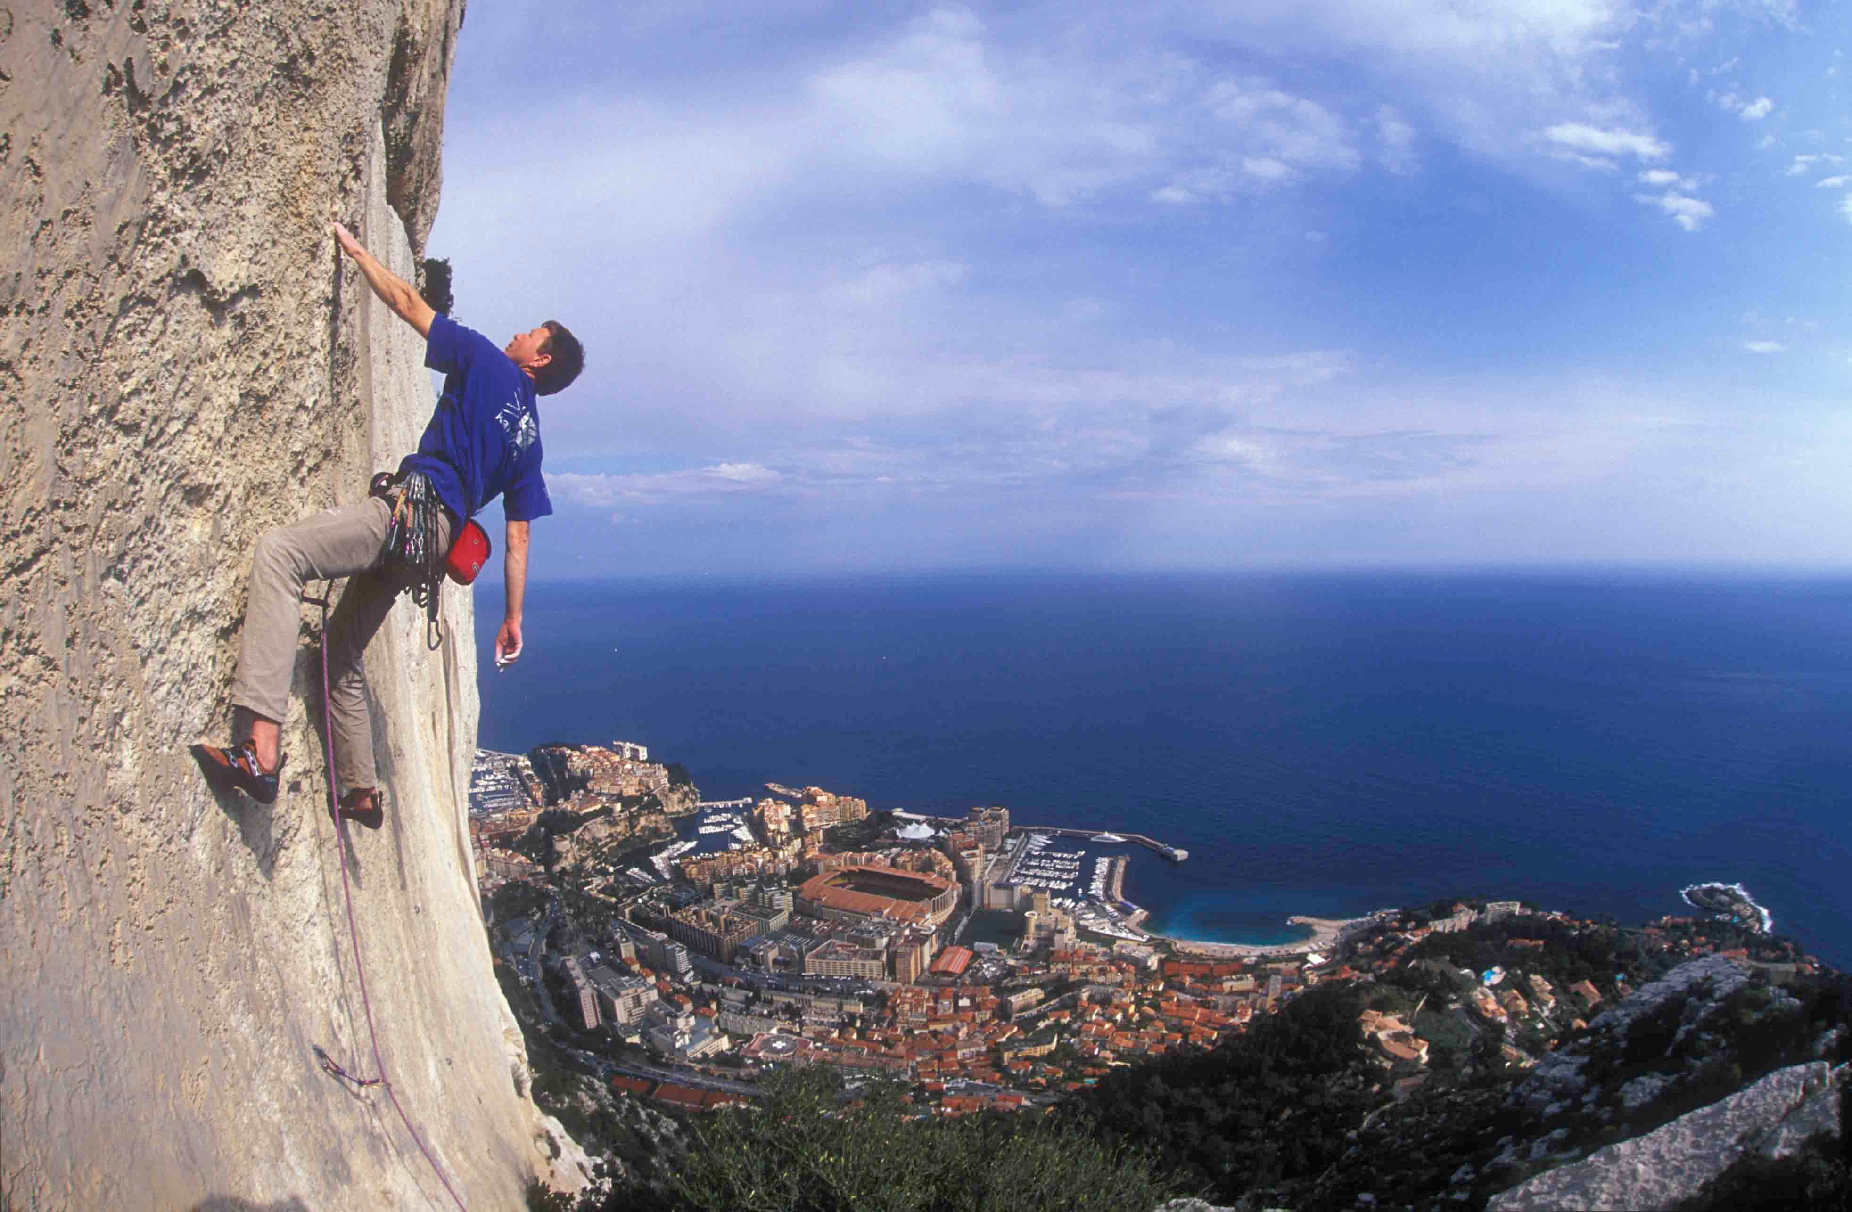
Creating Islamic Finance Regulations in Hostile Jurisdictions
The Case Study of Bosnia & Herzegovina

Slide 2

Content
Invocation & Thanks
Brief Explanatory Note
The Jurisdiction
Bigotry Measures
Legal Comparisons
Analysis
Conclusion

Slide 3

Invocation

Slide 4


Brief Explanatory Note
The Jurisdiction
Bigotry Measures
Legal Comparisons
Analysis
a

Slide 5
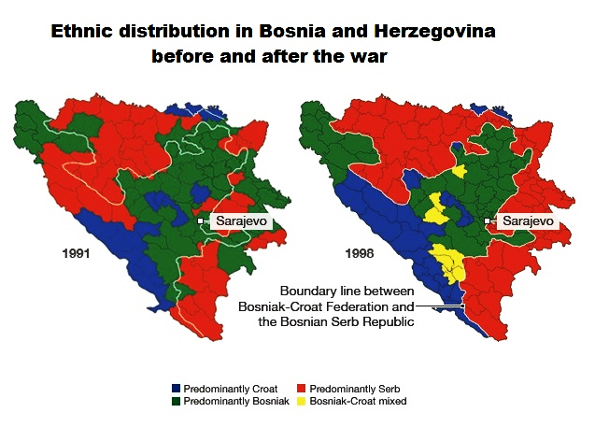
Brief Explanatory Note
The Jurisdiction
Bigotry Measures
Legal Comparisons
Analysis
Bosnia's War-Torn History
Dayton Accords
Current Government Structure
Implications
  Minority Power
  Impact on Legislation

Slide 6



Brief Explanatory Note
The Jurisdiction
Bigotry Measures
Legal Comparisons
Analysis
Why is this needed?
2007 Study
  UK
  Luxembourg
Pew Studies
  Yearly rank v. Trends
Political movement to the right

Slide 7

Brief Explanatory Note
The Jurisdiction
Bigotry Measures
Legal Comparisons
Analysis
Multiple changes (2003, 2005, etc.)
Section 47 of Finance Act
  Transactional Description, with Particularity
  Examples, descriptions, exemptions, rationale
Key underlying assumption

Slide 8
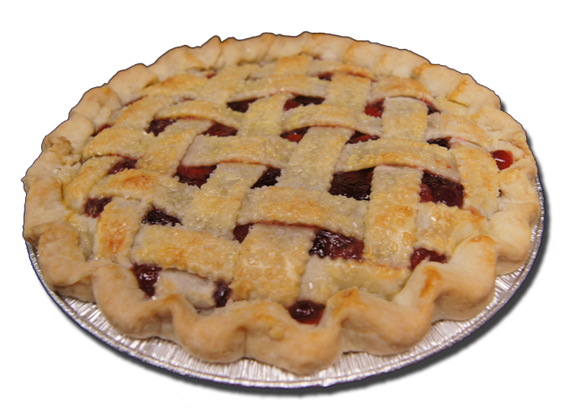
Brief Explanatory Note
The Jurisdiction
Bigotry Measures
Legal Comparisons
Analysis
Impressive history—1983, 1st takaful, sukuk
Taxation Circular
  Transactional Description, with Particularity
  Examples, descriptions, exemptions
Note on Luxembourg's slightly different emphasis

Slide 9
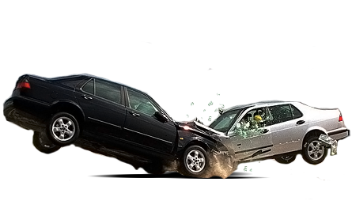
Brief Explanatory Note
The Jurisdiction
Bigotry Measures
Legal Comparisons
Analysis
One Islamic Bank seeking to promote IF
Letter of request
  Add “making and purchasing loans and financial leasing.”
  2 Arguments
Denied twice

Slide 10

Brief Explanatory Note
The Jurisdiction
Bigotry Measures
Legal Comparisons
Analysis
Structure
  Functional description
  Rationale
  Examples
Underlying assumption
  How to approve this?
Admit shortcomings
  Bosnia's uniqueness
  Widespread v. magnitude

Slide 11

Conclusion: Cause for Hope
The underlying assumption to both UK/Luxembourg
  The true meaning of these laws
  'Adaptive' & the maqasid-as-sharia
Bosnia doesn't have these problems
  Tax-free on critical instruments
  A huge opportunity, if lacking sophistication
  Great timing
  Recent example

Slide 12

Thank You!

