Slide 1
Islamic Financing in Europe
Recent Developments in Ireland
Faiza Ismail
Irish Research Council Scholar
University College Dublin

Slide 2
Problem
Is enough done to increase FDI through Islamic financing in Ireland? In this regard it is essential to examine
1-What opportunities exist in the country to promote IF?
2-How can these opportunities be utilised to bring in Islamic investors?

Slide 3
Methodology
Explores IF developments in Europe i.e. UK, France and Germany.
Examines IF in Ireland-identifies funds industry, aviation finance, SPV industry and trade financing as potential sources to promote IF in the country.
Suggests sukuk issuance, networking, setting up working groups and an active marketing strategy to utilise potential industries to develop IF in Ireland.

Slide 4
Why IF is being promoted in Europe?
Financial crisis 2008
Regulations
Alternate to conventional finance/ethical financing
Liquidity resulting from rising oil prices and
European Muslim population demand for Islamic financing.

Slide 5
IF in European Countries
United Kingdom
France
Germany
Ireland

Slide 6
United Kingdom
2.9 million Muslim population
1980 when London Metal exchange facilitated Murabaha deposit arrangement
In 1990s Islamic banking began operating in the UK
By 2004 double stamp duty and double taxation got resolved
2013 UK IF Task force was set up
2014 100 m sovereign sukuk was issued

Slide 7
France
Paris stock exchange set up a separate segment for Sukuk.
2007- Islamic Finance Commission was formed by Paris EUROPLACE
2008-Tax amendment to facilitate Sukuk
2010- Removal of double stamp duty and capital gains on property facilitated Sukuk issuance
‘In 2011, Chaabi Bank, through its 17 branches across France, launched Islamic deposit account to its customers’

Slide 8
Germany
2004-2009- First European Sukuk was issued
2009- Islamic financial institution was permitted to operate in the country
2015- Federal Financial Supervisory Authority (Bafin) issued licence to Kuveyt Turk (KT) to open a bank branch with initial investment of 45 million euro.

Slide 9
Ireland and Islamic Financing
‘A Strategy for Ireland’s International Financial Services 2015-2020’
‘Islamic finance will continue to feature in the sectoral and regional strategies outlined in IFS 2020’.

Slide 10
What IF develpoments are made in Ireland?
Gateway into euro region
Lowest corporate tax rate
English speaking country and
Common law tradition
Finance Act 2010
Double Taxation Agreements
Irish Stock Exchange
Amendment in Central Bank Act 1971- Central Bank (Supervision and Enforcement) Act 2013

Slide 11
Potential Opportunities
Fund Industry
Aviation Industry
SPV Industry
Trade financing

Slide 12
Irish Fund Industry
According to Kuwait Finance House (KFH), currently in Europe largest number of Islamic funds are listed in Ireland.
Two issues:
First the funds are listed in Ireland but not domiciled in the country.
Second success of the fund industry can be replicated to ensure to attract Islamic funds develop in similar pattern.

Slide 13
Irish Aviation Finance Industry
‘More than 50% of the world’s leased fleet is managed from Ireland. As the aviation growth markets shift towards Asia and the Middle East, this dominance is under threat.’
Department of Transport, Tourism and Sport, ‘An Integrated Irish Aviation Policy: Issues Paper for Consultation’ (2013)
Irish aviation industry can get a competitive boost if the industry gets finance from Asian investors and financiers.

Slide 14
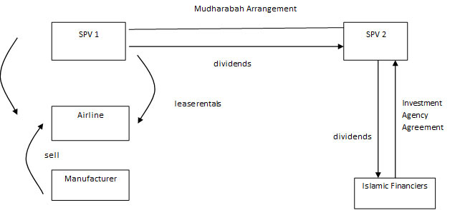
Islamic aviation finance
Source: Jia Hui Yip, ‘Islamic Aircraft Financing’ Bird & Bird

Slide 15
Islamic Aviation Financing
A combination of Ijarah (lease) and Mudaraba is the commonly used IF structures to invest in aviation finance. There is a sale and purchase agreement between aircraft manufacturer and airline to purchase an aircraft.

Slide 16
Special Purpose Vehicle (SPV) Industry in Ireland
‘According to the Irish Debt Securities Association around €500 billion of SPV assets are already resident in Ireland representing approximately 22 per cent of all European SPV assets.’
‘Government Targets Structured Finance as Growth Sector’ 18 (1) Finance Dublin, 4.
Sukuk heavily relies on SPVs and enhances the growth of Irish SPV industry.

Slide 17
Trade finance
Extensive tax treaty network with 60 countries
Royal College of Surgeons Ireland in collaboration with Medical University of Bahrain
ESBI, Kerry Group Plc, Mercury and Kentz- Irish traders conducting business in Arab countries

Slide 18
Recommendations
Sukuk- As a channel of utilising highlighted industry to facilitate Islamic investment
Towards possible future strategy
Networking-EI and JAICC
Working group-EI, IDA, CBI and RC
Marketing- Road shows, seminars, conferences, research and publications

