Slide 1
Shortcomings in the regulations pertaining to the purification of Islamic equities: Innovations from corporate finance
Dr. Mark Mulcahy, CFA
Department of Accounting, Finance & Information Systems

Slide 2
Background
The Islamic funds industry is estimated at 5.5 % of the over $1.0 trillion global Islamic finance industry (Wilson, 2009).
Both have high growth potential
  23% of the world’s population are Muslim
Focus here is on innovation in the Islamic funds industry
  Portfolio management and individual investors

Slide 3
Islam Prohibits Riba
In modern Islamic finance riba (excess) has become synonymous with interest-related activity
Riba is unequivocally forbidden in the Qur’an [2:278]
  . . . give up what remains [due to you] of interest, if you should be believers.

Slide 4
Permissible Variation
An absolute interpretation of the prohibition against riba would result in the funds industry being, ipso facto, off limits for Muslim investors (McMillen, 2011).
Absolute application has been replaced by permissible variation (Haniffa and Hudaib, 2010).
  The result is “shari’ah-compliant” products.

Slide 5
Permissible Variation
The implications of permissible variation for this paper are that some contamination by interest and debt is acceptable must be within “acceptable” levels (Derigs and Marzban, 2008).
The quid pro quo of permissible variation is that these need to be estimated and purified.
  How?
Notes:
AAOIFI set up in 1991 to prepare accounting, auditing, governance, ethics and shari’ah standards.

Slide 6
What to Purify?
Accounting and Auditing Organisation for Islamic Financial Institutions (AAOIFI) Shari’ah Standard 21
  “The figure [to be purified]. . . is arrived at by dividing the total prohibited income of the corporation whose shares are traded by the number of shares of the corporation”
Notes:
AAOIFI was set up in 1991 to prepare accounting, auditing, governance, ethics and shari’ah standards.

Slide 7
What to Purify?
S21 clearly covers interest income received from cash
  What about gains from the interest tax shield from debt?
The interest tax shield arises because interest expense on debt is tax-deductible such that by taking on debt (i.e. leverage) a company can reduce its tax bill.
Notes:
AAOIFI was set up in 1991 to prepare accounting, auditing, governance, ethics and shari’ah standards.

Slide 8
The Interest Tax Shield
The interest tax shield is acknowledged as a significant material benefit to firms and investors in the corporate finance literature,
  Cooper and Nyborg (2006), Modigliani and Miller (1963), Miles and Ezzell (1980, 1985), and Ruback (2002)
Because of the Qura’nical prohibition, the duty of care required to avoid riba is enhanced.
  Any material benefit above the capital sum lent is prohibited (Ahmad and Hassan, 2007).

Slide 9
The Interest Tax Shield
The reduction in tax is a benefit to the firm but society as a whole loses out
  erodes the corporate tax base (DeMooij, 2011)
The shield is a “gift” to the firm and its investors from society
  should this be allowed when Islam is based on social justice?
  tends to reinforce the unequal distribution of capital (Bigsten, 1987)

Slide 10
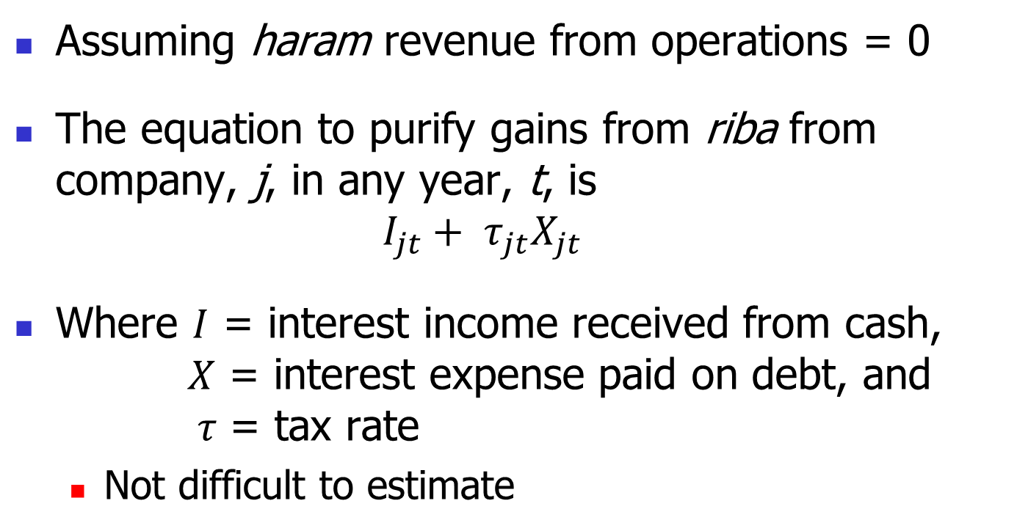
Comprehensive Purification
Assuming haram revenue from operations = 0
The equation to purify gains from riba from company, j, in any year, t, is
  $$I_{jt}+ τ_{jt}X_{jt}$$
Where $I$ = interest income received from cash, $X$ = interest expense paid on debt, and $τ$ = tax rate
  Not difficult to estimate

Slide 11
Example: Dow Chemical
Interest income received on cash: $40m
Interest expense paid on debt: $1,341m
Tax rate 2011 = 22.7%
Amount to be purified:
  $40m + (0.227*$304m) = $344m
  760% higher than the $40m if you only view riba as interest income only!

Slide 12
Conclusion
Purification practices vary
  Many Islamic funds seem to do no purification (no pro quo).
  Others purify interest received only (or other non-comprehensive variations).
It is the contention here that, based on the benefits accruing to investors from its application, the interest tax shield also needs to be purified from Islamic portfolios.

Slide 13
END

Slide 14
Islam Prohibits Riba
At the time of the revelation of the verses about riba, the only type of riba known was riba al-nasi’ah
  pertaining to the application of an exploitative, exorbitant or penal rate of interest.

Slide 15
Islam Prohibits Riba
Based on the strict application of this Qur’anical prohibition, it is not permitted for devout Muslims to be involved with riba in any way.
a hadith narrated by ‘Abu Dawud states that ‘The Messenger of Allah cursed the one who devours riba, the one who pays it, the one who witnesses it, and the one who documents it’.

Slide 16
The Interest Tax Shield
Hadith states that even the most trifling of gifts as a condition of a loan is prohibited.
Anas Ibn Malik on the authority of al Bayhaqi: The Prophet said: “When one grants you a loan and the borrower offers him a dish, he should not accept it; and if the borrower offers him a ride on an animal, he should not ride . . .”

