Slide 1

Maths Anxiety –
“something must be done”
Sue Johnston-Wilder

Slide 2
Aims of this session
To understand why maths anxiety is so prevalent
To begin to understand what we can do about it, for ourselves and our students
To take an approach rooted in positive psychology: resilience
To introduce a 3- level model for staff CPD

Slide 3
What is maths anxiety
“A feeling of tension, apprehension, or fear that interferes with maths performance” (Ashcraft, 2002)
Results in:
Negative attitudes & motivation towards maths
Avoidance
Lower grades
Negative self-perceptions
Impact on working memory
http://www.mccc.edu/~jenningh/Courses/documents/math_anxiety.pdf

Slide 4
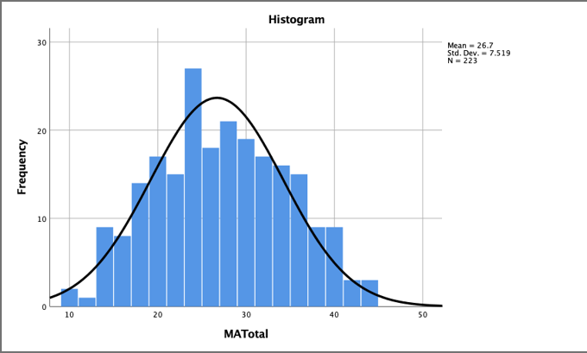
How prevalent is maths anxiety?

Slide 5
Maths anxiety …
... interferes with the process of doing maths
… affects learners, parents, teachers
… contagious
… prevalence across the world?
… impact? including avoidance
… often ignored or dismissed

Slide 6
The problem
Learners are naturally curious
Fear is learned
Things that cause fear become avoided
Vicious cycle
Combined with fixed mindsets:
“I am not a maths person”
Self-fulfilling prophecy

Slide 7
Maths teaching
A.L.I.V.E. maths
Accessible
Linked
Inclusive
Values-based
Engaging
(Johnston-Wilder et al, 2015)
T.R.I.E.D. maths
Tedious
Rote
Isolated
Elitist
De-personalised
(adapted from Nardi & Steward, 2003)

Slide 8
Thinking of maths anxiety through the lens of trauma and adverse experience

Slide 9
Reflecting on experiences
Think about your personal experiences of maths learning – positive experiences and negative experiences.

Slide 10
Student adverse prior experience
[the teacher] would make you stand in front of everyone, and then she would just be, like, “You’re not good, you don’t understand, you’re stupid.” (Halima)
I always felt like I was stupid … Starting maths this year it still gives me chills …‘Cos even now, you know, that fear of saying ‘Oh I don’t get it! I still don’t get it!’ is still there. (Nina)
Molly’s father would grasp her neck in frustration when she didn’t get it.

Slide 11
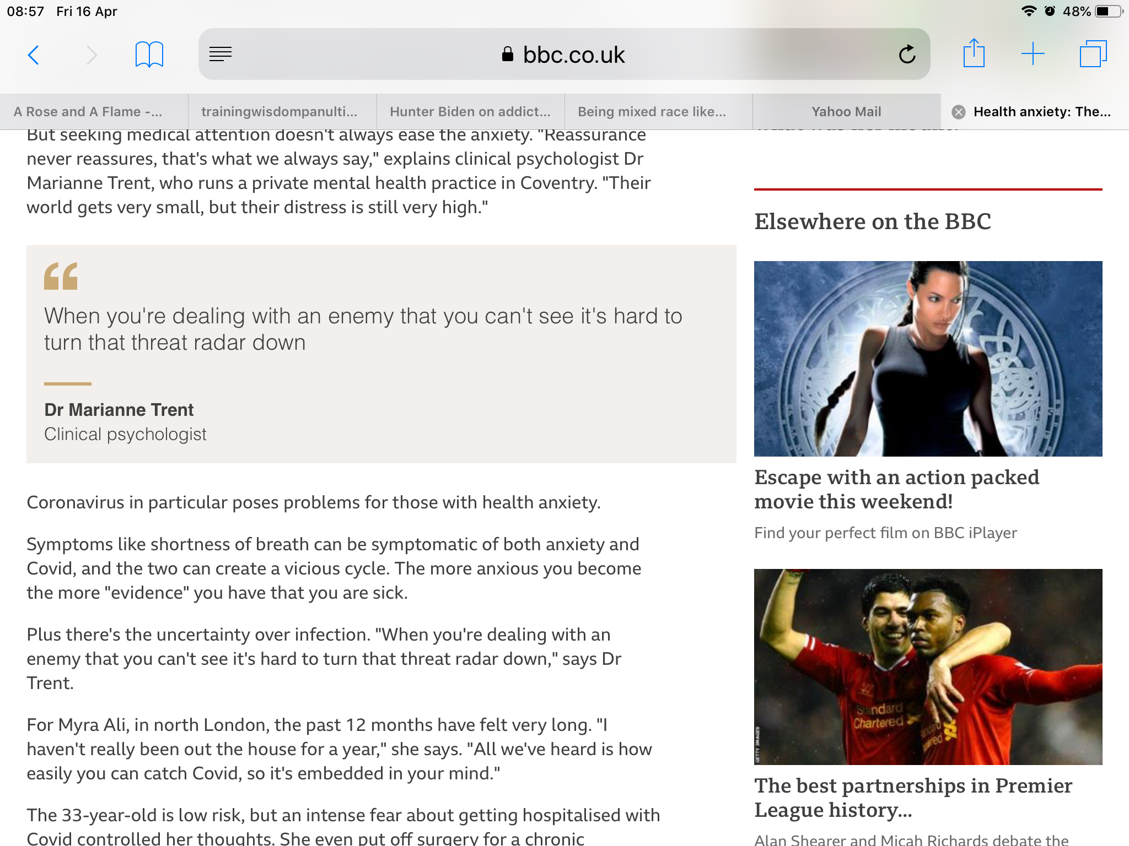
The power of the invisible threat
Notes:
In a different context Dr Trent said this.
K drew an image of herself protected by armour.

Slide 12
The maths monster
The expression “maths monster” arose at the end of a course for staff at University of Warwick who self-identified as maths anxious:
“Thank you for rescuing me from
the maths monster.”

Slide 13
Maths anxiety …
...is like an invisible monster, a grim reality for a
significant proportion of learners
… is acquired
...is disabling
...has been written about since 1950s
...now affects large numbers of people
...causes reduced or backwards progression
...can be addressed

Slide 14
‘It is not just behaviour it is managing fear, it is managing a very deep sense of failure, being rubbish’.
‘In the early stages [of teaching] it’s 90% psychology and only 10% maths’
(Quotations from maths teachers: ETF (2014) ‘Effective Practices in Post-16 Vocational Maths’)

Slide 15
Some brain facts for maths teachers
As a survival strategy, the brain seeks to distinguish
challenge from threat to well-being or survival
Includes physical and social threats, such as
being left behind or humiliated or shouted at
Previous threats are remembered
When the brain (sub-consciously) perceives a threat,
it initially responds by fight or flight mode

Slide 16
Mathematical Resilience …
…“a learner’s stance towards mathematics that enables pupils to continue learning despite finding setbacks and challenges in their mathematical learning journey”
(Johnston-Wilder & Lee, 2010, p. 38).

Slide 17
Learning requires psychological safety…
Relatedness
Autonomy
Competence …
… including competence to self-safeguard
(Ryan and Deci, 2017)

Slide 18
Competence to self-safeguard …
…can be achieved using three tools:
growth zone model
hand model of brain
triggering relaxation response
Shared between teacher, supporter and students, the tools help improve dialogue, awareness, and apt responses to reduce maths anxiety.

Slide 19
A toolkit for promoting mathematical resilience

Slide 20
Mathematical resilience
MR understanding of the emotional response to threat (the hand model)
Specific tools to manage (breathing response) and reinterpret experience
(the growth zone model)
Specific tools to thrive in the growth zone

Slide 21
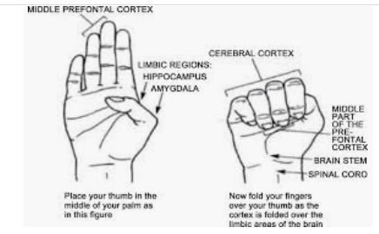
The hand model of the brain
(Dan Siegel)

Slide 22
The hand model of the brain
Key message: the brain can’t panic and think effectively at the same time
Dan Siegel explaining his model:
https://www.youtube.com/watch?v=gm9CIJ74Oxw
Maths resilience version:
https://www.youtube.com/watch?v=7zW8w9kuu6E&t=7s
Notes:
Please feel free to make your own, or invite the learners to make one.

Slide 23
The relaxation response…
… counters the stress (or “fight or flight”) response.
… by slowing breathing rate, relaxing muscles, and reducing blood pressure
Herbert Benson 2000
Notes:
Please feel free to make your own, or invite the learners to make one.

Slide 24
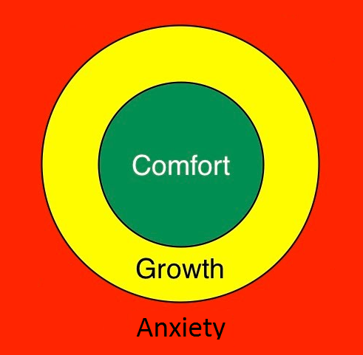
The growth zone model
Fight or flight mode
Notes:
Comfort – easy; Anxiety – not yet- too hard
Growth: safe enough, brave,
Heart racing; Mind goes blank; Feel stupid; Sweaty hands; Overwhelmed; Ashamed, embarrassed; Angry

Slide 25
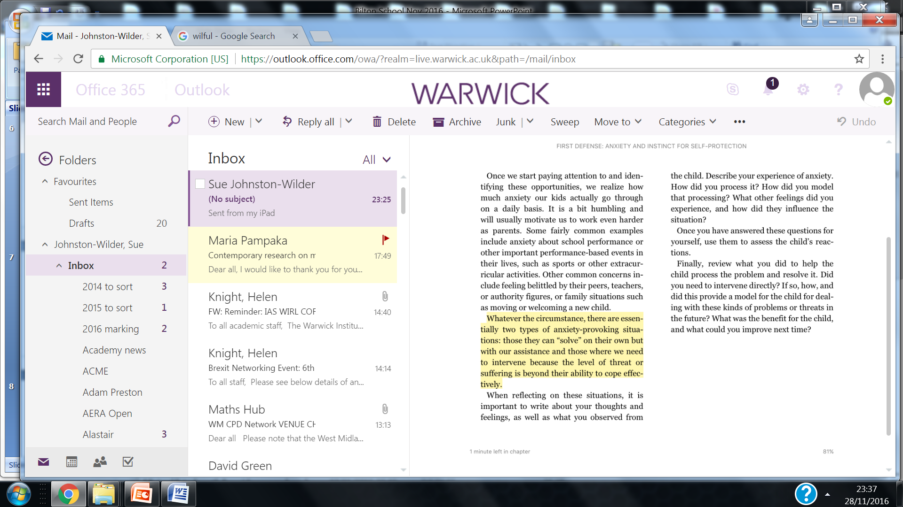
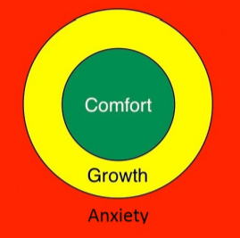
The growth zone model
It turns out, this is not new but re-packaged thinking:

Slide 26
The growth zone model
Accept feeling of stupidity in red zone as temporary
How to get out of the red zone?
Building experience of being in and extending the orange zone
Encouraging learners to come out of comfort.

Slide 27
The growth zone model: green zone
Cruising in the comfort zone can build self-confidence and confidence in the teacher & provide opportunities for practice & automaticity.

Slide 28
The growth zone model: red zone
The danger zone is where what is being asked is not within the learner’s reach yet, even with support, and mathematical well-being is under threat.
Stress increases, possibly to panic; little or no useful learning takes place.

Slide 29
Not stupid but panicking
Panic is temporary
To build resilience, learners need to understand this state is temporary (Seligman).

Slide 30
The growth zone model: amber zone
New learning happens in the growth zone where learners experience challenge with sufficient safe-guarding – it should be safe enough to make mistakes, get stuck, require support, find activities tiring.

Slide 31
The growth zone includes …
growth mindset
(Dweck, 2006)
struggle (persistence and perseverance)
(Seligman and Williams)
value – and autonomous motivation
(Ryan & Deci, 2017)
support and relatedness
(being enabled to recruit)

Slide 32
The blue zone …
… for completeness

Slide 33
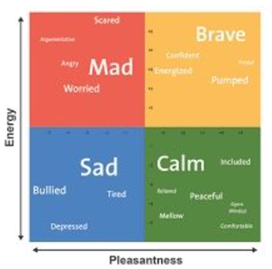
The four zone model …

Slide 34
Getting out of the red zone
Relaxation response (Benson 2000)
Rest and digest
5/7 breathing
Focus on 5 things you can hear
Go for a walk
Micro-mindfulness
…
Don’t try to do maths whilst your brain is focused on the “maths monster”!

Slide 35
Building the amber/growth zone
Ask questions
Try a simpler example
Support each other
Recruit help
Use the Internet
Expect to get stuck
Expect to make mistakes
Use rough work
Take time
...

Slide 36
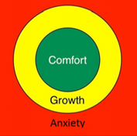
The growth zone model
a means to help learners understand and articulate their feelings when they are learning maths...
a means to safeguard the mathematical wellbeing of those involved in learning or supporting maths…

Slide 37
Tools in practice
Building a shared language for mathematical safeguarding
Red means stop talking and listen! This practice takes a while to develop as a teacher!
Some teachers give each learner a copy of the GZM to use with a coin
Some teachers give learners opportunity to write their own words for the feelings in each zone
How would you use the tools in your own practice?

Slide 38
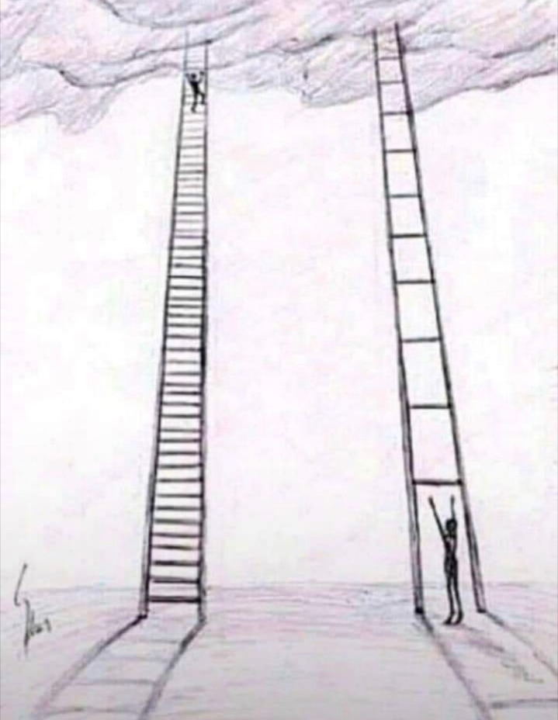
The ladder model – a 4th tool
“I need
another
rung”
Notes:
Teachers listening to learner experience as ladder is invisible in maths

Slide 39
The 3 – level model for CPD
Based on Homes & Grandison (2021)
Notes:
(

Slide 40
1 Anxiety aware practice…
Increase awareness of anxiety, how to recognise MA in learners and how to resist causing further harm
Based on Homes & Grandison (2021)
Notes:
(

Slide 41
2 Anxiety-informed practice…
Increase awareness of anxiety, how to recognise MA in learners and how to resist causing further harm;
Establish a safer teaching environment, promoting MR and enhancing progress in mathematics.
Based on Homes & Grandison (2021)
Notes:
(

Slide 42
Trauma-informed practice…
Safety
Trust
Choice
Collaboration
Empowerment
Homes & Grandison (2021)
Notes:
(

Slide 43
Self-efficacy and resilience
Mathematical resilience (MR) – “maintaining self-efficacy in the face of personal or social threat to mathematical well-being” (Johnston-Wilder & Lee, 2010)

Slide 44
Sources of self-efficacy
Bandura (1997) proposed four sources of self-efficacy (and in-efficacy):
  mastery experiences
  vicarious experiences
  verbal persuasion
  physiological and affective states.

Slide 45
Autonomous motivation
Personal value of maths, growth mindset, community – align with SDT needs for autonomy, competence and relatedness

Slide 46
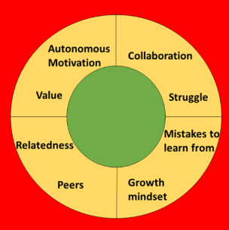
The enhanced growth zone model

Slide 47
Development of a research area
Conversations about mathematics anxiety and psychological resilience started in 2008
Starting to write about mathematical resilience
Working on mathematical resilience framework with teachers, students, parents, support staff, and with psychologists working on maths anxiety

Slide 48
Coaching for Mathematical Resilience course
24 hour course
Accredited by ASDAN
Evidence of efficacy
Dual led
Expensive

Slide 49
Coaching for Mathematical Resilience for individuals
one-to-one coaching
involves older learner, support staff or parent
Goodall, J. and Johnston-Wilder, S. (2015) Overcoming Mathematical Helplessness and Developing Mathematical Resilience in Parents: An Illustrative Case Study. Creative Education, 6, 526-535. doi: 10.4236/ce.2015.65052.
Johnston-Wilder, S. , Lee, C. and Mackrell, K. (2021) Addressing Mathematics Anxiety through Developing Resilience: Building on Self-Determination Theory. Creative Education, 12, 2098-2115. doi: 10.4236/ce.2021.129161.

Slide 50
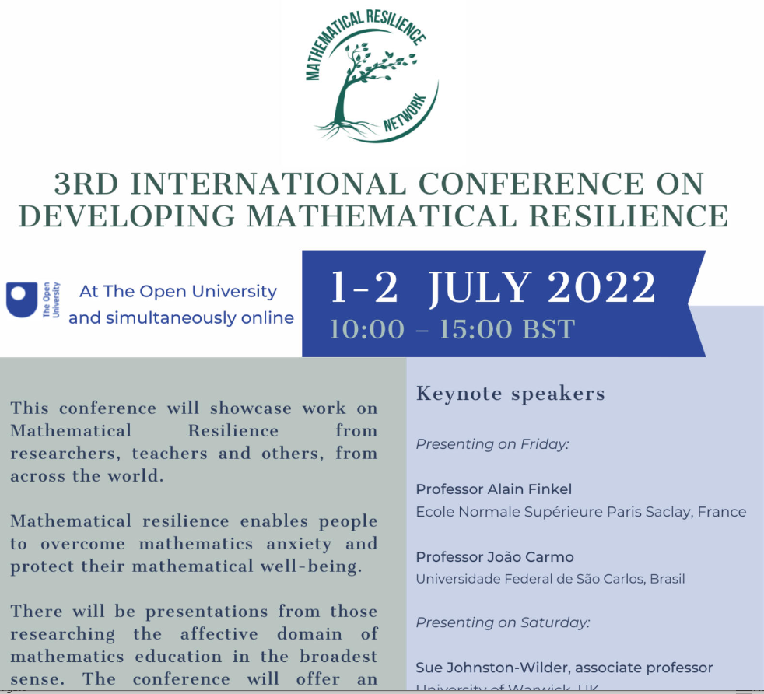
Supporting teachers with practitioner research

Slide 51
We can tackle the very real, invisible maths monster, together …
…building awareness, developing a shared language for mathematical safeguarding, enabling learner autonomy, encouraging learning communities that don’t leave people behind, building growth mindsets …

Slide 52
Allowing people to heal and flourish in maths …
‘The mums were so relieved to hear that maths anxiety is “real” and that they weren’t the only ones who felt physically sick before maths lessons and made to feel stupid.
They loved the approach of safeguarding and hadn’t previously thought about healing the maths trauma they had carried for decades
Everyone needs to hear this vital message’

Slide 53


Where next?
The future will involve building the mathematical resilience network globally, to share ideas, resources, findings and support, something we hope you will all wish to be part of, to tackle the impact of maths anxiety and allow mathematical learning to flourish and increase future sustainability.
https://warwick.ac.uk/fac/soc/ces/research/current/mathematicsresilience/mrn/

Slide 54
Further reading
The tools:
https://www.scirp.org/journal/paperabs.aspx?paperid=102510
At home:
https://www.scirp.org/journal/paperinformation.aspx?paperid=55378
https://www.mathsontoast.org.uk/how-talking-about-maths-suddenly-became-easier/
With a PhD student:
https://www.scirp.org/journal/paperinformation.aspx?paperid=85398
1 to 1 with an adult:
https://www.scirp.org/journal/paperinformation.aspx?paperid=112110
In class:
Para and Johnston-Wilder (2023) Addressing Mathematics Anxiety: a case study in a High School in Brazil – copy available from author
Background:
Siegel D (2011) Mindsight: The New Science of Personal Transformation
Benson H (2000) The Relaxation Response

