Slide 1
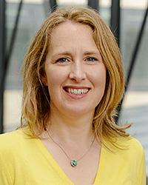
UCD Student Adviser
Anna Scully
anna.scully@ucd.ie
C1.27 Health Sciences Centre
0871319758

Slide 2
UCD Student Advisers Team
Reporting to the UCD Dean of Students.
Every student has a programme-based SA
Mature, Graduate Research SA
Wellness & community projects
Orientation & Peer Mentoring

Slide 3
Anna Scully UCD Student Adviser
Created in 2006
College of Health and Agricultural Sciences :
School of Nursing, Midwifery and Health Systems
School of Public Health, Physiotherapy and Sports Sciences

Slide 4
Why would I talk to my Student Adviser?
PERSONAL
FINANCIAL WORRIES
FAMILY TROUBLES
STRESS AND ANXIETY
COPING ISSUES
BEREAVEMENT
PRACTICAL CONCERNS
ASSISTANCE WITH UCD POLICIES
REFERRAL TO OTHER SERVICES

Slide 5
Confidential ‘listening ear’
Emotional and Psychological
A Friendly Face! You can come to us with anything – no matter how ‘small’ or how deeply serious the concern.
If you wish to discuss your needs and identify emotional and psychological supports, we can assist you in this process of personal development.
Referral and advice on specialist supports, if you need or choose this.

Slide 6
UCD Student Advisers www.ucd.ie/studentadvisers
Advice on the many other services in UCD that may support you such as Accommodation, Disability Support, Careers Office,
Listening to your concerns we will talk with your School or Programme or other services about your concerns if you wish.
UCD Student Adviser Confidentiality Statement

Slide 7
Assist you navigate UCD policies
Dignity and Respect
Equality, Inclusion and Diversity
https://www.ucd.ie/equality/support/dignityrespect/
Extenuating Circumstances Policy and Student Guide
Leave of Absence
Disciplinary processes eg Student Code, https://www.ucd.ie/secca/
Plagiarism

Slide 8
Practical assistance
If you are experiencing financial hardship we can support and advise on applying to the
Student EMERGENCY Fund or
the Student Support Fund
UCD Financial Information

Slide 9
UCD Student Advisers
Social
We support you in creating a community spirit in UCD, for example, at your local School level and through societies, and UCD staff/student committees
We encourage participation in Orientation and other University-wide projects, for example, UCD Volunteers Overseas, Peer Mentoring

Slide 10
Supporting social activity for SNMHS students.

Slide 11
‘Get the Balance Right’
Remember to relax and enjoy your time!
Of course, you do need to work as an independent learner, and consider your options in academic life.
Don’t forget to take good care of your self, and others around you.
Look out for Wellness events

Slide 12
Access & Lifelong Learning Centre www.ucd.ie/all
Disability Support Services
Mature
HEAR
Laptop grants processed
Support for Students who are Parenting
Mature Student Adviser Emma Somers

Slide 13
UCD Career Development centre www.ucd.ie/careers
This office will hold a series of seminars over the year on many careers
Advice & Information
First office on right as you come to JJL Library building.
Mark.cumisky@ucd.ie

Slide 14
UCD Student Health Centre
Located in the Student Centre, upstairs.. for registered students of UCD ~ Fees apply.
General Practitioners
Nurses
Psychologists/Counsellors ~free of charge
Psychiatrist
Small fees for specialist services..eg travel vaccinations, cervical smears

Slide 16
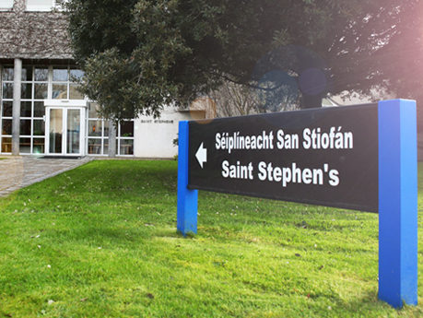
UCD Chaplaincy

Slide 17
Students’ Union Student Societies
& Sport
NAMSOC ( Nursing and Midwifery Society)
NAMSOC@ucd.ie
Auditor : Aliyah Olawepo
PhysioSoc
https://www.ucdsu.ie/
College officer is Tia Cullen
Martha Ní Riada
president@ucdsu.ie

Slide 18
UCD Student Supports
Student Advisers
Student Health – GP, Nurse, Psychiatrist
Counselling service
Addiction Counsellor (AA meetings also on campus)
Chaplains
Access Centre – Disability support
Students’ Union – various officers

Slide 19
www.ucd.ie/studentadvisers
Anna Scully
UCD Student Adviser
C1.27 Health Sciences Centre
email anna.scully@ucd.ie
‘phone (01) 716 6497
Mobile 087 131 9758

