Slide 1
CHAPTER 1. POSITIVE PSYCHOLOGY AND WELLBEING

Slide 2
LEARNING OBJECTIVES
Be able to describe the emergence, development and growth of positive psychology
Understand the PERMA theory of wellbeing
Be able to distinguish between
hedonic and eudaimonic wellbeing
subjective and psychological wellbeing; and social wellbeing
quality of life and
flourishing
Understand the benefits of wellbeing across multiple domains
Be able to explain the broaden and build theory of positive emotions

Slide 3
LEARNING OBJECTIVES
Be able to explain the theory of sustainable happiness, describe the relative contribution of genetic and environmental factors, and intentional actions to happiness, and appreciate the contribution of personality traits and a variety of environmental factors to subjective wellbeing
Appreciate the obstacles to wellbeing including the
happiness set point,
the hedonic treadmill,
the negativity bias,
the tendency to make demoralizing upward social comparisons, and
the tendency to make inaccurate affective forecasts
Understand the implications of research on factors related to wellbeing for the enhancement of personal wellbeing

Slide 4
EMERGENCE OF
CONTEMPORARY POSITIVE PSYCHOLOGY

Slide 5
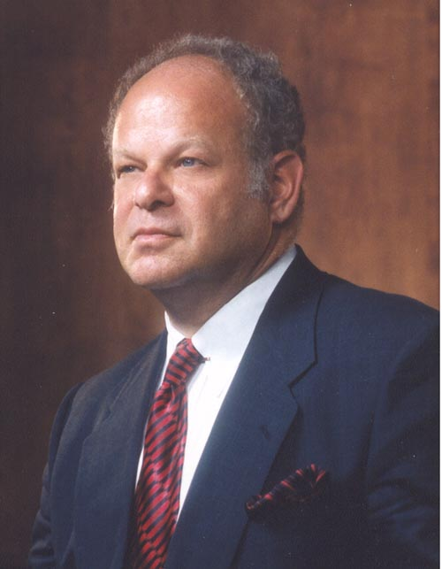
EMERGENCE OF CONTEMPORARY POSITIVE PSYCHOLOGY
Contemporary positive psychology was founded by Martin Seligman from Pennsylvania University as the new millennium dawned
He was disenchanted with traditional clinical psychology’s focus on
Deficits
Disabilities
Disorders
And all that is wrong with people
His mission was to establish a new field of positive psychology focused on
Well-being
Strengths
Resilience
And all that is right with people
Martin Seligman

Slide 6

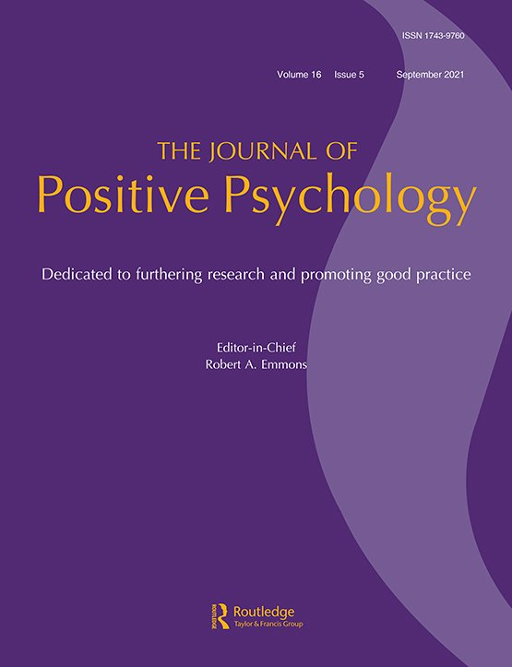



EMERGENCE OF CONTEMPORARY POSITIVE PSYCHOLOGY
Core group. Seligman drew together a group of influential established psychologists, and a group of early career psychologists, who helped him sketch out a positive psychology of well-being and strengths
IPPA & JoPP. He encouraged members of this core group to found the International Positive Psychology Association (IPPA), set up the Journal of Positive Psychology (JoPP), and write or edit many books on PP including the Handbook of Positive Psychology
PPC at U Penn. He set up the Positive Psychology Centre (PPC) at Pennsylvania University, developed the first masters programme in PP, a major research programme, & wrote best-selling books on PP for the public
Templeton grants. He supported much of this with funding from the Templeton Foundation
APA presidency. He used his appointment as president of the American Psychological Association (APA) in 1998 to launch PP as a new field

Slide 7
EMERGENCE OF CONTEMPORARY POSITIVE PSYCHOLOGY
International impact. Positive psychology started as a small US movement. It is now a worldwide and highly influential enterprise affecting academic psychology and applied psychology
Applied positive psychology. Positive psychology has been applied in schools, work settings, the military, and health care, (including clinical psychology) around the world
Academic influence. In a bibliometric analysis of 1.7 million articles Rusk and Waters found that positive psychology has become a unifying force within psychology, with positive psychology themes being present now in many branches of psychology and related disciplines (e.g., neurosciences, and psychiatry)

Slide 8
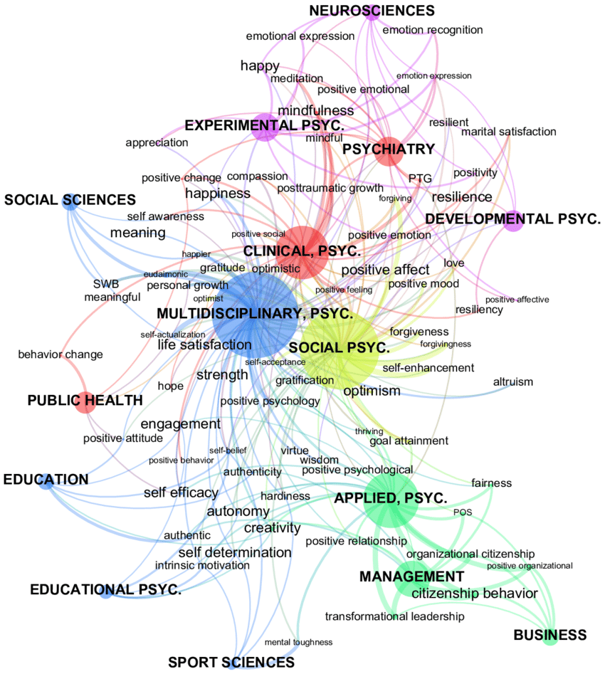
THE DISTRIBUTION OF 75 MOST COMMON POSITIVE PSYCHOLOGY KEY TERMS IN PSYCHOLOGY AND RELATED DISCIPLINES FROM 2007-2011 IN OVER 1.7 MILLION DOCUMENTS IN 700 PSYCINFO JOURNALS
Note. Distances between a given field and given term are closer where the term occur occurs in a higher percentage within that field, and the size of the field nodes indicate the prevalence of PP key terms within that field. Links indicate that 8% or more of term occurrences occur within a given field. Reproduced with permission of Taylor & Francis from Figure 4, p. 217 of Rusk, R. D., & Waters, L. E. (2013). Tracing the size, reach, impact, and breadth of positive psychology. Journal of Positive Psychology, 8(3), 207-221. https://doi.org/10.1080/17439760.2013.777766, Copyright © 2013 Taylor & Francis. Permission conveyed through Copyright Clearance Center, Inc.

Slide 9
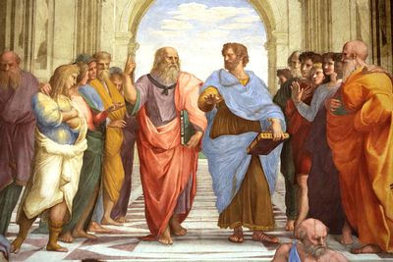



EMERGENCE OF CONTEMPORARY POSITIVE PSYCHOLOGY
PP & non-scientific traditions. Seligman distinguished Positive Psychology from traditions that focused on well-being which were not grounded in empirical science, notably
Philosophy & spiritual traditions
Humanistic psychology
Pop psychology
These traditions base their advice on how to achieve well-being on rational argument, faith, anecdotal evidence, or rhetoric
PP & research. Positive psychology’s advice on how to achieve well-being is based on empirical research
PP theories. Positive psychology research is guided by theories and some of these have their roots in philosophical or spiritual traditions, or humanistic psychology

Slide 10
PERMA THEORY OF WELLBEING

Slide 11
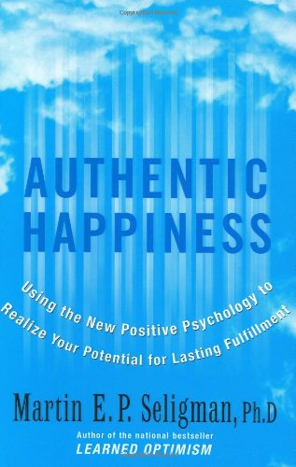

FROM AUTHENTIC HAPPINESS TO PERMA THEORY OF WELLBEING
In his 2002 book - Authentic Happiness, Seligman proposed that happiness was the main outcome of interest to PP and it was due to
The pleasant life - Pursuing positive emotions
The engaged life - Using positive traits and engagement in absorbing activities
The meaningful life - Cultivating meaningful positive relationships
In 2011 in his second positive psychology book - Flourish, Seligman replaced his authentic happiness theory with the PERMA well-being theory. PERMA is an acronym based on the first letter of each of the five elements of the theory
Positive emotion
Engagement
Relationships
Meaning, and
Accomplishment

Slide 12
FROM AUTHENTIC HAPPINESS TO PERMA THEORY OF WELLBEING
Not happy but fulfilled. Seligman abandoned Authentic Happiness theory in favour of PERMA well-being theory because happiness (positive affectivity) is normally distributed within the population (shown on next slide), yet many of the 50% of people who have below average happiness scores live fulfilling lives
Multidimensional well-being. If positive psychology was to understand and facilitate living a fulfilling life, then a multidimensional conceptualization of well-being was required which did not depend on happiness as the single outcome variable
Positive, chosen & independent. The elements of this multidimensional construct had to be things that
contributed to well-being
were actively chosen for their own sake, and
were measured relatively independently of each other

Slide 13
HAPPINESS IS NORMALLY DISTRIBUTED
MOST PEOPLE ARE MODERATELY HAPPY
In 1995 Myers and Diener aggregated data from 916 surveys of happiness & well-being involving over a million people in 45 nations around the world.
10-point scale. They transformed all the data onto a 10-point scale where 10 indicated extremely happy, 5 was neutral and 0 was very unhappy.
Normal distribution. Happiness was approximately normally distributed.
Not neutral. The average happiness rating was 6.75. It was not neutral at 5.
Moderately happy. They concluded that the average person was moderately happy
Based on Myers, D. G., & Diener, E. (1996). The pursuit of happiness. Scientific American, 274 (May), 54–56.

Slide 14
PERMA THEORY OF WELL-BEING
PERMA theory proposes that overall well-being depends upon the combination of our status in five domains
Positive emotion such as joy excitement, and contentment
Engagement in absorbing activities like sports or skilled work
Relationships which provide provide the experiences of attachment, support, loving, and being loved
Meaning derived from serving something bigger than ourselves like a sports club, community, charity, work organisation, political party, or religion. This gives us the feeling that life is valuable and worth living
Accomplishments including completing tasks, reaching goals, and achieving success in work or leisure activities. Accomplishments give us feelings of mastery and achievement
PERMA well-being
Positive emotion
Engagement
Relationships
Meaning
Accomplishments

Slide 15
PAUSE & PRACTICE - COMPLETE THE PERMA PROFILER
For each item, circle the response that best applies to you. 0 = never, not at all, terrible. 10 = always, completely, excellent To get your overall score sum item scores and divide by 16. Compare your overall score to the average score for people with high school to postgraduate education which range from 6.6 to 7.1 Scores above 7.1 indicate that you have a high level of well-being. Scores below 6.6. indicate a lower level of well-being.
Positive emotion
In general, how often do you feel joyful? | 0 | 1 | 2 | 3 | 4 | 5 | 6 | 7 | 8 | 9 | 10
In general, how often do you feel positive? | 0 | 1 | 2 | 3 | 4 | 5 | 6 | 7 | 8 | 9 | 10
In general, to what extent do you feel contented? | 0 | 1 | 2 | 3 | 4 | 5 | 6 | 7 | 8 | 9 | 10
Engagement
How often do you become absorbed in what you are doing? | 0 | 1 | 2 | 3 | 4 | 5 | 6 | 7 | 8 | 9 | 10
In general, to what extent do you feel excited and interested in things? | 0 | 1 | 2 | 3 | 4 | 5 | 6 | 7 | 8 | 9 | 10
How often do you lose track of time while doing something you enjoy? | 0 | 1 | 2 | 3 | 4 | 5 | 6 | 7 | 8 | 9 | 10
Positive relationships
To what extent do you receive help and support from others when you need it? | 0 | 1 | 2 | 3 | 4 | 5 | 6 | 7 | 8 | 9 | 10
To what extent have you been feeling loved? | 0 | 1 | 2 | 3 | 4 | 5 | 6 | 7 | 8 | 9 | 10
How satisfied are you with your personal relationships? | 0 | 1 | 2 | 3 | 4 | 5 | 6 | 7 | 8 | 9 | 10
Meaning
In general, to what extent do you lead a purposeful and meaningful life? | 0 | 1 | 2 | 3 | 4 | 5 | 6 | 7 | 8 | 9 | 10
In general, to what extent do you feel that what you do in your life is valuable and worthwhile? | 0 | 1 | 2 | 3 | 4 | 5 | 6 | 7 | 8 | 9 | 10
To what extent do you generally feel that you have a sense of direction in your life? | 0 | 1 | 2 | 3 | 4 | 5 | 6 | 7 | 8 | 9 | 10
Accomplishment
How much of the time do you feel you are making progress towards accomplishing your goals? | 0 | 1 | 2 | 3 | 4 | 5 | 6 | 7 | 8 | 9 | 10
How often do you achieve the important goals you have set for yourself? | 0 | 1 | 2 | 3 | 4 | 5 | 6 | 7 | 8 | 9 | 10
How often are you able to handle your responsibilities? | 0 | 1 | 2 | 3 | 4 | 5 | 6 | 7 | 8 | 9 | 10
General wellbeing
Taking all things together, how happy would you say you are | 0 | 1 | 2 | 3 | 4 | 5 | 6 | 7 | 8 | 9 | 10
Note: Adapted with permission from Table 5 on page 17 of Butler, J., & Kern, M. (2016). The PERMA-profiler: A brief multidimensional measure of flourishing. International Journal of Wellbeing, 6(3), 1–48. http://dx.doi.org/10.5502/ijw.v6i3.526 Copyright © by Peggy Kern.

Slide 16
PERMA PROFILER
Sample items rated on 10-point scale
Positive emotion
In general, how often do you feel joyful?
In general, to what extent do you feel contented?
Engagement
How often do you become absorbed in what you are doing?
How often do you lose track of time while doing something you enjoy?
Positive relationships
To what extent do you receive help and support from others when you need it?
How satisfied are you with your personal relationships?
Meaning
In general, to what extent do you feel that what you do in your life is valuable and worthwhile?
To what extent do you generally feel that you have a sense of direction in your life?
Accomplishment
How much of the time do you feel you are making progress towards accomplishing your goals?
How often do you achieve the important goals you have set for yourself?
Note. Adapted with permission of Peggy Kern from Table 5, p. 17 in Butler, J., & Kern, M. (2016). The PERMA-profiler: A brief multidimensional measure of flourishing. International Journal of Wellbeing, 6(3), 1–48. https://doi.org/10.5502/ijw.v6i3.526 Copyright © by Peggy Kern.

Slide 17
OTHER WAYS OF CONCEPTUALIZING OF WELLBEING
There are many other ways of conceptualizing wellbeing besides PERMA theory. The following two are widely used in PP research
Subjective or hedonic well-being. This is assessed with Ed Diener’s Satisfaction with Life Scale and scales that assess the balance of positive and negative emotions
Psychological or eudaimonic well-being. This is assessed with Carol Ryff’s Psychological Wellbeing Scale which evaluates autonomy, environmental mastery, personal growth, positive relations with others, purpose in life, and self-acceptance
Subjective well-being
Hedonic wellbeing
Satisfaction with life
High positive affect
Low negative affect
Psychological wellbeing
Eudaimonic wellbeing
Autonomy
Environmental mastery
Personal growth
Positive relations with others
Purpose in life
Self-acceptance

Slide 18
SATISFACTION WITH LIFE SCALE
Sample items rated on 7-point scale
The conditions of my life are excellent
I am satisfied with my life
So far I have gotten the important things I want in life
Note. Adapted with permission of Taylor & Francis from Table 1. p. 72 in Diener, E., Emmons, R., Larsen, R., & Griffin, S. (1985). The Satisfaction with Life Scale. Journal of Personality Assessment, 49, 71-75. https://doi.org/10.1207/s15327752jpa4901_13, Copyright © 2009 by Taylor & Francis. Permission conveyed through Copyright Clearance Center, Inc.

Slide 19
SCALE OF POSITIVE AND NEGATIVE EXPERIENCES
Items rated on 7-point scale
Positive
Good
Pleasant
Happy
Joyful
Contented
Negative
Bad
Unpleasant
Sad
Afraid
Angry
Note. Adapted with permission of Ed Diener from the scale on page 153-154 in Diener, E., Wirtz, D., Tov, W., Kim-Prieto, C., Choi, D., Oishi, S., & Biswas-Diener, R. (2010). New well-being measures: Short scales to assess flourishing and positive and negative feelings. Social Indicators Research, 97(2), 143-156. https://doi.org/10.1007/s11205-009-9493-y Copyright © 2009 by Ed Diener.

Slide 20
BENEFITS OF WELLBEING

Slide 21
BENEFITS OF WELLBEING
Five aspects of PERMA well-being are associated with a range of positive benefits
Positive emotions. The experience of frequent positive emotions has multiple benefits, notably
Better health & longevity
Better relationships and work performance
Engagement. Frequent engagement in absorbing skilled activities is associated with ‘flow’ experiences and better performance and satisfaction in
Educational and
Work environments
Relationships. Having close confiding relationships with family and friends is associated with
Greater happiness and
Better health
Meaning and purpose in life correlates with a wide range of indices of
Well-being and
Quality of life
Accomplishment of valued goals is associated with
Positive emotions and
Subjective well-being

Slide 22

WELLBEING & LONGEVITY – THE NUN STUDY
One of the most dramatic effects of well-being is its impact on longevity, a finding replicated in dozens of longitudinal studies
In a seminal study David Snowden found that the happiness expressed in autobiographical essays that 180 nuns wrote as they entered a religious order in early adulthood was associated with longevity
More than 50 years after they wrote the essays, the amount of positive emotions in the essays was judged by researchers
90% of the happiest quarter of nuns lived past the age of 85 compared with only 34% of the least happy quarter
Danner, D. D., Snowdon, D. A., & Friesen, W. V. (2001). Positive emotions in early life and longevity: Findings from the nun study. Journal of Personality and Social Psychology, 80(5), 804-813. http://dx.doi.org/10.1037/0022-3514.80.5.804

Slide 23
BROADEN & BUILD THEORY

Slide 24

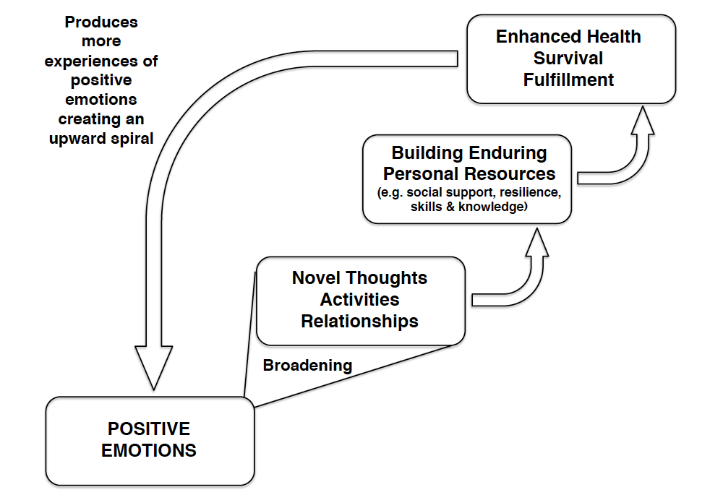
BARBARA FREDRICKSON’S BROADEN & BUILD THEORY
Barbara Fredrickson’s Broaden and Build Theory explains how positive emotions enhance well-being
Negative emotions narrow thought-action repertoires (TAR)
Positive emotions broaden momentary TAR. They lead to new thoughts about a wide variety of possible courses of action that we could potentially take
Broadening. This broadening of momentary thought-action repertories creates opportunities for building long lasting personal resources
Growth. This fosters personal growth and transformation by creating positive or adaptive spirals of emotions, thoughts and actions
Evolution. It was probably adaptive for negative emotions to narrow, and positive emptions to broaden thought action repertoires
Joy may broaden TAR & lead to creative work
These works (art, science, social relationships) are resources
These enhance life
This brings more joy
Barbara
Fredrickson

Slide 25
BARBARA FREDRICKSON’S BROADEN AND BUILD THEORY OF POSITIVE EMOTIONS
Note. Adapted with permission of Oxford University Press from Figure 3.1, p.16 of Cohn, M. & Fredrickson, B. (2009). Positive emotions. In C.R. Snyder & S. Lopez (Eds.), Handbook of positive psychology (2nd ed., p. 13-24). Copyright © 2009 Oxford University Press. Permission conveyed through Copyright Clearance Center, Inc.

Slide 26
CAUSES OF
WELLBEING

Slide 27

WELLBEING & HAPPINESS
An important strand of research on the causes of wellbeing has focused specifically of positive affectivity or happiness
Much of this section is therefore on the causes of happiness

Slide 28
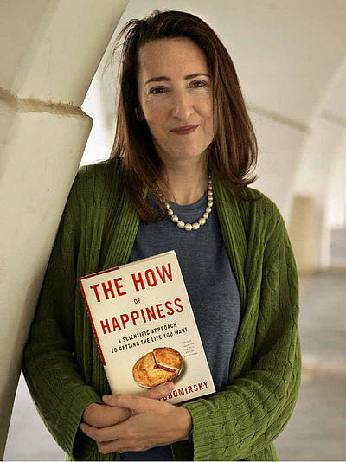
SONJA LYUBOMIRSKY’S THEORY OF SUSTAINABLE HAPPINESS
Sonja Lyubomirsky, following a review of available evidence, proposed that individual differences in happiness or positive affectivity are determined by 3 factors
Genetic factors account for 50% of individual differences in happiness
Circumstances account for 10% of individual differences in happiness
Intentional activities account for 40% of the individual differences in happiness
There is considerable latitude to enhance well-being if 40% of individual differences in positive emotions are under personal control
This justifies the development of positive psychology interventions to increase well being

Slide 29
SONJA LYUBOMIRSKY’S THEORY OF SUSTAINABLE HAPPINESS
Note. Adapted with permission of Sage from Figure 1, p.116 of Lyubomirsky, S., Sheldon, K. M., & Schkade, D. (2005). Pursuing happiness: The architecture of sustainable change. Review of General Psychology, 9(2), 111-131. https://doi.org/10.1037/1089-2680.9.2.111, Copyright © 2005 Sage. Permission conveyed through Copyright Clearance Center, Inc.

Slide 30
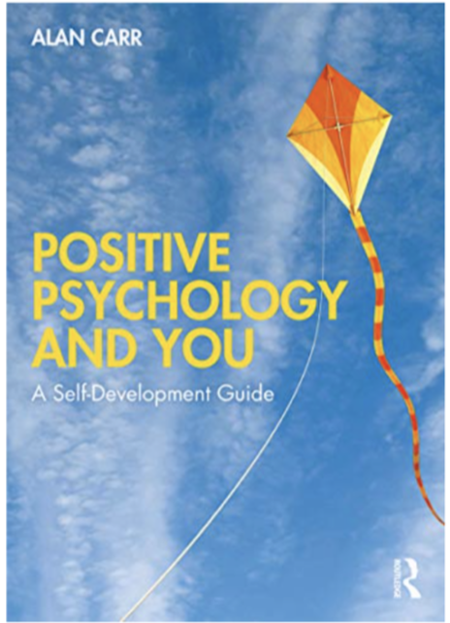
CAUSES OF HAPPINESS - INTENTIONAL ACTIVITIES &
POSITIVE PSYCHOLOGY INTERVENTIONS (PPIs)
Justification for PPIs. 40% of individual differences in positive emotions are due to intentional activities. This justifies developing PPIs
Positive psychology interventions (PPIs) invite clients to engage in intentional activities, including
Setting highly valued goals
Identifying and using personal strengths
Developing an optimistic outlook
Being grateful
Savouring pleasures
Finding flow
Mindfulness meditation
Relationship building
How to do PPIs. Details of how to use PPIs in your life are in the – Positive Psychology and You

Slide 31
CAUSES OF HAPPINESS - INTENTIONAL ACTIVITIES &
EFFECTS OF POSITIVE PSYCHOLOGY INTERVENTIONS (PPIs)
PPI Effectiveness. To find out how effective PPIs are, we conducted a meta-analysis of 347 studies involving over 72,000 participants (summarised in chapter 9). We found small to medium effect sizes for 6 outcome variables:
Wellbeing
Strengths
Quality of Life
Depression
Anxiety
Stress
PPIs were effective with clinical and non-clinical cases across the lifespan
Best PPI programmes
Contained multiple PPIs
Were longer with more sessions, and
Conducted face-to-face with a therapist rather than than online and self-help

Slide 32
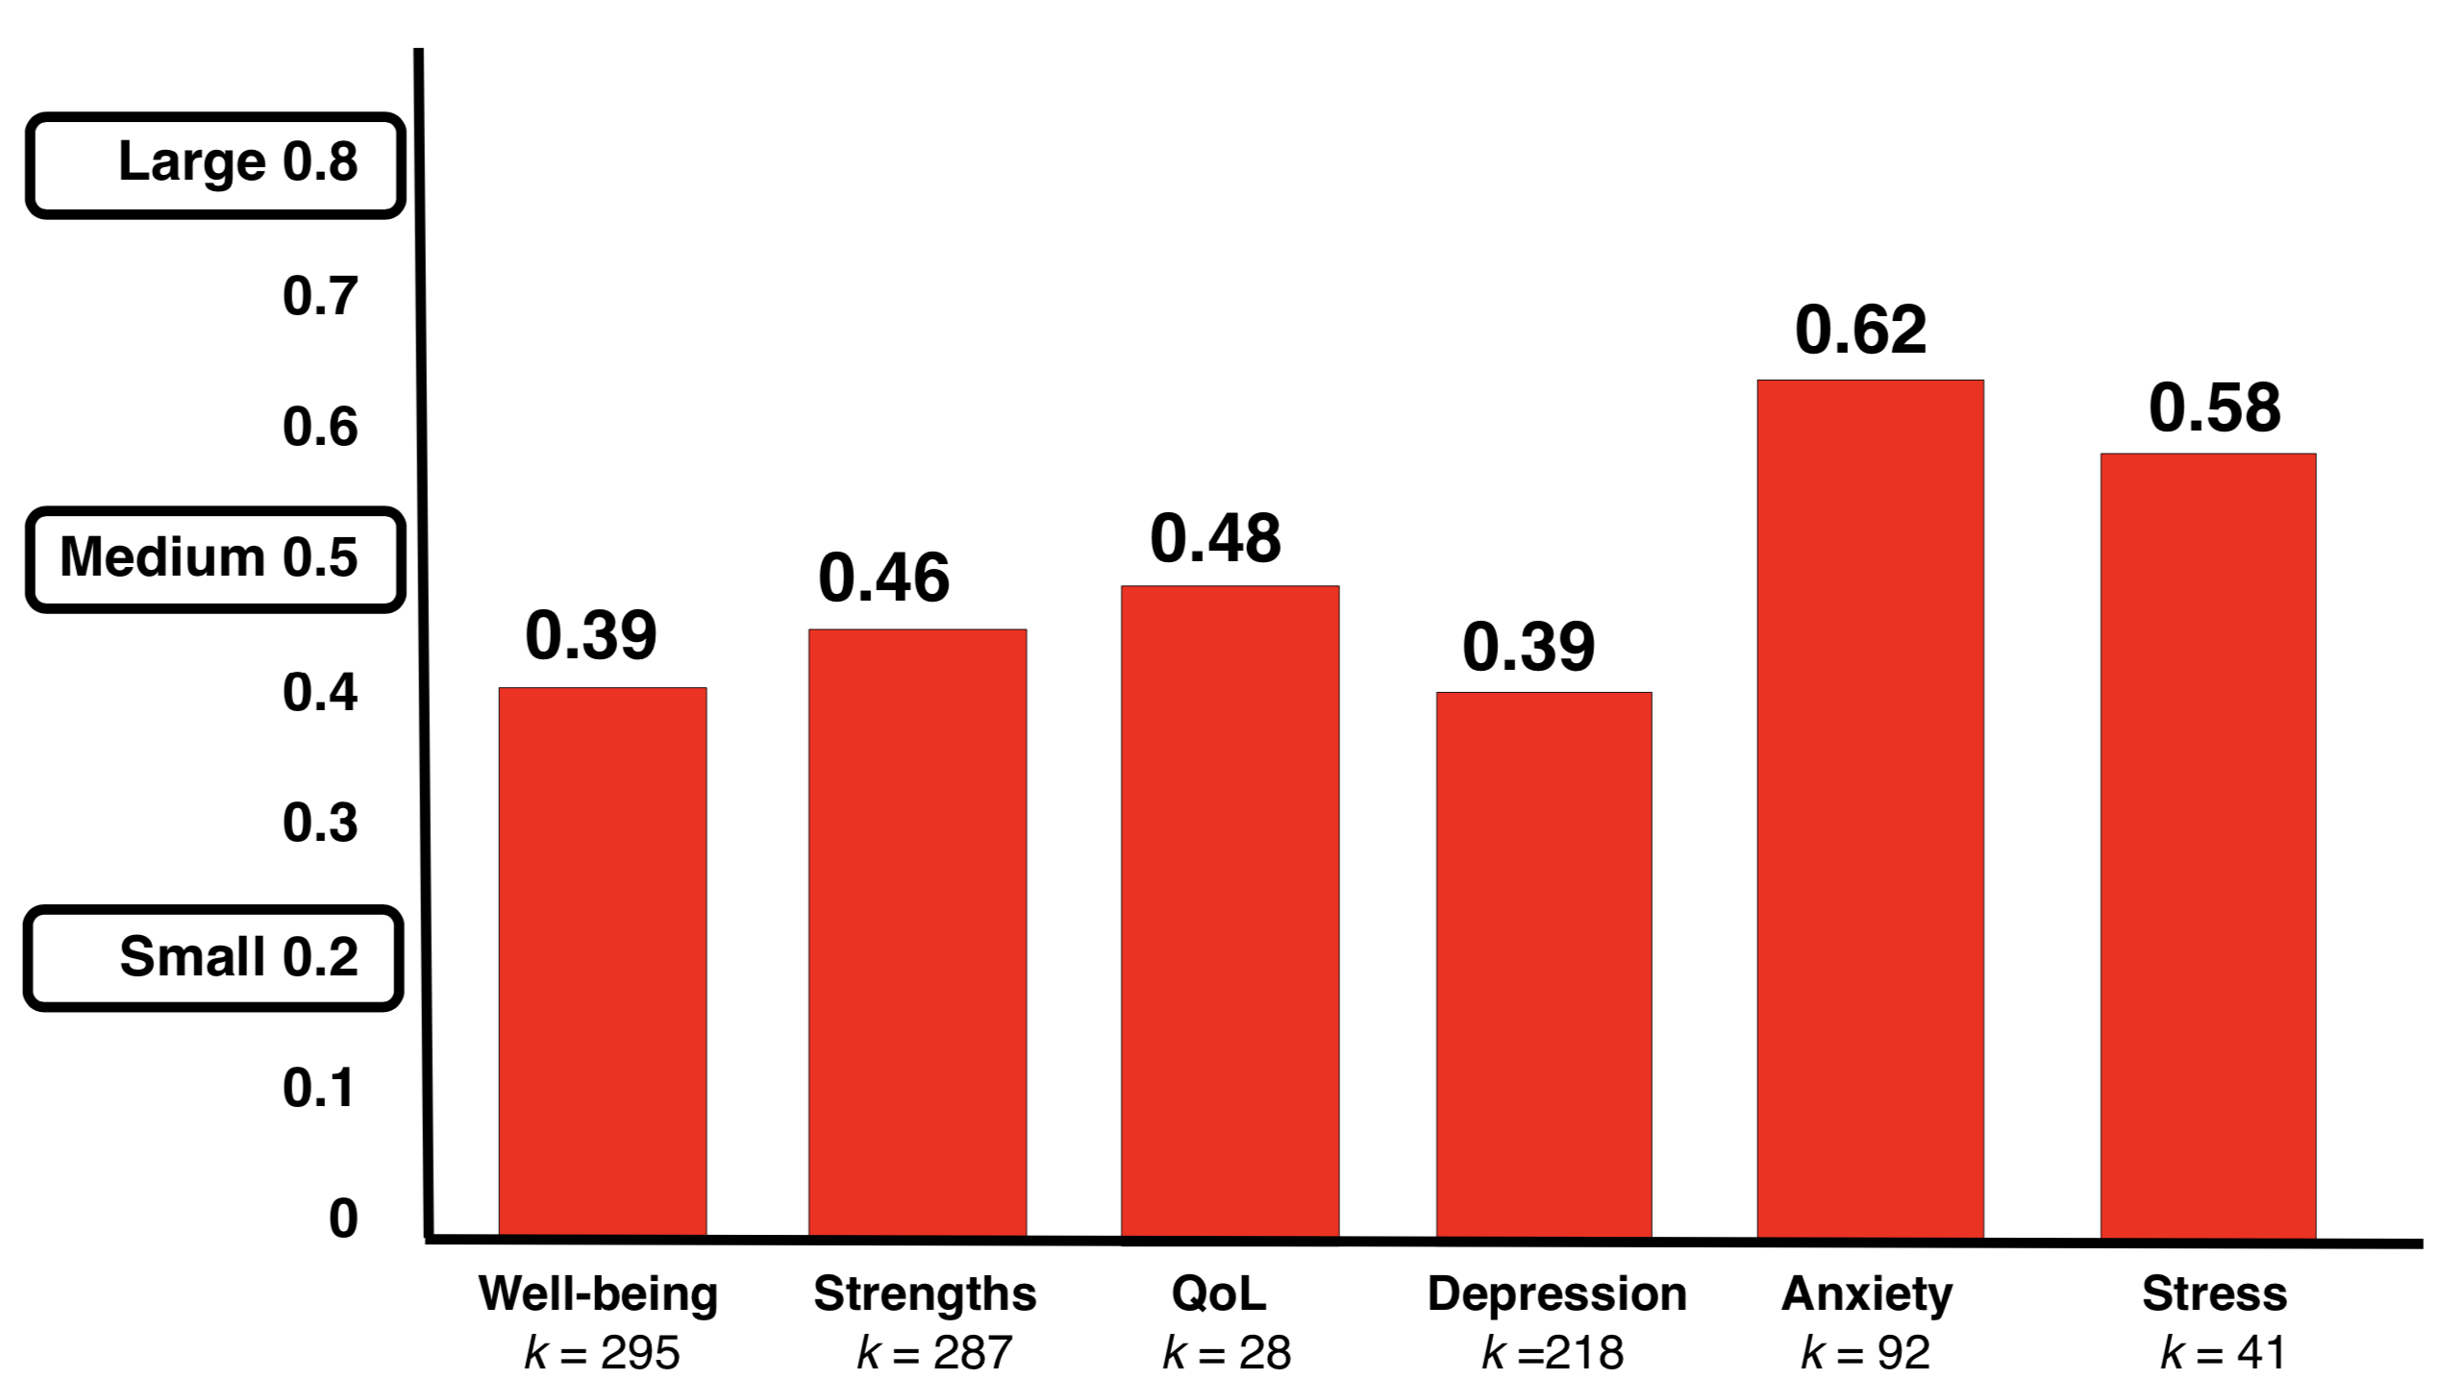
EFFECT SIZES FOR POSITIVE PSYCHOLOGY INTERVENTIONS COMPARED WITH WAITING LIST OR ALTERNATIVE INTERVENTION CONTROL GROUPS AFTER TREATMENT FROM A META-ANALYSIS OF 347 STUDIES CONTAINING 72,356 PARTICIPANTS
Note. Effect size values in this graph are Hedges g which is the difference between the means of positive psychological intervention groups and control groups divided by the pooled standard deviation of both groups and adjusted so greater weight is given to studies with bigger samples. k = the number of comparisons between positive psychological intervention groups and control groups in the meta-analysis. The graph is based on data from Carr, A., Cullen, K., Keeney, C., Canning, C., Mooney, O., Chinseallaigh, E., & O’Dowd, A. (2020). Effectiveness of positive psychology interventions: A systematic review and meta-analysis. Journal of Positive Psychology. https://doi.org/10.1080/17439760.2020.1818807

Slide 33

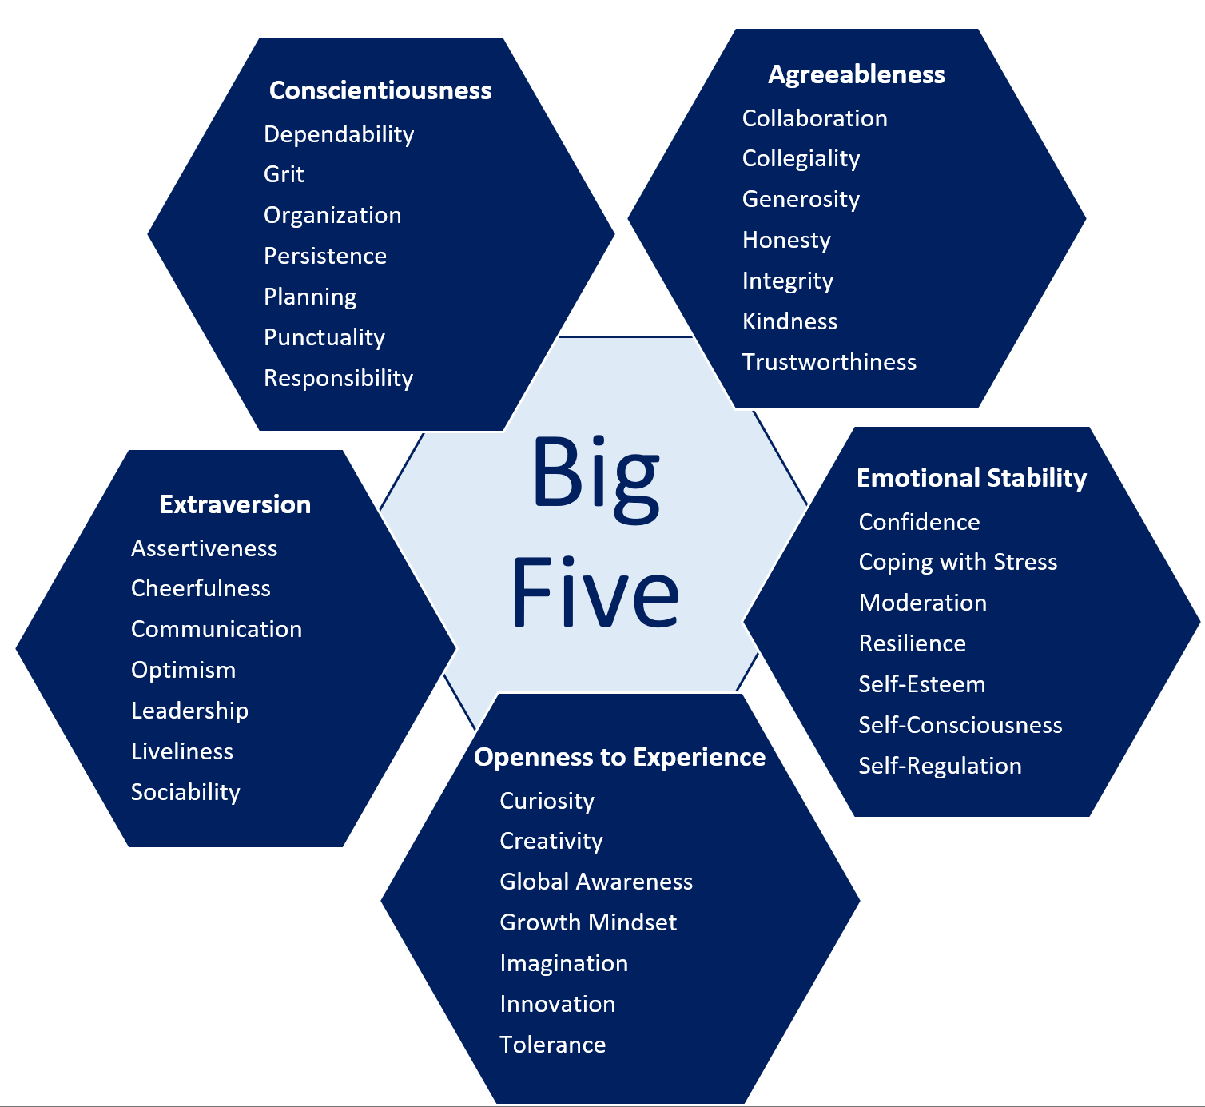
CAUSES OF HAPPINESS – GENETIC FACTORS & PERSONALITY TRAITS
Twin studies show that positive emotions are about 50% heritable
Happiness set-point. Genetic factors set an upper limit on how much happiness we usually experience. This level if often referred to as the happiness set-point
Personality traits. Genetic factors probably influence happiness via their effects on 4 of the 5 major personality traits which are about 50% heritable
Extraversion is the personality trait most strongly associated with positive emotions
Emotional stability, conscientiousness, and agreeableness have weaker, but significant correlations with happiness than extraversion

Slide 34





CAUSES OF HAPPINESS – CIRCUMSTANCES
Environmental circumstances account for about 10% individual differences in happiness
Supportive relationships. Marriage, kinship relationships and friendships increase happiness by providing social support
Education and employment increase positive emotions by giving life meaning, by providing opportunities for engagement in skilled activity, and by providing wealth
Wealth increases happiness up to the point where basic material needs are met. After that, even large increases in wealth do not lead to large and long-lasting increases in happiness
Religious practice is associated with happiness, especially in highly religious cultures. Religion may be associated with happiness because if provides meaning in life, a healthy lifestyle, social support, and rituals that support coping including prayer, meditation, singing, sacraments etc

Slide 35




CAUSES OF HAPPINESS – CIRCUMSTANCES
Leisure activities including sports, dancing, music, art, reading, film, volunteer charity work, vacationing, resting etc. contribute in the short-term to the experience of positive emotions. Leisure may also enhance well-being by meeting needs for autonomy, mastery, meaning, affiliation, and the need to recover from the demands of work or life pressures
The absence of severe illnesses. Severe, painful, debilitating or life-limiting illness may reduce long-term well-being. A high degree of adaptation occurs to most other illnesses or disabilities
Freedom. Individuals are happier in free societies: that is affluent stable democracies devoid of political oppression, social inequality, military conflict, corruption, and with fair tax structures and social welfare systems
A pleasant living environment. People are happier if they live in pleasant physical environments with adequate housing, close to amenities, and workplaces, with easy access to green spaces, and far from air and sound pollution associated with traffic and industry
Being female, and not middle-aged. Well-being is slightly higher among women, and among those over 50 & under 30. Across the lifecycle, happiness follows a U-shaped trajectory

Slide 36
OBSTACLES TO HAPPINESS

Slide 37

OBSTACLES TO HAPPINESS
An important strand of research on obstacles to well-being has focused specifically of positive affectivity or happiness
Much of this section is therefore on obstacles to happiness

Slide 38
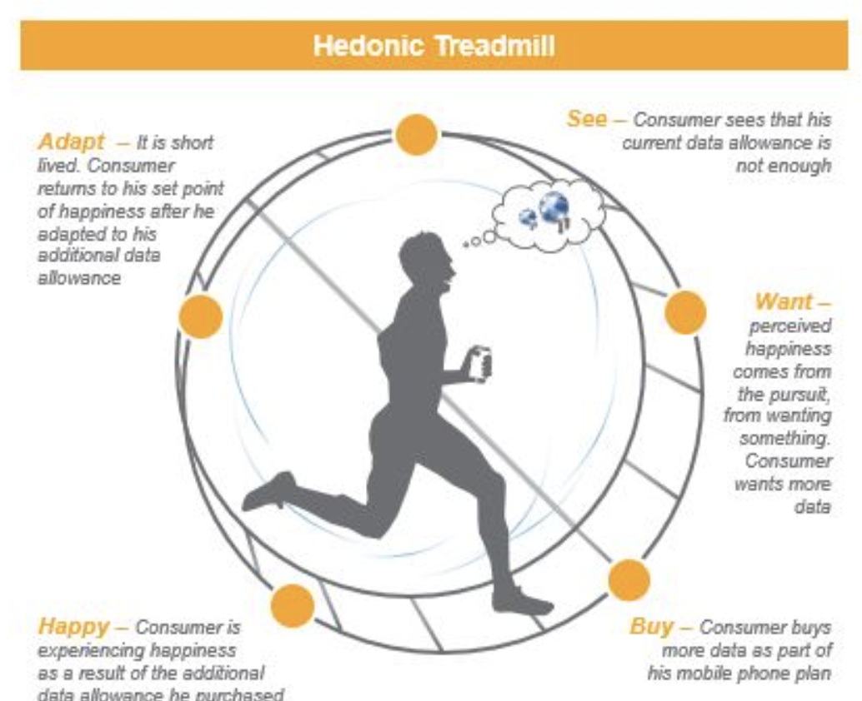
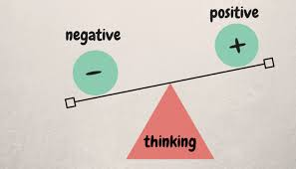

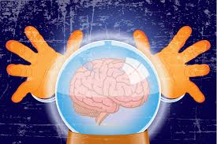
FOUR OBSTACLES TO HAPPINESS
Hedonic treadmill. We adapt to positive life events, so they no longer make us happy
Negativity bias. We focus more on negative than positive things, and this reduces happiness
Social comparison. When we compare ourselves to others who are better off than we are, this reduces well being
Affective forecasting. We are poor at predicting predicting situations that will make us happy

Slide 39
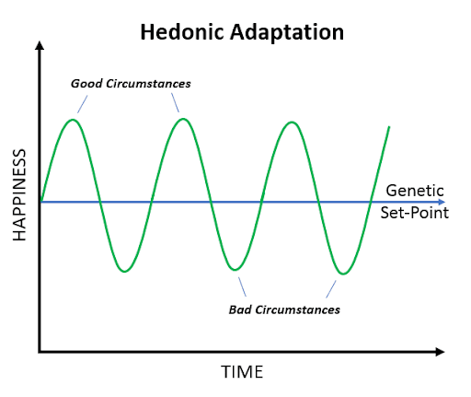
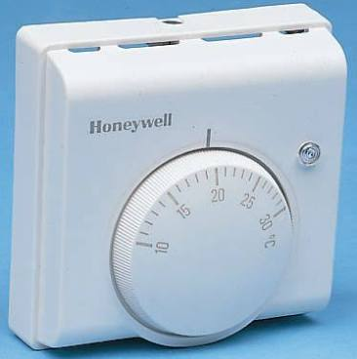
OBSTACLES TO HAPPINESS – HEDONIC TREADMILL
Hedonic treadmill. Brickman & Campbell proposed that we initially react and then adapt to good and bad circumstances returning to our genetically determined happiness set point
The happiness set point is like a thermostat
When we strive to get more things to make us feel long-term happiness, inevitably we adapt, and this motivates us strive for even more, and then the process of adaptation repeats again and again. This is why the process of striving and adapting is referred to as the hedonic treadmill

Slide 40
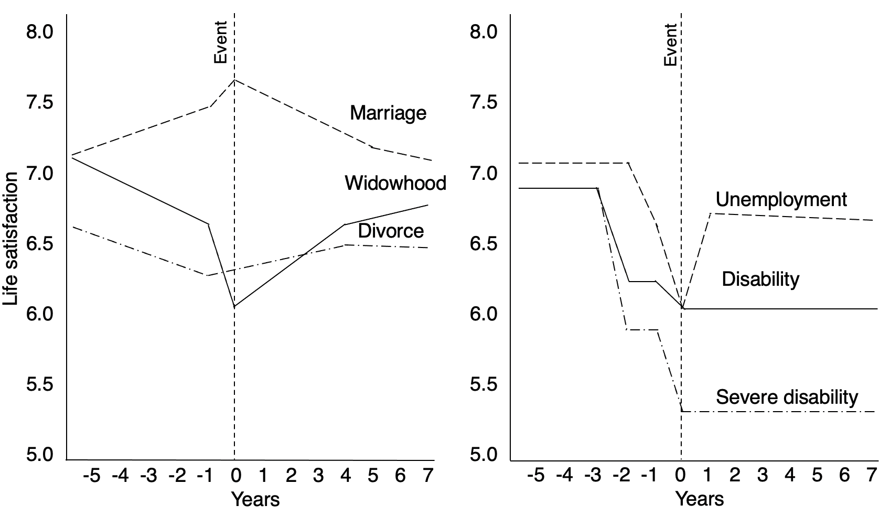
OBSTACLES TO HAPPINESS – HEDONIC TREADMILL
Complete adaption. Brickman showed that lottery winners and paralysed survivors of accidents eventually adapted to these major life stresses after about two years
Adaption is not always complete. Lucas found that people showed partial adaptation to marriage, divorce and widowhood, and no adaptation to severe disability, disability, and unemployment
Note. Reproduced with permission of Sage from Figure 1, p. 77 in Lucas, R. E. (2007). Adaptation and the set-point model of subjective well-being: Does happiness change after major life events? Current Directions in Psychological Science, 16(2), 75-79. https://doi.org/10.1111/j.1467-8721.2007.00479.x, Copyright © 2007 Sage. Permission conveyed through Copyright Clearance Center, Inc.

Slide 41
ADAPTATION TO POSITIVE & NEGATIVE EVENTS
8.0
7.5
7.0
6.5
6.0
5.5
5.0
Event
8.0
7.5
7.0
6.5
6.0
5.5
5.0
Event
Marriage
Widowhood
Unemployment
Life satisfaction
Divorce
Disability
Severe disability
-5 -4 -3 -2 -1 0 1 2 3 4 5 6 7
Years
-5 -4 -3 -2 -1 0 1 2 3 4 5 6 7
Years
Note. Reproduced with permission of Sage from Figure 1, p. 77 in Lucas, R. E. (2007). Adaptation and the set-point model of subjective well-being: Does happiness change after major life events? Current Directions in Psychological Science, 16(2), 75-79. https://doi.org/10.1111/j.1467-8721.2007.00479.x, Copyright © 2007 Sage. Permission conveyed through Copyright Clearance Center, Inc.

Slide 42
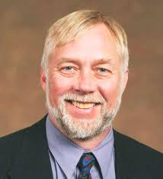

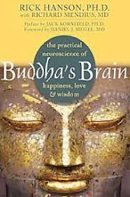

OBSTACLES TO HAPPINESS – NEGATIVITY BIAS
Bad is stronger than good. Roy Baumeister in a review paper called Bad is Stronger than Good concluded that a vast body of research shows that we focus on, remember, and adapt more slowly to negative than positive things
Evolution. From an evolutionary perspective this had survival value. Survivors always remembered to respond adaptively to negative events, and continually searched for new positive experiences
Rick Hanson (author of Buddha's Brian) says we have to actively appreciate positive experiences and weave them into the fabric of the brain, because the human brain is
Velcro for the bad &
Teflon for the good

Slide 43
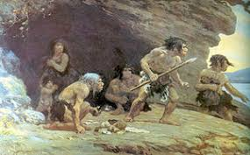
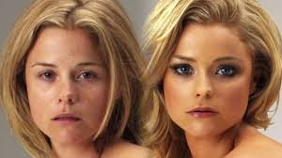
OBSTACLES TO HAPPINESS - SOCIAL COMPARISON
Social comparison involves comparing the self with others in terms of valued characteristics such as possessions, wealth, appearance, or achievements
Evolution. Before modern civilization, social comparison was adaptive because it motivated our ancestors to aspire to be the best in their social group at something, and this was a realistic goal in their lifetime because social groups were small and people within these groups had similar resources
In contemporary society with electronic media, social comparison is not always adaptive. Few can compete with media images. Online social groups are vast, and there are major inequalities in resources available to individuals

Slide 44


Upward social comparison
Contrast reduces well-being. When we contrast ourselves to others who are better off than we are, this reduces well-being because we focus on what we lack
Identification increases well-being. When we identify with others who are better off than we are, this increases our well being because we are inspired to be like them
Downward social comparison
Contrast increases well-being. When we contrast ourselves to others who are worse off than we are, this increases well-being because we become aware of how well-off we are
Identification reduces negative effect. When we identify with others who are worse off than we are, this decreases our well being because we realise that we could become like them if we lost what we have
Increase well-being, by adopting an identification strategy for upward social comparisons and a contrast strategy for downward social comparisons
OBSTACLES TO HAPPINESS - SOCIAL COMPARISON

Slide 45

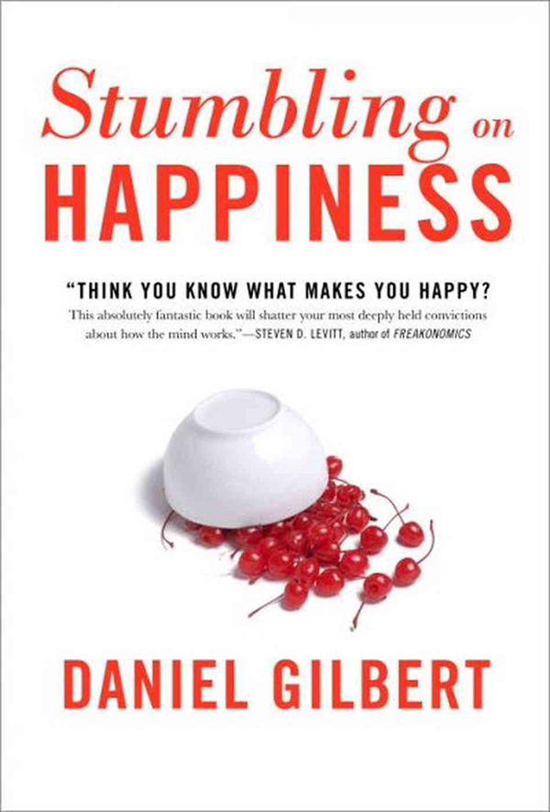
OBSTACLES TO HAPPINESS – AFFECTIVE FORCASTING
Affective forecasting. Daniel Gilbert at Harvard University found that we are poor at predicting situations that will make us happy, due to the following errors
Impact bias. We overestimate the strength and duration of future positive emotions, because we don’t take account of hedonic adaption. We forget that more money or possessions will not lead to long-lasting happiness
Focalism. We selectively focus on the positive, and neglect the negative. We may imagine that a work promotion will bring greater wealth and happiness. We neglect the negative emotions due to increased responsibilities, and limited power or resources to discharge these
Presentism. We predict the future will be like the present. On a cold winter’s day we predict that a month-long sunshine holiday would make us feel warmer and therefore happier. On the third week of this vacation we may feel unhappy because we are no longer cold and needing to be warmed up. In fact we are finding the heat oppressive
To improve well-being, develop a scepticism about these three biases the imagination suggests, and become more mindful of emotional reactions to situations

Slide 46
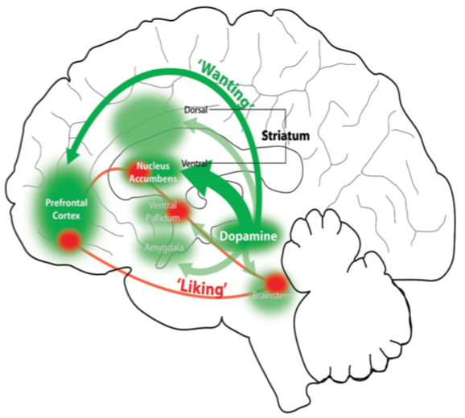
NEURAL CIRCUITS FOR WANTING AND LIKING
Liking and wanting are different aspects of positive affectivity, which involve different neural circuits and neurotransmitters.
Opioids are the ones that make us feel positive emotions
Dopamine motivates us to seek stimuli and situations that make us feel happy.
Note. Reproduced from Figure 1, p.10 in Berridge, K. C. (2018). Evolving concepts of emotion and motivation. Frontiers in Psychology, 9, 1647. https://doi.org/10.3389/fpsyg.2018.01647, Copyright © 2015 Berridge. This is an open access publication.

Slide 47
ENHANCING PERSONAL WELLBEING

Slide 48
STRATEGIES FOR ENHANCING WELLBEING
Positive emotions. Do things that make you feel positive emotions, and savour them (see savouring in chapter 4)
Hedonic treadmill. When you find things that make you feel happy, vary the ways to do them, and appreciate how good they make you feel
Social comparisons- Upward. When making upward social comparisons, make them with people who you can identify with and who you aspire to be like - your heroes. Don't compare yourself to the Joneses, or to media idols, or you will be disappointed that you can’t keep up with them.
Social comparisons- downward. When making downward social comparisons, focus on how much more you have accomplished than others. Don’t dwell on the possibility that you could lose your accomplishments and become like them.
Negativity bias. Expect to get small increases in happiness from large gains and successes; and large reductions in happiness from small losses and failures

Slide 49
STRATEGIES FOR ENHANCING WELLBEING
Affective forecasting. When forecasting how you will feel if you do something to make you feel better in the future, ask yourself what evidence you have from past experience that it will make you feel as good as you imagine, for as long as you imagine, and if you are neglecting to take account of other circumstances that may occur that would neutralise the good feelings
Education and work. Find flow by using skills that are intrinsically pleasing for tasks that are challenging and absorbing (see flow in chapter 4)
Relationships. Prioritise spending time with your family and friends, and making these relationships strong and lasting (see relationship building strategies in chapter 8)
Spirituality. Engage in religious or spiritual practices
Meaning, goals and values. Set and pursue valued goals that are not materialistic and that give your life meaning and purpose

Slide 50
STRATEGIES FOR ENHANCING WELLBEING
Environment
Secure physical and financial safety and comfort for yourself and your family, but don’t get on the hedonic treadmill of consumerism
Live near green spaces, or natural beauty, in an environment where there is pleasing music and art, and periodically enjoy fine weather
Health
Maintain a healthy lifestyle
Recreation.
Practice mindfulness meditation or progressive muscle relaxation (see mindfulness meditation in chapter 4, and relaxation in chapter 7)
Rest, relax, and take holidays in moderation
Do co-operative and/or absorbing recreational activities with groups of friends to create flow (see flow in chapter 4)

Slide 51
CONTROVERSIES ABOUT WELLBEING

Slide 52
CONTROVERSIES ABOUT WELLBEING
POSITIVE AND HUMANISTIC PSYCHOLOGY
Some positive psychologists have distanced themselves from the humanistic psychology movement which they view as being less committed to rigorous quantitative empirical research and confining interventions predominantly to clinical populations, with an overemphasis on negative aspects of life.
Some humanistic psychologists, in contrast have been critical of brief, pragmatic, positive psychology interventions, which they viewed as superficial, over emphasizing positive emotions, and failing to address existential issues which underpin wellbeing
The emergence of second wave positive psychology is one step along the road to rapprochement between these two traditions. Second wave positive psychology is shifting the balance away from hedonic towards eudaimonic wellbeing.

Slide 53
CONTROVERSIES ABOUT WELLBEING
POSITIVITY RATIOS
Barbara Fredrickson and Marcial Losada used complex mathematical modelling on daily ratings of positive and negative emotions from samples of university students in to show that a positive ratio of 3:1 was a tipping point for flourishing
Nicholas Brown, Alan Sokal, and Harris Friedman showed that mathematical modelling had been incorrectly applied and there was no convincing evidence that a positivity ratio of 3:1 was a tipping point for flourishing, which led Fredrickson and Losada to retract their claim of the 3:1 positive ratio as the tipping point for flourishing

