Slide 1
CHAPTER 2. GOALS & STRENGTHS

Slide 2
LEARNING OBJECTIVES
Identify the characteristics of highly valued goals and their relationship with wellbeing
Understand positive psychology interventions for setting highly valued goals and making progress towards them
Be able to explain the Values in Action (VIA) classification of strengths and virtues
Identify the main research findings of the VIA research programme
Know how to assess VIA strengths and virtues, identify signature strengths, and use these to enhance wellbeing

Slide 3
HIGHLY VALUED GOALS

Slide 4

GOALS – CASE EXAMPLE OF ANNE THE TEACHER
Anne’s most highly valued goal was to be a nursery school teacher for disadvantaged children
She wanted to do this to give these children a good start in life, and break the cycle of disadvantage
To pursue this highly valued goal she completed an education degree, got a job in nursery school, and did continuing professional education to improve her teaching skills
On a day-to-day basis, she planned and taught classes and developed good relationships with her pupils, their parents, and her colleagues
She did home visits to parents of all her new pupil’s
She made all her lessons exciting. She thought up new themes for her lessons every few weeks: rockets and space travel, super heroes, dinosaurs, and volcanoes

Slide 5
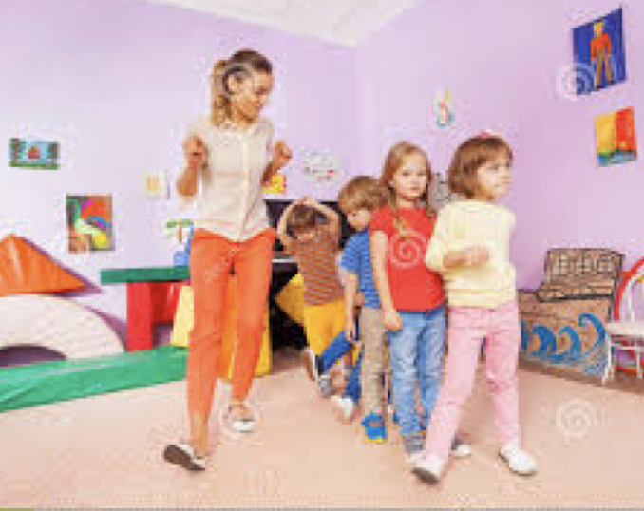
Despite being socially disadvantaged, Anne’s pupils progressed well under her instruction
Anne developed a strong sense of purpose in life and sense of accomplishment from the progress her pupils made
She also found learning new skills and teaching engaging
Anne developed very supportive relationships in college during her training, and later with her colleagues at the school where she worked
While some days were very stressful and left her exhausted, others brought Anne positive emotions such as joy, and pride in her pupil’s achievements.
Overall Anne’s commitment to her highly valued personal goal of being a nursery school teacher enhanced her PERMA well-being, Positive emotions, Engagement, Relationships, Meaning, & Accomplishment
GOALS – CASE EXAMPLE

Slide 6
GOAL FUNCTIONS
Goals the following functions. They
Give life direction
Motivate us to keep going
Organize us in terms of means and ends
Facilitate survival
Give life meaning (if they are highly valued)
Anne’s goals, in the case example, had these functions.
They gave her life direction by focusing her to pursue training and employment in teaching
They motivated her to work hard in college and in her teaching job
They organized her to study at college and prepare lesson plans in her teaching job
They gave her a good salary to support her basic needs and so facilitated survival
They gave her life meaning and purpose, as a teacher of disadvantaged children

Slide 7

CHARACTERISTICS OF HIGHLY VALUED GOALS
Research shows that the pursuit and attainment of highly valued goals is more likely if they are
1-Intrinsically rewarding, not extrinsically rewarding
2-Concordant with basic needs for autonomy, competence and relatedness
3-Involve doing valued activities, more than acquiring possessions
4-Involve approaching valued outcomes, more than avoiding unpleasant outcomes
5-Fit together harmoniously and don’t conflict
6-Are visualizable and challenging, not fuzzy and easy
7-Involve a high level of commitment, not little commitment
8-Can be monitored in a way that provides corrective feedback on progress

Slide 8
CHARACTERISTICS OF HIGHLY VALUED GOALS
In the case example, Anne’s goals had all of the following characteristics
Intrinsically rewarding. For Anne, the process of teaching children was intrinsically rewarding, she wanted to do if for its own sake. In contrast, writing end of term reports was extrinsically rewarding. It was tedious work which Anne did to get paid, so she could financially support herself
Concordant with basic needs. The 3 basic needs are autonomy, competence, and relatedness. In her classroom Anne was in charge of what happened, so teaching met her need for autonomy. She used well developed skills, so teaching met her need for competence. She also had good relationships with her pupils, their parents, and her colleagues, so her teaching job met her need for relatedness
Involve doing activities. Teaching involved preparing lessons, interacting with children, parents and colleagues, watching children make progress etc. Accumulating wealth and possessions was not a core aspect of Anne’s goals
Involve approaching valued outcomes. Ann’s work as a teacher mainly involved approaching things she wanted to do rather than avoiding things she did not want to do

Slide 9
CHARACTERISTICS OF HIGHLY VALUED GOALS
In the case example, Anne’s goals had these further characteristics
Fit together. Anne had other valued life goals including spending time with her family, and running to keep fit. Most of the time, these goals, and her goal of being a teacher did not conflict with each other
Are visualizable and challenging. It was easy for Anne to visualize on a day-to-day basis the sorts of teaching activities and lesson plans she intended to follow, and she usually set goals that were at the limit of her comfort zone
Involve a high level of commitment. Anne was highly committed to her goal of teaching disadvantaged children to give them a good start in life
Can be monitored in a way that provides corrective feedback on progress. All Anne’s pupils had individualized learning targets, and Anne kept weekly records of their progress. This allowed her to monitor how well she was doing as a teacher and provided corrective feedback, so she could change her teaching plans if some children failed to meet their targets

Slide 10

GOALS - BEST POSSIBLE SELF
In an experiment with 80 participants Laura King at the University of Missouri found that writing about life goals by imagining the best possible future self was an effective way of improving well-being and decreasing illness over a 5 month period
It was as effective and less distressing than writing about past trauma
It also had the added benefit of helping people clarify highly valued personal life goals

Slide 11

PAUSE & PRACTICE
GOALS - BEST POSSIBLE SELF
Visualize your ‘best possible self’
Write about how you visualize you will be over the next 10 years if everything in your life goes as well as it possibly could and all your hopes are fulfilled in the following areas:
Your physical and mental health
Your relationships with your partner, your family and your friends
Your achievements in your career at work or in your education
Your achievements in leisure activities, sports and arts
Note: Based on an exercise in King, L. A. (2001). The health benefits of writing about life goals. Personality and Social Psychology Bulletin, 27(7), 798–807. https://doi.org/10.1177/0146167201277003

Slide 12
PAUSE & PRACTICE
SET GOALS
Reflect on what you have written about your best possible self tells you about your answers to these questions:
What is really important to you?
What are your highest priorities in life?
What sorts of things do you value most?
What hopes and dreams for the future inspire you – draw you into the future?
What big overall courses of action do you want to make a commitment to?
Write down your highly valued goals in each of the areas of
Health/personal growth
Relationships
Achievements
Leisure activities
Other areas you may value such as spirituality

Slide 13
PAUSE & PRACTICE
REFINE GOALS
Check if your goals have the characteristics of highly valued goals that are most likely to enhance well-being
Intrinsically rewarding (not extrinsically rewarding)
Concordant with basic needs for autonomy, competence and relatedness
Involve doing valued activities (more than acquiring possessions)
Involve approaching valued outcomes (more than avoiding unpleasant outcomes)
Fit together (and don’t conflict)
Are visualizable and challenging (not fuzzy and easy)
Involve a high level of commitment (not little commitment)
Can be monitored in a way that provides corrective feedback on progress
Refine your highly valued goals if they don’t have these characteristics.

Slide 14
PAUSE & PRACTICE
MONITOR GOALS
Periodically write down your rating of progress towards each of your highly valued goals on a 10-point scale
On this scale 1 means you have made little progress towards achieving your highly valued goals and 10 means you have made a lot of progress
If your scores gradually increase, keep doing whatever it is that is allowing you to gradually make progress towards your highly valued goals
If your scores are remaining the same or dropping, then ask yourself:
Am I spending my time prioritising my highly valued goals?
Am I spending much time doing other things?
What obstacles would I have to overcome to spend more time pursuing my highly valued goals?
What would be the first small step that I could take today to start overcoming these obstacles?

Slide 15
STRENGTHS

Slide 16

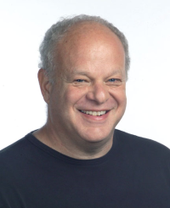
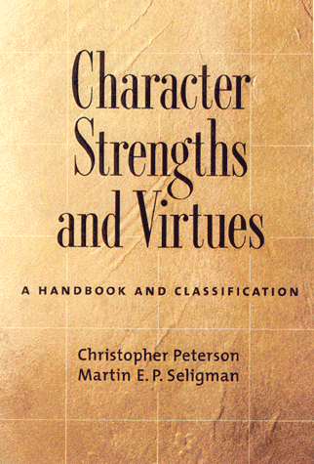
CHARACTER STRENGHTS & VIRTUES
Character strengths and virtues project was the first major positive psychology research programme
Peterson and Seligman team reviewed the virtues and character strengths referred to in major religious and philosophical traditions around the world and found 6 virtues that were universal, and 24 character strengths that supported these virtues (shown on the next slide)
Character Strengths and Virtues: A handbook and classification, published in 2004 summarised the project
Values in Action Inventory of Strengths (VIA-IS) is a 240-item inventory they developed to assess character strengths
The VIA-IS is free online, and gives instant feedback on scores on all 24 strengths, and identifies a small subset of signature strengths, which if you use and develop them will enhance your well-being.
The VIA-IS has been translated into many languages, there are a variety of versions of it, and a vast body of research based on it
Chris Peterson
Martin Seligman

Slide 17
VIA CLASSIFICATION OF CHARACTER STRENGHTS & VIRTUES
WISDOM
Creativity
Curiosity
Judgement
Love of learning
Perspective
COURAGE
Bravery
Perseverance
Honesty
Zest
HUMANITY
Love
Kindness
Social intelligence
JUSTICE
Teamwork
Fairness
Leadership
TEMPERANCE
Forgiveness
Humility
Prudence
Self-regulation
TRANSCENDENCE
Appreciation of beauty and excellence
Gratitude
Hope
Humour
Spirituality

Slide 18
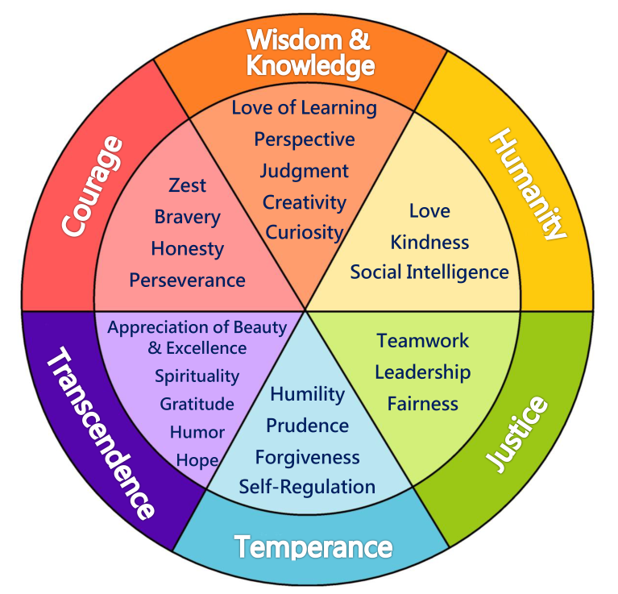
VIA CLASSIFICATION OF CHARACTER STRENGHTS & VIRTUES

Slide 19
SIGNATURE STRENGHTS
Peterson and Seligman proposed that signature strengths have the following characteristics
A belief that the strength is one of your core attributes
Excitement about using the strength
Rapid learning when the strength is first used
Continuous learning of new ways to use the strength
A yearning to find new ways to use the strength
A feeling that you will inevitably use the strength in many situations
Being invigorated rather than exhausted while using the strength
Creation of personal projects that revolve around the strength, and
Feelings of joy, zest, enthusiasm or ecstasy when using the strength

Slide 20
EXAMPLES OF HOW TO USE SIGNATURE STRENGTHS
Signature strengths may be used in small ways every day to increase wellbeing. Here are some examples.
Creativity – Today select a routine daily task and make a conscious decision to do it completely differently, using one of your other signature strengths
Perseverance – Today take an important task you have been avoiding doing for some time, and plan to do it in small stages. Then follow through on your plan
Kindness – Today do a favour for a friend or stranger and don’t make a big deal out of it
Fairness - Today, when you find you have made a mistake in your dealings with others, admit it and take responsibility for it
Forgiveness – Today when you feel annoyed with someone, try to understand and empathise with the other person’s reasons for being annoying, and let go of your negative feeling
Appreciation of beauty and excellence - Today stop and notice the natural beauty all around you

Slide 21
CHARACTER STRENGHTS - RESEARCH FINDINGS
Most & least common. Honesty, fairness & kindness are the most common strengths; the least common are self-regulation, humility, & prudence
Well-being. Hope and zest are the strengths most strongly associated with well-being
Relationships. In couples greater strengths are associated with higher relationship satisfaction. Strengths-based parenting has positive effects on parents’ and children’s well-being
Education and work. The strength – perseverance – is associated with academic achievement and work performance

Slide 22
CHARACTER STRENGHTS - RESEARCH FINDINGS
Health. Greater strengths are associated with illness prevention, better recovery from illness, and adjustment to illness
Mental health. Mental health or psychosocial problems may arise from overuse or underuse of strengths, illustrated on the next slide
OCD and social anxiety disorder are associated with overuse of social intelligence and underuse of self-regulation
Burnout among health professionals and counsellors is associated with forgiveness, honesty, hope, prudence, self-regulation, and judgement
Trauma. Greater strengths are associated with post-traumatic growth after trauma such as serious accidents and assaults. Post-traumatic growth means responding to trauma in a positive way by re-evaluating highly valued life-goals and the relative importance of material things and relationships in life
Using signature strengths. Controlled trials show that identifying and using signature strengths increases well-being

Slide 23
UNDERUSE & OVERUSE OF STRENGTHS
Underuse and overuse of strengths may be associated with psychosocial problems, illustrated by examples below
STRENGTH | UNDERUSE | OVERUSE
Creativity | Unimaginative | Eccentric, Odd
Bravery | Cowardly | Foolhardy
Kindness | Selfish | Compassion fatigued
Fairness | Prejudiced | Indecisive on justice issues
Forgiveness | Vengeful | Too lenient and permissive
Hope | Despair | Unrealistic Pollyanna-ism

Slide 24
RESEARCH FINDINGS ON THE FACTOR STRUCTURE OF CHARACTER STRENGHTS
In a factor analysis Peterson found two bipolar factors
focusing on the self or others
motivated by the head or heart
No one can show a high level of all strengths
You can have high levels of strengths that are close together e.g. gratitude and love
You can’t have high levels of strengths that are far apart e.g. prudence and zest
In developing our strengths we must make trade-offs
Other factor structures have been found for the VIA-IS
Note. Adapted with permission of Oxford University Press from Figure 6.3 Tradeoffs among character strengths, p. 158 in Peterson, C. (2006). A primer in positive psychology. New York, NY: Oxford University Press. Copyright © 2006 Oxford University Press. Permission conveyed through Copyright Clearance Center, Inc.

Slide 25
RESEARCH FINDINGS ON MINDFULNESS & CHARACTER STRENGHTS
There is a synergistic relationship between mindfulness & character strengths
Some character strength support the development of mindfulness - curiosity and hope
Other strengths are enhanced though mindfulness practice - appreciation of beauty and excellence and spirituality
Mindfulness-based strengths practice is a programme developed by Ryan Niemiec which integrates the practice of mindfulness and character strengths-use

Slide 26

STRENGTHS – CASE EXAMPLE OF ANNE THE TEACHER
Remember Anne who we met in our discussion of goals Anne worked in a nursery school and was devoted to her job. Her most highly valued goal was to give her disadvantaged pupils a good start in life
When she took the VIA-IS she found that her top five signature strengths were
Kindness
Love of learning
Creativity
Leadership and
Humour
One week, she carried out a series of tasks in which she used these skills to achieve her highly valued goal of giving her disadvantaged pupils a good start in life
To use her strength of kindness, Anne carefully selected stories that she knew her pupils would like a lot, and read these to them as a treat. Their favourite story was about giraffe who couldn’t dance at the jungle party. He was too awkward and shy. He sadly left the party and walked home. On his way home, he heard the sound of the wind in the trees under the moon, and found that this music made him want to dance. The other animals saw him, and were delighted that the giraffe had finally found music he could dance to

Slide 27

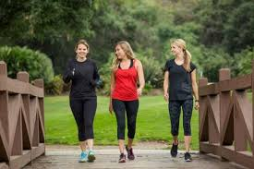
STRENGTHS – CASE EXAMPLE OF ANNE THE TEACHER
To use her strength of love of learning, Anne searched on the internet for continuing professional development courses relevant to nursery school teachers and took one of these
To use her strengths of creativity and humour, Anne wrote a series of funny sing-along and do-the-actions songs for her children, and taught them how to sing them and do all the actions. The kids loved the songs and they all laughed a lot about them
Leadership. Anne made a point of taking her two classroom assistants for a walk after work to build team morale, and in doing so used her strength of leadership
Review. Anne found that using her signature strengths increased her well-being from 6 or 7 to 8 or 9. She learned that she could creatively work out ways to use these strengths to move towards her highly valued goal of giving her disadvantaged pupils a good start in life
Plan. She planned to continue doing this exercise

Slide 28
PAUSE & PRACTICE
USING STRENGHTS TO ACHIEVE GOALS & INCREASE WELL-BEING
Do this exercise to help you use signature strengths to move towards highly valued goals and increase well-being
Complete the VIA-IS at https://www.viacharacter.org/survey/account/register and identify your top 5 signature strengths, or read the definitions of the 24 character strengths in your text book and identify which five of these that best describe you
Write a plan about using at least one of your signature strengths in a new way every day for a week to help you move towards the highly valued goals. You may find it helpful to read the list of ideas for how to use each of the 24 strengths in your textbook
Each evening for a week, write down what you were doing and how much well-being you were feeling on a 10-point scale before and after using one of your signature strengths in a new way
On this scale 0 means a very low level of well-being, 5 means your feelings were neutral, and 10 means an extremely high level of well-being.
At the end of the week review what you have written, and write down if using one of your signature strengths in a new way each day for a week helped you to move towards your highly valued goals and enhanced your well-being

Slide 29
CONTROVERSIES ABOUT STRENGTHS

Slide 30
CONTROVERSIES ABOUT STRENGTHS
PERSONALITY TRAITS vs CHARACTER STRENGTHS
Personality trait researchers argue that character strength scales may be assessing well-established personality traits – using new names (old wine in new bottles)
Studies of the relationship between personality traits and character strengths show that character strengths and personality trait scales have high correlations and so overlap, but not completely
Character strength scales are measuring more than those attributes assessed by personality questionnaires

Slide 31
CONTROVERSIES ABOUT STRENGTHS
CROSSCULTURAL VALIDITY OF CHARACTER STRENGTHS
Snow has argued that the VIA theory of strengths and virtues is not cross-culturally valid for 2 reasons
Non-western experts were not involved in judging the presence of virtues and strengths which Peterson and Seligman inferred were present in ancient non-western philosophical and religious texts
Subsequent research on the VIA classification system has relied largely on Westernized (computer literate) samples
No counter argument or valid cross-cultural research has been offered to address these issues

