Slide 1
CHAPTER 3.
GRATITUDE, HOPE, AND OPTIMISM

Slide 2
LEARNING OBJECTIVES
Understand how gratitude and appreciation, and hope and optimism are conceptualized within positive psychology
Understand the main theories of gratitude, hope and optimism
Know how to assess gratitude, hope and optimism
Distinguish between dispositional optimism and optimistic explanatory style
Identify the main research findings linking gratitude, hope and optimism to wellbeing and health
Be able to engage in exercises designed to enhance gratitude, hope and optimism

Slide 3
OPTIMISM & GRATITUDE
A POSITIVE MINDSET

Slide 4
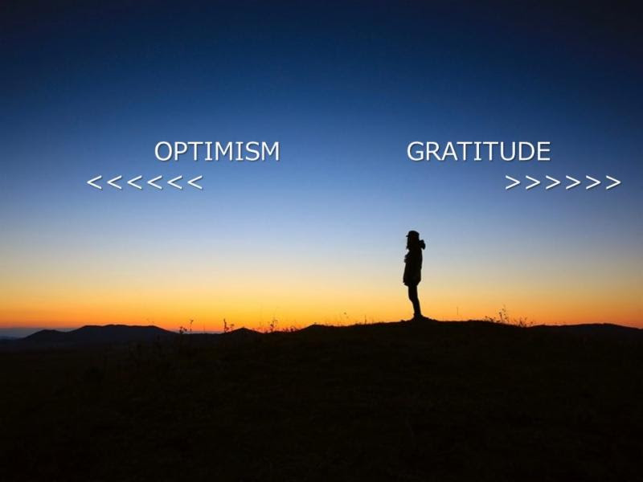
OPTIMISM & GRATITUDE – A POSITIVE MINDSET
  Positive mindset. Optimism and gratitude are central elements of positive mindset
  Optimism involves taking a positive perspective on the future. We expect the future to hold good things in store of us
  Gratitude involves taking a positive perspective on the past or present We are grateful for good things we received or that we have now
  Opposite of a depressive mindset. This optimistic, grateful, positive mindset is the opposite of the negative mindset associated with depression. In depression there is a negative perspective on the self, the world, and the future

Slide 5
OPTIMISM & GRATITUDE – A POSITIVE MINDSET
  Positive outcomes. Optimism and gratitude are both associated with positive outcomes in important life areas, including
    Well-being. PERMA WB, subjective WB, psychological WB
    Health. Physical and mental health, & adaptive coping with stress, loss and trauma
    Relationships. Positive early life and current relationships
    Career. Work, educational, and sports performance and satisfaction

Slide 6
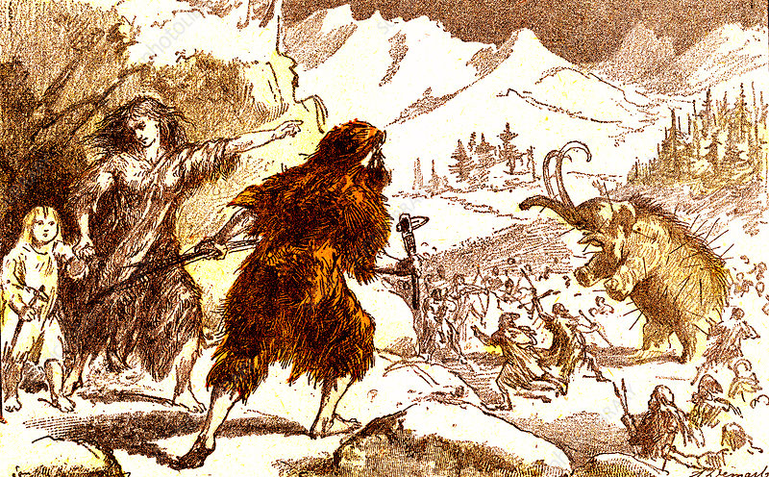
OPTIMISM & GRATITUDE – A POSITIVE MINDSET
  Evolution. Optimism and gratitude both were highly adaptive for our prehistoric ancestors
  Gratitude strengthened co-operative social relationships, and group cohesion
  Optimists strived to survive because they believed that things would work out well for them, while pessimists gave up and not as many survived

Slide 7
GRATITUDE

Slide 8
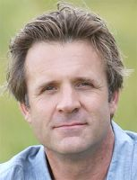
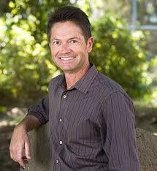
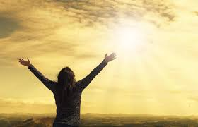
DEFINITION OF GRATITUDE
  Robert Emmons and Michael McCullough define gratitude as arising when
    We recognise that something good has happened to us
    An external source is responsible
    The good things are experienced as undeserved or unearned
  The external source may be another person, an animal, a deity, nature, or the universe
  We are grateful for the benefit
  We are grateful to the benefactor
  Grateful emotions urge us engage in prosocial behaviour
Michael
McCullough
Robert
Emmons

Slide 9
MEASURING GRATITUDE
  Trait & State Gratitude. Gratitude is measured with short self-report instruments that asses the general trait of gratitude or the specific momentary state of being grateful
  Gratitude Adjective Checklist assesses state gratitude. Respondents rate the degree to which the adjectives ‘grateful’, ‘thankful’, and ‘appreciative’ accurately describe how they are feeling in the present moment
  Gratitude Questionnaire 6 is the most widely used measure of trait gratitude. Respondents rate the degree to which they agree with 6 statements, such as ‘I have much in life to be thankful for’ (on the next slide)

Slide 10
PAUSE & PRACTICE - GRATITUDE
Measurement of Gratitude - Gratitude Questionnaire - 6
You may complete this questionnaire to assess how strong your current disposition to be grateful is. For each item circle the response that applies to you right now; add and sum the scores for all 6 items. Scores between 38 and 42 are in the average range. 25% of people get scores lower than this range and 25% of people get scores higher than this range.
1. | I have so much in life to be thankful for. | Strongly disagree 1 | Disagree 2 | Slightly disagree 3 | Neutral 4 | Slightly agree 5 | Agree 6 | Strongly agree 7
2. | If I had to list everything that I felt grateful for, it would be a very long list. | Strongly disagree 1 | Disagree 2 | Slightly disagree 3 | Neutral 4 | Slightly agree 5 | Agree 6 | Strongly agree 7
3. | When I look at the world, I don’t see much to be grateful for. | Strongly agree 7 | Agree 6 | Slightly agree 5 | Neutral 4 | Slightly disagree 3 | Disagree 2 | Strongly disagree 1
4. | I am grateful to a wide variety of people. | Strongly disagree 1 | Disagree 2 | Slightly disagree 3 | Neutral 4 | Slightly agree 5 | Agree 6 | Strongly agree 7
5. | As I get older I find myself more able to appreciate the people, events, and situations that have been part of my life history. | Strongly disagree 1 | Disagree 2 | Slightly disagree 3 | Neutral 4 | Slightly agree 5 | Agree 6 | Strongly agree 7
6. | Long amounts of time can go by before I feel grateful to something or someone. | Strongly agree 7 | Agree 6 | Slightly agree 5 | Neutral 4 | Slightly disagree 3 | Disagree 2 | Strongly disagree 1
Reproduced with permission from McCullough, M. E., Emmons, R. A., & Tsang, J. (2002). The grateful disposition: A conceptual and empirical topography. Journal of Personality and Social Psychology, 82(1), 112-127. http://dx.doi.org/10.1037//0022-3514.82.1.112, appendix, The Gratitude Questionnaire-6 (GQ-6), p. 127. Copyright © 2002 by the American Psychological Association.

Slide 11
FACTORS THAT INFLUENCE GRATITUDE
Cognitive factors
  Receiving an undeserved gift
  The value of the gift to us
  The goodness of the gift
  The gratuitousness of the gift
Personality factors
  Agreeableness
  Religiosity
  Empathy
  Humility
  Self-esteem
  Low Narcissism
  Low cynicism
  Low materialism
Demographic factors
  Females
  Older people
Parent child relationships
  Secure attachment
  Role modelling gratitude
  Socializing children to be grateful
Neurobiological factors
  Medial prefrontal cortex
Genetic factors
  COMPT gene - dopamine
  CD38 gene – oxytocin

Slide 12
COGNTIVE FACTORS THAT INFLUENCE GRATITUDE
The level of gratitude we experience is determined by the extent to which we recognize 4 things listed here
That we have received an undeserved gift
The value of the gift to us
  Sara Algoe studied gratitude in college sororities where established members (big sisters) showered new members (little sisters) anonymously with gifts during their first week in the sorority to make them feel welcome
  At the end of the week, when the identity of the big sisters was revealed, the perceived thoughtfulness of the gifts (their psychological value to recipients) predicted the level of gratitude experienced by little sisters
The goodness of the giver in intentionally and freely giving the gift or benefit, which was costly to them
The gratuitousness of the gift which exceeds the normal social expectations that we have of others
  In a vignette study Daniel Bar-Tal found that people felt less grateful towards their mother than a stranger for an identical favour

Slide 13
PERSONALITY FACTORS & GRATITUDE
These traits have positive correlations with gratitude
  Agreeableness
  Religiosity
  Empathy
  Humility
  Self-esteem
These traits have negative correlations with gratitude
  Narcissism
  Cynicism
  Materialism

Slide 14
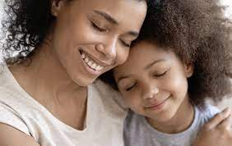

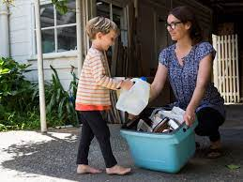
PARENT-CHILD FACTORS FACTORS & GRATITUDE
Children develop greater trait gratitude when their parents
  Provide them with a secure attachment experience
  Act as gratitude role models
  Socialise them to be thankful
  Place them in gratitude-related activities (play dates with other children & families that express gratitude)

Slide 15
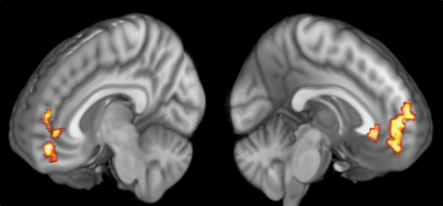
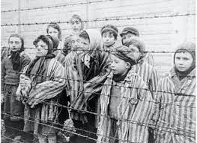
NEUROBIOLOGICAL FACTORS & GRATITUDE
Glen Fox induced gratitude in participants while they underwent functional magnetic resonance imaging
They asked participants to focus on feelings of gratitude (and rate these) as they read first person accounts of intense feelings of gratitude holocaust survivors experienced when they received lifesaving food and clothing from strangers
Gratitude ratings correlated with activity in a region of the medial prefrontal cortex
Note. Reproduced from Figure 5. Medial prefrontal activity correlating with participants’ gratitude ratings in Fox, G. R., Kaplan, J., Damasio, H., & Damasio, A. (2015). Neural correlates of gratitude. Frontiers in Psychology, 6, 11. https://doi.org/10.3389/fpsyg.2015.01491, Copyright © 2015 Fox, Kaplan, Damasio and Damasio. This is an open access publication.

Slide 16
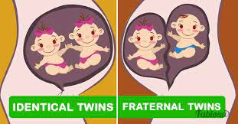

GENETIC FACTORS & GRATITUDE
A twin study showed that gratitude was 40% heritable
Variants of two genes are associated with gratitude
  COMPT gene which affects the neurotransmitter dopamine, associated with reward seeking
  CD38 gene affects oxytocin, referred in popular culture as the ‘love hormone’ or ‘tend and befriend’ hormone

Slide 17
EVOLUTIONARY THEORIES OF GRATITUDE
Early Evolutionary theories propose that gratitude evolved because it supports co-operative relationships vital to the survival of the species
Reciprocal altruism. Robert Trivers proposed that gratitude evolved to promote reciprocal (tit-for-tat) altruism, and that the amount of gratitude we experience is determined by costs and benefits of altruistic acts
Upstream reciprocity. Martin Nowak and Sébastien Roch, proposed that gratitude evolved to promote passing on benefits to third parties: paying-it-forward
Strengthening non-kin relationships. Michael McCullough proposed that gratitude evolved to strengthen non-kin relationships, and so is more strongly evoked in non-kin, than in kin relationships. This hypothesis is supported by Bar-Tal’s finding, where participants felt less gratitude towards their mother than a stranger for an identical favour

Slide 18
EVOLUTIONARY THEORIES OF GRATITUDE
Later Evolutionary theories propose that gratitude evolved to facilitate making and maintaining psychologically intimate relationships, not just improving economically beneficial, tit-for-tat relationships with strangers
Broaden and build theory. Barbara Fredrickson proposed that the positive emotion of gratitude does not elicit narrow tit-for-tat responses, but broader creative responses that enhance the quality of relationships for the long-term and so benefit the survival of the species
Find-remind-and-bind theory. Sara Algoe proposed that gratitude evolved to support the establishment and maintenance of close relationships
  It helps people find others who are good candidates for close relationships because they are particularly tuned-in and responsive to their needs
  It reminds people of the value of these relationships
  It binds them to partners and friends by making them feel appreciated, and by encouraging behaviour that prolongs relationships
The witness effect theory. Sara Algoe’s proposed that witnessing helping and gratitude between two people, strengthens the relationship quality between witnesses and those they observed, and this supports the development of communal group alliances. This was an extension of the find-remind-and-bind theory from the dyadic to the group level of analysis

Slide 19

BENEFITS OF GRATITUDE
Gratitude leads to better
Wellbeing
Prosocial behaviour
Quality couple relationships
Functioning in organizational contexts
Mental and physical health

Slide 20
GRATITUDE & WELLBEING
Gratitude leads to greater wellbeing because it
facilitates
Activation of a gratitude schema
More positive self-evaluations
Greater mindfulness
A stronger sense of meaning and purpose in life
The use of an active coping style to deal with life challenges
Greater support from friends, romantic partners, and family

Slide 21

GRATITUDE & MENTAL HEALTH
Gratitude is associated with better mental health indexed by
  Less depressed mood
  Less suicidality among those at risk
  Better adjustment among people with drug and alcohol problems
  Greater post-traumatic growth
Gratitude enhances mental health because it facilitates
  Positive reframing of difficult situations
  More adaptive coping
  Self-compassion
  Self-esteem

Slide 22
GRATITUDE & PHYSICAL HEALTH
Gratitude is associated with better
  Perceived physical health
  Sleep quality
  Adjustment to illnesses including heart disease, arthritis, and inflammatory bowel disease
  Improvement in biomarkers of health including inflammation and blood pressure
Gratitude enhances physical health because it facilitates
  Healthier lifestyles
  Help seeking for health problems and following prescribed medical regimes
  Greater social support from friends and family
  More adaptive coping with stress

Slide 23
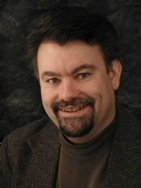
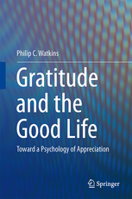
AMPLIFICATION THEORY OF GRATITUDE
Philip Watkins has proposed that gratitude increases many aspects of well-being because it amplifies the good in one’s life
Gratitude helps us to identify people, relationships, experiences and things that are important for well-being, and motivates us to engage with these to enhance the good in our lives
As an amplifier increases the strength of a sound signal, gratitude increases the signal strength of good things in our lives that we direct attention to
Gratitude makes us value the good things currently in our lives, and also good things that have happened in the past by increasing our access to positive memories
Philip Watkins

Slide 24
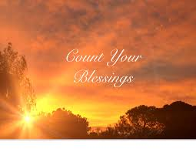
EFFECTS OF COUNTIUNG BLESSINGS
The finding that gratitude has many benefits inspired research on interventions which aim to induce gratitude and enhance wellbeing
Robert Emmons pioneered research on gratitude interventions
He showed that people who kept a gratitude journal in which they recorded good things that they were grateful for each day showed increased positive mood compared to people who wrote about hassles they had encountered
This intervention – often called
  counting blessings or
  3 good things
  has been replicated many times
Robert Emmons

Slide 25

GRATITUDE INTERVENTIONS
Robert Emmons has incorporated a variety of gratitude interventions into a 3 week programme in his book - Gratitude Works
Counting blessings / being thankful for for 3 good things
Gratitude letter and visit
Giving thanks to whom and for what
Giving thanks for three gifts, and paying it forward
Being thankful for the ending of a chapter in your life
Being thankful for a gift by imagining its absence
Being thankful for good things that come from bad experiences
Robert Emmons

Slide 26
PAUSE & PRACTICE
GRATITUDE – COUNTING BLESSINGS
Set aside ten minutes for gratitude journaling
List three good things that happened today
These should be things for which you can give other people, God, or nature some credit, e.g., someone giving you a compliment; a friend contacting you; someone helping you; noticing the beauty of the world; noticing your health or other personal characteristic
For each of the three things on your list, spend some time visualising the good thing happening and then write down
    What exactly happened
    Why you think it happened
    What it means to you
    All the reasons you can think of that explain why you think it went well
    Whether or not you told someone that it happened
    What you can do to make it happen again, and remember next time to tell someone about it
Before and after the exercise write down a well-being rating for how you feel at that exact moment on a 10-point scale from 1 which means you are extremely sad to 10 which means you are extremely happy
Look at the difference between your ratings before and after the exercise and decide if this exercise improved your well-being
Note: Based on an exercise in Emmons, R. A., & McCullough, M. E. (2003). Counting blessings versus burdens: An experimental investigation of gratitude and subjective well-being in daily life. Journal of Personality and Social Psychology, 84(2), 377–389. http://dx.doi.org/10.1037//0022-3514.84.2.377

Slide 27
HOPE & OPTIMISM

Slide 28
DEFINITIONS OF HOPE & OPTIMISM IN POSITIVE PSYCHOLOGY
  While taking a positive perspective on the past is central to gratitude, adopting a positive future orientation is a key feature of both hope and optimism
  In positive psychology there have been 3 main lines of research on hope and optimism
    Hope. Rick Snyder construct - the ability and determination to plan and pursue pathways towards desired goals, despite obstacles
    Dispositional Optimism. Michael Scheier and Charles Carver’s construct - the general expectation that more good things than bad will happen in the future
    Optimistic explanatory style. Martin Seligman’s construct - the tendency to attribute negative events such as failure to external, specific, transitory characteristics (for example, bad circumstances)

Slide 29
HOPE

Slide 30
HOPE THEORY
  Rick Snyder proposed that hope is the sum of two components:
    Pathways. The ability to plan ways to achieve desired goals despite obstacles
    Agency. Motivation to use these pathways
  Hope theory is diagrammed on the next slide & explained below
  In any situation where a valued goal is pursued, hopeful goal-directed behaviour is determined by the interaction of 3 elements
    Outcome value. The degree to which the specific goal is valued [e.g. strongly valuing getting a good grade on an essay]
    Pathway thoughts about possible ways to achieve the specific goal and related expectations about how effective these will be in achieving the goal [e.g. plans for researching and writing the essay and expecting to do a good job]
    Agency thoughts about how effective one will be in following pathways to the specific goal [e.g. I’m fairly sure I can and will write this essay]
  All three of these factors will be dependent upon hope thoughts and the related emotional set based on past developmental experiences in two areas
    Pathway thoughts about goal pursuit in general, based on developmental lessons concerning correlations and causality [e.g. I’ve planned to research and write good essays in the past and this has paid off]
    Agency thoughts based on developmental lessons about the self as author of causal chains of events [e.g. I’ve got good grades before so I can do it again]

Slide 31
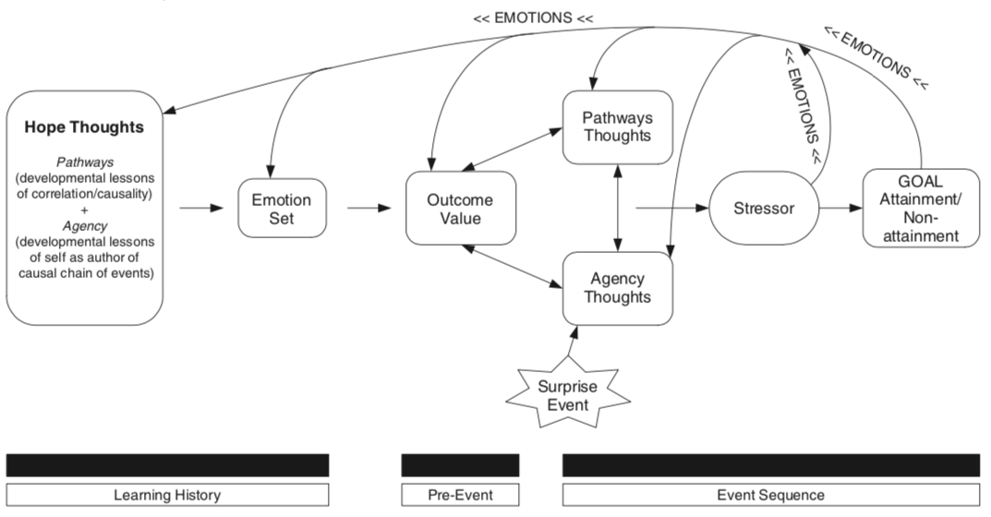
HOPE THEORY
Note. Reproduced with permission of the American Psychological Association from Figure 6.1. Hope theory model, p. 81 in Gallagher, M. W., Teramoto Pedrotti, J., Lopez, S. J., & Snyder, C. R. (2019). Hope. In M. W. Gallagher, & S. J. Lopez (Eds.), Positive psychological assessment: A handbook of models and measures (2nd ed., pp. 77-95).Washington, DC: American Psychological Association, https://doi.org/10.1037/0000138-006, Copyright © 1994 American Psychological Association. Permission conveyed through Copyright Clearance Center, Inc.

Slide 32
HOPE THEORY
  Emotions
    Emotions arising from goal pursuit [represented by curve arrow in the diagram] affect current and long-term thoughts and emotions about pathways to goals, the role of personal agency in achieving these, and the degree to which goals are valued
    If goal pursuit is going well, positive emotions will reinforce the goal-pursuit process
    If goal pursuit is not doing well, negative emotions will undermine the process of goal-pursuit
  Surprise events
    Positive or negative surprise events, that elicit strong emotions, may occur during goal pursuit [e.g. your computer crashes when your writing your essay, or a friend gives you some good material]
    These surprise-based emotions elicit arousal that may be transformed into agency or motivation

Slide 33
HOPE THEORY
Predictions about state hope
  State hope is strongest when there is an intermediate probability of attaining goals due to moderately challenging stressors
  Where we are certain of achieving our goals, hope is unnecessary
  Where we are certain that we will not, then we become hopeless
Predictions about trait hope
  People with high trait hope look for alternative pathways to achieve goals, and when successful in overcoming barriers, experience positive emotions which reinforce hopeful thinking
  People with low trait hope typically become “stuck”, engage in negative ruminative thoughts, the consequent negative emotions. These processes erode hope and impede goal pursuit

Slide 34
DEVELOPMENTAL HOPE THEORY
Snyder proposed that the development of hope in childhood and adolescence was influenced by
Cognitive development as described by Piaget
Parental behaviour
  Role modelling hopeful behaviour
  Coaching children in overcoming obstacles to achieve goals
  Providing children with a warm, structured, predictable, fair home environment that facilitates secure attachment

Slide 35
ASSESSMENT OF HOPE
  Hope may be assessed as a trait and state with these 2 scales
    Adult dispositional hope scale
    Hope State Scale
  They yield total scores, and scores for hope-related agency and pathways
  Versions of these short scales have bee developed for children

Slide 36
PAUSE & PRACTICE
COMPLETE THE ADULT DISPOSITIONAL HOPE SCALE
You may complete this questionnaire to assess how strong your current level of hope is. For each item circle the response that applies to you right now. Sum the scores for all 6 items. Scores between 23 and 27 are in the average range. 25% of people get scores lower than this range and 25% of people get scores higher than this range. Please circle the answer that applies to you to show how much you agree or disagree with each of the following statements
 | Agency
1 | I energetically pursue my goals. | Definitely false 1 | Mostly false 2 | Mostly true 3 | Definitely true 4
2 | My past experiences have prepared me well for my future. | Definitely false 1 | Mostly false 2 | Mostly true 3 | Definitely true 4
3 | I’ve been pretty successful in life. | Definitely false 1 | Mostly false 2 | Mostly true 3 | Definitely true 4
4 | I meet the goals that I set for myself. | Definitely false 1 | Mostly false 2 | Mostly true 3 | Definitely true 4
 | Pathways
5 | I can think of many ways to get out of a jam | Definitely false 1 | Mostly false 2 | Mostly true 3 | Definitely true 4
6 | There are lots of ways around any problem | Definitely false 1 | Mostly false 2 | Mostly true 3 | Definitely true 4
7 | I can think of many ways to get the things in life that are important to me. | Definitely false 1 | Mostly false 2 | Mostly true 3 | Definitely true 4
8 | Even when others get discouraged, I know I can find a way to solve the problem. | Definitely false 1 | Mostly false 2 | Mostly true 3 | Definitely true 4
Note. Adapted with permission of the American Psychological Association from Appendix, p. 585 in Snyder, C. R., Harris, C., Anderson, J. R., Holleran, S. A., Irving, L. M., Sigmon, ... Harney, P. (1991). The will and the ways: Development and validation of an individual-differences measure of hope. Journal of Personality and Social Psychology, 60(4), 570–585. https://doi.org/10.1037/0022-3514.60.4.570, Copyright © 1991 American Psychological Association.

Slide 37
RESEARCH FINDINGS ON HOPE
Genetic factors. Hope is is about 41% heritable
Neurobiological factors. Trait hope may be subserved by the bilateral medial orbitofrontal cortex, which has been shown to support reward-related processing, problem solving, and goal-directed behaviour
Gender. Males and females do not have different levels of dispositional hope
Wellbeing. Hope is correlated with wellbeing
Many positive correlates. Hope is correlated with all of the following variables
  Secure adult attachment
  Social support
  Resilience
  Emotional stability
  Extraversion
  Conscientiousness
  Self-esteem
  Self-compassion
  Attention to positive information
  Meaning or purpose in life
  Religiosity

Slide 38
RESEARCH FINDINGS ON HOPE
School & Work. Hope is associated with better performance at school and work
Mental health. Hope is a protective factor for people with mental health problems such as depression, anxiety, psychosis and PTSD
Adjustment to physical illness. Hope is associated with better adjustment to conditions such as chronic pain, cancer, heart disease, spinal cord injury, multiple sclerosis, psoriasis, arthritis, diabetes, asthma, sickle cell disease, and burn injuries

Slide 39
HOPE THERAPY
Rick Snyder’s Hope Therapy helps clients to
  Formulate clear goals
  Produce numerous pathways to these
  Motivate themselves to pursue their goals
  Reframe obstacles as challenges to be overcome
It is based on Jerome Frank’s insight that hope is a factor common to all effective psychotherapies in his book Persuasion and Healing
It draws on practices from cognitive behaviour therapy, solution-focused therapy, and narrative therapy
Hope therapy has a small evidence base

Slide 40
DISPOSITIONAL OPTIMISM

Slide 41
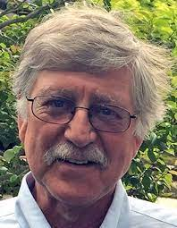
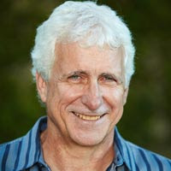
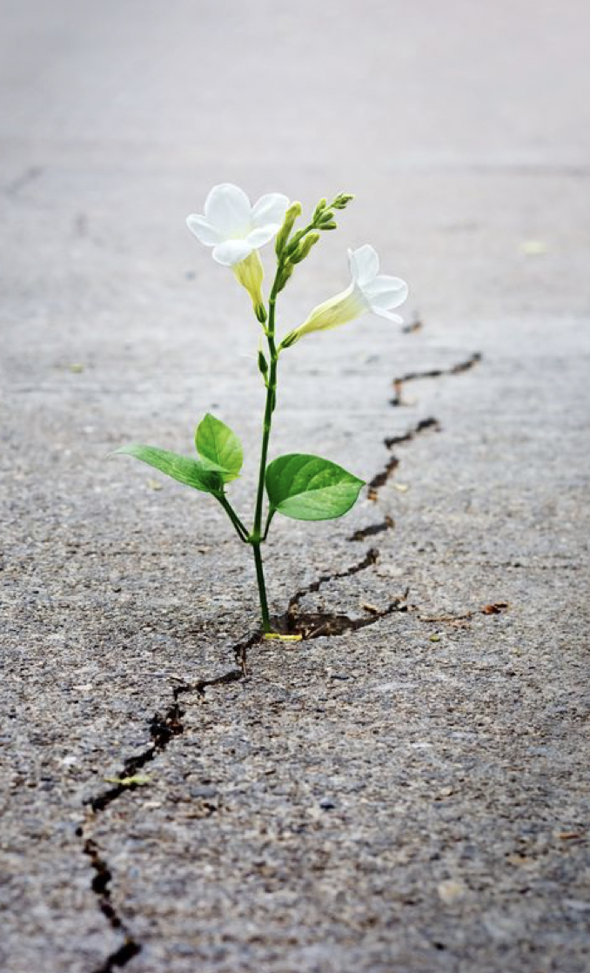
MEASUREMENT OF DISPOSITIONAL OPTIMISM
  Dispositional optimism. Michael Scheier and Charles Carver’s defined it as the general expectation that more good things than bad will happen in the future
  Life Orientation Test-Revised (LOT-R) assesses dispositional optimism
  Respondents rate the degree to which they agree with 6 statements, such as
  ‘In uncertain times I usually expect the best’
Michael
Scheier
Charles
Carver

Slide 42
PAUSE & PRACTICE - OPTIMISM
Measurement of Dispositional Optimism - The Life Orientation Test-Revised
You may complete this questionnaire to assess how strong your current disposition to be optimistic is. For each item circle the response that applies to you right now; add and sum the scores for all 6 items. Scores between 11 and 17 are in the average range. 25% of people get scores lower than this range and 25% of people get scores higher than this range. Please circle the answer that applies to you to show how much you agree or disagree with each of the following statements
1 | In uncertain times I usually expect the best | Strongly Agree 4 | Agree 3 | Unsure 2 | Disagree 1 | Strongly Disagree 0
2 | If something can go wrong for me it will | Strongly Agree 0 | Agree 1 | Unsure 2 | Disagree 3 | Strongly Disagree 4
3 | I’m always optimistic about my future | Strongly Agree 4 | Agree 3 | Unsure 2 | Disagree 1 | Strongly Disagree 0
4 | I hardly ever expect thing to go my way | Strongly Agree 0 | Agree 1 | Unsure 2 | Disagree 3 | Strongly Disagree 4
5 | I rarely count on good things happening to me | Strongly Agree 0 | Agree 1 | Unsure 2 | Disagree 3 | Strongly Disagree 4
6 | Overall I expect more good things to happen to me than bad | Strongly Agree 4 | Agree 3 | Unsure 2 | Disagree 1 | Strongly Disagree 0
Adapted from Scheier, M. F., Carver, C. S., & Bridges, M. W. (1994). Distinguishing optimism from neuroticism (and trait anxiety, self-mastery, and self-esteem): A reevaluation of the life orientation test. Journal of Personality and Social Psychology, 67(6), 1063-1078. http://dx.doi.org/10.1037/0022-3514.67.6.1063, Table 6, Items composing the Revised Life Orientation Test, p 1073.

Slide 43
RESEARCH FINDINGS ON DISPOSITIONAL OPTIMISM
Matthew Gallagher surveyed optimism levels of 150,048 individuals from 142 countries. The survey was representative of 95% of the world’s population
Optimism was measured with this question: ‘Please imagine a ladder with steps numbered from zero at the bottom to 10 at the top.
The top of the ladder represents the best possible life for you and the bottom of the ladder represents the worst possible life for you.
On which step do you think you will stand about five years from now?’
Dispositional optimism was experienced around the world
  The average optimism rating was 6.7
  84% expected their future life to be at, or above the midpoint of 5 on a 10 point scale
The 3 most optimistic countries were:
  Ireland (8.4)
  Brazil (8.3)
  Denmark (8.3)
The 3 least optimistic counties were:
  Zimbabwe (4.6)
  Egypt (5.1)
  Haiti (5.1)
More optimistic people were
  Younger
  Wealthier
  Better educated
  Female
  Had higher subjective wellbeing
  Had higher perceived health

Slide 44
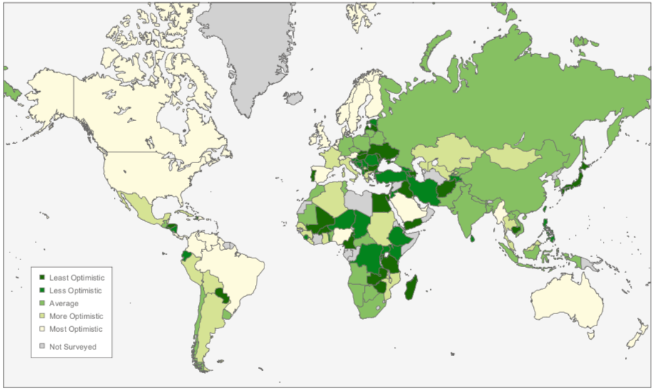
OPTIMISM AROUND THE WORLD
Reproduced with permission from Figure 1, p. 436 in Gallagher, M. W., Lopez, S. J., & Pressman, S. D. (2013). Optimism is universal: Exploring the presence and benefits of optimism in a representative sample of the world. Journal of Personality, 81(5), 429-440. https://doi.org/10.1111/jopy.12026 Copyright © 2013 Wiley.

Slide 45
RESEARCH FINDINGS ON DISPOSITIONAL OPTIMISM
  Genetic and environmental determinants. Optimism is moderately heritable, and parental socio-economic status is an important environmental factor contributing to the development of optimism
  Neurobiological factors. In right-handed people, the the left hemisphere subserves optimism (and positive affectivity), while the right hemisphere subserves negative affectivity, and vigilance for threats to well-being
  Culture. The average level of optimism is higher in societies that place greater value on individualism and egalitarianism
  Personality. Optimistic people tend to be hopeful, extraverted and emotionally stable, have high self-esteem, high generalised self-efficacy, and are resilient in the face of adversity
  Coping. Dispositional optimism is positively associated with problem-focused coping & negatively associated with avoidant coping

Slide 46
RESEARCH FINDINGS ON DISPOSITIONAL OPTIMISM
  Wellbeing and mental health. There is a high correlation between dispositional optimism and both wellbeing and mental health
  Physical health. Optimists have better physical health, fewer health problems, less illness-related pain, better adjustment to chronic illness, and better recovery from illness
  Close relationships. Optimism is correlated with relationship satisfaction, and this association is mediated by social support and problem-solving
  Work. Optimism is associated with greater work-related creativity, job satisfaction, and wellbeing at work
  Athletic performance. Optimism is associated with better athletic performance and sports-satisfaction
  Positive psychological interventions (PPIs). PPIs leads to short-term increases in optimism

Slide 47
OPTIMISTIC EXPLANTORY STYLE

Slide 48
OPTIMISTIC EXPLANATORY STYLE
Optimistic explanatory style is the tendency to give optimistic explanations for specific situations in terms of 3 dimensions
  Personalization or Internality ranging from due to something about the self (internal) or to circumstances (external)
  Permanence or Stability ranging from due to some cause that will be present in the future (stable) or not (unstable)
  Pervasiveness or Globality ranging from due to some cause that will influence many areas of life (global) or just one (specific)
Optimists attribute success to internal, stable, global factors, e.g. I did well on the exam because I am intelligent
Optimists attribute failure to external, unstable, specific factors, e.g., I did not do well on the exam because I had the flu

Slide 49
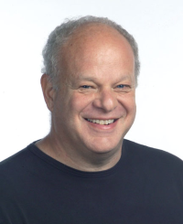
MEASUREMENT OF OPTIMISTIC EXPLANATORY STYLE
Optimistic explanatory style was conceptualized by Martin Seligman in his early studies of depression before the launch of contemporary positive psychology
Optimistic explanatory is assessed with the CAVE and the ASQ.
CAVE - Content Analysis of Verbal Explanations. A method for rating explanations for success and failure given in speeches, newspaper articles, and other texts
ASQ - Attributional Style Questionnaire (ASQ). A self-report questionnaire
  On the ASQ respondents are given a series of hypothetical events which have positive and negative outcomes. For example, your partner has been treating you more lovingly
  They are asked to indicate what they think would be the one major cause of each of these events
  They then are invited to rate these causes for internality, stability, and globality
  Ratings are combined to give indices of optimism and pessimism
Martin
Seligman

Slide 50
MEASUREMENT OF OPTIMISTIC EXPLANATORY STYLE
 | Pessimistic explanatory style example | Optimistic explanatory style example
Imagine this situation happened to you | Your partner has been treating you more lovingly | Your partner has been treating you more lovingly
Write down one major cause of the situation | Because they pity me, with all the bad luck I’ve had recently | Because they really like me for who I am
Rate the extent to which the cause is due to something about you (internal) or circumstances (external) External 1 2 3 4 5 6 7 Internal | 1 External Due to circumstances | 7 Internal Due to me
Rate the extent to which in the future the cause will be present again (stable) or not (unstable) Unstable 1 2 3 4 5 6 7 Stable | 1 Unstable Will not be present again | 7 Stable Will be present again
Rate the extent to which the cause is something that influences just this area of your life (specific) or many areas (global) Specific 1 2 3 4 5 6 7 Global | 1 Specific Influences just this area of my life | 7 Global Influences many areas of my life
Note: Based on Peterson, C., Semmel, A., von Baeyer, C., Abramson, L.T., Metalsky, G.I., and Seligman, M.E.P. (1982). The Attributional Style Questionnaire. Cognitive Therapy and Research, 6, 287-300. doi:http://dx.doi.org/10.1007/BF01173577

Slide 51
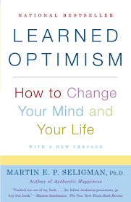
LEARNED OPTIMISM
Seligman’s early research on depression led to
Learned helplessness theory. Proposed that depression developed when people encountered uncontrollable stresses, and attributed the causes of this and subsequent failures to control these to internal, stable, global factors
Learned optimism theory. Proposed that depression could be prevented and well-being enhanced if people learned to attribute failures to external, transient, specific factors, and successes to to internal, stable, global factors
Penn Resilience Programme (PRP). This programme was designed to help children develop learned optimism. This was a forerunner of Seligman launching contemporary positive psychology interventions

Slide 52
RESEARCH FINDINGS ON OPTIMISTIC EXPLANATORY STYLE
  Universal optimistic bias. Most people have an optimistic bias, and attribute negative failures to external, transient, specific factors, while attributing successes to internal, stable, global factors. Depressed people, in contrast, have a pessimistic bias.
  Genetic and environmental determinants. Optimistic explanatory style is moderately heritable, and develops in children whose parents role model and reinforce using an optimistic explanatory style
  Well-being & health. Individuals with an optimistic explanatory style are less likely to develop physical health problems, depression or suicidality when they face major stressful life events than individuals with a pessimistic explanatory style, and to show greater wellbeing and post-traumatic growth
  Coping. An optimistic explanatory style is positively associated with problem-focused coping & negatively associated with avoidant coping

Slide 53
RESEARCH FINDINGS ON OPTIMISTIC EXPLANATORY STYLE
  Close relationships. An optimistic explanatory style is associated with high rates of positive interactions and long-term marital relationship satisfaction
  School, Work & Sports. There are inconsistent research findings on the relationship between optimistic explanatory style and performance in school, work and sports contexts. Some but not all studies found a correlation between optimistic explanatory style and performance
  Success in public life. Studies using the CAVE show that an optimistic explanatory style is associated with electoral success in the USA, resilience to stress among international leaders, and military aggression and risk taking in the gulf war and the second world war
  Preventing depression with the Penn Resilience Programme (PRP). There are inconsistent research findings on the effectiveness of the PRP in preventing depression in children. PRP has been effective in some but not all studies and meta-analyses of multiple studies. PRP aims to prevent depression by teaching children how to attribute failures to external, transient, specific factors, while attributing successes to internal, stable, global factors

Slide 54
PENN RESILIENCE PROGRAMME
Designed by Martin Seligman’s team to help school-age children develop optimistic rather than pessimistic explanatory attributional styles and so prevent depression
It is a 12-week programme containing skills training on
  Optimistic thinking (attributional retraining)
  Negotiation
  Conflict management
  Assertiveness
  Problem-solving
  Decision-making
  Relaxation

Slide 55
LEARNED OPTIMISM
A key element of the Penn resilience programme for helping children learn optimism involved learning the ABCDE attributional retraining strategy for coping with dips in mood
A stands for the Adversity or Antecedent event that you found difficult. e.g., Someone you know doesn’t say hello when you pass them on the other side of the street
B stands to your Beliefs about the situation. This is your interpretation or explanation of the situation or the story you told yourself about it. e.g. they don’t like me
C stands for the Consequences for your mood (on a 10-point scale), bodily sensations, and behaviour. e.g., your mood drops from a 7 to a 3, you feel down and want to withdraw
D stands for Distraction, Distancing or Disputation. These strategies are described below. They will help you to move towards an optimistic thinking style and away from a pessimistic thinking style
E stands for Energisation or the extent to which using distraction, distancing or disputation increased your mood
Note: Based on Seligman, M.E.P. (2006). Learned optimism (Vintage edition). New York: Random House

Slide 56
LEARNED OPTIMISM
In the ABCDE analysis of situations where there is a drop in mood, D stands for Distraction, Distancing or Disputation. These are three strategies for challenging pessimism
Distraction
Saying STOP and hitting the table
Snapping yourself on the wrist with an elastic band
Looking at a flashcard with STOP written on it
Writing down your pessimistic ruminations immediately
Postponing pessimistic rumination until a specific time later in the day
Distancing
Telling yourself that a pessimistic interpretation of the situation is just one set of beliefs, and not the true facts
Acknowledging that there are always other more optimistic explanations, and some of these may be equally valid

Slide 57
LEARNED OPTIMISM
In the ABCDE analysis of situations where there is a drop in mood, D also stands for Disputation – the final strategy for for challenging pessimism
You may dispute your pessimistic beliefs by examining the evidence, alternatives, implications, and usefulness related to these beliefs
Evidence. What is the evidence for the pessimistic beliefs about the situation, and does this evidence show that these beliefs are not 100% true? e.g., what is the evidence that a person who did not say help does not like me?
Alternatives. Is there an alternative optimistic interpretation of the situation, where I can attribute this negative event to external, transient, specific factors, rather than internal global, stable factors? e.g., perhaps they did not see or hear me
Implications. If you cannot justify an optimistic interpretation of the situation, are the implications of your pessimistic beliefs catastrophic with major long-term negative consequences or just a bit of a temporary nuisance? e.g., If they don’t like me is that a disaster or a nuisance?
Usefulness. If you cannot decide whether there is more evidence for an optimistic or pessimistic interpretation of the adversity, decide which set of beliefs is most useful for you in terms of improving your mood and achieving your valued goals?

Slide 58

LEARNED OPTIMISM
In the ABCDE analysis of situations where there is a drop in mood, E stands for Energisation or the extent to which using distraction, distancing or disputation increased your mood
In the example where a friend passed on the other side of the road and didn’t say hello, the initial mood drop was form 7 to 3
Following disputation, it increased from 3 to 6

Slide 59
PAUSE & PRACTICE
ABCDE STRATEGY FOR DEVELOPING OPTIMISM
To increase your use of an optimistic thinking style, for the next week, each day do an ABCDE analysis of at least one adverse situation that you found stressful or difficult, and use this strategy to increase your well-being
When you do an ABCDE analysis, here is what A, B, C, D and E stand for A stands for the Adversity or Antecedent event that you found difficult B stands to your Beliefs about the situation. This is your interpretation or explanation of the situation or the story you told yourself about it. C stands for the Consequences for your mood (on a 10-point scale), bodily sensations, and behaviour D stands for Distraction, Distancing or Disputation. These strategies will help you to move towards an optimistic thinking style and away from a pessimistic thinking style. E stands for Energisation or the extent to which using distraction, distancing or disputation increased your mood.

Slide 60
CONTROVERSIES ABOUT OPTIMISM & GRATITUDE

Slide 61
CONTROVERSIES ABOUT OPTIMISM & GRATITUDE
GRATITUDE & ABUSE - OPTIMISM AND RISK
Some critics of positive psychology attribute to the positive psychology movement the naïve view that the use of strengths, including gratitude and optimism, is always a good thing, and then point out the flaw in this approach
Expressing gratitude to a bully or abuser may reinforce bullying and abuse
Being optimistic in high-risk situations like gambling or speeding while driving may have harmful consequences.
In chapter 2 it was noted that a central tenet of positive psychology of strengths is that for all personal strengths, both underuse and overuse may have negative consequences
There is a golden mean to be achieved in the optimal use of strengths such as gratitude, hope and optimism. Achieving this balance is partly context dependent

Slide 62
CONTROVERSIES ABOUT GRATITUDE
GRATITUDE & APPRECIATION
Among gratitude researchers, some have argued that appreciation and gratitude are a single construct, and others have proposed that they are separate constructs
Alex Wood found a single factor solution to a factor analysis of three self-report scales that assessed gratitude and appreciation and proposed that this supported the idea that gratitude and appreciation were a single trait
Mitchel Adler and Nancy Fagley proposed that appreciation was a broad construct within which the narrower construct of gratitude was nested
Philip Watkins proposed that appreciation of the simple things in life was one of 3 aspects of gratitude. The other two were being grateful for benefits from others and being grateful for not being deprived of the good things in life
This controversy over the links between appreciation and gratitude remains unresolved

