Slide 1
CHAPTER 4. SAVOURING, FLOW & MINDFULNESS

Slide 2
LEARNING OBJECTIVES
Understand how savouring, flow, and mindfulness are conceptualized within positive psychology
Understand the main theories of savouring, flow, and mindfulness
Know how to assess savouring, flow, and mindfulness
Identify the main research findings linking savouring, flow, and mindfulness to wellbeing and health
Be able to engage in exercises designed to enhance savouring, flow, and mindfulness

Slide 3
SAVOURING, FLOW & MINDFULNESS

Slide 4
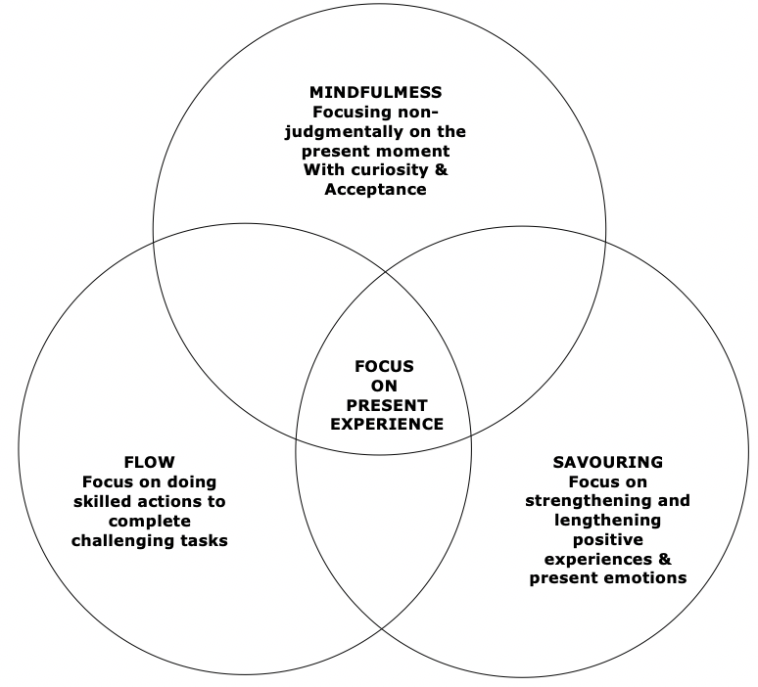
SAVOURING, FLOW, & MINDULNESS
Savouring, flow, and mindfulness meditation are related, yet distinct processes that enhance wellbeing
Savouring. We actively focus on lengthening and strengthening positive experiences and present emotions, e.g., listening to a favourite piece of music. We may attempt to block negative emotions and distractions
Mindfulness. We focus attention on a specific stimulus in the present moment, for example, the breath, and observe other sensations, thoughts, and feelings as they arise and dissolve in awareness. We are non-judgmental and don’t try to strengthen & prolong positive sensations or block out negative emotions
Flow. The focus is on carrying out a skilled activity to the limits of our ability, for example, playing a computer game or musical instrument. During flow, we lose awareness of the self and the emotions that we are experiencing as we become absorbed in skilful activity, and experience a strong sense of control over our actions

Slide 5
SAVOURING, FLOW, & MINDFULNESS
Present focus. In savouring, flow, and mindfulness, attention is intentionally focused on a specific aspect of present experience:
Pleasant sensations in savouring
The breath or some other stimulus in mindfulness meditation
Skilled activity in flow
The 3 are correlated. Mindfulness is moderately correlated with both savouring and aspects of flow, notably the sense of control over skilled actions

Slide 6
SAVOURING, FLOW, & MINDULNESS
Positive effects. Savouring, flow, and mindfulness have a range of positive effects on
Well-being
Mental health and adjustment to physical illness
Relationships
Performance in work, education, & sports
Mindfulness has the largest evidence-base, especially its positive effects on physical and mental health, e.g. preventing relapse in chronic depression
PERMA Theory. Research on savouring and flow supports two predictions of PERMA theory (mentioned in chapter 1)
Savouring increases positive emotions
Flow increases engagement in skilled activities at work, sports, or leisure activities

Slide 7
SAVOURING

Slide 8

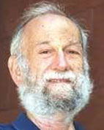
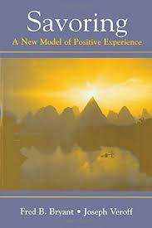
SAVOURING
Fred Bryant and Joseph Veroff initiated contemporary research on savouring
Savouring is the process of paying attention to, appreciating, and enhancing positive experiences
When you stop and smell the roses instead of walking past without noticing them, you are savouring.
There are parallels between coping and savouring
Coping refers to strategies that reduce the extent to which adverse events lead to negative emotions
Savouring refers to strategies that increase the extent to which good events lead to positive emotions
Savouring strategies from Bryant and Veroff’s Ways of Savouring Scale are on the next slide
Fred Bryant
Joseph Veroff

Slide 9
SAVOURING STRATEGIES
Sharing | Including others in, or telling them about positive experiences
Memory building | Actively creating memories of positive experiences by, for example, taking mental photographs
Self-congratulation | Acknowledging or celebrating personal successes
Comparing | Comparing positive experiences to less favourable situations
Sensory-Perceptual sharpening | Focusing attention on specific stimuli to heighten positive experiences
Absorption | Complete immersion in positive experiences
Behavioural expression | Expressing positive feelings by, for example, laughing, hugging, clapping, screaming, or jumping up and down
Temporal awareness | Being aware of the transience of positive experiences
Counting blessings | Appreciating good fortune
Avoiding kill-joy thinking | Not worrying, feeling guilty, or thinking negative thoughts such as ways positive experiences could have been better

Slide 10
FOUR PRIMARY SAVOURING PROCESSES AND
RELATED POSITIVE FEELINGS
Type of mentation | Attentional Focus ______________________________________________ External world Internal world
Cognitive reflection | Thanksgiving (Gratitude) | Basking (Pride)
Experiential absorption | Marvelling (Awe) | Luxuriating (Physical pleasure)

Slide 11
PAUSE & PRACTICE - SAVOURING
Measurement of Savouring - Perceived ability to savour positive outcomes scale (PASPO) This questionnaire assesses your capacity to savour positive emotions in the present moment. For each item, circle the answer that applies to you. Sum item scores to get a total. Scores range from 5 to 25, with high scores indicating a greater capacity to savour positive emotions in the present moment.
1. | When good things have happened in your life, how much do you feel you have typically been able to appreciate or enjoy them? | Not at all 1 | A little bit 2 | Some 3 | A lot 4 | A great deal 5
2. | Compared to most other people you know, how much pleasure have you typically gotten from good things that have happened to you? | Not at all 1 | A little bit 2 | Some 3 | A lot 4 | A great deal 5
3. | When something good happens to you, compared to most other people you know, how long does it usually affect the way you feel? | Not for very long 1 | For a little bit 2 | Some 3 | For a long time 4 | For a very long time 5
4. | When good things have happened to you have there ever been times when you felt like everything was really going your way; that is, when you felt on top of the world, or a great deal of joy in life, or found it hard to contain your positive feelings? How often would you say you felt like that? | Never 1 | Rarely 2 | Once in a while 3 | Some-times 4 | Often 5
5. | How often would you say you feel like jumping or shouting for joy? | Never 1 | Rarely 2 | Once in a while 3 | Some-times 4 | Often 5
Reproduced with permission of Blackwell from Table 1, Items used to measure beliefs about avoiding, coping, obtaining, and savouring, p.782 in Bryant, F. B. (1989). A four-factor model of perceived control: Avoiding, coping, obtaining, and savouring. Journal of Personality, 57(4), 773-797. https://doi.org/10.1111/j.1467-6494.1989.tb00494.x, Copyright © 1989 Blackwell. Permission conveyed through Copyright Clearance Center, Inc.

Slide 12
SAVOURING THEORY
Conditions essential for savouring
Freedom from social and esteem needs
A sense of being in the here and now
Focusing attention mindfully on positive experiences
Situations that intensify savouring
Novel situations
Situations that require effort
Rare or bitter sweet situations (e.g. first or last time doing something)
Savouring leads to more intense positive feelings when
Attention is focused on pleasurable sensations
The experience is lengthened
The experience is complex
The experience leads to greater stress reduction
Processes that intensify both savouring positive events and coping with negative events
Sharing feelings with supportive others
Creating a meaningful narratives by writing or talking about significant events
Acknowledging the fleetingness of life experiences
Appreciating how fortunate it is that unlikely positive events actually occurred
Taking a humorous perspective
Taking a spiritual or religious perspective
Personality traits that enhance savouring
High self-esteem
Trait mindfulness
Sensation seeking
Achievement motivation
Tolerance for ambiguity
A present-focused time orientation
A low level of impatience

Slide 13
SAVOURING RESEARCH FINDINGS
Demographic & social factors associated with savouring
Women savour more than men and use three specific savouring strategies more
Sharing with others
Behavioural expression of positive feelings
Counting blessings
Western culture. People in western culture have stronger beliefs about the value of savouring and so engage in it more often
Social support. People with supportive confiding relationships are savour more, and experience greater wellbeing
Having managed adversity. A history of successfully managing adverse stressful life events
Modest resources. Not having an abundance of positive resources
Impatience. Not being prompted to be impatient

Slide 14
SAVOURING RESEARCH FINDINGS
Personality traits associated with savouring
Greater savouring ability is associated with high levels
Self-esteem
Wisdom
Mindfulness
Extraversion
Optimism
Secure adult attachment style
Harmonious passion
Greater savouring is also associated with low levels of
Neuroticism
Guilt
Hopelessness
Negative schizotypy (which includes introversion and a limited ability to derive pleasure from social and physical stimulation)
Insecure adult attachment style
Obsessive passion

Slide 15
SAVOURING RESEARCH FINDINGS
Wellbeing, health, relationships & work
Wellbeing. Savouring positive experiences has a significant effect on wellbeing, especially positive emotions
Mental Health. Savouring is is associated with better mental health and fewer anxiety and depressive symptoms in vulnerable groups with
Non-optimal early family experiences
Older adults
Members of gender and sexual minorities
Cancer patients
War veterans
Patients with schizophrenia spectrum disorders
Relationship satisfaction. Savouring is associated with better quality couple relationships
Work engagement & Performance. Savouring enhances work engagement and performance

Slide 16
SAVOURING INTERVENTIONS RESEARCH FINDINGS
In a meta-analysis of 16 studies involving over 1,700 participants, Jennifer Smith found that savouring interventions had a small but significant effect on positive emotions
Longer interventions had a greater effect than shorter interventions
Past, present, and future oriented interventions had similar effects
Past oriented savouring interventions
Thinking about one’s deepest thoughts and feelings concerning a specific positive event
Using imagery and memorabilia to support reminiscence about positive events
Vividly recalling and writing about three positive daily events
Basking in achievement arising from personal efforts
Reflecting on personal acts of kindness
Present-focused savouring interventions
Taking a 20 minute walk each day and noticing as many positive things as possible
Focusing on two pleasurable experiences each day for two to three minutes and making them last as long as possible
Increasing the use of savouring strategies such as sharing positive experiences, taking mental photographs, and counting blessings
Spending 15 minutes twice a week taking mindful photographs of friends or scenes, making the photographs as beautiful and pleasing as possible
Future oriented savouring exercises
Vividly imagining four positive events that might reasonably be expected to happen tomorrow
Focusing on scarcity, by thinking about how few opportunities remain to engage in a particular positive experience

Slide 17
PAUSE & PRACTICE - SAVOURING
Prepare
Today, take a brief vacation for about 20 minutes
Have your vacation where you will not be interrupted or distracted
Set aside your worries, concerns, and responsibilities for the duration of your vacation
Do something that you find intrinsically enjoyable like going for a walk, reading a novel, taking a bath, listening to music, eating a favourite fruit, or looking at a painting
Use many savouring strategies to strengthen and lengthen positive feelings
Experience things as if for the first time
Notice and savour each sensation or action that you find pleasurable
Take mental photographs so that you construct vivid positive memories
Label each positive feeling that you experience, so it will be easy to recall
Outwardly express your positive emotions in some way that feels right to you
Assess effects of savouring on positive emotions.
Later today before sleeping, reminisce about your daily vacation, recalling and reliving the positive feelings you savoured
If you wish, write a brief account of your daily vacation
Before and after your vacation, rate the strength of your positive emotions on a scale from 1 to 10, noticing the extent to which it increased your positive emotions
Note: This exercise is based on the daily vacation exercise on page 211 in Bryant, F. B., & Veroff, J. (2007). Savouring: A new model of positive experience. Mahwah, NJ: Lawrence Erlbaum.

Slide 18
FLOW

Slide 19
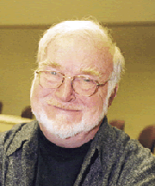
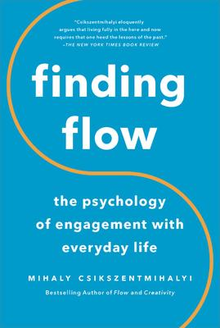

FLOW
Mihaly Csikszentmihalyi initiated contemporary research on flow
Flow. When we become absorbed in challenging skilled tasks that are intrinsically motivating we experience flow
Flow activities. Flow may occur when absorbed in work and education; sports, running, and challenging physical activities; music and art; and computer based activities including video games
Flow & enjoyment. During flow there is a profound sense of enjoyment in doing skilled activities that we find intrinsically rewarding
Flow & identify. After flow experiences we may experience a strengthened sense of identity
Flow has 9 dimensions shown in the next slide
Mihaly Csikszentmihalyi

Slide 20
9 FLOW DIMENSIONS
Antecedents | 1-Challenge-skill balance | The challenges posed by the task are at the limits of available skills
 | 2-Clear goals | Tasks are carried out to achieve well defined goals, using well-developed automatic skills
 | 3-Immediate feedback | Immediate feedback is available to indicate progress towards goals
Momentary experiences | 4-Focused concentration | Tasks require total concentration
 | 5-Absorption & automaticity | We become so absorbed that we don’t see ourselves as separate from our actions, & experience our actions as automatic
 | 6-Sense of control | There is a heightened sense of control over our actions
Consequences | 7-Loss of self-consciousness | During flow self-awareness disappears; the sense of identity is strengthened after the task is completed
 | 8-Distorted time perception | Time appears to speed up or slow down
 | 9-Autotelic experience | Activities that lead to flow are intrinsically rewarding or autotelic; autotelic comes from the Greek words for self (auto) and goal (telos)

Slide 21
PAUSE & PRACTICE – FLOW
Assessment – Flow Short Scale
After you have completed an activity you can assess the intensity of your flow experience with this scale. Rate each item on a scale of 1 to 7 where 1 means not at all 4 means partly, and 7 means very much. Sum the 10 item scores to give an overall score between 10 and 70. Higher overall scores indicate that you experienced a higher level of flow.
1. | I feel just the right amount of challenge | 1 | 2 | 3 | 4 | 5 | 6 | 7
2. | My thoughts/activities run fluidly and smoothly | 1 | 2 | 3 | 4 | 5 | 6 | 7
3. | I don’t notice time passing | 1 | 2 | 3 | 4 | 5 | 6 | 7
4. | I have no difficulty concentrating | 1 | 2 | 3 | 4 | 5 | 6 | 7
5. | My mind is completely clear | 1 | 2 | 3 | 4 | 5 | 6 | 7
6. | I am totally absorbed in what I am doing | 1 | 2 | 3 | 4 | 5 | 6 | 7
7. | The right thoughts or movements occur of their own accord | 1 | 2 | 3 | 4 | 5 | 6 | 7
8. | I know what I have to do each step of the way | 1 | 2 | 3 | 4 | 5 | 6 | 7
9. | I feel that I have everything under control | 1 | 2 | 3 | 4 | 5 | 6 | 7
10. | I am completely lost in thought | 1 | 2 | 3 | 4 | 5 | 6 | 7
Note: From Engeser, S., & Rheinberg, F. (2008). Flow, performance and moderators of challenge-skill balance. Motivation and Emotion, 32(3), 158-172. https://doi.org/10.1007/s11031-008-9102-4, appendix, p. 170,

Slide 22
FLOW
HIGH CHALLENGE & HIGH SKILL USE
Flow occurs when we do highly challenging tasks that require a high level of skill
Note: Based on a diagram on p. 31 in Csikszentmihalyi, M. (1997). Finding flow: The psychology of engagement with everyday life. New York: Basic Books.

Slide 23
AUTOTELIC PERSONALITY
Csikszentmihalyi proposed that people with an autotelic personality had 7 traits that facilitate the more frequent and intense experience of flow
Curiosity
Persistence
Low self-centeredness
Intrinsic motivation
High capacity for concentration and attentional control
Enjoyment of challenges and transformation of threats into challenges
Transformation of boredom and tedium into stimulating experiences
Research shows that people with an autotelic personality have more intense and frequent flow experiences which leads to greater wellbeing

Slide 24
FLOW - RESARCH FINDINGS
Experience sampling research has shown that flow occurs more often in engaging activities
Note: Based on data on p. 37 of Csikszentmihalyi, M. (1997). Finding flow: The psychology of engagement with everyday life. New York: Basic Books.

Slide 25
FLOW - RESARCH FINDINGS
Genetic factors. Flow-proneness is moderately heritable
Neurobiology. Rene ́ Weber found that flow experiences are associated with the synchronization of attentional and reward neural networks
Autotelic personality. People with an autotelic personality and frequent flow experiences have higher levels of
Extraversion
Emotional stability (or low neuroticism)
Conscientiousness
Mindfulness
Mental toughness
Wellbeing. Flow correlates with subjective wellbeing satisfaction with life, and positive affectivity
Mental health. Autotelic personality and flow experiences are protective factors for people vulnerable to depression, suicide risk and & burnout. Interventions that foster flow experience (e.g. walking, gardening, cooking) may contribute to the wellbeing of individuals with mental health difficulties

Slide 26
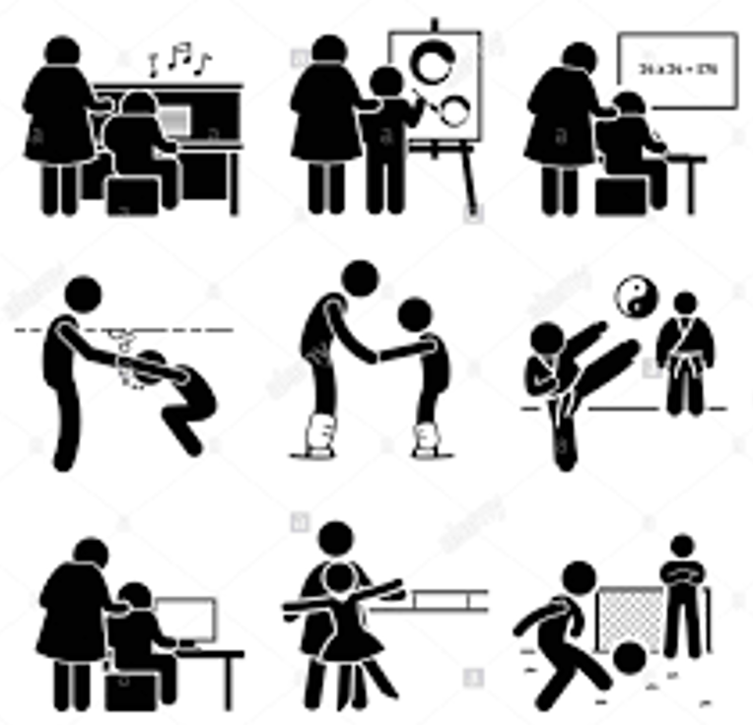

FLOW, ACTIVITIES & SPORT- RESEARCH FINDINGS
Activities. Many activities induce flow
Sports and athletics
Skilled work
Skilled recreational activities
Education and scholarship
Sport. Flow enhances performance in
Running
Rock climbing
Basketball
Netball
Soccer
Tennis
Cycling
Reading and writing fiction
Appreciating and creating art and music
Computer-based activities
Skateboarding
Figure skating
Swimming
Chess
Horse racing
Golf

Slide 27


FLOW & WORK - RESARCH FINDINGS
Flow occurs in jobs where workers
Have a sense of control
Use well-developed skills to do challenging tasks
Receive feedback on clear goals
Experience organizational support
Flow at work is characterized by
Absorption in work activities
Enjoyment
Intrinsic motivation
Flow at work leads to
Job satisfaction
Work engagement
Service quality
Teamwork
Creativity

Slide 28

FLOW & EDUCATION - RESARCH FINDINGS
Schools that facilitate flow
Make learning enjoyable
Match educational challenges with pupils’ skills levels
Create a positive, collaborative teaching and learning environment
Provide pupils with with ‘scaffolding’ during skill acquisition
Encourage active involvement in learning activities
Promote the development of intrinsic motivation to learn new knowledge and skills
Show that things learned in school are relevant life outside school

Slide 29


FLOW & IT- RESEARCH FINDINGS
Flow experiences may occur when using IT for
Learning
Creating
Marketing & consuming products, services, art, and music
Creating and playing computer games
Reading, writing, & corresponding by email
Searching for information
Flow experiences that occur within IT environments are facilitated by
The match between IT skills and challenges in IT environments
The vividness, speed, interactivity, importance and attractiveness of IT environments
Telepresence (the extent to which we feel present in IT environments)
IT-related flow can contribute to internet addiction, especially in anxious people with low self-esteem

Slide 30

FLOW & GROUPS - RESARCH FINDINGS
Group flow may occur in sports teams, musical bands, or work groups etc. where individuals collaborate in skilled activities to achieve a challenging shared goal
Interactional synchrony (shared state of mind) occurs in group flow
Mutual responsiveness (group members responding fluently to each other to achieve a goal) occurs in group flow
Antecedents of group flow
Positive, trusting, supportive relationships
Collaboration
Good communication
Collective competence
Knowledge of group members’ skills
Outcomes of group flow
Exceptional collective performance
Synergy
Creativity
Enhanced group-efficacy
Fusion of personal identity with the group
Positive collective experience.

Slide 31
FLOW & FAMILIES - RESARCH FINDINGS
Kevin Rathunde found that families characterised by optimal levels of clarity, centring, choice, commitment and challenge reported more frequent flow experiences.
Clarity. Goals and feedback were unambiguous and children knew clearly what was expected of them
Centring. Children knew that their parents were interested in what they were doing and experiencing now in the present, and were not preoccupied with whether they would get a good job or a place in a good college after they finished school
Choice. Children believed that they had a degree of choice over how they behaved and that different choices, including breaking parental rules, were associated with different consequences
Commitment. Children felt that the family was sufficiently safe for them to unselfconsciously become involved in activities and sports that really interested them without fear of being judged negatively, criticised or humiliated
Challenge. Parents provided children with increasingly complex opportunities for exercising their skills as they became older and more skilful

Slide 32
PAUSE & PRACTICE - FLOW
There are two parts to this exercise.
In the first do a task that normally leads to flow
In the second do a task that does not normally lead to flow, but change the way you do it to increase the chances of experiencing flow
Before and after each task rate the intensity of your flow experience using the flow short scale (on the next slide). And compare these ratings to find out how intense your flow experience has been
Tasks that normally lead to flow
Engage in an activity that you know is normally absorbing
Before and afterwards complete the short flow scale and compare these scores to find out how intense your flow experience has been
Tasks that normally do not lead to flow
Engage in a task that you know is not normally absorbing, and change the way you do it to make it more absorbing
Do tedious tasks more quickly and try to make them more challenging
Do complex tasks more slowly, and if they are exceptionally complex consider breaking them down into manageable subtasks
Set difficult goals and monitor movement towards goals as you are doing your tasks
Before and afterwards complete the short flow scale and compare these scores to find out how intense your flow experience has been

Slide 33
FLOW SHORT SCALE
After you have completed an activity you can assess the intensity of your flow experience with this scale. Rate each item on a scale of 1 to 7 where 1 means not at all 4 means partly, and 7 means very much. Sum the 10 item scores to give an overall score between 10 and 70. Higher overall scores indicate that you experienced a higher level of flow.
1. | I feel just the right amount of challenge | 1 | 2 | 3 | 4 | 5 | 6 | 7
2. | My thoughts/activities run fluidly and smoothly | 1 | 2 | 3 | 4 | 5 | 6 | 7
3. | I don’t notice time passing | 1 | 2 | 3 | 4 | 5 | 6 | 7
4. | I have no difficulty concentrating | 1 | 2 | 3 | 4 | 5 | 6 | 7
5. | My mind is completely clear | 1 | 2 | 3 | 4 | 5 | 6 | 7
6. | I am totally absorbed in what I am doing | 1 | 2 | 3 | 4 | 5 | 6 | 7
7. | The right thoughts or movements occur of their own accord | 1 | 2 | 3 | 4 | 5 | 6 | 7
8. | I know what I have to do each step of the way | 1 | 2 | 3 | 4 | 5 | 6 | 7
9. | I feel that I have everything under control | 1 | 2 | 3 | 4 | 5 | 6 | 7
10. | I am completely lost in thought | 1 | 2 | 3 | 4 | 5 | 6 | 7
From Engeser, S., & Rheinberg, F. (2008). Flow, performance and moderators of challenge-skill balance. Motivation and Emotion, 32(3), 158-172. https://doi.org/10.1007/s11031-008-9102-4, appendix, p. 170,

Slide 34
MINDULNESS

Slide 35
MIND-WANDERING & MINDFULNESS
Mindfulness meditation is a way of training the mind to deal more effectively with mind-wandering, and negative mood states that come from the way we react to normal mood fluctuations that occur during mind-wandering
Mind-wandering is associated with a particular brain state called the default mode of brain function, which evolved to help our prehistoric ancestors scan the environment for big physical threats (like lions, bears, landslides, and floods)
In modern life mind-wandering and the default mode of brain function involves thinking about many minor social threats that lead to normal mood fluctuations
Normal mood fluctuations – being a little sad, angry or anxious – do not make us distressed. The way we react to normal mood fluctuations causes a downward spiral of distress, e.g.
Ruminating endlessly about small negative past events
Worrying about the future and anticipating the worst
Making harsh negative judgments about how we managed small past negative events and will handle future challenges
Trying to supress normal mood fluctuations
Mindfulness meditation allows us to become skilful at recognising that our recollections of, and ruminations about past episodes of distress, and our worries about the future are not objective facts. They are just subjective thoughts.

Slide 36

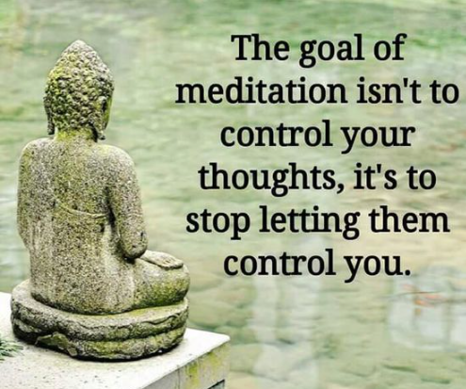
MINDFULNESS
Buddhism. Mindfulness meditation was imported into contemporary positive psychology from Buddhism
Mindfulness involves paying attention, on purpose, in the present moment, without judgment to our immediate sensory experience with an attitude of curiosity, openness, and acceptance
Thoughts are not facts. Thoughts and feelings are construed as transient subjective phenomena, not permanent facts about the world
Mind wandering. During mindfulness meditation, attention will inevitably wander to regrets, sadness, or anger about the past, or worries and anxieties about the future
Guiding attention. When this happens, we guide attention back to the breath or awareness of the body
Avoid embroilment. By doing this we avoid becoming embroiled in judging these thoughts or feelings, or trying to change them. We accept them for what they are: transient subjective phenomena

Slide 37
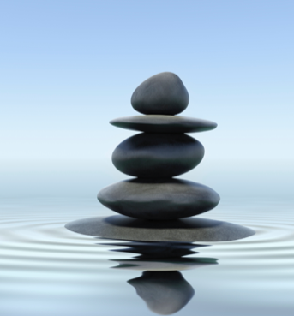
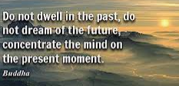
MINDFULNESS
Mindfulness is both a
State induced by meditation and a
Trait that refers to the disposition of living mindfully
You may assess your level of trait mindfulness by completing the Five Facet of Mindfulness Questionnaire (on the next slide) which assesses the capacity to
Observe the world as it is now
Describe these immediate experiences
Act with awareness by focusing on what is happening in the present moment
Be non-judgmental and refrain from making judgments about whether your immediate experience is good or bad, and
Be non-reactive to negative thoughts and feelings

Slide 38
PAUSE & PRACTICE – MINDFULNESS ASSESSMENT
You may complete this Five Facet of Mindfulness Questionnaire to assess trait mindfulness For each item circle the response that best applies to you in the past week To get your score on each facet, sum item scores and divide by the number of items in the facet To get your overall score sum item scores and divide by 24 Scores range from 1 to 5. Higher scores indicate greater mindfulness
Observing | Very rarely true |  |  |  | Very often true
I pay attention to physical experiences, such as the wind in my hair or sun on my face | 1 | 2 | 3 | 4 | 5
Generally, I pay attention to sounds, such as clocks ticking, birds chirping, or cars passing | 1 | 2 | 3 | 4 | 5
I notice the smells and aromas of things | 1 | 2 | 3 | 4 | 5
I notice visual elements in art or nature, such as colours, shapes, textures, or patterns of light and shadow | 1 | 2 | 3 | 4 | 5
Describing
I’m good at finding the words to describe my feelings | 1 | 2 | 3 | 4 | 5
I can easily put my beliefs, opinions, and expectations into words | 1 | 2 | 3 | 4 | 5
Even when I’m feeling terribly upset, I can find a way to put it into words | 1 | 2 | 3 | 4 | 5
It’s hard for me to find the words to describe what I’m thinking | 5 | 4 | 3 | 2 | 1
When I feel something in my body, it’s hard for me to find the right words to describe it | 5 | 4 | 3 | 2 | 1
Acting with awareness
I find it difficult to stay focused on what’s happening in the present moment | 5 | 4 | 3 | 2 | 1
It seems I am “running on automatic” without much awareness of what I’m doing | 5 | 4 | 3 | 2 | 1
I rush through activities without being really attentive to them | 5 | 4 | 3 | 2 | 1
I do jobs or tasks automatically without being aware of what I’m doing | 5 | 4 | 3 | 2 | 1
I find myself doing things without paying attention | 5 | 4 | 3 | 2 | 1
Non-judging of inner experience
I tell myself that I shouldn’t be feeling the way I’m feeling | 5 | 4 | 3 | 2 | 1
I make judgments about whether my thoughts are good or bad | 5 | 4 | 3 | 2 | 1
I tell myself I shouldn’t be thinking the way I’m thinking | 5 | 4 | 3 | 2 | 1
I think some of my emotions are bad or inappropriate and I shouldn’t feel them | 5 | 4 | 3 | 2 | 1
I disapprove of myself when I have illogical ideas | 5 | 4 | 3 | 2 | 1
Non-reactivity to inner experience
I watch my feelings without getting carried away by them | 1 | 2 | 3 | 4 | 5
When I have distressing thoughts or images, I don’t let myself be carried away by them | 1 | 2 | 3 | 4 | 5
When I have distressing thoughts or images, I feel calm soon after | 1 | 2 | 3 | 4 | 5
Usually when I have distressing thoughts or images I can just notice them without reacting | 1 | 2 | 3 | 4 | 5
When I have distressing thoughts or images, I just notice them and let them go | 1 | 2 | 3 | 4 | 5
Note: Adapted from Bohlmeijer, E., ten Klooster, P. M., Fledderus, M., Veehof, M., & Baer, R. (2011). Psychometric properties of the five facet mindfulness questionnaire in depressed adults and development of a short form. Assessment, 18(3), 308-320. http://dx.doi.org/10.1177/1073191111408231. You can complete a 39-item on-line version of the five facets of mindfulness questionnaire at http://awakemind.org/quiz.php

Slide 39
MINDFULNESS
In mindfulness meditation we accept that negative, positive, and neutral thoughts will enter the mind and distract attention away from a focus on immediate sensory experiences
Each time this happens we gently bring attention back to our immediate sensory experience
We acknowledge that the thoughts that distract us from our immediate sensory experience will stay briefly and then dissolve
We avoid becoming embroiled in trying to change them, judge them, or stop them
We suspend attempts to look to the past for guidance on how to solve problems in the present and plan for the future

Slide 40
PAUSE & PRACTICE – MINDFULNESS: 3 MINUTE BREATHING SPACE
Step 1. Become aware
Begin by adopting an erect and dignified posture, whether you are sitting or standing. If possible, close your eyes. Then, bringing your awareness to your inner experience, ask: What is my experience right now?
What thoughts are going through the mind? As best you can, acknowledging thoughts as ‘just thoughts’, not facts, perhaps putting them into words
What feelings are here? Turning toward any sense of emotional discomfort or unpleasant feelings, acknowledging their presence
What body sensations are here? Perhaps scanning the body to pick up any sensations of tightness or bracing
Step 2. Gathering
Then redirect your attention to focus on the physical sensations of the breath breathing itself
Move in close to the sense of the breath in the belly…feeling the sensations of the belly wall expanding as the breath comes in…and falling back as the breath goes out
Follow the breath all the way in and all the way out, using the breathing to anchor yourself into the present
Step 3. Expanding
Now expand the field of your awareness around your breathing, so that, in addition to the sensations of the breath, it includes a sense of the body as a whole, your posture, and facial expression
If you become aware of any sensations of discomfort, tension or resistance, zero in on them by breathing into them on each in-breath and breathing out of them on each out-breath, as you soften and open.
If you want you might say to yourself on the out-breath, “It’s okay, whatever it is, it’s already here: let me feel it.”
As best you can, bring this expanded awareness into the next moments of your day
Note: Reproduced with permission of the Licensor through PLSclear from p. 183-184 of Williams M., Teasdale, J., Segal, Z. & Kabat-Zinn, J. (2007). The mindful way through depression. New York, NY: Guilford. Copyright © 2007 Guilford

Slide 41
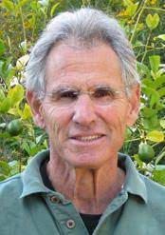
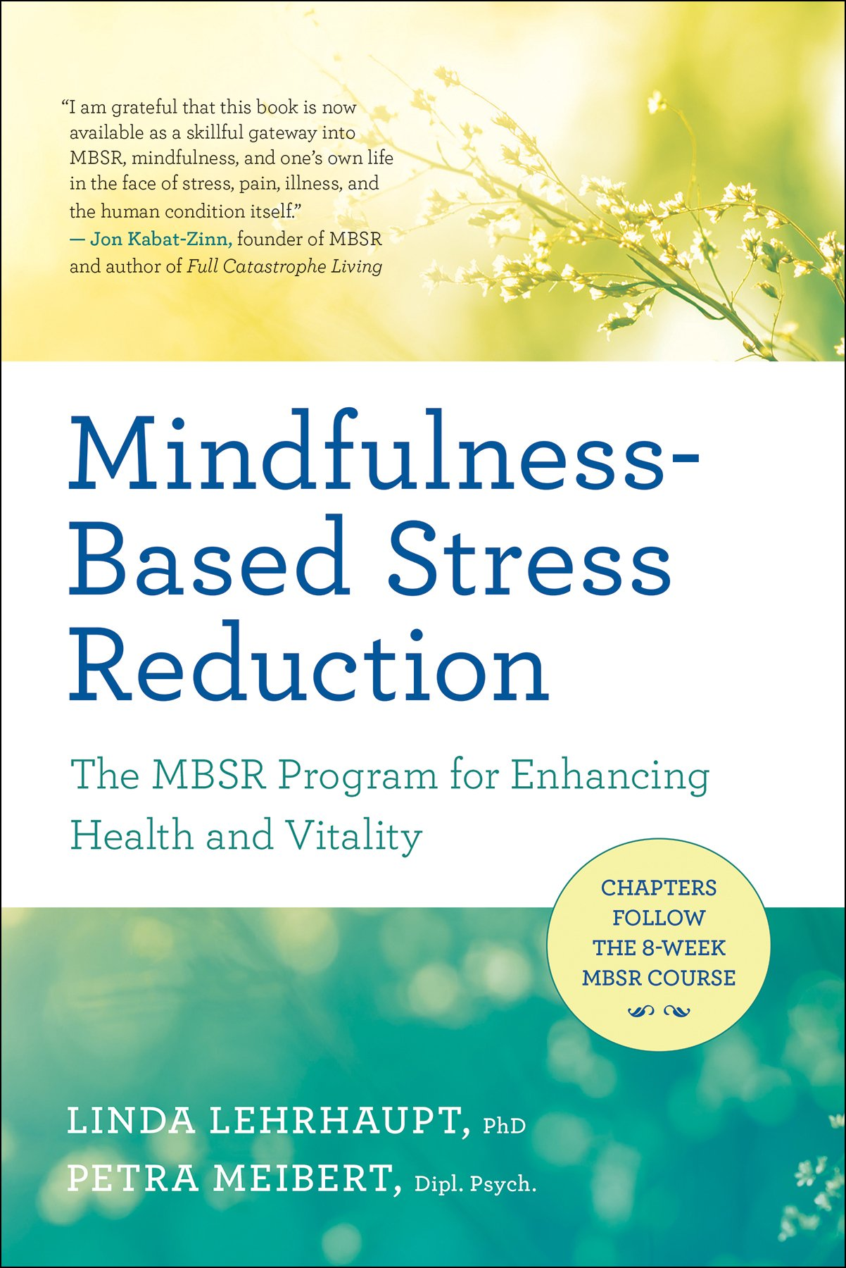
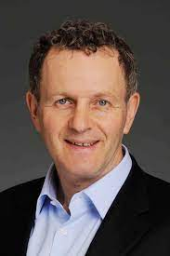

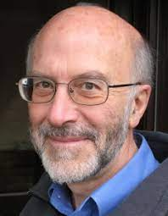
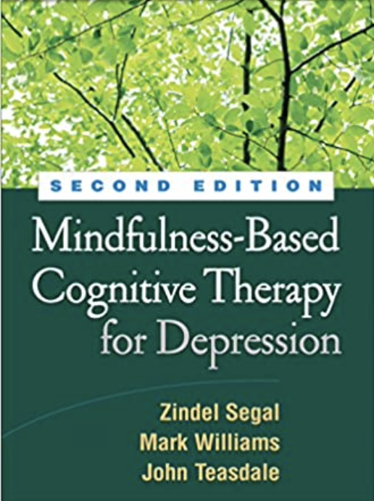
EVIDENCE BASED MINDFULNESS PROGRAMMES
Mindfulness Based Stress Reduction (MBSR) was developed by Jon Kabat Zinn for people with painful medical conditions, and to help healthy people manage stress
Mindfulness Based Cognitive Therapy (MBCT), an adaptation of MBSR, was developed by Zindel Segal, Mark Williams, & John Teasdale to help people with chronic depression delay or avoid relapsing
8 weekly group sessions. Both MBSR and MBCT are offered as group training or therapy programmes. They include eight weekly 2.5-3 hour sessions, a one day retreat, and regular daily homework of about 45 minutes between sessions, some of which are supported by audio recorded guidance.
Jon Kabat Zinn
Zindel Segal
Mark Williams
John Teasdale

Slide 42
MINDFULNESS RESEARCH FINDINGS
Healthy adults and children
Compared with no-intervention control groups, MBSR, MBCT, mindfulness meditation retreats, and briefer mindfulness interventions have positive effects on many indices of well-being and stress, at 3-6 months follow-up.
Effects range from small to large with longer programmes (MBSR & MBCT) having best effects
The effects on mindfulness and active interventions like relaxation training are similar
Work performance
Compared with no-intervention control groups, in businesses, schools, and healthcare services, mindfulness interventions promote job satisfaction, work performance, health and wellbeing at 4 months follow-up
Mindfulness has a greater positive effect on job satisfaction than performance
Mindfulness is no more effective than other stress management interventions, such as relaxation training and yoga
Sport
Mindfulness interventions enhance performance athletes, cyclists, dart throwers, hammer throwers, hockey players, hurdlers, judo fighters, rugby players, runners, shooters, and volleyball players
Compared with no-intervention control groups, mindfulness interventions have large positive effects on performance, mindfulness, flow, and competitive anxiety

Slide 43
MINDFULNESS RESEARCH FINDINGS
Mental health disorders
Mindfulness interventions (MBCT and MBSR) have positive effects on
Depression, Anxiety, & PTSD
Addiction, Eating disorders, & Psychosis
ADHD in children
Compared with no-intervention or treatment-as usual, they lead to small to medium reductions in symptoms of depression, anxiety and stress, and increases in quality of life at 6-12 months follow-up.
Mindfulness interventions have similar effects to other evidence-based interventions, e.g. CBT or medication.
Physical health disorders
Compared with treatment-as-usual or no-treatment control groups, mindfulness based interventions, have a small positive effect on pain reduction and ameliorating depressive symptoms in people with chronic pain conditions
Mindfulness based interventions also improve psychological adjustment to cancer, vascular disease, HIV/AIDS, multiple sclerosis, diabetes, inflammatory bowel disease, and traumatic brain injury
Self-help & online mindfulness programmes
These yield small to medium positive effects for people with, and without clinical problems on mindfulness, depression and anxiety symptoms, and stress
Longer self-help programmes are more effective

Slide 44
MINDFULNESS – BEING & DOING MODES
Mindfulness helps us to become skilled at switching from the ‘doing mode” to the ‘being mode’
The doing mode is useful for solving external problems
The doing mode is maladaptive when used to solve internal problems, such as managing distressing emotions
If feeling a bit sad, in the ‘doing mode’ we may ruminate about why we feel sad, remember previous episodes of sadness, and catastrophise about the future, and feel even sadder
At these times, we feel better if we shift gear from the doing to the being mode
BEING MODE | DOING MODE
Conscious choice of actions | Automatic pilot when doing things
Relating to experience through direct sensation | Using abstract thought to solve problems
Acceptance of experience as it is | Striving to change things
Viewing thoughts as mental events | Viewing thoughts as facts
Approaching unpleasant experiences with curiosity | Avoiding unpleasant thoughts
Living in the present | Mental time travel to the past or future
Self-compassion and nourishing activities | Self-criticism and depleting activities

Slide 45
MINDFULNESS
PERSONALITY TRAITS & PERSONAL CHARACTERISTICS
Personality traits People with a high level of trait mindfulness have high scores on the following 3 of the Big 5 personality traits
Emotional stability (low level of neuroticism)
Conscientiousness
Agreeableness
Positive characteristics. People with a high level of trait mindfulness have high levels of the following personal characteristics
Confidence
Emotional regulation
Creativity
Meaning in life
Pro-social behaviour
Negative characteristics. People with a high level of trait mindfulness have low levels of the following personal characteristics
Depression & Anxiety
Stress & Burnout
Impulsivity
Eating and substance use disorders
Life-satisfaction
Mental health
Satisfying relationships
Secure adult attachments
Job satisfaction and performance

Slide 46
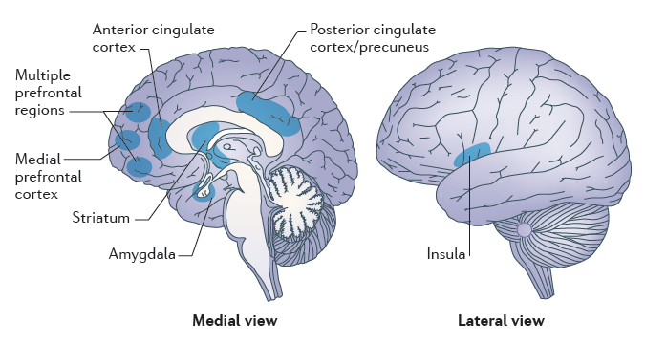
BRAIN REGIONS INVOLVED IN MINDFULNESS MEDITATION
Attention control: anterior cingulate cortex and the striatum
Emotion regulation: multiple prefrontal regions, limbic regions including the amygdala and the striatum
Self-awareness and empathy: medial prefrontal cortex, the posterior cingulate cortex, the precuneus and the insula
Note: Reproduced with permission of Springer Nature from Figure 1 on p. 217 in Tang, Y., Hölzel, B., & Posner, M. (2015). The neuroscience of mindfulness meditation. Nature reviews. Neuroscience, 213-225, https://doi.org/10.1038/nrn3916, Copyright © 2015, Springer Nature. Permission conveyed through Copyright Clearance Center, Inc.

Slide 47
CONTROVERSIES ABOUT
SAVOURING, FLOW & MINDFULNESS

Slide 48
CONTROVERSIES ABOUT
SAVOURING, FLOW & MINDFULNESS
The main controversy is: Are savouring, flow and mindfulness always a good thing for all people?
Excessive savouring of life’s pleasures may contribute to obesity, addiction, or relationship problems associated with selfishness
Some activities that lead to flow may entail significant health risks, e.g., speeding, armed combat, and skydiving; others may lead to adverse social effects, e.g., spending excessive time in work, sports, or IT-based activities
Willoughby Britton, in a review found that some adolescent males and acute cancer patients, had adverse responses to mindfulness training including distress and dissociation

