Slide 1
CHAPTER 6. GIFTEDNESS, CREATIVITY, AND WISDOM

Slide 2
LEARNING OBJECTIVES
Be able to define giftedness in terms of Renzulli three ring model of giftedness, Gardner’s theory of multiple intelligences, and Sternberg’s WICS model
Be able to describe some research findings on gifted children concerning early gifted performance, genetic and environmental origins of giftedness, family backgrounds of gifted children and their psychological adjustment, and the neurobiology of giftedness
Understand Csikszentmihalyi’s systems model of creativity and Sternberg and Lubart’s investment theory of creativity
Give an account of some important research findings on creative products, people, processes, and environments
Understand different conceptual models for explaining wisdom including wisdom as the final stage of personality and cognitive development, wisdom as an expert knowledge system and the balance theory of wisdom
Be able to define growth mindset and grit, and give an account of their impact on educational and occupational success
Understand the practical implications of the psychology of giftedness, creativity, wisdom, growth mindset, and grit

Slide 3
GIFTEDNESS, CREATIVITY & WISDOM

Slide 4
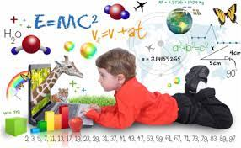
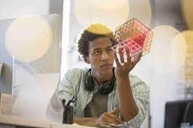
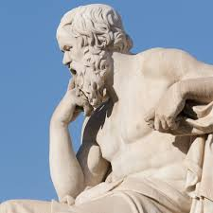
GIFTEDNESS, CREATIVITY & WISDOM
Giftedness in childhood, creativity in adulthood, and wisdom in later life
May lead to outstanding achievements across the lifespan
Involve more than just high IQ
Gifted children have outstanding talent
Creative adults break new ground in science and art
Wise people make exceptionally sound judgements

Slide 5
GIFTEDNESS

Slide 6
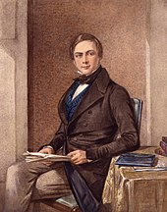
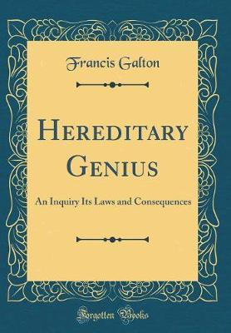
GIFTEDNESS – GALTON’S EARLY STUDY
Francis Galton’s (1822-1911) Hereditary Genius (1869) was a retrospective investigation of the families of eminent people
Found that eminence ran in families
Concluded that giftedness was hereditary
Current evidence shows that both genetic and environmental factors contribute to giftedness; gifted children
Have outstanding innate talent
Are motivated to practice a great deal to master their talent

Slide 7
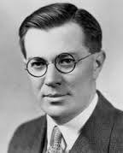
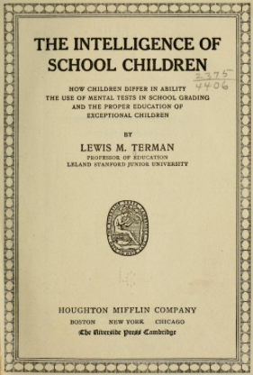
GIFTEDNESS – TERMAN’S EARLY STUDY
Lewis Terman (1877-1956) tested over 1000 children with the Stanford-Binet Intelligence Test & followed up those with IQs over 140 for 35 years
He found that children with high IQs had exceptional
Physical health
Behavioural adjustment
Moral development

Slide 8
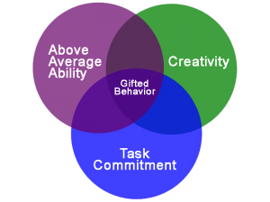
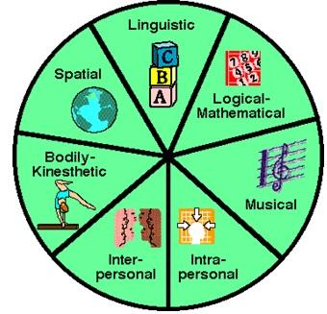
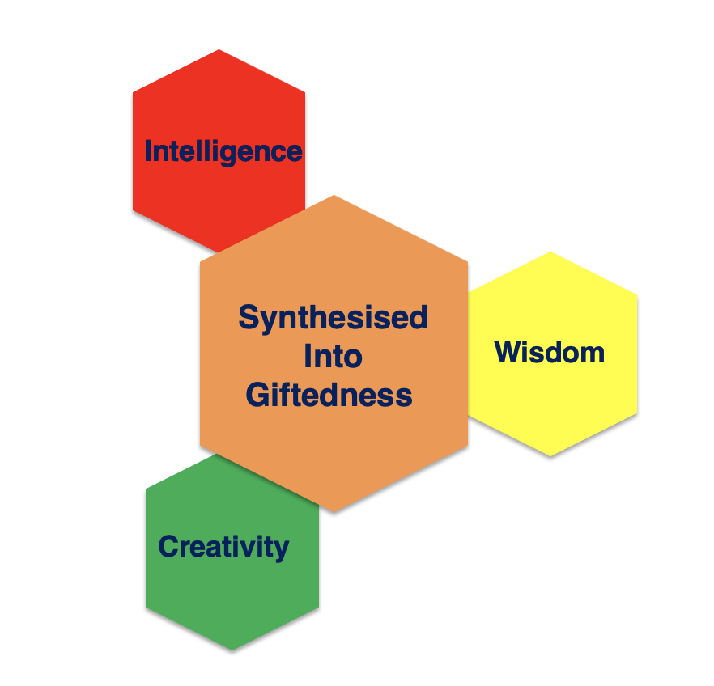
GIFTEDNESS – DEFINITIONS – HIGH IQ
Following Terman, early research defined giftedness as IQs over 140, but there were 3 problematic research findings
Many high IQ children did not become exceptionally productive adults
Many gifted painters and musicians did not have high IQs
Gifted individuals had similar rates of social and emotional difficulties to their less talented peers
Problems with the High IQ definition of giftedness led to broader definitions
Renzulli’s three ring model
Gardner’s model of multiple intelligences
Sternberg’s wisdom, intelligence and creativity synthesized (WICS) model
Renzulli’s
Three Ring Model
Gardner’s
Multiple Intelligences
Sternberg’s WICS

Slide 9
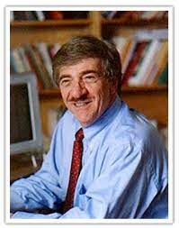
GIFTEDNESS – DEFINITIONS – 3 RING MODEL
In Renzulli’s three ring model, giftedness involves
Outstanding general ability
Creativity in the domain of high ability
Commitment and a high level of motivation to develop skills in the domain of high ability
Joseph Renzulli

Slide 10

GIFTEDNESS – DEFINITIONS – MULTIPLE INTELLIGENCES
In Gardner’s model of multiple intelligences, giftedness, represents outstanding ability in one of the multiple intelligences
Howard Gardner

Slide 11
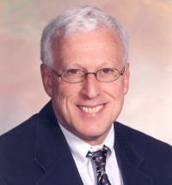
GIFTEDNESS – DEFINITIONS - WICS
In Sternberg’s wisdom, intelligence and creativity synthesized (WICS) model gifted people are viewed as using their intelligence in creative ways to accomplish things, and their wisdom to discern how to do this in a way that will have a significant and positive impact on society
Robert Sternberg
Intelligence
Synthesised
Into
Giftedness
Wisdom
Creativity

Slide 12
GIFTEDNESS
CONTEMPORARY PSYCHOLOGICAL RESEARCH FINDINGS
Heritability & practice. Twin studies show that giftedness is about 50% heritable, and about 10,000 hours of practice is required to excel in an area of expertise, such as music
Family background. Gifted children typically grow up in child-centred families where parents
Model hard work and high achievement
Provide an intellectually and artistically stimulating environment
Offer children a high level of autonomy
Expect a high level of excellence
Mental health. Gifted children have similar levels of depression and suicidal ideation as non-gifted children, and possibly lower levels of anxiety
Childhood giftedness and adult creativity. Only a minority of gifted children develop into creative adults who make major innovative contributions to their field
Child savants. Child savants – who excel in one area (e.g. music or maths) but have low IQs - typically have autism spectrum disorders/conditions or traits

Slide 13
GIFTEDNESS
CONTEMPORARY NEUROBIOLOGICAL RESEARCH FINDINGS
Neural resource hypothesis. The brains of gifted people are structurally or functionally different from those of their non-gifted counterparts
This is supported by research indicating that subgroups of gifted children and adults with talents for art, music, and maths have enhanced development in brain regions specific to their talents
Neural efficiency hypothesis. Gifted people use their brains more efficiently than others
This is supported by research indicating that people with high IQs or specific talents solve problems in their area of expertise with less brain activity as indexed by electroencephalogram recordings than those with lower IQs or without specific talents
Integration of neural resource and efficiency hypotheses. Gifted people may have brains that have developed either due to genetic factors or frequent practice in ways that facilitate expert performance, and their brains function more efficiently than the brains of their non-gifted counterparts

Slide 14
CREATIVITY

Slide 15
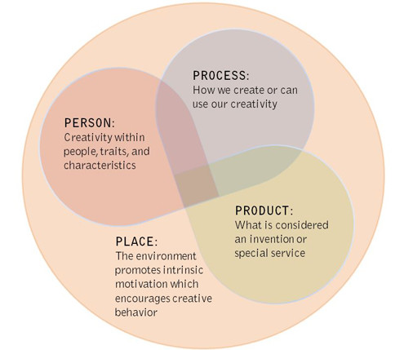
CREATIVITY – DEFINITION
Creativity is a process through which a person or group makes a product that is both novel and useful within the context of a specific environment
This definition highlights 4 key concepts
Creative person or group
Creative product
Creativity process
Creativity facilitating environment or place

Slide 16
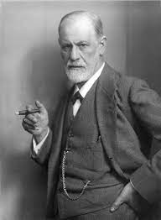
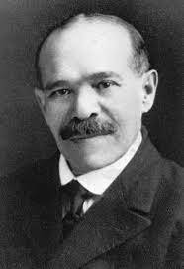
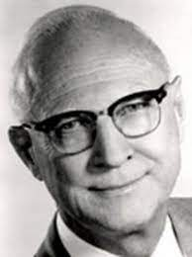
CREATIVITY – EARLY THEORIES
Psychoanalysis. Sigmund Freud (1856-1939) proposed that creativity arose from non-rational primary process thinking, and creative products in art and science were a socially acceptable way of expressing unacceptable unconscious aggressive and sexual drives
Gestalt psychology. Max Wertheimer (1880-1943) proposed that figure-ground reversal, and delaying closure were central to creativity
Psychometric testing. J.P. Guildford (1897-1987) developed IQ-style divergent thinking tests to measure creativity. Divergent and convergent thinking were part of his Structure of the Intellect model of human abilities
Freud
Wertheimer
Guildford

Slide 17
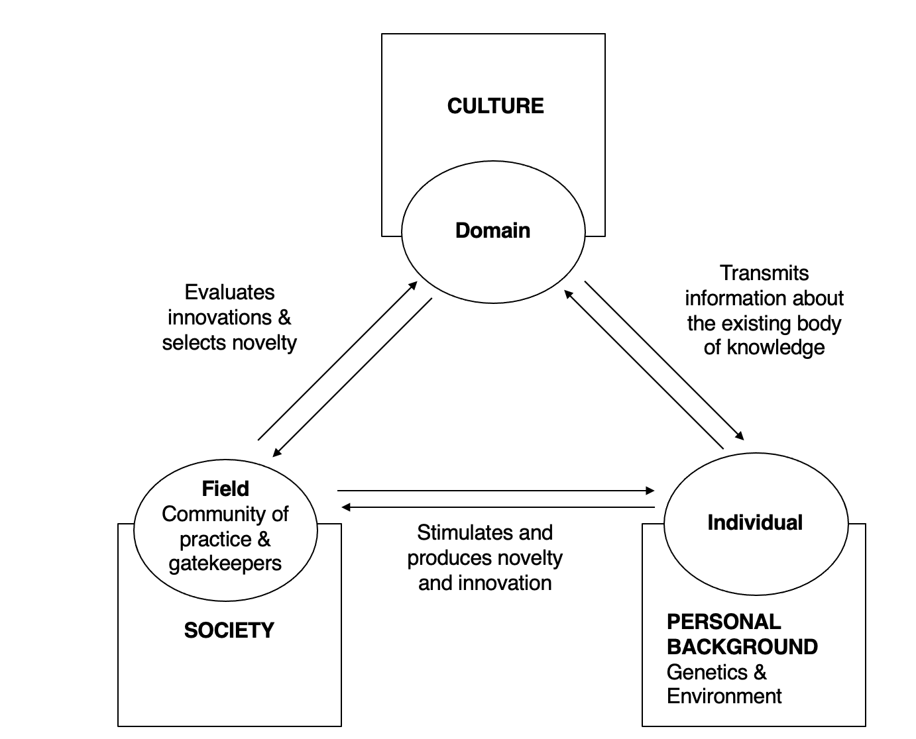
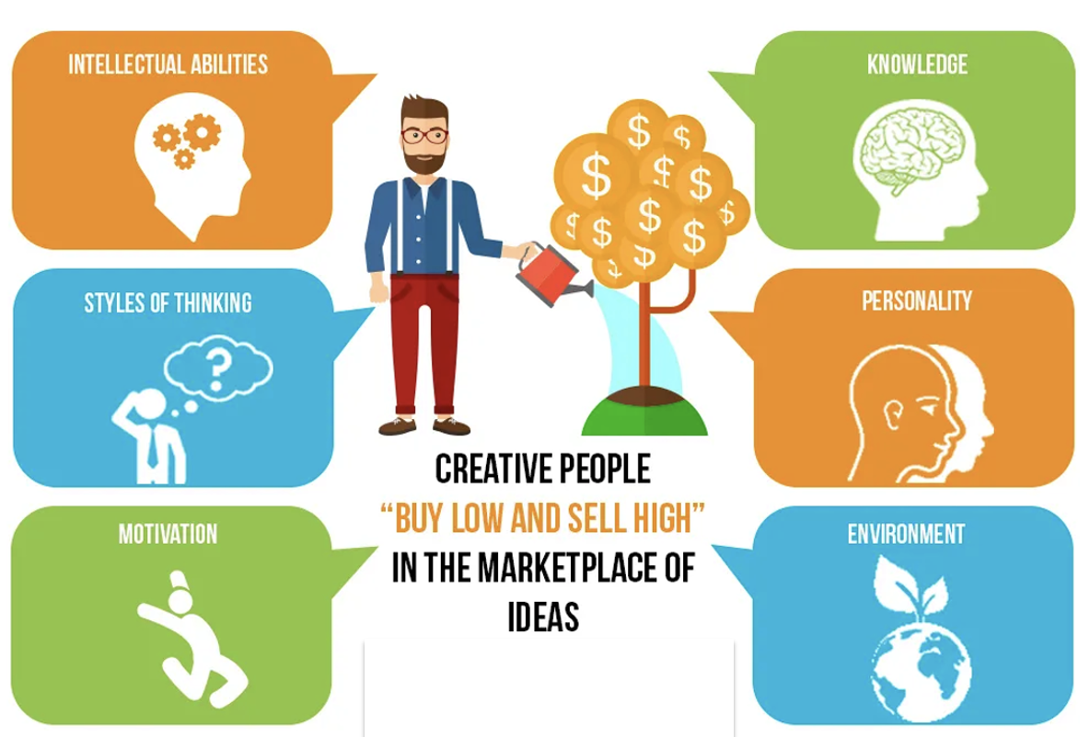
CREATIVITY – CONTEMPORARY THEORIES
Csikszentmihalyi systems model of creativity is particularly important because of his role as a founder of the field of positive psychology
Sternberg and Lubart’s investment theory of creativity and subsequent developments of this theory, will also be outlined, because of Sternberg’s prominent role in developing modern psychological approaches to intelligence, giftedness, creativity and wisdom

Slide 18
CSIKSZENTMIHALYI SYSTEMS MODEL OF CREATIVITY
Creativity arises from the dynamic interaction of three systems
The individual with his or her talents, personality traits and motivations
The domain which consists of the symbol-system, rules, techniques, practices and guiding paradigm
The field which consists of people working within the same domain (artists, scientists, critics, journal editors) whose activity is governed by the same domain-specific rules and practices
These 3 systems are embedded in 3 larger systems
The individual is embedded in their personal background, including genetic and environmental factors
The domain is embedded in the wider culture
Members of the the field are also members of society

Slide 19
CSIKSZENTMIHALYI SYSTEMS MODEL OF CREATIVITY
Transmission of rules. For creativity to occur, a set of rules and practices must be transmitted from the domain to the individual
Creation of novel innovation. The individual must then produce a novel innovation in the content of the domain
Motivation to produce this creative variation occurs when an appropriately talented individual responds to a tension between competing colleagues or critics within a field, or where there is a pronounced gap between the low demands of routine work within a field and the high ability of the person entering the field
Acceptance of innovation. The innovation must then be selected by the field for inclusion in the domain and must also be transmitted through time if it is to be accepted by the community who make up the field

Slide 20
CSIKSZENTMIHALYI SYSTEMS MODEL OF CREATIVITY
CULTURE
Domain
Transmits information about the existing body of knowledge
Evaluates innovations & selects novelty
Field
Community of practice & gatekeepers
Stimulates and produces novelty and innovation
Individual
SOCIETY
PERSONAL
BACKGROUND
Genetics &
Environment

Slide 21
STERNBERG AND LUBART’S INVESTMENT THEORY OF CREATIVITY
Creative people ‘buy low and sell high’ in a field of ideas
They ‘buy’ or adopt poorly developed ideas which are unpopular or unfamiliar but which have growth potential
They ‘invest’ creatively in these and develop them into ‘creative products’
They ‘sell’ the novel ideas to colleagues in their field

Slide 22
STERNBERG AND LUBART’S INVESTMENT THEORY OF CREATIVITY
Six factors are necessary to ‘buy low and sell high’ in a field of ideas
Intelligence to see problems in novel unconventional ways, recognise which problems are worth pursuing, and the ability to sell one’s ideas to others
Field knowledge. Sufficient knowledge about a field to move forward in it, but not so much that one is paralysed by conventional practices
Divergent thinking style. The capacity to think in novel ways about effective problem-solving and to think about the big picture as well as details
Personality traits.
Sensible risk taking particularly in the area of buying low and selling high
Persistence in overcoming obstacles (in tolerating the field’s resistance to one’ new ideas),
Self-efficacy
Tolerance for uncertainty and ambiguity
Intrinsic motivation to work in the field
A supportive environment which rewards creative contributions to the field

Slide 23
STERNBERG AND LUBART’S INVESTMENT THEORY OF CREATIVITY

Slide 24
CREATIVITY – RESEARCH FINDINGS
Research finding on creativity may be classified as those that focus on creative
Products
People
Processes
Places - Facilitating environments

Slide 25
CREATIVE PRODUCTS - CLASSIFICATION
Kaufman and Beghetto distinguish between big, little, mini and pro C creativity products
Big C creativity products are outstanding innovations such Einstein’s theory of relativity or Leonardo da Vinci’s Mona Lisa
Little c creativity products are creative solutions or outputs in daily work or leisure activities, such as developing a new system at work or doing a painting for a friend
Mini c creativity products are produced by novices in the early stages of learning their field before they become experts
Pro c creativity products are produced by professionals who have developed beyond little c creativity
Theories. Csikszentmihalyi systems model of creativity and Sternberg and Lubart’s investment theory apply to pro c and big C creativity, but not to little c or mini c creativity.

Slide 26
CREATIVE PRODUCTS – RESEARCH METHODS
Historical case study methods are used to research Big C products where experts rate products of creative genius
Amabile’s creative assessment technique is used to research products of little c or everyday creativity where creative products are rank ordered and rated by judges on likert scales that assess creativity

Slide 27
CHARACTERISTICS OF CREATIVE PEOPLE - RESEARCH FINDINGS
Divergent thinking (assessed with Torrance’s Test of Creative Thinking) is a characteristic of creative people. The test shows that divergent thinking is normally distributed in the population and a better predictor of creative achievement than intelligence
Intelligence. There is a small positive correlation between IQ and creativity
Openness and extraversion are the two big-5 personality traits most strongly correlated with creativity
Vulnerability to bipolar disorder and psychosis (schizotypy) are correlated with creativity. Creative production occurs when individuals with these conditions are energised and functioning well, rather that when they are hypomanic or psychotic

Slide 28
CHARACTERISTICS OF CREATIVE PEOPLE - RESEARCH FINDINGS
Intrinsic and Extrinsic Motivation
Intrinsic motivation is critical during the period just prior to and during creative insight
Extrinsic motivators such as task-relevant feedback or the prospect of recognition may be important before and after creative insight
Positive and Negative Emotions
Positive emotions signal that we are safe and facilitates playful divergent thinking
Negative emotions signal that something is wrong and motivates us to work hard to find creative solutions to make things right again

Slide 29
CHARACTERISTICS OF CREATIVE PEOPLE - RESEARCH FINDINGS
GENETIC FACTORS
Genetic factors influence the following psychological and neurobiological factors, which in turn facilitate creativity
Intelligence
Divergent thinking
Domain specific factors such as musical ability
Personality traits such as openness to experience
Psychopathological factors such as vulnerability to bipolar disorder or psychosis
Neurobiological factors such as the efficiency of dopamine and serotonin neurotransmission systems

Slide 30
CHARACTERISTICS OF CREATIVE PEOPLE - RESEARCH FINDINGS
NEUROBIOLOGICAL PROCESSES
Creativity is subserved by neural networks (and NOT located in one brain region e.g. the right hemisphere)
Different types of creative tasks (visual, musical, literary, kinaesthetic, or scientific) involve different neural networks
Creativity involves (at least) three major neural networks
Default mode network, associated with spontaneous generation of ideas
Executive control network, associated with goal directed thinking
Salience network involved in detection and allocation of neural resources to relevant tasks
The interplay between the default mode network and the executive control network subserves the interplay between spontaneous and controlled thought processes involved in creativity.
The salience network facilitates switching between default mode network and the executive control network at different stages of the creativity process

Slide 31
CHARACTERISTICS OF CREATIVE PEOPLE - RESEARCH FINDINGS
COGNITIVE PROCESSES
Creativity stages proposed by gestalt psychologists
Preparation
Incubation
Insight
Verification
Big C creativity development documented by Simonton
After a 10 year period of immersion adults make their creative contributions which are typically a network of interrelated projects
Creative output is curvilinear and follows an inverted-backwards J shaped function
Best creative work is usually produced at the point of greatest productivity
Output
Time

Slide 32
CREATIVE PLACES (OR ENVIRONMENTS) - RESEARCH FINDINGS
Family environments
Trauma (early bereavement, illness, disadvantage) is common among Big C creative people and may motivate creative work
Family support fosters creative output in Big C creative people
Work teams with high creative output have these attributes
Vision and commitment to team goals
Support for innovation within the team
A shared concern with excellent task performance
Team cohesion and commitment to the work team
Good communication within the team and between the team and the organization
Culture
Western individualist cultures promote little c creativity whereas eastern collectivist cultures promote conformity
Exposure to multiple cultures and access to IT increases creativity

Slide 33
CREATIVITY TRAINING - RESEARCH FINDINGS
Little c creativity may be enhanced by training
Little c creativity programmes lead to improvements on measures of
Divergent thinking
Creative problem solving
Creative work performance.
Effective programmes help people develop creative cognitive skills rather than motivation, personality traits, or interpersonal skills
These programmes involved active learning by doing carefully designed exercises

Slide 34
CREATIVITY TRAINING - RESEARCH FINDINGS
The creative problem-solving programme is an example of an effective creativity training course. There are 6 steps in the programme
Mess finding, where a situation that presents a challenge is identified
Data finding, where facts related to the situation are sought
Problem finding, where the various problems associated with the mess are identified and a useful framing of the main underlying problem is made
Idea finding, where many solutions to the main problem are brainstormed
Solution finding, where the best solution to the main problem is identified
Acceptance where an effort is made to gain acceptance for the solution from the involved people and a plan of action to implement the solution is agreed

Slide 35
PAUSE & PRACTICE - PERSONAL CREATVITY
Provide yourself with good environments in which there are many opportunities to select a domain in which to be creative, and work without distractions
Every day set yourself a problem to solve that is of interest to you
Work on the problem for an uninterrupted period and then write down what you achieved
Create a vision of what problem you want to solve or what art you wish to create
Use metaphor, emotional language and vague or poetic language if you cannot be precise when creating this intuitive vision
Develop basic skills to enter the domain (linguistic, mathematical, musical, artistic or athletic)
Master all relevant domain-specific knowledge so you reproduce the domain in your mind
Widen the span of your attention both to the inner and outer world and give up taking usual assumptions, rules and practices for granted
Irreverently question orthodoxies and be playfully curious about why things are so
Focus attention on doing the task and completing it to your own satisfaction not for outside rewards
Work to do your personal best rather than to beat the competition
Take risks when you come up with possible ideas or tentative solutions, no matter how bizarre these might be
Be optimistic that you can improve your creative output

Slide 36
PAUSE & PRACTICE - PERSONAL CREATVITY
WHEN YOU REACH AN IMPASSE
Create subgoals by working backwards from the main goal; then work forwards step-wise from where you are towards the goals
List all the attributes of a problem or potential solution and then recombine them in different ways. Consider extreme cases (small and large); use elimination, substitution, combination, modification, rearrangement, of one or all elements to rethink the solution
Consider an analogous problem. Work with a number of metaphorical representations of the problem; consider the problem in terms of visual, auditory and verbal representations
Set the problem aside and work on something else to allow incubation to occur and then return to the problem refreshed
Produce a lot of creative efforts and your most creative work will come when you are most productive

Slide 37
WISDOM

Slide 38
WISDOM IS A VIRTUE
Virtue. Wisdom is a virtue in many philosophical and religious traditions
VIA classification of virtues and character strengths. In the VIA classification, the virtue of wisdom is supported by the character strengths of
Creativity
Curiosity
Judgement
Love of learning
Perspective

Slide 39

DEFINITION OF WISDOM
Dilip Jeste’s definition of wisdom – based on a consensus opinion of a panel of experts - is that it is a complex trait involving a balanced integration of nine components
Expert social decision-making ability and pragmatic knowledge of life
Prosocial attitudes and behaviour
A capacity to maintain emotional homeostasis with a bias towards positive emotions
A capacity for reflection and understanding
A capacity to expect and cope with uncertainty
Tolerance for different values in others and an understanding of the relativity of values
Spirituality
Openness to new experiences
A sense of humour.
Wisdom, involving these nine features, is expressed in actions which aim to enhance the wellbeing of both the self and society.

Slide 40
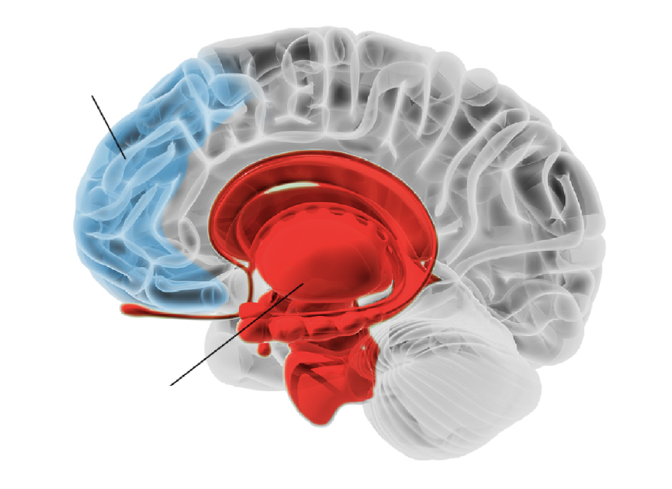
NEUROBIOLOGY OF WISDOM
Prefrontal cortex
The ‘wise’ brain
Makes decisions
Controls Impulses
Dilip Jeste found that aspects of wisdom are subserved by distinct neuroanatomical structures and neurocircuitry
Wisdom involves modulation of the functions of phylogenetically primitive limbic system, by the more recently developed prefrontal cortex
Limbic system
The ‘emotional, impulsive’ brain
Seeks pleasure Avoids pain

Slide 41
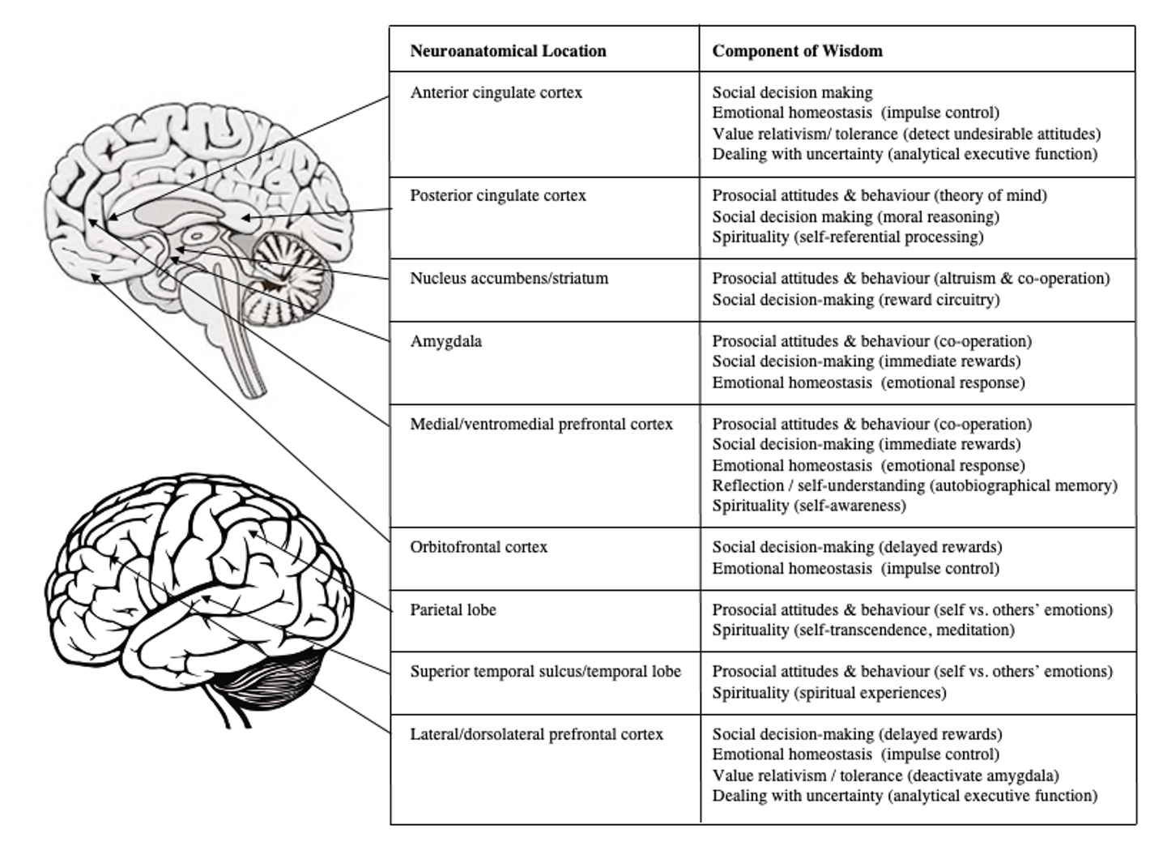
NEUROBIOLOGY OF WISDOM
Note. Reproduced with permission of The Licensor through PLSclear from Figure 4.1, p. 78 in Lee, E. E., & Jeste, D. V. (2019). Neurobiology of wisdom. In R. J. Sternberg, & J. Glück (Eds.), The Cambridge handbook of wisdom (pp. 69-93). New York, NY: Cambridge University Press. https://doi.org/10.1017/9781108568272.005, Copyright © 2019 Cambridge University Press.

Slide 42
ASSESSMENT OF WISDOM
Performance measures
Judgements about the wise courses of action to take in complex social situations are rated by experts on criteria associated with wisdom
Derived from theories that emphasise the cognitive aspect of wisdom; wisdom as expert knowledge or an advanced stage of cognitive development
Example: Baltes’ Berlin Wisdom Paradigm
Self-report measures.
Individuals indicate the extent to which they agree or disagree with self-descriptive statements about their typical behaviour, indicative of wise thoughts, feelings, and behaviours
Derived from theories in which wisdom is conceptualized as a mature personality type
Example: Brief Wisdom Screening Scale

Slide 43
ASSESSMENT OF WISDOM
PERFORMANCE MEASURE: BALTES’ BERLIN WISDOM PARADIGM
Participant thinks aloud about hypothetical complex problems that require wise judgments
“Somebody gets a phone call from a good friend. The friend says that he cannot go on anymore, and that he has decided to commit suicide. What could the person consider and do in such a situation?”
Experts rate the wisdom shown in think-aloud transcripts on five criteria.
Expert factual knowledge. Knowledge about reasons for wanting to commit suicide
Expert procedural knowledge. Knowledge about how to talk helpfully with the caller
Life-span contextualism. Awareness of how life phases, situations, and cultural factors may influence the caller’s behaviour
Value relativism. Awareness and acceptance of the caller’s values which may differ from one’s own
Recognition and management of uncertainty. Awareness of, and ability to address unpredictability in response to the caller, and in consideration of the caller’s life situation

Slide 44
ASSESSMENT OF WISDOM
SELF-REPORT MEASURE: BRIEF WISDOM SCREENING SCALE
Sample items rated on 5-point scale
I am able to integrate the different aspects of my life
I always try to look at all sides of a problem
I don’t worry about other people’s opinions of me
My peace of mind is not easily upset
It seems I have a talent for reading other people’s emotions
I have grown as a result of losses I have suffered
I have dealt with a great many different kinds of people during my lifetime
Note. Adapted from Table 6, p. 405 in Glück, J., König, S., Naschenweng, K., Redzanowski, U., Dorner, L., Straßer, I., & Wiedermann, W. (2013). How to measure wisdom: Content, reliability, and validity of five measures. Frontiers in Psychology, 4, 14. https://doi.org/10.3389/fpsyg.2013.00405, Copyright © 2013 Author. This is an open access publication.

Slide 45
ASSESSMENT OF WISDOM
RESEARCH FINDINGS
Large correlations between different performance measures of wisdom
Large correlations between different self-report measures of wisdom
Medium correlations between performance and self-report measures of wisdom
Self-report and performance measures of wisdom are assessing different constructs or different aspects of the same construct

Slide 46
ASSESSMENT OF WISDOM
RESEARCH FINDINGS
Moderate correlations between wellbeing and self-report measures of wisdom
Small correlations between wellbeing and performance measures of wisdom
Wellbeing is more strongly associated with viewing oneself as wise rather than the ability to make wise judgements

Slide 47
THEORIES OF WISDOM
Personality theories – Wisdom is an advanced stage of personality development
Erikson – Wisdom is a virtue that arises in later life during the 8th and final stage of personality development
Ardelt – Wisdom is an advanced stage of personality development in which the cognitive ability to perceive reality as it is, the reflective ability understand events from multiple perspectives, and the emotional ability to have compassion for others are integrated
Levenson – Self-transcendence is is a developmental trajectory involving the phases of self-knowledge, detachment, and integration that forms a pathway to wisdom
Cognitive theories – Wisdom is an advanced stage of cognitive development
Grossman – Wise reasoning requires intellectual humility, acceptance of uncertainty, seeking multiple perspectives, and integrating these
Baltes – Wisdom is an expert knowledge system concerning the pragmatics of life that links mind and virtue
Sternberg – Wisdom is the application of practical intelligence, and the tacit knowledge that such intelligence entails, to solve problems in a way that achieves a balance among what is best for the self and others to achieve a common good

Slide 48
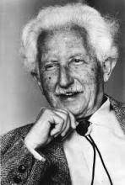
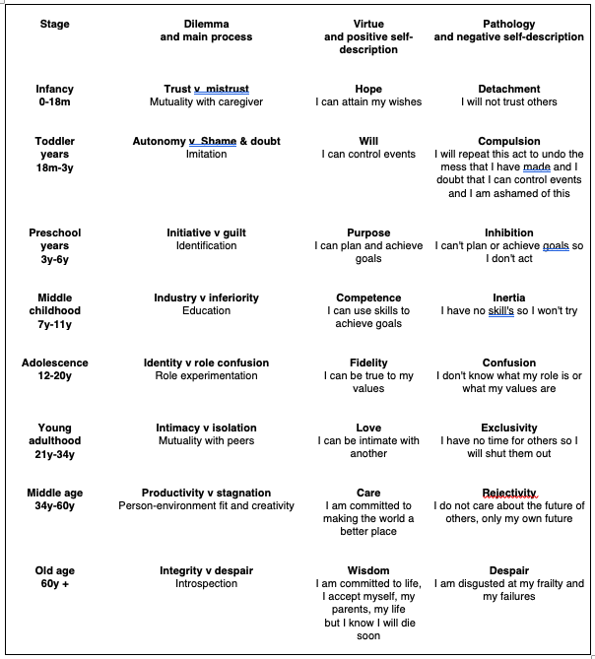
ERIKSON'S MODEL – WISDOM AS A VIRTUE IN THE FINAL STAGE OF PERSONALITY DEVELOPMENT
Erik Erikson
Note. Based on Erikson, E (1959). Identity and the Life Cycle. New York: International University Press.

Slide 49
ERIKSON’S MODEL - RESEARCH FINDINGS
Over the lifespan people face the psychosocial dilemmas entailed by Erikson’s theory and develop the virtues or vulnerabilities associated with the successful or unsuccessful resolution of them
Passage through the stages is more variable than the theory suggests
Demarcation lines between stages are blurred
People can address later life stages early in life or return to past stages in later life

Slide 50
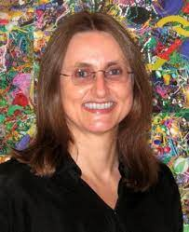
ARDELT’S 3 DIMENSIONAL THEORY OF WISDOM
Cognitive Ability to see reality as it is
Reflective
Ability to see events from multiple perspectives
Monika Ardelt
WISDOM
Affective Ability to have compassion for others
Wisdom is an advanced stage of personality development in which the cognitive ability to perceive reality as it is, the reflective ability understand events from multiple perspectives, and the emotional ability to have compassion for others are integrated

Slide 51
ARDELT’S 3 DIMENSIONAL THEORY OF WISDOM – RESEARCH FINDINGS
Ardelt used archival data from 120 adults, aged 58-82, who had been followed up for 40 years at Berkeley to evaluate the correlates of wisdom as she defines it
Social support in early adulthood predicted the development of wisdom 40 years later.
Resilience. Those who developed into wise older people, responded to economic hardship during the Great Depression of the 1930s with psychological growth, suggesting that wisdom entails a capacity to thrive in the face of adversity
Life satisfaction. Wisdom was a stronger predictor of life satisfaction in old age than health, wealth, or physical and social environments

Slide 52

LEVENSON’S SELF-TRANSCENDENCE THEORY OF WISDOM
Integration involves the dissolution of “inner selves” which are reflected in the psychological defences that protect the sense of selfhood against threats to self-worth
Detachment arises as we become aware of the transience of relationships, roles, and achievements that create and sustain a sense of self
Rick Levenson
Self-knowledge involves developing an awareness of the sources of one’s sense of self in roles, achievements, relationships, and beliefs
Self-transcendence arises as we pass through the stages of self-knowledge, detachment, and and integration.
During this process we detach from external definitions of the self and dissolve rigid boundaries between self and others.

Slide 53
LEVENSON’S SELF-TRANSCENDENCE THEORY OF WISDOM
RESEARCH FINDINGS
Levenson found that self-transcendence assessed with the Adult Self-Transcendence Inventory is correlated with
Age,
Meditation practice
Spirituality
Emotional stability
Openness to experience
Extraversion
Conscientiousness
Agreeableness
Positive mental health
Social support

Slide 54

GROSSMAN’S COGNITIVE THEORY OF WISE REASONING
Wise reasoning develops after passing through Piaget’s 4 stages of cognitive development
Sensorimotor
Preoperational
Concrete operational
Formal operational
Wise reasoning involves four key competencies
Intellectual humility. knowing the limits of one’s knowledge
Tolerance for uncertainty. Recognizing that in complex situations there is uncertainty about the stability of people’s positions and their openness to change
Multiple perspectives. Seeking multiple perspectives on complex problems, since single perspectives may not fully reflect all the complexities of the situation
Integrating different perspectives sometimes through negotiation and compromise
Igor Grossman

Slide 55
GROSSMAN’S COGNITIVE THEORY OF WISE REASONING -
RESEARCH FINDINGS
Wise reasoning assessed with Grossman’s Wise Reasoning Paradigm and the Situated Wise Reasoning Scale is associated with
A high ratio of positive to negative emotions
Interpersonal wellbeing
Self-regulation
Openness to a range of political viewpoints during elections
Growth orientation
Being trained to reflect on situations as if one were a distant observer

Slide 56
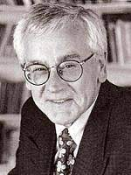
BALTES’ COGNITIVE THEORY OF WISDOM AS EXPERT KNOWLEDGE
Wisdom is an expert knowledge system that includes knowledge about
Human development
The multiple biological, psychological, social, cultural, physical and spiritual contexts associated with the human condition
The limits of one’s own knowledge and expertise
The meaning of life
The way to conduct one’s life in the pursuit of excellence, with due regard to both personal wellbeing and the common good
Paul Baltes

Slide 57
BALTES’ COGNTIVE THEORY OF WISDOM - RESEARCH FINDINGS
Baltes’ research group found the following
Social intelligence and life experience. Variables which combine aspects of analytical intelligence with aspects of personality such as social intelligence and cognitive style account for 15% of the variance in wisdom, as does life experience, as shown on the next slide
Not IQ or big 5. In contrast, IQ tests and personality traits from traditional personality inventories each only accounted for 2% of the variance in wisdom
Groups. Higher levels of wisdom occurred in group situations, where others were consulted before making judgments
Training. People can be trained to make wise judgements, through appropriate prompting during decision-making
Early adulthood. Wisdom first appears in early adulthood, and few people progress beyond the level of wisdom they attain at this time, unless exposed to significant life events

Slide 58
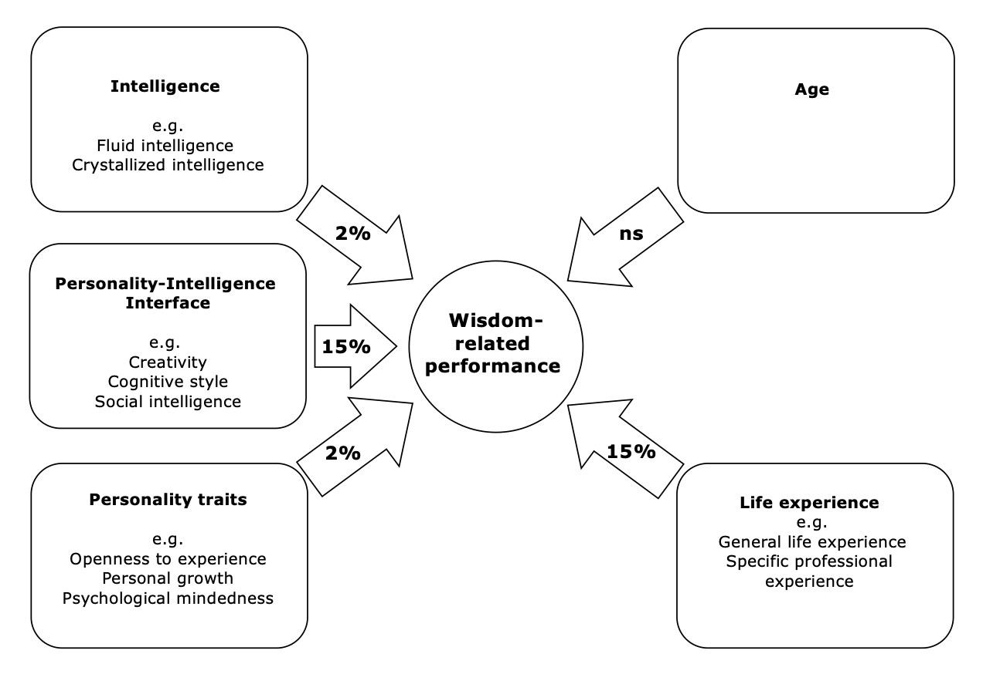
BALTES’ PREDICTORS OF WISDOM-RELATED PERFORMANCE IN ADULTS
Note. Based on Figure 3, p.130 in Baltes, P. B., & Staudinger, U. M. (2000). Wisdom. A metaheuristic (pragmatic) to orchestrate mind and virtue toward excellence. The American Psychologist, 55(1), 122-136. doi:https://doi.org/10.1037/0003-066X.55.1.122 Percentages are unique predictive contributions that are based on communality analysis, ns = not significant.

Slide 59
STERNBERG’S BALANCE THEORY OF WISDOM
Wisdom is the application of practical intelligence, and the tacit knowledge that such intelligence entails, to solve problems in a way that achieves a balance among what is best for the self and others to achieve a common good
Tacit knowledge is ‘knowing how to’ rather than ‘knowing that’
Values. The goal of achieving the common good is informed by ethical values
Balancing interests. Wisdom involves applying tacit knowledge to problem-solving in a way that achieves a balance among
Intrapersonal interests - personal wishes
Interpersonal interests - things that would be good for relationships with others involved in the problem situation
Extrapersonal interests - things that would be good for everyone affected by the problem situation within society
Balancing responses to environments. Wisdom also involves applying tacit knowledge to problem-solving in a way that achieves a balance among multiple types of responses to environmental contexts including
Adapting to the current social environment
Shaping the current social environment so that adaptation can occur
Selecting a new social environment in which there is a better fit between analytical abilities and the types of problems that must be solved for successful adaptation to occur

Slide 60
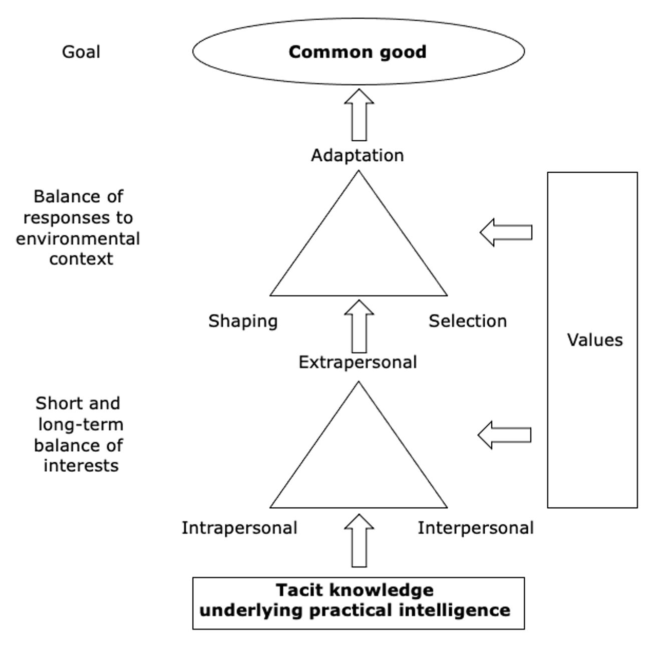
STERNBERG’S BALANCE THEORY OF WISDOM
Note. Reproduced with permission of Sage, Figure 1 on p. 354 of Sternberg, R. J. (1998). A balance theory of wisdom. Review of General Psychology, 2(4), 347-365. https://doi.org/10.1037/1089-2680.2.4.347, Copyright © 1998 Sage. Permission conveyed through Copyright Clearance Center, Inc.

Slide 61
STERNBERG’S BALANCE THEORY OF WISDOM - TRAINING
Sternberg has developed a programme for teaching wisdom in schools based on his balance theory of wisdom which incorporates the following general principles
Be a role model for wise judgements
Invite students to read about real life cases of wise decisions
Encourage and reward students for making wise judgments
Show how wise, balanced decisions can make life satisfying
Explain the usefulness of the idea - ‘a rising tide raises all ships’
Help pupils to identify their own interests, those of other people, and those of institutions and to balance these when they make judgements
Help pupils understand the ideas of adapting to situations, shaping them, and selecting them and how to balance these three options
Help pupils articulate their own values, and their understanding of the common good and show them how to use these in wise decision making
Help pupils see that important questions and answers evolve over time depending on changing life circumstances
Show the importance of understanding issues from multiple perspectives, and of withstanding pressures to see things only from one point of view

Slide 62
STERNBERG’S BALANCE THEORY OF WISDOM - TRAINING
Sternberg has developed a programme for teaching wisdom in schools based on his balance theory of wisdom which incorporates the following general principles
Be a role model for wise judgements
Invite students to read about real life cases of wise decisions
Encourage and reward students for making wise judgments
Show how wise, balanced decisions can make life satisfying
Explain the usefulness of the idea that a rising tide raises all ships.
Help pupils to identify their own interests, those of other people, and those of institutions and to balance these when they make judgements
Help pupils understand the ideas of adapting to situations, shaping them, and selecting them and how to balance these three options
Help pupils articulate their own values, and their understanding of the common good and show them how to use these in wise decision making
Help pupils see that important questions and answers evolve over time depending on changing life circumstances
Show the importance of understanding issues from multiple perspectives, and of withstanding pressures to see things only from one point of view

Slide 63
PAUSE & PRACTICE – MAKE WISE JUDGEMENTS
ABOUT COMPLEX PROBLEMS
Remember that each of us has access to incomplete information about the past and present; uncertainty about the future; and limited information processing capacity so our judgements are always imperfect, constrained and should always be open to revision
Recognise that different people may hold different beliefs about what is right or true depending upon their perspective, their geographic and social context, and also remember that people’s ideas evolve over time
Consider the many themes and contexts of life such as the self, family, peer group, school, workplace, community, society and culture and the variations and interrelations among these across the lifespan
Balance your own interests and those of others involved with the problem and the wider community to achieve a common good for all and expect that the outcome of such decision making will usually involve a statement about some people conforming or adapting to the environment; some people taking steps to shape the environment so they can fit into it with greater ease; and some people selecting a new environment which suits their skills and interests better

Slide 64
GROWTH MINDSET &
GRIT

Slide 65
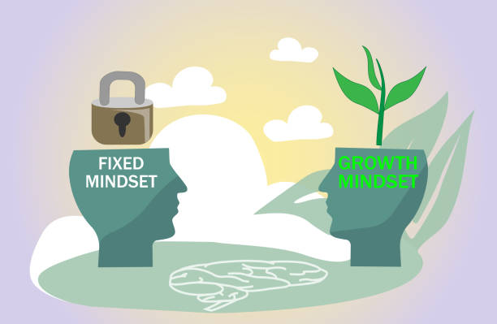

GROWTH MINDSET & GRIT
Giftedness, creativity and wisdom may lead to important accomplishments
Accomplishment also depends on
Growth mindset. Personal beliefs about the impact of effort on developing intelligence, abilities and talents and aspects of personality
Grit. Commitment to sustained effort to achieve valued goals

Slide 66

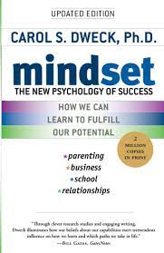
GROWTH MINDSET
Carol Dweck showed that children who believed that they could develop their intelligence and personality traits through personal effort, experienced greater academic and social success
Growth vs Fixed mindset. Growth mindset is distinguished from a fixed mindset, where the belief is that intelligence and personality are genetically determined and unchangeable
Resilience. A growth mindset leads to greater resilience and academic achievement among pupils facing adversity because students with a growth mindset attribute failure to situational factors, and this motivates them to work harder to develop the skills they need to avoid further failures.

Slide 67
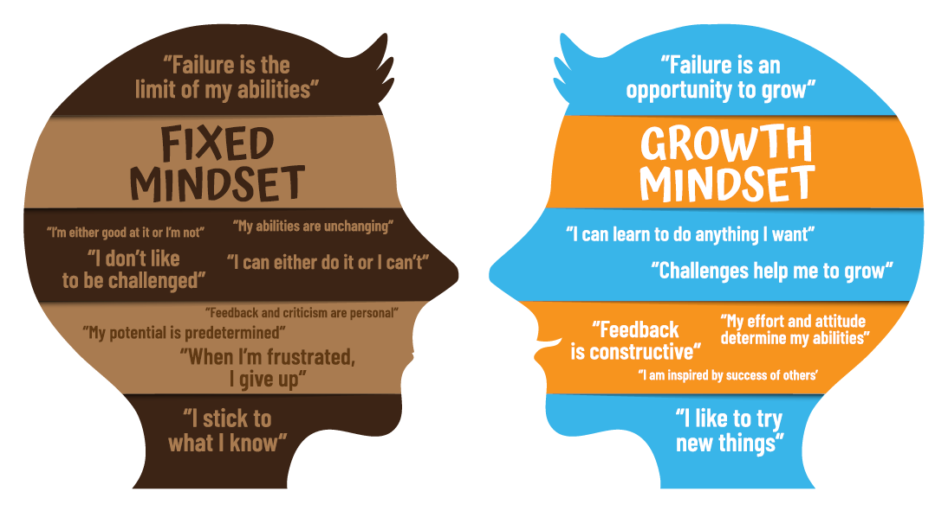
GROWTH & FIXED MINDSETS

Slide 68
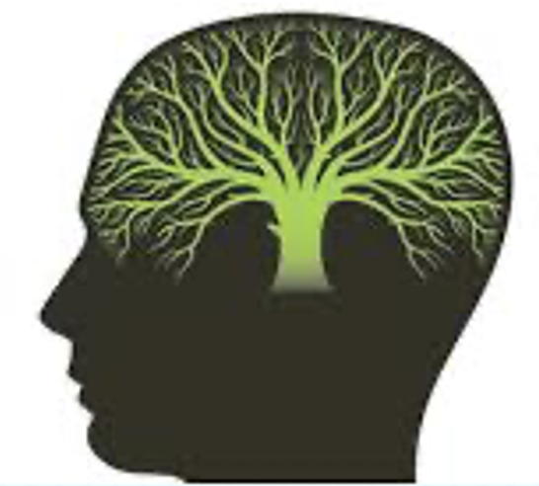
GROWTH MINDSET TRAINING
Training that promote a growth mindset
Conveys information about neuroplasticity through a memorable metaphor, for example, ‘the brain is like a muscle that gets stronger when you exercise it’
Specifies things that may be done to develop a growth mindset ‘exercise your brain by doing things that make you think hard in school.’
Includes stories from notable figures who have used a growth mindset
Includes experiential exercises - writing letters to a student who had fixed mindset thoughts such as ‘I’m smart, so I don’t have to work hard’ or ‘I’m stupid, and there’s nothing I can do about it’ – to help them develop a growth mindset

Slide 69


GRIT
Angela Duckworth pioneered research on grit
Grit is the tendency to work towards valued long-term goals with a high level of interest, effort, passion, and commitment
Duckworth’s research showed that Grit predicted
Surviving the arduous first summer of military training for the US army
Retention in the US Special Forces
Retention and performance among novice teachers
Graduation from Chicago public high schools
Reaching the final rounds of the US National Spelling Bee competition
Grit predicted these accomplishments, beyond the level of prediction made by measures of relevant talents such as IQ, standardized achievement test scores, and physical fitness
Angela Duckworth

Slide 70
GRIT-S SCALE
Sample items rated on 5-point scale
Setbacks don’t discourage me
I am a hard worker
I finish whatever I begin
Note. Adapted with permission of Taylor & Francis Group, LLC (Lawrence Erlbaum) from Table 1 on p. 167 of Duckworth, A. L., & Quinn, P. D. (2009). Development and validation of the short grit scale (GRIT–S). Journal of Personality Assessment, 91(2), 166-174. https://doi.org/10.1080/00223890802634290. Copyright © 2009 Taylor & Francis Group, LLC. Permission conveyed through Copyright Clearance Center, Inc. Take the grit scale at http://angeladuckworth.com/grit-scale/.
.

Slide 71
PAUSE & PRACTICE – DEVELOP A GROWTH MINDSET
Think of the brain as a muscle that gets stronger when you exercise it by doing things that are challenging and make you concentrate and ‘think hard’
Every day do some things that you find interesting that challenge you to concentrate, remember, reason, and make judgments
Look for personal stories of people who have struggled and overcome obstacles to achieve goals that were important to them, and which initially they believed were beyond their abilities and talents. Look to these role models for inspiration for you to stretch yourself and grow your skills and abilities
Write a letter. Imagine someone who believes ‘I’m smart, so I don’t have to work hard’ or ‘I’m stupid, and there’s nothing I can do about it’. Write a letter to them helping them to begin to believe that they can grow their abilities and talents: that these are not fixed or static
Plan to grow. Think about challenging tasks you could do, new strategies you could use, or people you could ask for advice to help you grow your abilities and talents and achieve your potential

Slide 72
PAUSE & PRACTICE – CULTIVATE GRIT
Select a single highly valued long-term goal, that is connected to some greater good beyond yourself
Expect to work hard towards this goal for years
Set short and medium term goals to help you achieve your main long-term, highly valued goal
Say ‘No’ to goals, projects and activities that distract you from pursuing your long-term goal
Develop a work routine that suits you
Work at the limits of your competence, so the challenges you face are at, or just beyond the level of your skill
Expect setbacks and mistakes
Think of setbacks as signals. Mistakes, setbacks, slow progress, frustration, and confusion are signals that you are gaining expertise and so are likely to succeed in the long-term
More of the same vs. Doing something different. Distinguish between setbacks that can be overcome by trying harder and doing ‘more of the same’, and those that that can be overcome by changing course and ‘doing something different’
Savour intrinsically rewarding efforts. Each day notice how intrinsically rewarding it is for you to put in the effort to work for your highly valued goal and savour this effort
Treat yourself for extrinsically rewarding efforts. Each day reward your efforts for doing tasks that are not intrinsically rewarding by giving yourself a treat
Grow a network of family, friends, colleagues, mentors, and coaches who understand your passionate pursuit of your goals, believe that your efforts will be successful, and support you in your work
Regularly take stock of all the steps you have taken towards your highly valued long-term goal; reflect on how much you enjoy this work; check that that you are still on course; and reflect on the additional steps you have to take in future to keep your support network going, and to achieve your overall goal

Slide 73
CONTROVERSIES ABOUT
GIFTEDNESS, CREATIVITY, AND WISDOM

Slide 74
CONTROVERSIES ABOUT GIFTEDNESS
NATURE vs NURTURE
In the field of giftedness there is controversy over the relative importance of innate endowment and intensive practice
Some researchers argue that the talents of gifted children are the product of intensive deliberate practice while others argue that the talents of gifted children are innate
There is evidence that most gifted children show outstanding talent before practice, but then are motivated to practice a great deal to master their talent

Slide 75
CONTROVERSIES ABOUT CREATIVITY
SPECIFIC vs GENERAL
In the field of creativity there is controversy over whether creativity is domain-specific or general
Those that argue for domain specificity propose that a creative person’s unique talents and developmental history subserve their creativity in a specific domain and that this creativity would not be transferable to another domain
Evidence from case studies of eminent creative giants such as Darwin and Freud support this viewpoint
Those who propose that creativity is a general trait applicable across multiple domains, are supported by research which shows that creative people from a range of fields have similar profiles and score high on tests of divergent thinking and also obtain high scores on personality traits such as openness to experience
It may be that creativity requires some degree of shared or general characteristics, but also some domain-specific talent and training
It may also be that big C creativity and pro c creativity are domain specific, whereas little c and mini c creativities are general.

Slide 76
CONTROVERSIES ABOUT WISDOM
FINAL COGNITIVE vs PERSONALITY DEVELOPMENT STAGE
In the field of wisdom research, the main controversy is over whether wisdom is a final stage of personality development or an expert knowledge system

