Slide 1
CHAPTER 7.
POSITIVE SELF

Slide 2
LEARNING OBJECTIVES
Be able to distinguish between self as an agent and self as an object
Be able to describe self-esteem and the concept of defensive self-esteem
Understand the sources and outcomes of self-efficacy
Be able to describe highly adaptive defences, and their correlates
Be able to give an account of adaptive coping strategies
Be able to use information on self-esteem, self-efficacy, adaptive defences, and functional coping strategies to enhance personal wellbeing

Slide 3
SELF

Slide 4


THE SELF & SELF DEVELOPMENT
  The modern conception of the self & the idea in positive psychology that the self may be developed through psychological practices is a recent phenomenon
  In westernised countries, before about 1500 AD people’s identities were viewed as relatively fixed and defined not by personal choice and effort but by individual’s
    Occupation,
    Position in their families
    Position in their society, country, and relationship to their monarch
    Position in the universe defined by religious beliefs and relationship to their deity
  The modern interest in the self and self-development arose partly through
    Availability of autobiographic writing and arts
    Questioning the prevailing faith in deities, monarchs, and values
    Rise of democracy, social & occupational mobility, literacy, & increased wealth of ‘ordinary people’
    Popularization of psychology and self-reflection following Freud’s ‘discover of the unconscious’

Slide 5
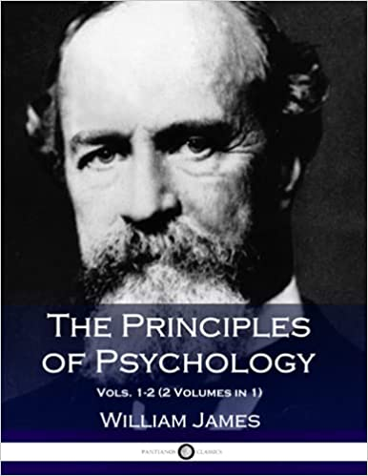
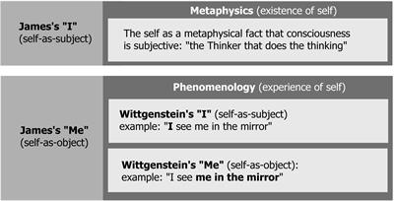
SELF AS SUBJECT & OBJECT
  The distinction between
    self-as-subject or agent
    self-as-object
  was first introduced by
  William James (1842-1910)
  in his seminal work:
  Principles of Psychology.
  Some features of these two aspects of the self are on the next slide

Slide 6
SELF AS SUBJECT & OBJECT
Self as subject | Self as object
Self-awareness | Self-representation
Self as ‘I ‘ | Self as ‘Me’
Self as consciousness | Self-concept
Self as collection of states of consciousness | Self-schemas
Self as a perceiver | Self as an object of perception
Self as biological organism adapting to environment | Self as a concept socially constructed in a community and culture
Self as organism with capacity to learn | Self as a repertoire of learned skills
Self as speaker | Self constructed in language
Subjective experience | Narrative self and autobiographical memory
Self as organism motivated to achieve (conflicting) goals | Ideal self and possible selves as goals to be pursued
Self-regulation | Self-evaluative beliefs
Self as user of coping strategies and defence mechanisms | Self-esteem and self-efficacy

Slide 7
SELF AS SUBJECT & OBJECT IN POSITIVE PSYCHOLOGY
  Within positive psychology research there has been a focus on self as both subject & object
  Self as object
    Self-esteem – positive evaluation of the self
    Self-efficacy – positive beliefs about our ability to uses skills to achieve goals
  Self as subject
    Self-regulation – capacity to regulate emotions
    Adaptive defence mechanisms – unconscious strategies for managing intrapsychic conflict
    Functional coping strategies – conscious strategies for dealing with external demands

Slide 8
SELF-ESTEEM

Slide 9
SELF-ESTEEM
  In 1890 William James defined self-esteem as the feeling of self-worth that derives from the ratio of our actual successes to our pretensions
  Self-worth is based on a comparison of how we are, and how we aspire to be in the future
  Self-esteem is hierarchically organised, with overall global self-esteem based on general judgements of self-worth and beneath this, sub-types of self-esteem based on evaluations of self-worth in within the
    Family
    School
    Work-setting
    Leisure setting
    Peer group

Slide 10
SELF-ESTEEM ASSESSMENT
  Self-esteem is assessed with multi-item self-report scales such as
    Rosenberg’s Self-Esteem Inventory
    Coopersmith Self-esteem Inventory for children and adults
    Multidimensional Self-Esteem Inventory for adults
  The 4-item lifespan self esteem scale for people aged 4-90 is on the next slide

Slide 11
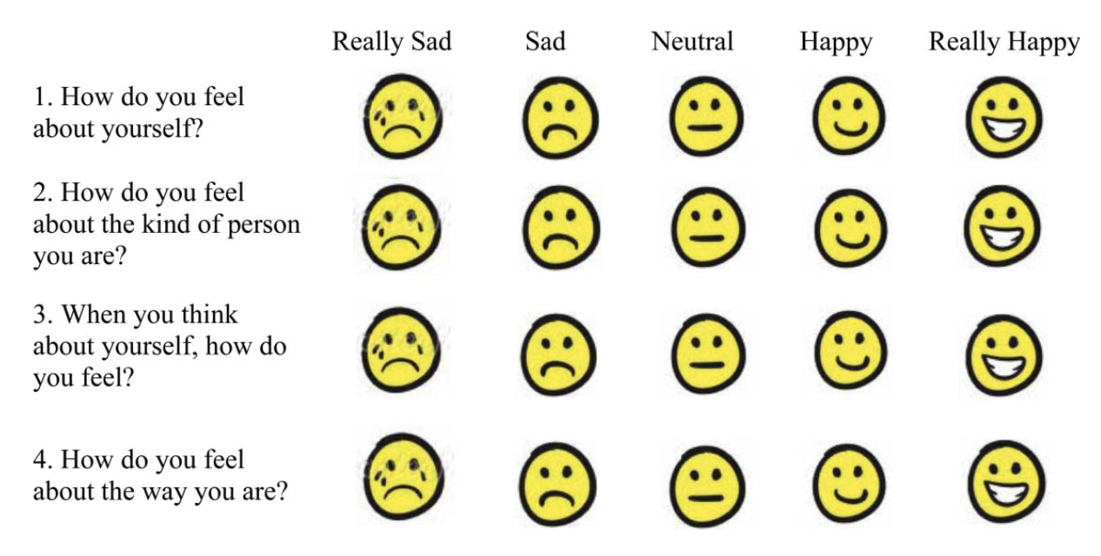
PAUSE & PRACTICE - ASSESS YOUR SELF-ESTEEM
Lifespan self-esteem scale
  For each of the 4 items below circle the answer that applies to you
  Score each item as follows: 1 = really sad, 2 = sad, 3 = neutral, 4 = happy, 5 = really happy
  Sum your item scores to get your overall score
  The normal range for self-esteem across the lifespan on this scale 12-18.
Note: Reproduced with permission or Taylor & Francis from Figure1 on page 88 of Harris, M. A., Donnellan, M. B., & Trzesniewski, K. H. (2018). The lifespan self-esteem scale: Initial validation of a new measure of global self-esteem. Journal of Personality Assessment, 100(1), 84-95. https://dx.doi.org/10.1080/00223891.2016.1278380, Copyright © 2017 Routledge / Taylor & Francis. Permission conveyed through Copyright Clearance Center, Inc.

Slide 12
DEVELOPMENT OF SELF-ESTEEM
  Twin studies show that self-esteem is about 40% heritable
  Self-esteem follows a well-defined trajectory over the life span shown on the next slide which is based on a meta-analysis of data from over 300 international longitudinal studies
  Children are more likely to develop high self-esteem
    In families with economic security
    Where both parents are present and have a good relationship
    Where their mothers do not suffer from depression
    Where they experience parental warmth and emotional support, intellectual stimulation, and support for the development of autonomy
  Individual differences in self-esteem are relatively stable over the life span

Slide 13
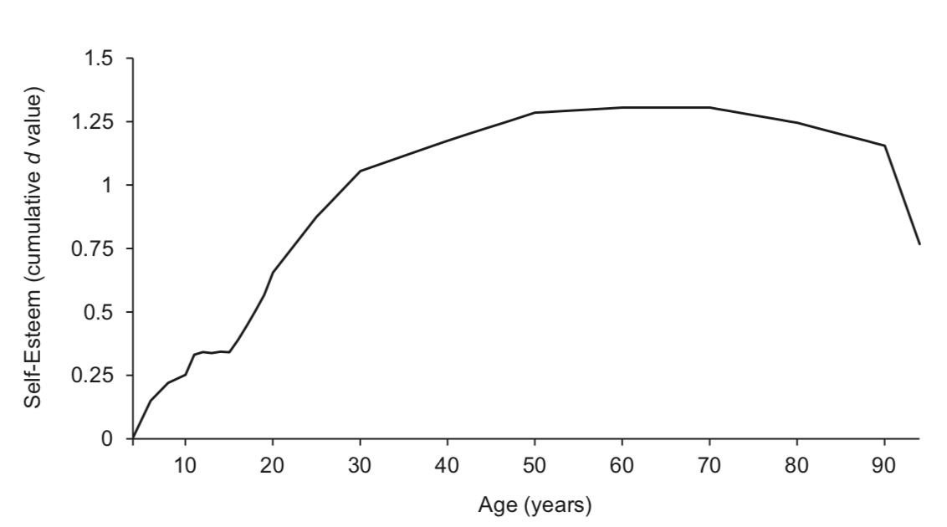
DEVELOPMENT OF SELF-ESTEEM OVER THE LIFESPAN
Note. Reproduced with permission of the American Psychological Association from Figure 3, p.1066 in Orth, U., Erol, R. Y., & Luciano, E. C. (2018). Development of self-esteem from age 4 to 94 years: A meta-analysis of longitudinal studies. Psychological Bulletin, 144(10), 1045-1080. https://doi.org/10.1037/bul0000161, Copyright © 2018 American Psychological Association. The graph shows cumulative effect sizes (d) relative to self-esteem at 4 years.

Slide 14
DEVELOPMENT OF SELF-ESTEEM
  Meta-analyses of many studies show that self-esteem improvement programmes for both children and adults are effective at increasing self esteem, but there is very little evidence that they increase the correlates of self esteem
  Self-esteem predicts success and wellbeing in life in important domains notably relationships, education, work, and both physical and mental health
  Positive relationships enhance self-esteem, and high levels of self-esteem have beneficial effects on relationships.
  Stressful life events such as having a serious accident, contracting a chronic disease, or suffering criminal victimization have a negative impact on self-esteem
  While work success and socio-economic status are associated with self-esteem, longitudinal studies show that they have limited causal impact on self-esteem

Slide 15
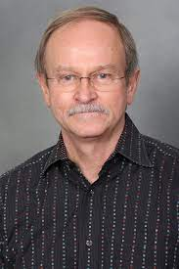
DEFENSIVE SELF-ESTEEM
Christopher Mruck’s two factor model of self-esteem in the next slide is a framework for understanding defensive self-esteem
The two axes within the model are
  Competence. Skills for competing tasks
  Worthiness. The experience of having a sense of worth
There are two categories of defensive self-esteem
  Type1. Low competence & high sense of worth
    Extreme sensitivity to criticism of competence because of a sense of incompetence
    When competence is questioned by others, they brag, criticise and blame others
    An extreme version of this type of defensive self esteem occurs in narcissistic personality disorder
  Type 2. High competence & low sense of worth
    Extreme sensitivity to criticism of personal worth
    When worth is questioned, they become immersed in their work and show workaholic behaviour (compensating for a low sense of worthiness through overachievement)
    An extreme version of this type of defensive self-esteem leads to bullying and inappropriate aggression, and is referred to as antisocial self-esteem
Chris Mruck

Slide 16
SELF-ESTEEM WORTHINESS, AND COMPETENCE
Note. Based on Mruk, C. (2013). Self-esteem and positive psychology (4th ed.). New York, NY: Springer, Figure 5.6, p.150.

Slide 17
IMPROVING SELF-ESTEEM
Skills training. Training in problems-solving skills, social skills, assertiveness skills, academic skills, and work-related skills, may increase self-esteem associated with low competence in these areas
Environmental changes. Where a low sense of worthiness derives from poverty or social disadvantage, environmental changes such as occupational retraining, occupational placement, or social relocation to a less disadvantaged area may enhance self-esteem
CBT & Mindfulness. Where a low sense of worthiness is due to unrealistically high aspirations, despite a realistic level of achievement, cognitive therapy may help challenge high standards, or mindfulness training may facilitate acceptance that self-critical thoughts are transient mental phenomena rather than accurate representations of reality

Slide 18
PAUSE & PRACTICE
FOSTERING SELF-ESTEEM IN CHILDREN
Accept your children’s profile of strengths and limitations
Set explicit high, but attainable standards in their areas of strength
Support children in attaining these standards
Adopt a consistent authoritative parenting style in which you treat your children with warmth and respect and allow them some influence over the way household routines and rules for good conduct are set and enforced
Be a good role model for your children by coping with life challenges using an active problem-solving coping style

Slide 19
SELF-EFFICACY

Slide 20
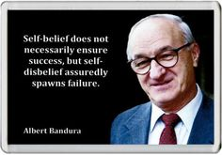
SELF-EFFICACY
Albert Bandura is the originator of self-efficacy theory
Perceived self-efficacy refers to beliefs about our capacity to perform tasks to achieve specific goals
In the next slide it may be seen in right hand side of the diagram that self-efficacy beliefs, affect outcome expectations, and these affect performance

Slide 21
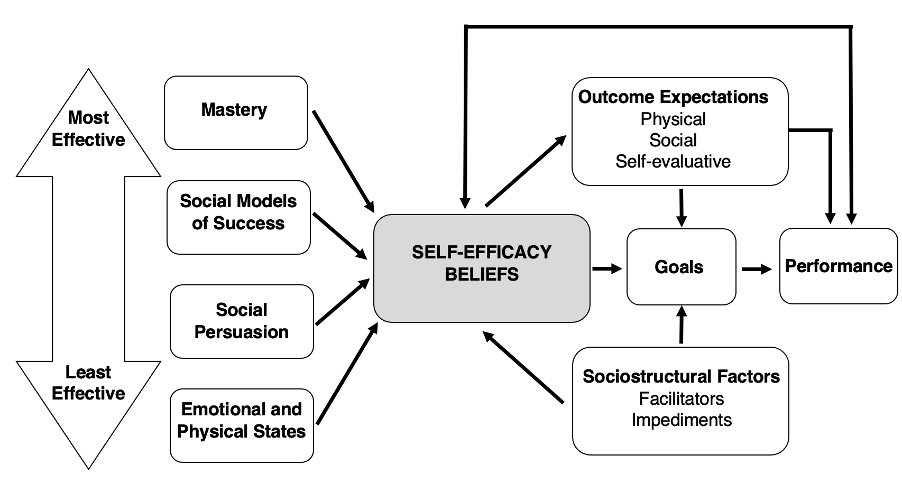
BANDURA’S SELF-EFFICACY THEORY
Note. Based on Bandura, A. (1977). Self-efficacy: Toward a unifying theory of behavioural change. Psychological Review, 84(2), 191-215. https://doi.org/10.1037/0033-295X.84.2.191, Figure 2, p. 195; and Bandura, A. (2012). On the functional properties of perceived self-efficacy revisited. Journal of Management, 38(1), 9-44. https://doi.org/10.1177/0149206311410606, Figure 2, p. 14.

Slide 22
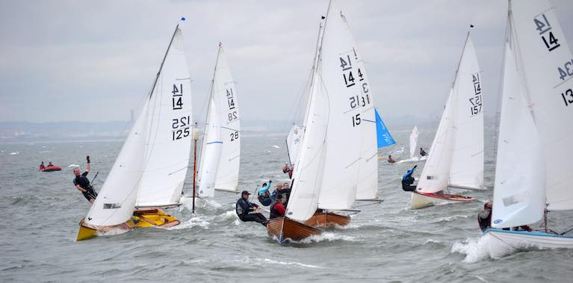
SELF-EFFICACY
This example illustrates other aspects of the diagram on the previous slide
If I judge myself to be capable of sailing my boat round a race course in a 25 knot per hour wind, this is a self-efficacy belief
The anticipated physical pleasure of coming ashore after the exertion of doing so and winning a sailing race, the social approval of other competitors for winning, and the self-satisfaction are physical, social and self-evaluative positive outcome expectations respectively
The act of sailing around the course is a performance
The impact of self-efficacy beliefs on performance is also mediated by goals (for example, aiming to win a sailing race), and sociostructural factors that may facilitate or impede performance (for example, the competitiveness of our boat in comparison with that with other competitors in the race).

Slide 23
SELF-EFFICACY
The overall strength of self-efficacy beliefs is influenced by mastery, social models of success, social persuasion, and emotional and physical states (listed on the left side of the next slide)
Mastery refers to past experiences of successful task completion, for example, winning previous sailing races
Social models of success, refers to having viewed others achieve successful task completion, for example, watching other expert sailors win similar sailing races
Social persuasion refers to processes such as being coached to perform better
Positive emotional and physiological states, such as excitement and joy have a positive impact on self-efficacy beliefs. Its easier to believe that winning a sailing race is possible when feeling happy and excited that when feeling frightened and panicky
These 4 factors fall on a continuum in terms of their impact on self-efficacy beliefs with mastery having the greatest impact

Slide 24
BANDURA’S SELF-EFFICACY THEORY
Note. Based on Bandura, A. (1977). Self-efficacy: Toward a unifying theory of behavioural change. Psychological Review, 84(2), 191-215. https://doi.org/10.1037/0033-295X.84.2.191, Figure 2, p. 195; and Bandura, A. (2012). On the functional properties of perceived self-efficacy revisited. Journal of Management, 38(1), 9-44. https://doi.org/10.1177/0149206311410606, Figure 2, p. 14.

Slide 25

SELF-EFFICACY
Efficacy beliefs lead to expectations about the positive or negative effects performance
Where performance is linked to outcome, research shows that efficacy beliefs predict expected and actual outcome in a range of domains including
  Academic achievement
  Occupational success
  Sports performance
  Parenting
  Creativity
  Dieting
  Adherence to medical regimes
  Pain management
  Smoking cessation
  Anxiety management

Slide 26
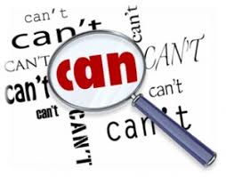
SELF-EFFICACY - CORRELATES
Cognitive correlates
  Greater cognitive resourcefulness
  Greater strategic flexibility
  More effective management of challenges
  A future-time perspective
  A focus on potentially beneficial opportunities rather than risks
  Visualise successful outcomes to guide problem-solving
Motivational correlates
  Set challenging goals
  Persist in striving to achieve goals
  View obstacles as surmountable
  Attribute failure to controllable factors such as insufficient effort
Emotional correlates
  Less worry and negative thinking about potential threats
  Use problem-focused coping to manage solvable problems & stresses
  Use emotion-focused coping to to manage stress responses e.g., social support, humour, relaxation and exercise
Health correlates
  More efficient immune system functioning
  Better physical and mental health

Slide 27
SELF-EFFICACY - INTERVENTIONS
Self-efficacy enhancement programmes are effective for
  Improving reading in school children
  Increasing physical exercise
  Quitting smoking
  Increasing condoms use to prevent HIV infection
  Facilitating a healthy diet
  Fatigue management
  Managing cancer-related pain and distress
  Managing high blood pressure
  Managing diabetes
  Caring for older adults with dementia
  Caring for children
Effective self-efficacy enhancement programmes
  Help individuals master specific skills relevant to their particular goals
  Provide opportunities to observe skilled role models
  Coach individuals in skills development and use
  Facilitate emotional self-regulation.
Face-to-face individual and group formats are more effective than digital formats

Slide 28
PAUSE & PRACTICE
DEVELOPING SELF-EFFICACY
In a specific domain set overall goals, along with a series of intermediate small but achievable goals to insure mastery experiences occur frequently
When you achieve goals, acknowledge your mastery experiences and reflect on how competent you expect to be next time you attempt to achieve a similar goal
Observe other people who have succeeded through sustained effort in working towards goals like yours
Arrange for significant members of your social network or coaches who know the domain in which you wish to excel to persuade you that you can succeed in mastering manageable goals
Pursue goals when you are physically and mentally fit and in a positive mood

Slide 29
HIGHLY ADAPTIVE DEFENCE MECHANISMS

Slide 30
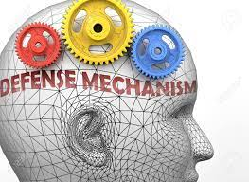
DEFENCE MECHANISMS
Defence mechanisms are
Unconscious processes
That regulate negative affect (especially anxiety)
Associated with intrapsychic conflict about unacceptable sexual or aggressive impulses, or traumatic memories
Based in the psychoanalytic tradition
Described by Sigmund Freud
They are distinct from coping strategies

Slide 31
DEFENCE MECHANISMS V COPING STRATEGIES
Defence mechanisms | Coping strategy
Defence mechanisms (e.g. repression) are unconscious processes that regulate negative affect (especially anxiety) associated with intrapsychic conflict about unacceptable sexual or aggressive impulses or traumatic memories, and were introduced into modern psychology within the psychoanalytic tradition by Sigmund Freud | Coping strategies are conscious processes for dealing with external demands (such as exams) that outstrip personal resources (such as our memory of the material being examined) and were introduced into modern psychology within the cognitive-behavioural tradition
Unconscious | Conscious
Regulate negative affect due to intrapsychic conflict | Regulate negative affect due to imbalance between excessive external demands and limited personal psychological resources
Psychanalytic tradition | Cognitive behavioural tradition

Slide 32
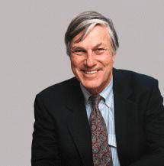
HIGHLY ADAPTIVE DEFENCE MECHANISMS
George Vaillant developed the defensive functioning scale which organizes defence mechanisms into a series of levels from dysregulated to highly adaptive
The scale was included in the Appendix DSM-IV
The highly adaptive level there were 8 defence mechanisms
  Anticipation
  Affiliation
  Altruism
  Humour
These highly adaptive defences regulate anxiety and maximise the possibility of gratification by transforming anxiety arising from conflict between unacceptable impulses and injunctions into positive action (shown on next slide)
Less adaptive defences regulate anxiety by
  Keeping impulses & injunctions out of consciousness
  Distorting the image of self and others
  Acting out negative impulses
Self-assertion
Self-observation
Sublimation
Suppression
George Vaillant

Slide 33
DEFENCE MECHANISMS

Slide 34
HIGHLY ADAPTIVE DEFENCE MECHANISMS
Anticipation. Considering and partially experiencing emotional reactions and the consequences of these before the conflict or stress occurs and exploring the various solutions to these problematic emotional states
Affiliation. Seeking social support from others, sharing problems with them and doing this without making them responsible for the problem
Altruism. Dedication to meeting the needs of others and receiving gratification from this without engaging in excessive self-sacrifice
Humour. Reframe situations that gives rise to conflict or stress in an ironic or amusing way
Self-assertion. Expressing conflict-related thoughts or feelings in a direct yet non-coercive way
Sublimation. Channelling negative emotions arising from conflict into socially acceptable activities such as work, sports or art
Suppression. Intentional avoidance of thinking about conflict for a brief period (‘parking it’)

Slide 35
ASSESSMENT OF DEFENCE MECHANISMS
DEFENCE MECHANISM RATING SCALE
The Defence Mechanism Rating Scales allows 27 defence mechanisms to be rated from interview recordings
Defences are grouped into 7 levels
  (1) Mature defences: affiliation, altruism, anticipation, humour, self-assertion, self-observation, sublimation and suppression
  (2) Obsessional defences: isolation, intellectualisation and undoing;
  (3) Other neurotic defences: repression, dissociation, reaction formation and displacement;
  (4) Minor image distorting narcissistic defences: omnipotence, idealisation and devaluation;
  (5) Disavowal defences: denial, projection, rationalisation and fantasy;
  (6) Major image distorting borderline defences: splitting and projective identification; and
  (7) Action defences: acting out, passive aggression and hypochondriasis
The rating scales have criteria for rating the presence or absence of the defences
They correlate with measures of adaptive functioning and mental health

Slide 36
HIGHLY ADAPTIVE DEFENCE MECHANISMS - RESEARCH FINDINGS
In a 50 year longitudinal study of three large cohorts George Vaillant used the defence mechanism rating scales to assess defences from interview transcripts and found that using highly adaptive defence mechanisms in the 20s was predictive in middle and later life of
  Greater well-being
  Better personal adjustment
  Better social support
  Higher marital satisfaction
  Higher income
  Less disability
  Greater resilience in the face of life stresses

Slide 37
HIGHLY ADAPTIVE DEFENCE MECHANISMS - RESEARCH FINDINGS
Subsequent research of adaptive defences has shown the following
  For cancer patients, adaptive defences lead to better physical and emotional functioning during recovery
  For mental health problems, adaptive defences facilitate a positive therapeutic alliance in psychotherapy which promotes recovery
  Psychotherapy leads to an increase in the use of adaptive defence mechanisms

Slide 38
PAUSE & PRACTICE
HIGHLY ADAPTIVE DEFENCE MECHANISMS
Make point of noticing situations in which you are feeling an internal conflict between an unacceptable impulse or emotion and a wish not to express that impulse or emotion
When you notice these conflict situations, pause before reacting, and consider using one of the highly adaptive defence mechanisms
Anticipation
Affiliation
Altruism
Humour
Self-assertion
Sublimation
Suppression
Write down the adaptive defence you used and rate on a scale of 1 to 10 how effective it was in helping you deal with the internal conflict.

Slide 39
FUNCTIONAL COPING STRATEGIES

Slide 40
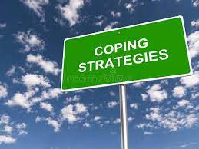
COPING STRATEGIES
Coping strategies are
Conscious processes
For dealing with external demands (such as exams), not intrapsychic conflict
They are used when demands tax personal resources (such as our memory of the material being examined)
They were introduced into modern psychology within the cognitive-behavioural tradition
They are distinct from defence mechanisms

Slide 41
CLASSIFICATION OF COPING STRATEGIES
Coping strategies may be classified as
Problem-focused
  Aim to reduce stress
  Useful for controllable stresses
Emotion focused
  Aim to reduce stress responses
  Useful for uncontrollable stresses
Avoidant
  Aim to avoid source of stress
  Useful in short-term
Coping strategies may be classified as
Functional
  Lead to long-term well-being
Dysfunctional
  Lead to short-term well-being, but long-term increased stress

Slide 42
EXAMPLES OF TYPES OF COPING STRATEGIES
Type | Aim | Functional | Dysfunctional
Problem-focused | Reduce source of stress | Systematic problem solving | Ineffective problem solving
Emotion-focused | Reduce stress responses | Social support | Destructive relationships
 |  | Spiritual or religious support | Joining cults
 |  | Catharsis | Denial
 |  | Positive reinterpretation | Self-blaming or blaming others
 |  | Meditation & relaxation | Drug and alcohol misuse
 |  | Physical exercise | Aggression
 |  | Meaningful work (in a balanced lifestyle) | Workaholism
Avoidance-focused | Avoid source of stress | Temporary distraction | Long-term distraction

Slide 43

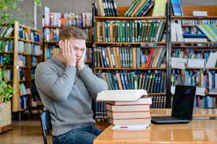
THE COPING PROCESS
The diagram on the next slide is a model of the coping process
We respond to challenging life events, like going to university for the first time, by appraising the demands that this places upon us, and then coping with these demands using functional or dysfunctional coping strategies
We may appraise the demands positively and use of functional coping strategies (attending lectures, studying well, making friends) which enhances wellbeing
We may appraise the demands as exceeding personal resources, and use dysfunctional coping strategies (isolating ourselves, procrastinating doing assignments, drinking too much) which in the short-term may reduce distress but in the long term may have a negative effect on wellbeing
The cognitive process of appraisal influences how the body reacts at a neurobiological level, and ultimately how stress impacts on health
This process of coping with transitory demanding life events, is influenced by
  The environmental system (e.g. financial difficulties & supportive relationships)
  The personal systems (e.g. personality traits & self-efficacy)

Slide 44
THE COPING PROCESS
Note. Based on Moos, R. H., & Holahan, C. J. (2003). Dispositional and contextual perspectives on coping: Toward an integrative framework. Journal of Clinical Psychology, 59(12), 1387-1403. https://doi.org/10.1002/jclp.10229, Figure 1, p.1393.

Slide 45
FUNCTIONAL PROBLEM-FOCUSED COPING STRATEGIES
Accepting responsibility for solving the problem
Seeking accurate information about the problem
Seeking dependable advice and help
Developing realistic action plans
Carrying out plans either alone or with the help of other people
Staying focused by postponing engaging in competing activities
Maintaining an optimistic view of one’s capacity to solve the problem

Slide 46
FUNCTIONAL EMOTION-FOCUSED COPING STRATEGIES
Social support. Engaging in close confiding relationships
Catharsis. Processing of emotionally charged thoughts and memories within the context of a confiding relationship, or by writing
Seeking meaningful spiritual or religious support which provides long-term membership of a socially supportive community, encourages a balanced moral lifestyle, and provides meaning an purpose in life
Positive reinterpretation of challenging situations though benefit-finding; taking an ironic humorous perspective, or finding meaning or purpose in life by facing adversity
Post-traumatic growth which involves 5 processes: recognition of personal strength, improved relationships with other people, a greater appreciation of life, spiritual and existential transformation, and an increased openness to new possibilities.
Meaningful work paid or voluntary within the context of a balanced lifestyle

Slide 47
FUNCTIONAL EMOTION-FOCUSED COPING STRATEGIES
Self-forgiveness by accepting responsibility for wrongdoing, making a commitment to moral values and accepting that one has violated these; and compassionately accepting the self as someone who has done wrong but is committed to good moral values in the future
Mindfulness meditation paying attention, on purpose, in the present moment, without judgment to immediate sensory experience with an attitude of curiosity, openness and acceptance during practices such as mindfulness of the breath and body or the body scan (described in chapter 4)
Progressive muscle relaxation. A series of exercises for reducing muscle tension. The exercises involve tensing and relaxing muscles groups, one at a time, in all areas for the body including the hands, arms, shoulders, back, feet, legs, buttocks, hips, stomach, chest, neck and face
Energising routines including physical exercise, sport, or yoga

Slide 48
PAUSE & PRACTICE - FUNCTIONAL COPING STRATEGIES
Make a point of noticing situations in which there are intense external demands on you, that are difficult to cope with
When you notice these demanding situations, consider using one of the functional coping strategies
For controllable demands, consider using problem-focused coping strategies
For uncontrollable demands or for controlling stress responses use emotion-focused coping strategies
Write down the coping strategy you used and rate on a scale of 1 to 10 how effective it was in helping you deal with stressful demands
PROBLEM-FOCUSED COPING
Accepting responsibility for solving the problem
Seeking accurate information about the problem
Seeking dependable advice and help
Developing realistic action plans
Carrying out plans either alone or with the help of other people
Staying focused by postponing engaging in competing activities
Maintaining an optimistic view of one’s capacity to solve the problem
EMOTION-FOCUSED COPING
Social support
Catharsis
Seeking meaningful spiritual or religious support
Positive reinterpretation
Post-traumatic growth
Meaningful work
Self-forgiveness
Mindfulness meditation
Progressive muscle relaxation
Energising routines

Slide 49
CONTROVERSIES ABOUT THE SELF

Slide 50
CONTROVERSIES ABOUT THE SELF
Dualism. Any psychological theory that proposes the self if the main ‘driver’ of the body is open to the problem faced by René Descartes’ (1596-1650) who proposed that material-body was directed by non-material soul, even though by definition the immaterial cannot influence the material
Self-esteem and self-efficacy. There are arguments that these are distinct constructs, since predictions based on measure of self-efficacy are more accurate than those based on self-esteem. There is also an argument that self-evaluative beliefs may be hierarchically organised with global beliefs about self-worth at the top of the hierarchy and specific efficacy beliefs beneath this
Defence mechanisms and coping styles. There is an argument that these are quite distinct phenomena. There is an alternative viewpoint that all self-regulatory procedures fall along a number of continua including the degree to which we are consciously aware of them, and the degree to which we deliberately use them

