Slide 1
CHAPTER 8.
POSITIVE RELATIONSHIPS

Slide 2
LEARNING OBJECTIVES
Be able to explain processes that account for the association between positive social relationships and wellbeing, including social support, Love 2.0, co-operation, attachment, empathy, altruism, kindness, meaning in life, capitalization, and forgiveness
Develop basic skills for loving kindness meditation, active constructive responding, and forgiveness to enhance personal wellbeing
Give an account of contemporary theories of romantic love including behavioural systems theory, neurobiological theory, Sternberg’s duplex theory, and Gottman’s sound relationship house theory
Summarize key research findings on couple relationship satisfaction
Describe relationship education and positive psychology interventions for couples
Understand key skills for enhancing romantic relationships including expressing fondness and appreciation and managing conflict
Give an account of authoritative parenting and positive psychology parenting
Understand key skills for enhancing parent-child relationships including quality time, accommodating to children’s temperaments, promoting prosocial behaviour, discouraging problem behaviour, problem-solving and negotiation, facilitating positive emotions, nurturing signature strengths, and being a positive role model.

Slide 3
RELATIONSHIPS

Slide 4
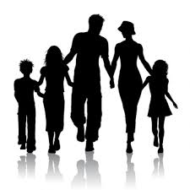



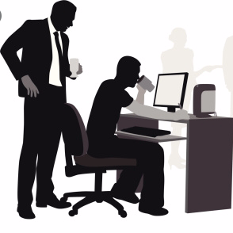
RELATIONSHIPS
Benefits of relationships. Positive relationships with family, friends, colleagues and the wider community lead to greater
  Wellbeing
  Mental and physical health
  Accomplishments at work and in sports
  Resilience when recovering from serious illness, e.g. cancer and heart disease
  Longevity

Slide 5


RELATIONSHIPS
Evolution. The capacity to make and maintain close relationships was adaptive for our prehistoric ancestors
Those who formed relationships survived because they could
  Mate
  Form families and tribes
  Obtain food
  Build safe dwellings, and
  Protect themselves from predators and enemies
Those who could not form relationships could not do these things and so did not survive

Slide 6
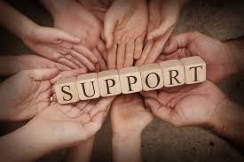
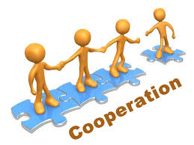

RELATIONSHIPS
In contemporary society 3 mechanisms link relationships to wellbeing
  Support. In close relationships we obtain social support
  Co-operation. At work, in sports, and at home, relationships help us co-operate when doing tasks that can’t be done alone
  Positive experiences. Relationships provide a context for
    Love or attachment
    Empathy, altruism, and kindness
    Meaning in life
    Active-constructive responding to capitalizing
    Forgiveness

Slide 7
SOCIAL SUPPORT

Slide 8
SOCIAL SUPPORT
  Supportive close relationships buffer people from stress
  Individuals with supportive relationship show
    Better recovery and quality of life following major illnesses including cancer, heart attacks, and stroke
    Fewer depressive symptoms when coping with chronic stress
    Fewer PTSD symptoms in the aftermath of life-threatening stress
  Longevity. In a meta-analysis of 50 studies involving over 100,000 people from 17 countries, Eran Shor found that people with low levels of social support were 11% more likely to die prematurely than those with adequate social support

Slide 9
SOCIAL SUPPORT
  Social support counteracts the negative effects of stress by affecting the way we think and feel, and our physiological state
  When we talk with someone we are close to, who empathises with our stressful situation…
  Thinking. We put our difficulties in perspective
  Feeling. We feel understood, less isolated, and more positive affect
  Physiological state. Our heart rate, blood pressure, cortisol levels all gradually return to normal, and the immune system functions better

Slide 10
LOVE 2.0

Slide 11

LOVE 2.0
  Moments of connection. Love 2.0 is a term coined by Barbara Frederickson for brief moments of positive social connection that enhance wellbeing, by broadening thought-action repertoires and creating opportunities for building lasting resources. (This is an extension of her Broaden and Build Theory discussed in chapter 1.)
  For example - You meet a colleague in the corridor at work, smile at each other, and briefly joke about an email that was circulated to all staff that morning about not wasting time talking in corridors

Slide 12
LOVE 2.0
  During Love 2.0 moments of connection
  Positive emotion is shared
  Mutual care is expressed
  Behavioural synchrony occurs between 2 people’s actions where they mirror each other’s gestures
  Biological synchrony occurs between certain neurobiological processes: an overlap between the areas of both individuals’ brains that become particularly active and their oxytocin waves also synchronise (Oxytocin is the hormone that regulates the calm-and-connect response)
  Positivity resonance occurs, where each person amplifies the positive emotional experience of the other and the impulse to express care

Slide 13
LOVE 2.0
  Positivity resonance is more likely to occur when both people
  Feel safe
  Are present in the same physical place at the same moment in time (rather than interacting virtually)
  Are making eye contact
  Are touching
  Are mirroring gestures

Slide 14
PAUSE & PRACTICE – LOVING KINDNESS MEDITATION
  Wellbeing can be enhanced by actively organising our lives to create more moments of connection - Love 2.0.
  We can prepare ourselves to make the most of such opportunities by regularly engaging in meditation practices in which we focus on compassion and loving-kindness
  In compassion and loving kindness meditations, positive feelings are directed towards
    The self
    Then towards loved ones
    Then towards strangers
    Then toward someone with whom we experience conflict or difficulty
    Finally toward all people
  Practice the befriending or loving kindness meditation facilitated by Mark Williams (9:37). https://www.youtube.com/watch?v=pLt-E4YNVHU

Slide 15
CO-OPERATION

Slide 16
CO-OPERATION
    Big goals. Co-operative relationships make it possible to purse big goals that would not be achievable without the help of others
    Better teamwork. Co-operative relationships improve the efficiency of parenting teams, work teams, and sports team
    Better children. Children of parents who co-operate effectively with each other have greater wellbeing, are happier, and have better academic achievement
    Better organizations. In work teams, colleagues who co-operate are more productive, return better profits, and engage in high quality communication in which trust is a central feature
    Better sports performance. Sports teams that co-operate perform better and win more competitions

Slide 17
ATTACHMENT

Slide 18
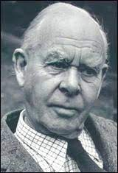
ATTACHMENT
    Relationship habits. People have habitual ways of interacting with others within important relationships
    Attachment theory is currently the most influential explanation for this phenomenon
    John Bowlby in the UK in the 1960s developed attachment theory to explain how children exposed to different parenting experiences develop distinctive styles for interacting with their parents, and other important people in their lives
    Secure attachments develop in children whose parents regularly meet their needs in predictable ways. They trust that their parents will be available to them when needed to provide them with a sense of safety and security
    Insecure attachments develop if parents fail to do this
John Bowlby

Slide 19
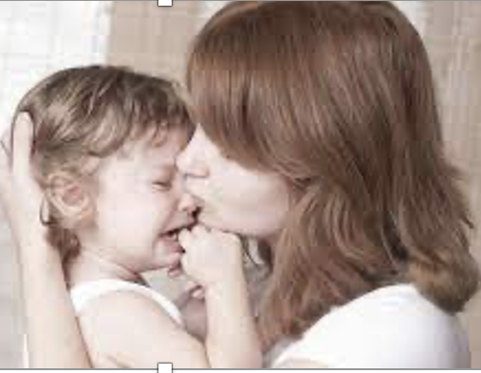
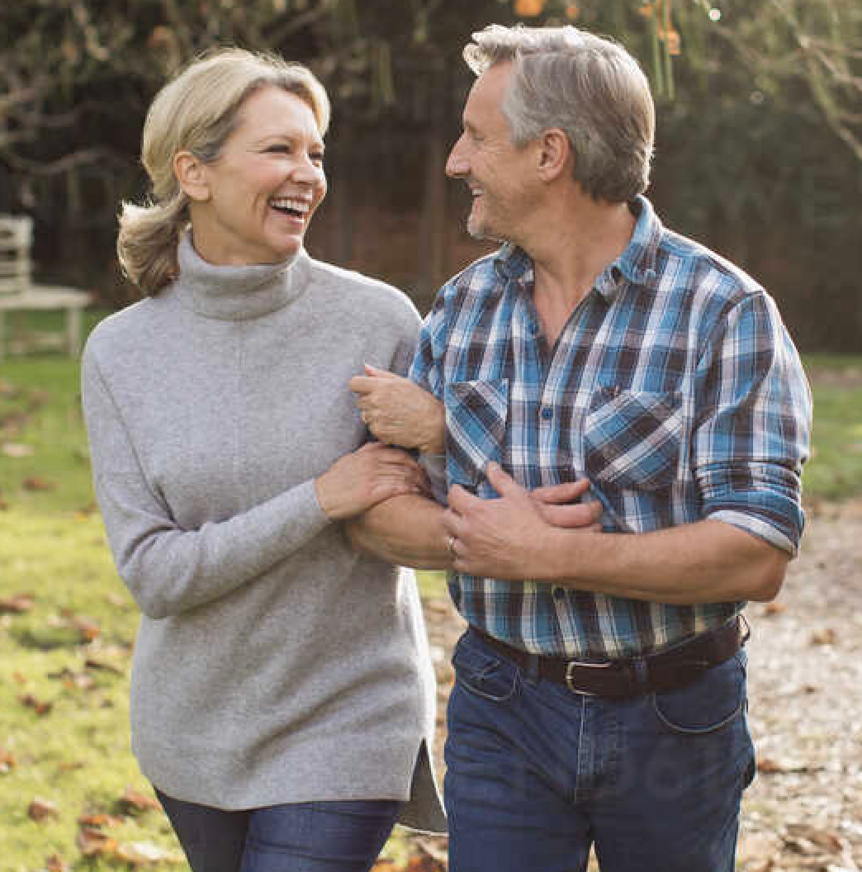
ATTACHMENT
    Evolution & attachment. Attachment behaviour is genetically programmed, essential for survival of the species, and elicited in children between 6 months and 3 years when faced with danger
    Proximity seeing in danger. In such instances children seek proximity with their parents. When comforted they return to the activity of exploring the immediate environment around the parent
    Repetition. The cycle repeats each time the child perceives a threat & children gradually build internal working models or ‘maps’ of attachment relationships based on the way these episodes are managed by parents in response to children's needs for safety and security
    Internal working models allow people to make predictions about how the self and significant others will behave within relationships
    Attachment styles. There are at least 3 different insecure attachment styles and at least one main secure attachment style
    Childhood attachment influences adult attachment style. Childhood attachment styles which govern the way children behave in relationships with their parents, in later life influence the way individuals conduct relationships with important people, especially romantic partners

Slide 20
ATTACHMENT
    Secure attachment. Securely attached infants and adults react to their parents and romantic partner as if they believe that they will be there to support them when needed
    Insecure attachment. Insecurely attached infants and adults react to their parents and romantic partners as if they believe that they cannot be depended upon for support when needed
    Attachment styles may be classified based on whether the internal working model of the self and others is positive or negative, and whether there are high or low levels of anxiety and avoidance, shown in the next slide

Slide 21
ATTACHMENT STYLES
Note. Based on Ainsworth, M. D. S., Blehar, M. M., Waters, E., & Wall, S. (1978). Patterns of attachment: A psychological study of the strange situation. Hillsdale, NJ: Erlbaum; Main, M., & Solomon, J. (1990). Procedures for identifying infants as disorganized/disoriented during the Ainsworth Strange Situation. In M. T. Greenberg, D. Cicchetti, & E. M. Cummings (Eds.), The John D. and Catherine T. MacArthur Foundation series on mental health and development. Attachment in the preschool years: Theory, research, and intervention (p. 121–160). Chicago, Il: University of Chicago Press; Bartholomew, K. (1990). Avoidance of intimacy: An attachment perspective. Journal of Social and Personal Relationships, 7(2), 147-178. https://doi.org/10.1177/0265407590072001; and Brennan, K. A., Clark, C. L., & Shaver, P. R. (1998). Self-report measurement of adult attachment: An integrative overview. In J. A. Simpson & W. S. Rholes (Eds.), Attachment theory and close relationships (p. 46–76). New York, NY: Guilford.

Slide 22
PAUSE & PRACTICE – ASSESS YOUR ADULT ATTACHMENT STYLE WITH THE
EXPERIENCE IN CLOSE RELATIONSHIP INVENTORY – 12 (ECR-12)
Please read each of the following statements and circle the answer opposite it that shows the extent to which it describes your feelings about romantic relationships. Please think about all your relationships (past and present) and respond in terms of how you generally feel in these relationships. Add up your scores for the attachment avoidance scale and for the attachment anxiety scale. On each scale, scores range from 6 to 42. Low scores indicate greater attachment security.
 | Attachment Avoidance
1. | I feel comfortable depending on romantic partners | Strongly disagree 7 | Disagree 6 | Disagree a little 5 | Unsure 4 | Agree a little 3 | Agree 2 | Strongly agree 1
2. | I usually discuss my problems and concerns with my partner | Strongly disagree 7 | Disagree 6 | Disagree a little 5 | Unsure 4 | Agree a little 3 | Agree 2 | Strongly agree 1
3. | I tell my partner just about everything | Strongly disagree 7 | Disagree 6 | Disagree a little 5 | Unsure 4 | Agree a little 3 | Agree 2 | Strongly agree 1
4. | I don’t mind asking romantic partners for comfort, advice, or help | Strongly disagree 7 | Disagree 6 | Disagree a little 5 | Unsure 4 | Agree a little 3 | Agree 2 | Strongly agree 1
5. | I don’t feel comfortable opening up to romantic partners | Strongly disagree 1 | Disagree 2 | Disagree a little 3 | Unsure 4 | Agree a little 5 | Agree 6 | Strongly agree 7
6. | I feel comfortable sharing my private thoughts and feelings with my partner | Strongly disagree 7 | Disagree 6 | Disagree a little 5 | Unsure 4 | Agree a little 3 | Agree 2 | Strongly agree 1
 | Attachment Anxiety
7. | I worry that romantic partners won’t care about me as much as I care about them | Strongly disagree 1 | Disagree 2 | Disagree a little 3 | Unsure 4 | Agree a little 5 | Agree 6 | Strongly agree 7
8. | I worry a fair amount about losing my partner | Strongly disagree 1 | Disagree 2 | Disagree a little 3 | Unsure 4 | Agree a little 5 | Agree 6 | Strongly agree 7
9. | I worry about being abandoned | Strongly disagree 1 | Disagree 2 | Disagree a little 3 | Unsure 4 | Agree a little 5 | Agree 6 | Strongly agree 7
10. | I worry about being alone | Strongly disagree 1 | Disagree 2 | Disagree a little 3 | Unsure 4 | Agree a little 5 | Agree 6 | Strongly agree 7
11. | I need a lot of reassurance that I am loved by my partner | Strongly disagree 1 | Disagree 2 | Disagree a little 3 | Unsure 4 | Agree a little 5 | Agree 6 | Strongly agree 7
12. | If I can’t get my partner to show interest in me, I get upset or angry | Strongly disagree 1 | Disagree 2 | Disagree a little 3 | Unsure 4 | Agree a little 5 | Agree 6 | Strongly agree 7
Note. Reproduced with permission of Guilford from Items 2, 6, 8, 9, 14, 15, 18, 24, 25, 27, 29, and 31 in appendix 3.1 pp.69-70 of Brennan, K. A. Clark, C.L., & Shaver, P.R. (1998). Self-report measurement of adult attachment: An integrative overview. In J. A. Simpson & W.W. Rholes (Eds.), Attachment theory and close relationships (pp.46-76). New York, NY: Guilford Press, Copyright © 2015 Guilford; and Hogrefe, from Table 2 on p.144 and Table 4 on p. 147 of Lafontaine, M.-F., Brassard, A., Lussier, Y., Valois, P., Shaver, P. R., & Johnson, S. M. (2016). Selecting the best items for a short-form of the Experiences in Close Relationships questionnaire. European Journal of Psychological Assessment, 32(2), 140-154. https://doi.org/10.1027/1015-5759/a000243, Copyright © 2015 Hogrefe

Slide 23
DETERMINANTS OF SECURE ATTACHMENT RESEARCH FINDINGS
Sensitive parenting. Parenting that is sensitive to children’ needs, plays a far greater role in the development of attachment security than genetic or temperamental factors
Secure parental attachment style. Parents with a secure attachment style are more likely to provide sensitive parenting
Low stress & high support. Parenting quality is also dependent on stresses and supports present in parents’ environments

Slide 24
ATTACHMENT
RESEARCH FINDINGS ON CORRELATES & INTERVENTIONS
Correlates of secure attachment include
Positive relationships with romantic partners, and friends
Emotional understanding
Self-regulation
Mindfulness
Hope
Resilience
Forgiveness
Interventions and secure attachment
For both children and adults, psychotherapy has been shown to modify insecure attachment styles so that there is a reduction in attachment anxiety and/or avoidance, and an increase in attachment security
Secure attachment is associated with a stronger working alliance and better outcome in psychotherapy

Slide 25
EMPATHY, ALTRUISM, KINDNESS, AND VOLUNTEERING

Slide 26
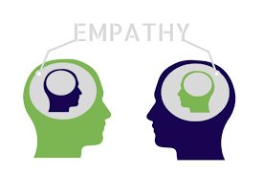
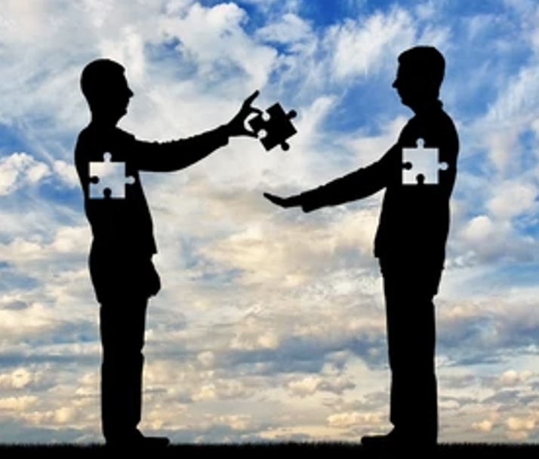


EMPATHY, ALTRUISM, KINDNESS, AND VOLUNTEERING
Relationships provide a context for
  Empathy
  Altruism
  Kindness
  Volunteering
All of these impact on wellbeing

Slide 27
EMPATHY

Slide 28
EMPATHY
Empathy has 3 components. It is the capacity to develop a cognitive understanding, emotional awareness, and bodily feeling of the experiences of another person
  Cognitive component. Predicting that the child who has fallen and hurt themselves is in pain, will cry, and call for their mother
  Emotional component. . Feeling an urge to comfort a child who has fallen and hurt themselves
  Physiological component. Flinching when watching another person being hit, or smiling when others smile

Slide 29
EMPATHY
Evolution of empathy. Empathy evolved because it had major survival benefits for humans, notably bonding individuals to each other, especially mothers to children
Determinants of empathy. Factors that contribute to the development of empathy include
  Secure parent-child attachment
  Family cohesion
  Authoritative parenting style, characterised by high warmth & moderate control
Effects of empathy. Positive outcomes in psychotherapy & medical practice
Empathy deficits. Healthcare professionals develop empathy deficits following a sustained high level of contact with distressed patients where empathy is required, when provided with insufficient support

Slide 30
ALTRUISM

Slide 31
ALTRUISM
Altruism is the intention to improve another person’s situation, for that reason alone, at a cost to the oneself and without expectation of reward
Empathy may motivate altruistic prosocial behaviour
Evolution. Altruism evolved because it enhanced the survival of groups of humans

Slide 32
ALTRUISM
Determinants of altruism. Factors that contribute to the development of altruism include
  Secure parent-child attachment
  Family cohesion
  Authoritative parenting style, characterised by high warmth & moderate control
  Parental monitoring of children’s behaviour and acting as altruistic role models
  Higher parental education & income
  Exposure to prosocial role models in peer groups, and the media
  Suffering from group-based violence, may enhance motivation to help other disadvantaged people (the ‘altruism born of suffering’ theory)
Pathological altruism may lead to
  Burnout in helping professions
  Co-dependency and supporting addiction in family members
  Violent behaviour towards an outgroup (to altruistically help an ingroup)

Slide 33
KINDNESS

Slide 34

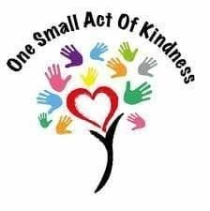
KINDNESS
Random acts of kindness enhance doners wellbeing. Sonja Lyubomirsky found that for acts of kindness to increase wellbeing the number of acts, the size of the acts, the variety of acts, and the time frame for doing these acts are important
  Number & Time frame. The number of acts of kindness must be high enough within a short time frame so we see ourselves as being kinder than usual (5 acts of kindness in a day had a bigger impact on wellbeing than 5 acts of kindness spaced over a week)
  Variety. A wider variety of different types of acts of kindness led to greater wellbeing than repeating the same act.
  Size. Larger acts of kindness (for example, regularly helping a disadvantaged child learn to read), up to a point, may boost wellbeing more than smaller acts (for example, lending someone your bicycle)
Pay it forward effect. Acts of kindness create better communities by inspiring others to carry acts of kindness.
Sara Pressman asked 83 individuals to perform random kind acts for other people in the community for 90 minutes. After being the recipient of such acts of kindness, 39% said that they had spontaneously ‘paid it forward’ by doing random acts of kindness for others
Sonja
Lyubomirsky

Slide 35
PAUSE & PRACTICE - KINDNESS
In this exercise, there is an invitation for you to plan to carry out acts of kindness for others
Here are some examples:
helping a friend carry their shopping to the car
visiting an older person who may be lonely
helping a colleague at work who is overloaded
helping someone with their homework
During this week select a day. On that day do five small acts of kindness, or one or two large acts of kindness. The important thing is that you are aware that you are being much kinder on this day, than you normally would be on other days
It’s also important that you do a variety of different acts of kindness, so that you do not feel like you are mechanically repeating the same act again and again
Do not bite off more than you can chew, and do so much that you feel overwhelmed
The person or people who you help do not have to know that you have helped them
Before and after you do this task, write down your well-being rating on a scale of 1 to 10 where 1 is a very low level of well-being and 10 is a very high level of well-being. Notice the effect of this acts of kindness task on your level of well-being. Also write down the acts of kindness that you carried out and reflect on what is says about you as a person that you did these acts
giving money to charity
lending a friend some money
minding a child during an emergency
getting a coffee for a colleague at work
Note: Based on an exercise in Lyubomirsky, S., Sheldon, K. M., & Schkade, D. (2005). Pursuing happiness: The architecture of sustainable change. Review of General Psychology, 9(2), 111-131. doi:http://dx.doi.org/10.1037/1089-2680.9.2.111

Slide 36
VOLUNTEERING

Slide 37
VOLUNTEERING
Volunteering involves making a commitment over a period of time to engaging in sustained acts of kindness.
Wellbeing. Volunteering improves health and wellbeing at all stages of the lifespan
  In adolescents
  Less depression
  Less alcohol and drug use
  Less delinquency
  Fewer intended pregnancies
  Fewer school problems
Volunteering improves wellbeing because it involves
Viewing others more positively and deserving of help
Receiving gratitude from those we help
Appreciating our own good fortune (social comparison)
Enhancing our self-image as compassionate and altruistic
Learning new skills
Developing supportive relationships with other volunteers
Developing meaning and purpose in life
In older adults
More positive mood
More physical activity
More longevity

Slide 38
MEANING IN LIFE

Slide 39

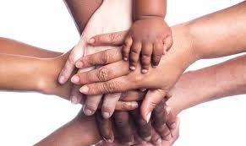
MEANING IN LIFE
Relationships give life meaning, purpose and direction
Meaning in life may mediate the relationship between relationships and wellbeing
Michael Steger invited participants to take photographs of things that made their lives meaningful, and asked them to explain why the items in their photographs contributed to their meaning in life
He found that relationships were the primary source of meaning in life for 90% of participants
Explanations for why relationships gave life meaning were classified into these categories providing
  Love
  Care
  Support
  Understanding
  Guidance
  Encouragement
Michael Steger
Inspiration
Values
A reason to live
A context for self-development
A context for having fun together

Slide 40
ACTIVE CONSTRUCTIVE RESPONDING

Slide 41

ACTIVE CONSTRUCTIVE RESPONDING
Capitalization is telling others good news. By telling others about our good fortune, we are making the most of, or capitalising on our positive experiences. When others respond to our good news with enthusiasm, this increases our wellbeing.
Shelly Gable found that that there are 4 ways of responding when another tells you good news based on whether the response is
  Active or passive
  Constructive or destructive
Active-constructive responding is the only type of response that increased well-being and strengthened relationships
Shelly Gable

Slide 42
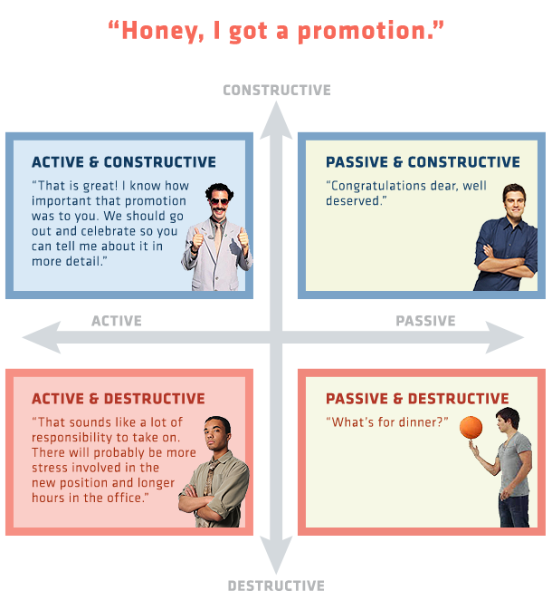

Slide 43
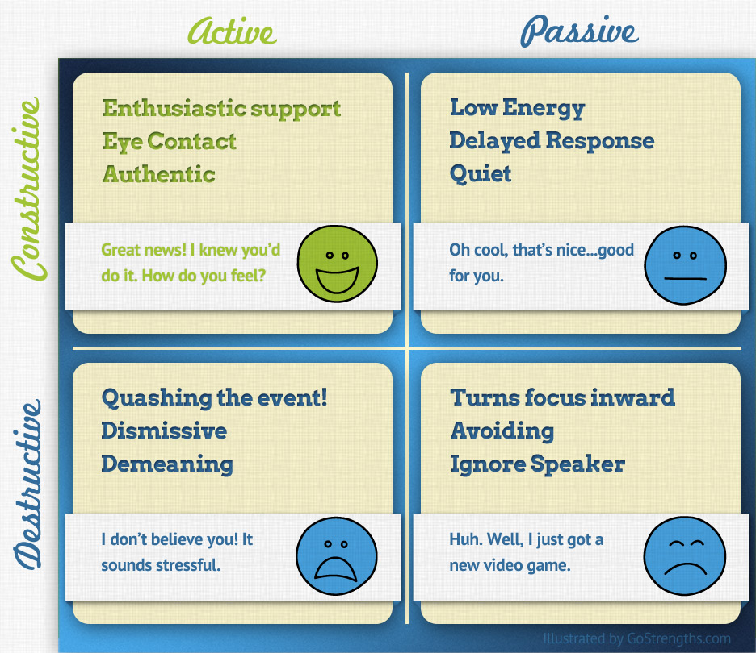

Slide 44
PAUSE & PRACTICE - ACTIVE CONSTRUCTIVE RESPONDING
Visualise meeting the people to whom you want to respond actively and constructively
Imaging the sorts of good things or successes that they are likely to mention to you when you meet and write these down
For each of these possible successes, write down the active and constructive responses you would like to give when they mention these good things or successes to you
Plan to ask them to describe their successes in great detail, so that their account is lengthened
Plan to elaborate what their account
Plan to celebrate their success
Be on the lookout for opportunities to put this rehearsal into action by responding actively and constructively
When you give an active and constructive response allow yourself to experience positive emotions such as enthusiasm, joy or pride about the other person success or good fortune. Don’t fake it

Slide 45
FORGIVENESS

Slide 46
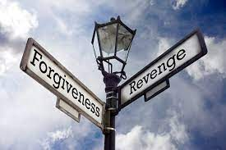
FORGIVENESS
Forgiveness & Revenge. Humans have evolved to engage in both revenge and forgiveness in response to dealing with situations involving being threatened or harmed
Revenge acts as a deterrent against further transgressions
Forgiveness maintains relationships between victims and transgressors, by preventing t-it-for tat reprisals, and turning conflict into co-operation

Slide 47
FORGIVENESS V REVENGE
Forgiveness | Revenge
May create a risk of further transgression, if forgiveness is viewed as weakness | Deterrent against further transgressions if revenge is viewed as strength
Prevents tit-or-tat reprisals | Creates tit-for-tat reprisals
Maintains relationships / alliances | Loss of relationships / alliances
Adaptive where The need for relationships is high The risk of further transgression is low The cost of revenge is high | Adaptive where The need for relationships is low The risk of further transgression is high The cost of forgiveness is high
Forgiveness leads to greater wellbeing and mental and physical health | Embitterment leads to reduced wellbeing

Slide 48
FORGIVENESS – RESEARCH FINDINGS
Personality traits & forgiveness
Forgiving people score high on
measures of
Empathy
Perspective-taking
Emotional stability
Agreeableness
Secure adult attachment style
Religiousness
Situational factors & forgiveness
People find it easier to forgive transgressions that are
Less intentional
Less severe
Less dangerous
Entail fewer negative consequences
For which the transgressor apologises
And occur in close, satisfying committed relationships
Forgiving people score low on measures of
Rumination about transgressions
Anger
Depression

Slide 49
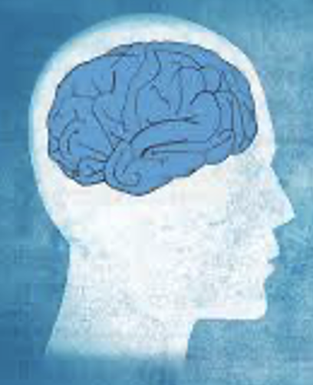

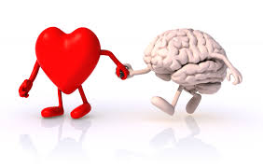
DECISIONAL & EMOTIONAL FORGIVENESS
Decisional forgiveness. A personal decision is made to forgive the transgressor, not to seek revenge, and make the relationship as good as it was before the offence. It is is a stepping stone to emotional forgiveness
Emotional forgiveness. Emotional empathy for the transgressor is experienced, and as a result less negative and more positive feelings toward them occur. This improves mental and physical health
Head & Heart. Decisional & emotional forgiveness are experienced as the ‘head’ and ‘heart’ of the forgiveness process

Slide 50

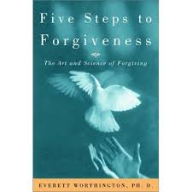
FORGIVENESS INTERVENTIONS
Everitt Worthington’s REACH group therapy programme is one of the most widely researched forgiveness interventions. REACH is an acronym which stands for
  Recall the hurt
  Empathise with the offender
  Give the Altruistic gift of forgiveness
  Make a Commitment to forgive
  Hold onto forgiveness when doubts occur
Meta-analyses of many outcome studies show that forgiveness interventions like the REACH programme lead to significant increases in forgiveness and reductions in anger, stress and depression for individuals who have experienced
  Divorce or separation
  Infidelity
  Betrayal
  Ethnic conflict
  Assault
  Abuse
  Incest
Better outcomes occur for longer programmes offered in individual rather than group format and for people who have suffered less severe offences
Everitt Worthington

Slide 51
PAUSE & PRACTICE - FORGIVENESS
Step 1. List the main reasons why you want to be a more forgiving person
Step 2. Write a list of five of the greatest hurts you have experienced in your life. These may be
Disappointments by your parents
Criticisms by teachers
Betrayals by friends or romantic partners, or
Being criticised or let down by people at work
Step 3. Pick one of the hurts you listed in Step 2, and write a brief description for each of the elements in the REACH process
R: Recall the hurt by writing a brief description of how you were hurt and its effect on you
E: Empathise with the transgressor by writing a brief description of what external pressures caused them to hurt you
A: Give the Altruistic gift of forgiveness by writing down a reason why you may want to unselfishly grant forgiveness
C: Commit to forgiveness by writing down your intention to forgive the transgressor now, or at some point in the future
H: Write down the strategies you will use when doubts make it difficult for you to Hold onto this forgiveness
Step 4. Write down what you admire most about two forgiveness role models from your current life or from the past (e.g., Nelson Mandela, Jesus of Nazareth, Mahatma Gandhi, Martin Luther King, etc.)

Slide 52
PAUSE & PRACTICE - FORGIVENESS
Step 5. Write a letter to yourself expressing your desire to be a more forgiving person
Step 6. Write down specific things you could do to begin to become a more forgiving person
Step 7. Write down how you are going to think and talk differently, in future, about one of the five hurts you listed in step 2 to show that you are more forgiving
Step 8. Write down something that you intend to do differently to become more forgiving
Step 9. Imagine how you would talk to one of the people you listed in step 2 so that they would know you are forgiving them
Step 10. List the strengths of the person towards whom you have the most negative feelings (from your list of 5 hurts in step 2)
Step 11. Write down the name of a person you trust to whom you have said you want to be more forgiving. Try to give to another person, whatever it is that the person you trust gives you that makes it possible for you to say that you want to be more forgiving
Step 12. Write a list of specific things you could do to show warmth towards the people who have hurt you, listed in step 2. Use this as a first step to start a campaign of feeling warmth towards your “enemies”
Note. Based on exercise H-8 in Worthington, E. L., Jr. (2016). The path to REACH forgiveness: Less than two hours to becoming a more forgiving person self-directed learning workbook. Virginia Commonwealth University, USA. http://www.evworthington-forgiveness.com/diy-workbooks

Slide 53
COUPLE RELATIONSHIPS

Slide 54

COUPLE RELATIONSHIPS
Couple relationships & wellbeing. Individuals in satisfying couple relationships, especially marriage, have better health and wellbeing, and live longer
Evolution and couple relationships. Humans have evolved to find long-term loving relationships very satisfying. These relationships created a context for rearing children to maturity, and so ensured survival of the species
Benefits of marriage. Today marriage confers a range of benefits on people that may make them happier, such as social support, a social role as a spouse and parent, and posterity

Slide 55


COUPLE RELATIONSHIPS
Variability. There is variability in the course of relationship satisfaction over the lifespan. Jared Anderson found five distinct trajectories in a 40-year US longitudinal study of 706 couples (see graph on the next slide)
  Nearly two thirds of participants in their study (groups 4 and 5) reported high and stable levels of marital happiness over a 40 year period
  The remaining third showed a curvilinear pattern of high happiness, decline, and recovery (group 3); a pattern of continuous low happiness (group 2); or a pattern of low happiness that subsequently declined (group 1)

Slide 56
FIVE DIFFERENT TRAJECTORIES OF MARITAL HAPPINESS
ACROSS THE LIFESPAN
Note. Adapted with permission of the American Psychological Association from Figure 1, p. 591 in Anderson, J. R., Van Ryzin, M. J., & Doherty, W. J. (2010). Developmental trajectories of marital happiness in continuously married individuals: A group-based modelling approach. Journal of Family Psychology, 24(5), 587-596. https://doi.org/10.1037/a0020928, Copyright © 2010 American Psychological Association. Permission conveyed through Copyright Clearance Center, Inc.

Slide 57

COUPLE RELATIONSHIPS - RESEARCH FINDINGS
Personality traits associated with relationship satisfaction include
  Emotional stability
  Extraversion
  Agreeableness
  Conscientiousness
  Secure adult attachment style
  Empathy
  Emotional intelligence
  Mindfulness
Relationship factors associated with relationship satisfaction include
  Collaborative and supportive coping with adversity
  Communication
  Responsiveness
  Generosity
  Gratitude
  Humour
  Engagement in joint leisure activities
  Sexual satisfaction
Demographic factors such as education, income, ethnicity, gender, age, and marriage duration are not consistently associated with stable relationship satisfaction

Slide 58

THEORIES OF ROMANTIC LOVE
NEUROBIOLOGICAL THEORY OF LOVE
Helen Fisher proposed that romantic relationships involve 3 systems that have evolved because they are adaptive for our species
  The sexual drive system evolved to motivate people to have sex with a range of potential partners. Testosterone levels are associated with the sex drive in men and women, and the hypothalamus and the amygdala are the two brain structures associated with this drive
  The attraction system evolved to motivate people to focus their attention on preferred partners likely to produce fit offspring or with the resources to support the development of offspring. Attraction, and an obsessive focus on a preferred mate, are associated with elevated dopamine activity in the reward pathways of the brain
  The attachment system evolved to motivate people to sustain their relationships long enough to rear their offspring. Attachment, and the process of mutual care and companionship, are associated with oxytocin activity in the nucleus accumbens and vasopressin activity in the ventral pallidum
Helen Fisher

Slide 59

THEORIES OF ROMANTIC LOVE
STERNBERG’S DUPLEX THEORY OF LOVE
Robert Sternberg proposed a duplex theory which integrates his ‘love as a story’ theory and his triangular theory
  Triangular theory proposed that each type of love is characterized by different levels of intimacy, passion, and commitment. Consummate love involves high levels of intimacy, passion and commitment and is associated with high relationship satisfaction
  Love as a story theory proposed that where partners have similar thematic love stories their relationship satisfaction is higher, e.g., love is like a democracy in which partners share power equally; or love is like history in which couples record or remember a series of important events.
  Duplex theory proposed that for long-term relationships to be satisfying couples must have similarly high levels of intimacy, passion and commitment, and similar thematic love stories
Robert Sternberg

Slide 60
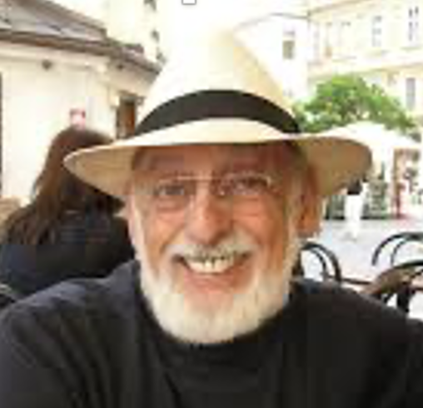
THEORIES OF ROMANTIC LOVE
SOUND RELATIONSHIP HOUSE THEORY
John Gottman proposed sound relationship house theory of romantic love based on factors that distinguished couples who divorced from those who didn’t in a longitudinal study of couple relationship stability. Those who stayed together
Engaged in five times more positive exchanges than negative exchanges
Actively worked to repair relationship conflicts
Began discussions of disagreements with a ‘gentle start-up’
Expressed positive emotions, humour and affection for their partners during disagreements
Used self-regulation strategies to prevent high levels of distress or anger
Empathise with their partners’ and took their view into account when reaching compromises
John Gottman

Slide 61
THEORIES OF ROMANTIC LOVE
SOUND RELATIONSHIP HOUSE THEORY
John Gottman proposed sound relationship house theory of romantic love based on factors that distinguished couples who divorced from those who didn’t in a longitudinal study of couple relationship stability. Those who stayed together
Accepted that some conflicts were unresolvable, and these were fuelled by partners’ commitment to underlying highly valued goals
Expressed admiration and fondness for each other
Responded to each other’s ‘bids’ for emotional connection
Saw each other in a positive light and gave their partners the benefit of the doubt
Talked about things that they both valued and gave meaning to their relationships
John Gottman

Slide 62
THEORIES OF ROMANTIC LOVE
SOUND RELATIONSHIP HOUSE THEORY
In Sound Relationship House Theory, Gottman proposed seven positive strategies for increasing relationship satisfaction based on factors that distinguished couples who divorced from those who didn’t in a longitudinal study of couple relationship stability
Build love maps by regularly communicating about significant relationships, people, projects and events in each other’s lives
Share expressions of fondness and admiration regularly so that your partner knows how much your care for, and respect them
Turn towards your partner by being attuned to, and responsive to their bids for emotional connection
Take a positive perspective assuming that your partner has your best interests at heart, and giving them the benefit of the doubt when conflict arises
Manage conflict by resolving solvable problems, and accepting that in any long-term relationship there will be some incompatibilities and unresolvable differences
Make life dreams come true by supporting each other to reach highly valued goals
Create shared meaning by talking about, or engaging in activities or rituals that express shared values

Slide 63
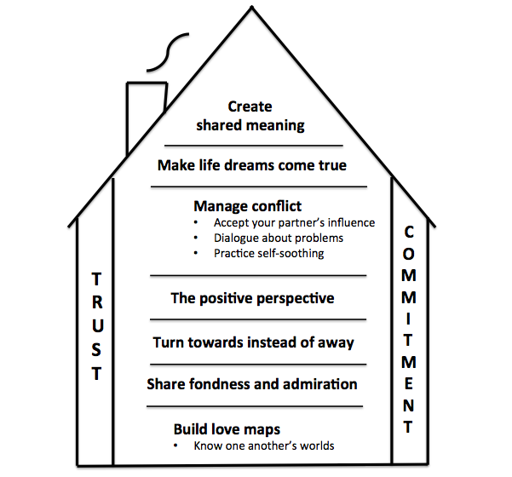
SOUND RELATIONSHIP HOUSE THEORY
Note. Based on Navarra R.J., Gottman J.M. (2018) Sound Relationship House in Gottman Method Couples Therapy. In J. Lebow, A. Chambers, & D. Breunlin (Eds.), Encyclopedia of Couple and Family Therapy. Springer, Cham. https://doi.org/10.1007/978-3-319-15877-8_208-1

Slide 64
COUPLE RELATIONSHIPS INTERVENTIONS
Sound Relationship House interventions. Gottman has shown in a series of studies that couples relationships are enriched through group-based training in ‘Sound Relationship House’ strategies
Relationship education. Starting in the 1980s many relationship education programmes have been developed and evaluated. They typically span 1-6 sessions and include skills training in
  Communication
  Expression of affection
  Conflict-management or problem-solving
Evaluation of relationship education. Meta-analyses indicate that relationship education
  Improves communication & relationship satisfaction in middle-class educated couples who are experiencing a mild degree of relationship distress
  Has a very small effect on couples with low SES because the economic challenges these couples face prevent them from thriving regardless of their relationship skills
Positive Psychology Interventions for couples. Research on contemporary positive psychology interventions for couples is relatively new . Results are promising. They include, for example
  Shelly Gable’s research on active constructive responding (Mentioned in this chapter)
  Sara Algoe’s research on couples’ expression of gratitude (Mentioned in chapter 3)
  Couple interventions involving the use of signature strengths, savouring, flow, and mindfulness, and emotional intelligence

Slide 65
PAUSE & PRACTICE - EXPRESSING FONDNESS AND APPRECIATION
Every day, on a moment-to-moment basis, notice when your partner is ‘doing things right’ or being the kind of person you admire
Tell you partner that you admire, appreciate, or are grateful for the positive things they do and that you admire their positive personal characteristics
If you regularly let your partner know that you admire and appreciate their positive attributes and the things they do, this will maintain the ratio of positive to negative exchanges above 5:1 and enhance the quality of your relationship
Here are some things you may notice about your partner
  Being kind / gentle / funny / strong / sexy / brave / thoughtful / loyal / generous / beautiful / dependable / calm / hardworking / fair / energetic / forgiving / flexible / honest / tolerant / wise
  Showing affection, kissing, having sex
  Playing music or movies that you like, listening to how your day went, understanding you
  Planning stuff to do with the house, planning holidays, paying bills
  Supporting your involvement in leisure activities / sports / arts
  Supporting you during life challenges: births, deaths, moving house, changing jobs, illnesses
  Contacting you during the day, getting groceries, collecting the kids, taking the kids to activities / appointments / playdates, taking care of grandparents

Slide 66
PAUSE & PRACTICE – MANAGING CONFLICT (PART1)
The aim of this exercise is for you and your partner to manage conflict and resolve a solvable problem
Invite your partner to spend 30 minutes with you doing this exercise
Select a private place and time that suits you both when you will not be interrupted or distracted
Turn off phones, computers, tablets, TVs, radios and other potential distractions
Take turns of being the speaker and listener
Start-up
Begin with a soft ‘start-up’ that takes the form
  There is a difficulty
  Both of us are involved in it
  This is how I feel about it
  This is what I need or would prefer
Problem-solving
Break big problems into a number of smaller problems and then deal with these one at a time
For each small problem, brainstorm solutions
Look at the price and payoff of each solution, for each of you
Settle on the solution that suits you both best
Agree to try out the solution, and then afterwards to review how well it worked
Negotiating a compromise
Accept that finding a solution that suits you both will involve a degree of compromise
Let each other know the needs you can compromise on, and the core needs on which you can’t compromise
When reaching a compromise, allow your partner to influence you

Slide 67
PAUSE & PRACTICE – MANAGING CONFLICT (PART2)
Self-soothing
If you become keyed up while negotiating a compromise, take a couple of minutes to sooth yourself
Breath in for a count of 3 an out for a count of 6, three times
Repair connection
If you become involved in negative emotional exchanges, repair the connection in your relationship
Remind yourself how much you and your partner care about each other and value your relationship
Remind yourself that it’s important to keep the ratio of positive negative exchanges above 5:1
Express positive emotions, show affection, or make a humorous comment about the situation
Be tolerant of your partner’s idiosyncrasies, imperfections, and differences, and remind yourself that these are not intended to make your life difficult. They are unfortunate incompatibilities that occur in all long-term relationships

Slide 68
PARENT-CHILD RELATIONSHIPS

Slide 69


PARENT-CHILD RELATIONSHIPS
Children’s well-being. Individuals who have good relationships with their parents across the lifespan are
  Happier
  Have better physical and mental health
  Better peer and romantic relationships
  Better educational and occupational adjustment
Parents’ wellbeing depends on the balance of the demands of childrearing, and available coping resources
  Children enhance parental wellbeing when they have the time, energy, skill, social support, and financial resources to meet the demands of rearing children, and children fulfil parental need to procreate, to be connected to extended families and communities, and give parents’ lives meaning and direction
  Where the demands children place upon parents outstrip their capacity to cope, then their wellbeing is diminished

Slide 70
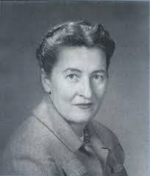
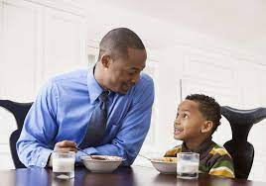
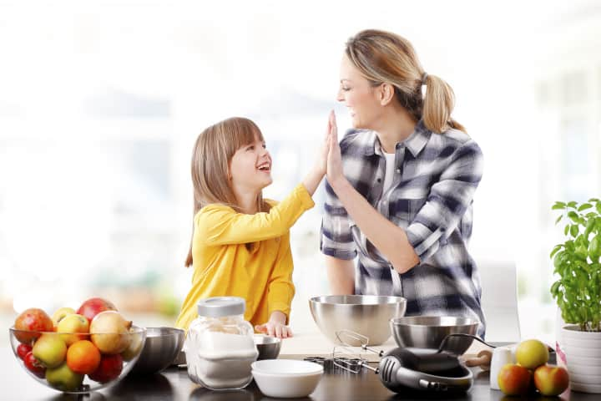
PARENT-CHILD RELATIONSHIPS
Authoritative parenting. Diana Baumrind identified three distinct parenting styles
  Authoritarian parents are demanding, but unresponsive to their children’s emotional needs
  Permissive parents are responsive to their children’s emotional needs, though undemanding
  Authoritative parents in contrast to these two non-optimal parenting styles, combine high levels of both warm responsiveness and demandingness
Children of authoritative parents show high levels of
  Wellbeing
  Prosocial behaviour
  Self-reliance
  Self-control
  Confidence
  Achievement motivation
Diana Baumrind

Slide 71

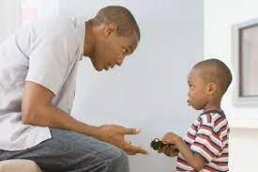

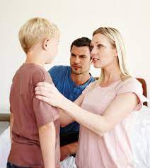
PARENT-CHILD RELATIONSHIPS
Authoritative parents are warm towards their children, but also enforce clear rules and expectations
Parenting skills that constitute an authoritative parenting style include
  Spending ‘quality time’ with the child
  Accommodating to the child’s temperament
  Nurturing and rewarding prosocial behaviour, while also reducing opportunities for problem behaviour, and discouraging it
  Using problem-solving and negotiation skills

Slide 72

POSITIVE PSYCHOLOGY PARENTING
Parenting interventions designed to prevent antisocial behaviour based on authoritative parenting parenting & related skills pre-date the development of contemporary positive psychology
Martin Seligman proposed that positive psychology parenting aims to promote flourishing and involves two key processes:
Facilitating children’s experience of positive emotions
Supporting children to identify and use their signature strengths

Slide 73

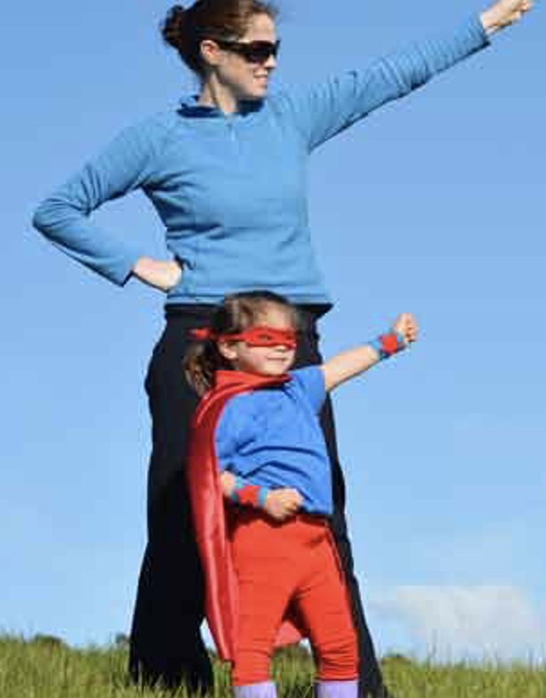
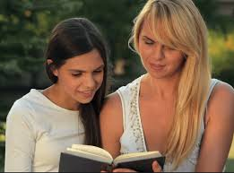
POSITIVE PSYCHOLOGY PARENTING
Parental Role Models. Parents may promote flourishing by being good role models for skills and practices that research in positive psychology has shown improve wellbeing including:
  Setting and pursuing valued life goals
  Identifying and using signature strengths
  Developing a positive mindset characterised by gratitude & optimism
  Incorporating savouring, flow, and mindfulness into daily life
  Cultivating emotional intelligence, creativity, and wisdom
  Cultivating self-esteem and self-efficacy
  Using adaptive defence mechanisms and coping strategies
  Practicing kindness, compassion, forgiveness
  Enhancing relationships

Slide 74
CONTROVERSIES ABOUT RELATIONSHIPS

Slide 75
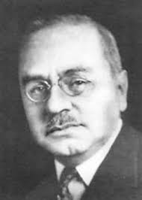

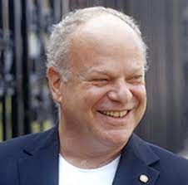
DIFFERENT MEANINGS OF ‘POSITIVE’ APPLIED TO PARENTING
Theodoros Kyriazos and Anastassios Stalikas identified three ways in which the term ‘positive’ is used to describe psychological approaches to parenting
Positive discipline refers to using firm, fair, caring, and respectful methods rather than corporal punishment to promote positive child behaviour and discourage problematic behaviour in children with behaviour problems. It was introduced into psychology by psychanalyst, Alfred Adler in Austria and popularised in the USA by Rudolf Dreikurs
Positive parenting refers to a confident, warm, consistent approach to parenting and a low-conflict approach to family life. The Triple P Positive Parenting Programme, an evidence-based intervention, is based on ideas from social learning theory and family systems theory and was developed by Matt Sanders in Australia
Positive psychology parenting refers to facilitating children’s experience of positive emotions and use of signature strengths to help them flourish rather than to prevent or ameliorate behaviour problems. It is a fledgling innovation proposed by Martin Seligman
Alfred Adler
Matt Sanders
Martin Seligman

Slide 76
IS SKILLS TRAINING NECESSARY FOR
COUPLES TO IMPROVE THEIR RELATIONSHIPS?
Relationship education is based on the assumption that communication and problem-solving skills training is essential for improving relationship quality
Two lines of research - relationship awareness and relationship check-up - suggest that skills training - relational education - may not always be necessary for enhancing relationship satisfaction
Relationship awareness. Ronald Rogge found that a brief four hour relationship awareness intervention was as effective as an 18 hour skills training programmes in preventing relationship dissolution three years later.. 11% of couples who received either intervention ended their relationships compared with 24% of those in a no-intervention control group.
Relationship check-up. In a meta-analysis of 12 studies Hanne Fentz and Tea Trillingsgaard found that relationship check-up had a positive, small and significant effect on relationship satisfaction at up to six months follow-up. With relationship check-up, couples complete questionnaires on relationship functioning and receive written feedback pointing out strengths and weaknesses of the relationship, areas for relationship enrichment, and in some programmes couples discuss the feedback with a professional

