Slide 1
CHAPTER 9.
POSITIVE PSYCHOLOGY
INTERVENTIONS

Slide 2
LEARNING OBJECTIVES
Be able to describe positive psychotherapy and other clinical positive psychology intervention (PPI) programs.
Give an account of PPI programs for implementation in schools and organizations.
Summarize the evidence supporting the effectiveness of PPIs.

Slide 3
DEFINITION OF PPIs

Slide 4
POSITIVE PSYCHOLOGY INTERVENTIONS (PPIs)
PPI development is a central mission of positive psychology
PPIs have been used in educational, work, and sports contexts and in clinical settings
PPIs are described in previous chapters
    C2. Setting valued goals and using signature strengths
    C3. Developing optimism and gratitude
    C4. Savouring pleasures, finding flow, and cultivating mindfulness
    C5. Using emotional intelligence
    C6. Developing creativity and wisdom
    C7. Developing self-esteem, self-efficacy, functional coping strategies, positive defence mechanisms, and engaging in post-traumatic growth
    C8. Volunteering, practicing kindness and forgiveness, active constructive responding, expressing appreciation, and engaging in quality time

Slide 5
DEFINITION OF PPIs
Definition. PPIs are evidence-based interventions in which the goal of wellbeing enhancement is achieved through pathways that are consistent with positive psychology theory
PERMA theory. Pathways associated with Seligman’s PERMA theory include
    Promoting savouring of pleasurable experiences
    Fostering engagement in absorbing skilful activities
    Enhancing relationships
    Promoting meaning and purpose, and
    Supporting accomplishments
Strengths theory. The development of character strengths is the main pathway associated with Peterson and Seligman’s theory of virtues and strengths

Slide 6
PPI EFFECTIVENESS

Slide 7
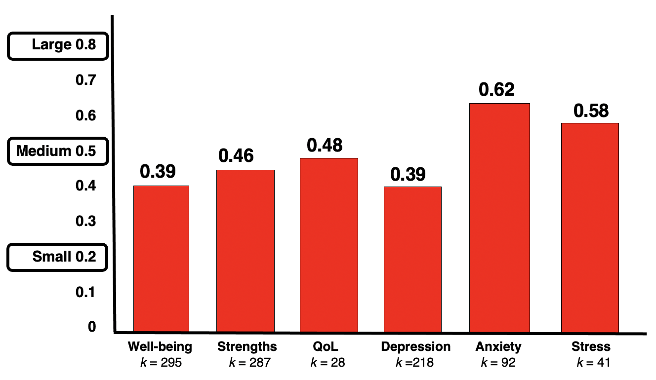
PPI EFFECTIVENESS
Carr et al (2020) synthesised the results of 347 studies involving over 72,000 participants from clinical and non-clinical child and adult populations in 41 countries
The effect of PPIs with an average of ten sessions over six weeks offered in multiple formats and contexts was evaluated
At post-test, PPIs had a significant small to medium effect on wellbeing, strengths, QoL, depression, anxiety, and stress

Slide 8
Large 0.8
0.7
0.6
Medium 0.5
0.4
0.3
Small 0.2
0.1
0
PPI EFFECTIVENESS
0.62
0.58
0.48
0.46
0.39
0.39
Well-being Strengths QoL Depression Anxiety Stress
k = 295 k = 287 k = 28 k =218 k = 92 k = 41
Note. Effect size values in this graph are Hedges g which is the difference between the means of positive psychological intervention groups and control groups divided by the pooled standard deviation of both groups and adjusted so greater weight is given to studies with bigger samples.
k = the number of comparisons between positive psychological intervention groups and control groups in the meta-analysis.
The graph is based on data from Carr, A., Cullen, K., Keeney, C., Canning, C., Mooney, O., Chinseallaigh, E., & O’Dowd, A. (2020). Effectiveness of positive psychology interventions: A systematic review and meta-analysis. Journal of Positive Psychology. https://doi.org/10.1080/17439760.2020.1818807

Slide 9
PPI EFFECTIVENESS
Carr et al. (2020) found that gains reported immediately after completing PPIs were maintained 3 months later
After 7 months gains had begun to dissipate
PPI programmes were more effective if they
    Contained multiple PPIs rather than just one intervention
    Were of longer duration
    Contained more sessions
    Were offered face-to-face in an individual or group format rather than as a self-help, computer or book-based interventions
    Were offered to individuals with clinical problems, rather than healthy people

Slide 10
Large 0.8
0.7
0.6
Medium 0.5
0.4
0.3
Small 0.2
0.1
0
PPI EFFECTIVENESS WITH CLINICAL & NON-CLINICAL CASES
0.65
0.57
0.59
0.61
0.56
0.52
0.50
0.48
0.43
0.36
0.36
0.35
Well-being Strengths QoL Depression Anxiety Stress
Clinical Non-Clinical
Note. Effect size values in this graph are Hedges g which is the difference between the means of positive psychological intervention groups and control groups divided by the pooled standard deviation of both groups and adjusted so greater weight is given to studies with bigger samples.
The graph is based on data from Carr, A., Cullen, K., Keeney, C., Canning, C., Mooney, O., Chinseallaigh, E., & O’Dowd, A. (2020). Effectiveness of positive psychology interventions: A systematic review and meta-analysis. Journal of Positive Psychology. https://doi.org/10.1080/17439760.2020.1818807

Slide 11
POSITIVE PSYCHOTHERAPY

Slide 12



POSITIVE PSYCHOTHERAPY
Positive psychotherapy was developed by Tayyab Rashid and Martin Seligman
This 15-session programme has 3 phases
  In phase 1 therapists help clients experience a sense of mastery by developing a personal narrative focusing on strengths rather than problems
  In phase 2 therapists help clients develop skills for reappraising memories of negative or traumatic experiences. This facilitates the growth of a balanced perspective, and relinquishment of a negative world view
  In phase 3 therapists help clients pursue their meaning and purpose in life by using signature strengths, and deepening important relationships
Tayyab Rashid

Slide 13
POSITIVE PSYCHOTHERAPY
OVERVIEW
Phase 1. Building mastery by reauthoring personal narrative with strengths
1. Positive introduction & gratitude journal
2. Character strengths & signature strengths
3. Practical wisdom
4. A better version of me
Phase 2. Re-evaluating negative memories.
5. Open and closed memories
6. Forgiveness
7 Satisficing instead of maximizing
8. Gratitude
Phase 3. Developing meaning in life
9. Hope and Optimism
10. Posttraumatic growth
11. Savouring
12. Positive relationships
13. Positive communication
14. Altruism
15. Meaning and purpose

Slide 14
POSITIVE PSYCHOTHERAPY
SESSION FORMAT
Start and end with a 5-minute meditation or relaxation exercise
Review gratitude journal items
Review concept learned in the previous session and homework
Psychoeducation about new concept
In-session practice of skill related to new concept
Discuss in-session practice
Homework plan

Slide 15
POSITIVE PSYCHOTHERAPY
PHASE 1
Phase 1. Building mastery by reauthoring personal narrative with strengths
1. Positive introduction & gratitude journal
2. Character strengths & signature strengths
3. Practical wisdom
4. A better version of me

Slide 16
POSITIVE PSYCHOTHERAPY
SESSION 1. POSITIVE INTRODUCTION & GRATITUDE JOURNAL
Therapist presents the framework of positive psychotherapy, the therapist’s and client’s roles and responsibilities, and the structure of a typical session
Psychoeducation on strengths and gratitude
Client writes a one-page positive autobiographical story which shows the client at their best, and illustrates their strengths
For homework, each night the client writes down 3 good things for which they are grateful and what made these happen

Slide 17
POSITIVE PSYCHOTHERAPY
SESSION 2. CHARACTER STRENGTHS & SIGNATURE STRENGTHS
Therapist provides psychoeducation on signature strengths
Client watches videos of people displaying each of 24 character strengths and identifies their own 5 signature strengths and which of these are associated with the head and the heart
Client identifies strengths that they underuse or overuse, and those they would most like to have
For homework, the client compiles a list of signature strengths using self-report sheets, feedback from Values in Action Inventory of Strengths (https://www.viacharacter.org), and feedback from a family member and a friend

Slide 18
POSITIVE PSYCHOTHERAPY
SESSION 3. PRACTICAL WISDOM
Therapist coaches client in applying signature strengths in a balanced way to solve problems using 5 practical wisdom strategies
  Name specific things that you will do to use your strengths
  Use strengths relevant to the situation
  Resolve conflict about which strength to use, by choosing the one closest to your core values (e.g., courage and prudence, zest and self-regulation)
  Reflect on the impact of using your strengths on others, from their point of view
  Fine-tune and calibrate your use of strengths to suit the situation
For homework, the client applies four practical wisdom strategies to resolve 3 specific challenges in their lives

Slide 19
POSITIVE PSYCHOTHERAPY
SESSION 4. A BETTER VERSION OF ME
Therapist facilitates development of a written plan of positive, pragmatic, and persistent self-development that involves using strengths to achieve goals
Goals should be specific, measurable, achievable, valued, supported by client’s social network, integrated into their life situation
Goals may involve being more mindful/relaxed, having a healthier lifestyle, strengthening relationships, being more engaged at work
Therapist helps clients identify benefits of the plan for them, the timeline of the plan, and a friend who will support them doing the plan
For homework, the client writes a self-development plan in which they will use strengths to adaptively to work towards specific, measurable, achievable goals

Slide 20
POSITIVE PSYCHOTHERAPY
PHASE 2
Phase 2. Re-evaluating negative memories
5. Open and closed memories
6. Forgiveness
7 Satisficing instead of maximizing
8. Gratitude

Slide 21
POSITIVE PSYCHOTHERAPY
SESSION 5. OPEN & CLOSED MEMORIES
Therapist facilitates the recollection, writing and processing of open negative memories (i.e., memories of difficult situations where closure has not been achieved) for example grudges or bitter memories
Therapist coaches clients in four positive re-appraisal strategies
Create distance from the memory. Describe the memory in the third person as if you were a documentary maker to create distance between you and the memory, and allow you to revise the meaning the memory has for you and your feelings about it
Reconsolidate the memory. In a calm relaxed state recall the memory in detail focusing on positive aspects you may have overlooked, and how these fit with your most important values
Mindfully observe the memory. Any time the memory comes to mind, observe it mindfully as if you were watching a film, rather than getting caught up in it, and then notice that eventually the memory passes out of awareness
Divert attention away from the memory. Any time the memory comes to mind, as soon as possible notice the cues that triggered the memory, and engage in a task that interests you
For homework, the client writes down bitter memories and explores 4 ways to deal with them adaptively (creating distance, reconsolidating, mindfully observing, and diverting attention)

Slide 22
POSITIVE PSYCHOTHERAPY
SESSION 6. FORGIVENESS
Therapist Therapist provides psychoeducation on forgiveness as a process using the REACH model
  Recall the event in detail
  Empathize with the perpetrator by creating a plausible story to explain why they hurt you
  Give the Altruistic gift of forgiveness, by remembering a time when you were forgiven for transgressing
  Commit yourself to forgive publicly by telling someone you trust, or writing a forgiveness letter
  Hold onto forgiveness by reminding yourself that you have forgiven the transgressor any time you experience vengefulness, and listing the things that help you hold onto forgiveness or weaken your resolve to do so
For homework, the client writes a forgiveness letter describing a transgression and related emotions and pledges to forgive the transgressor (if appropriate). The client decides whether or not to send the letter

Slide 23
POSITIVE PSYCHOTHERAPY
SESSION 7. SATISFICING INSTEAD OF MAXIMIZING
Therapist provides psychoeducation on the benefits of satisficing (choosing a good enough option after reviewing a few options) compared with maximizing (choosing the best option after reviewing all options)
Client explores domains of life in which they satisfice or maximise, and drafts a plan to increase satisficing

Slide 24
POSITIVE PSYCHOTHERAPY
SESSION 8. GRATITUDE
Therapist provides psychoeducation on benefits of gratitude (which undoes negative emotions and builds positive relationships) and invites client to write a gratitude letter and do a gratitude visit
For homework, the client writes a letter to someone who helped them and who they have never properly thanked
For homework, the client arranges to meet the person who helped them and reads the gratitude letter to them

Slide 25
POSITIVE PSYCHOTHERAPY
PHASE 3
Phase 3. Developing meaning in life
9. Hope and Optimism
10. Posttraumatic growth
11. Savouring
12. Positive relationships
13. Positive communication
14. Altruism
15. Meaning and purpose

Slide 26
POSITIVE PSYCHOTHERAPY
SESSION 9. HOPE & OPTIMISM
Therapist helps clients to see that challenges are temporary and to build hope by identifying best possible realistic outcomes
For homework, the client writes about 3 doors that closed and 3 doors that then opened

Slide 27
POSITIVE PSYCHOTHERAPY
SESSION 10. POSTTRAUMATIC GROWTH
Therapist provides psychoeducation about posttraumatic growth which involves
  Recognition of personal strength
  Improved relationships with other people
  A greater appreciation of life
  Spiritual and existential transformation
  An increased openness to new possibilities
  Compassion for others who suffer.
Therapist invites clients to explore thoughts and feelings about a traumatic experience that continues to bother them
For homework, the client writes in an uncensored way for 20 minutes on each of 4 days about a past trauma and then writes down how this helped them understand (1) what the experience meant to them, (2) their ability to handle similar situations, and (3) their relationships in a different light

Slide 28
POSITIVE PSYCHOTHERAPY
SESSION 11. SAVOURING
Therapist provides psychoeducation on slowing down pleasant activities and savouring them though mindful attention
Slowing down strategies
  Slow down gradually rather than suddenly
  Start with a few areas
  Deliberately focus on slow peaceful experiences
  Talk to loved ones about the hazards of speed (e.g., accidents and stress)
  Say no to extra commitments more often and avoid overscheduling
  Make computer and smart-phone ‘device-free’ time zones
Savouring strategies
  Sharing positive experiences with others
  Building positive memories by taking mental photographs
  Sensory perceptual-sharpening by focusing on specific positive stimuli
  Absorption in positive experiences
  Being aware of the temporal transience of positive experiences
For homework, the client selects and uses one slowness technique and one savouring technique that suit them

Slide 29
POSITIVE PSYCHOTHERAPY
SESSION 12. POSITIVE RELATIONSHIPS
Therapist provides psychoeducation on the value of
  Personal relationships in promoting well-being
  Appreciating the signature strengths of family members or loved ones as a way of strengthening relationships
For homework,
  The client invites family members or loved ones to take the Values in Action Inventory of Strengths online
  The client and family or loved ones draw a family tree that includes signature strengths of all members of the family and discuss ways of enriching relationships by celebrating each other’s signature strengths

Slide 30
POSITIVE PSYCHOTHERAPY
SESSION 13. POSITIVE COMMUNICATION
Therapist provides psychoeducation on capitalizing (sharing good news with others) and 4 ways of responding to others good news by combining active or passive with constructive or destructive response styles
Therapist coaches client in active–constructive responding
For homework, the client practices active-constructive responding to positive events reported by partner
For homework, the client and partner identify each other’s strengths and share and appreciate these

Slide 31
POSITIVE PSYCHOTHERAPY
SESSION 14. ALTRUISM
Therapist provides psychoeducation on how altruism helps both the self and others
Therapist invites client to watch a short film (Gift Singapore Inspiration Drama Short Film https://www.youtube.com/watch?v=za5r4adt3IM) and reflect on the altruism shown in the film
Therapist helps client explore ways of using signature strengths to offer the gift of time in serving something much larger than the self
For homework, the client gives the gift of time by doing something that requires a fair amount of time and the use of signature strengths, such as mentoring a child or doing community service

Slide 32
POSITIVE PSYCHOTHERAPY
SESSION 15. MEANING & PURPOSE
Therapist facilitates client’s exploration of meaningful activities that contributes to the greater good that they may wish to pursue in the next 10 years in light of their personal strengths and self-knowledge that they have developed during the programme
For homework, the client writes how they would like to be remembered, emphasising their positive contribution to the world

Slide 33
POSITIVE PSYCHOTHERAPY
MECHANISMS OF ACTION
Clients re-orient their attention, memory and expectations towards positive rather than negative aspects of their lives
Clients experience more positive emotions
The identification and use of signature strengths creates a context within which clients are more likely to experience wellbeing
Interpersonal exercises enhance the quality of clients’ relationships which give life meaning and purpose and strengthen wellbeing
The quality of the therapeutic relationship which is characterized by warmth, empathy and genuineness is a vital therapeutic factor

Slide 34
OTHER
POSITIVE PSYCHOLOGY PROGRAMMES

Slide 35
OTHER POSITIVE PSYCHOLOGY PROGRAMMES
14 Fundamentals of Happiness Programme
Wellbeing Therapy
Quality of Life Therapy
Person Centred Approaches
Posttraumatic Growth Therapy
Solution-Focused Therapy
Positive Family Therapy
Positive Couple Therapy
Voyages to Wellbeing
The Strengths Model
The Good Lives Model

Slide 36
OTHER POSITIVE PSYCHOLOGY PROGRAMMES
FORDYCE’S 14 FUNDAMENTALS
PSYCHOLOGY OF HAPPINESS PROGRAMME
1. Be more active and keep busy
2. Spend more time socializing and having quality time with other people
3. Be productive at meaningful work and pastimes
4. Get better organized and plan things out so you accomplish one or two important tasks each day
5. Stop worrying because it is unpleasant and unproductive
6. Lower your expectations and aspirations, set achievable goals so you will be rewarded by your successes and will be disappointed less often
7. Develop positive, optimistic thinking.
Note. Based on Fordyce, M. W. (1983). A Program to Increase Happiness: Further Studies. Journal of Counselling Psychology, 30(4), 483-498.

Slide 37
OTHER POSITIVE PSYCHOLOGY PROGRAMMES
FORDYCE’S 14 FUNDAMENTALS
PSYCHOLOGY OF HAPPINESS PROGRAMME
8. Get present-oriented and live in the moment; don’t worry about past hurts or future catastrophes
9. Know yourself, accept yourself, like yourself and help yourself
10. Develop an outgoing, social personality and spend time with people you enjoy and meeting new people
11. Be yourself and do not disguise who you are, so you will attract people who like you for who you are
12. Let go of negative feelings and problems; don’t ruminate
13. Develop a close romantic relationship
14. Value happiness and pursue it with vigour
Note. Based on Fordyce, M. W. (1983). A Program to Increase Happiness: Further Studies. Journal of Counselling Psychology, 30(4), 483-498.

Slide 38
OTHER POSITIVE PSYCHOLOGY PROGRAMMES
14 Fundamentals of Happiness Programme. Fordyce developed and evaluated the fourteen fundamental principles for happiness programme which includes sessions on a wide range of practical self-help exercises (described on the previous 2 slides)
Wellbeing Therapy. Fava developed wellbeing therapy in Italy as a relapse prevention intervention for patients who had had been treated for anxiety or depression
Quality of Life Therapy. This is an integration of cognitive therapy practices with ideas from positive psychology, was developed by Frisch. In this approach therapy plans are tailored to address clients’ prioritized goals drawn from 16 areas assessed by the Quality of Life Inventory

Slide 39
OTHER POSITIVE PSYCHOLOGY PROGRAMMES
Person Centred Approaches. Person-centred approaches are based on the work of Carl Rogers who proposed that therapist empathy, warmth, genuineness and unconditional positive regard were essential components of a strong therapeutic alliance and effective therapy
In the UK, Joseph’s positive therapy places a premium of the quality of the therapeutic relationship
In the US Sheldon’s self-determination theory approach, clinical interventions for problems are designed so that they meet clients’ needs for competence, relatedness and autonomy

Slide 40
OTHER POSITIVE PSYCHOLOGY PROGRAMMES
Posttraumatic Growth Therapy. Calhoun and Tedeschi developed an approach to therapy that aims to promote post-traumatic growth which includes:
  Recognition of personal strength
  Improved relationships with other people
  A greater appreciation of life
  Spiritual and existential transformation
  An increased openness to new possibilities
  Compassion for others who suffer

Slide 41
OTHER POSITIVE PSYCHOLOGY PROGRAMMES
Solution-Focused Therapy. deShazer and Kim Berg developed solution focused therapy which aims to identify infrequent exceptional episodes in which clients’ problem were expected to occur but did not, and arrange for clients to increase the frequency of these exceptions. O’Hanlon and Bertolino have integrated PPIs into the practice of solution-focused therapy
Positive Family Therapy. This was developed by the Conoleys and combines ideas and practices from family therapy and positive psychology
Positive Couple Therapy. Kauffman & Silberman integrated of couple therapy and positive psychology bey balancing the usual focus on couples’ problems with an equal focus on positive emotions and relationship strengths

Slide 42
OTHER POSITIVE PSYCHOLOGY PROGRAMMES
Voyages to wellbeing. Cloninger developed this approach to help people who had recovered from psychological problems, enhance their wellbeing by increasing their self-directedness, cooperativeness, and self-transcendence using exercises based on cognitive behaviour therapy and mindfulness meditation

Slide 43
OTHER POSITIVE PSYCHOLOGY PROGRAMMES
CLONINGER’S
VOYAGES TO WELL-BEING PROGRAMME
Set 1
1. What makes you happy? – Recognizing what brings joy
2. What makes you unhappy? – Understanding traps in thinking
3. Experiencing well-being – Quieting the mind’s turmoil
4. Union in nature – Awakening your physical senses
5. Finding meaning — Awakening your spiritual senses
Note. Based on Cloninger CR.(2006). The science of well-being: an integrated approach to mental health and its disorders. World Psychiatry, 5, 71-76.

Slide 44
OTHER POSITIVE PSYCHOLOGY PROGRAMMES
CLONINGER’S
VOYAGES TO WELL-BEING PROGRAMME
Set 2
6. Beyond mindfulness – Cultivating soulfulness
7. Observing and elevating your thoughts
8. Observing and elevating your human relationships
9. Charting your maturity and integration
10. Contemplation of being
Note. Based on Cloninger CR.(2006). The science of well-being: an integrated approach to mental health and its disorders. World Psychiatry, 5, 71-76.

Slide 45
OTHER POSITIVE PSYCHOLOGY PROGRAMMES
CLONINGER’S
VOYAGES TO WELL-BEING PROGRAMME
Set 3
11. Can you learn to reduce stress?
12. Calming your fears
13. Observing the power-seekers in your life
14. Contemplation of mysteries
15. Constant awareness
Note. Based on Cloninger CR.(2006). The science of well-being: an integrated approach to mental health and its disorders. World Psychiatry, 5, 71-76.

Slide 46
OTHER POSITIVE PSYCHOLOGY PROGRAMMES
The strengths model. Rapp developed this approach to working in partnership with people recovering from chronic and severe mental health problems, which involves drawing on strengths to achieve goals

Slide 47
OTHER POSITIVE PSYCHOLOGY PROGRAMMES
The good lives model. Ward developed this approach to treating sex offenders
The primary goal is to reduce the risk of relapse by providing offenders with the skills, values, opportunities, and supports necessary for meeting their needs for the goods of life in more adaptive ways
The goods of life include
  knowledge
  excellence in play and work
  excellence in agency
  inner peace
  friendship
  community
  spirituality
  Happiness
  creativity

Slide 48
POSITIVE PSYCHOLOGY
IN SCHOOLS

Slide 49
POSITIVE PSYCHOLOGY IN SCHOOLS
Positive psychology has been introduced into schools in a variety of ways ranging from the specific lessons to the whole school approach.
Specific lessons approach. Lessons are given on developing positive psychology skills such as mindfulness, gratitude and kindness
Whole school approach. A positive psychology ethos is introduced into all aspects of school life for staff and pupils

Slide 50

PENN RESILIENCE PROGRAMME
EXAMPLE OF A SPECIFIC CLASSES APPROACH
TO POSITIVE PSYCHOLOGY IN SCHOOLS
Designed by Martin Seligman’s team to teach learned optimism and prevent depression in young people
It is a 12-week programme containing skills training on
  Optimistic thinking
  Negotiation
  Conflict management
  Assertiveness
  Problem-solving
  Decision-making
  Relaxation
It has been evaluated in a large number of studies with mixed results

Slide 51

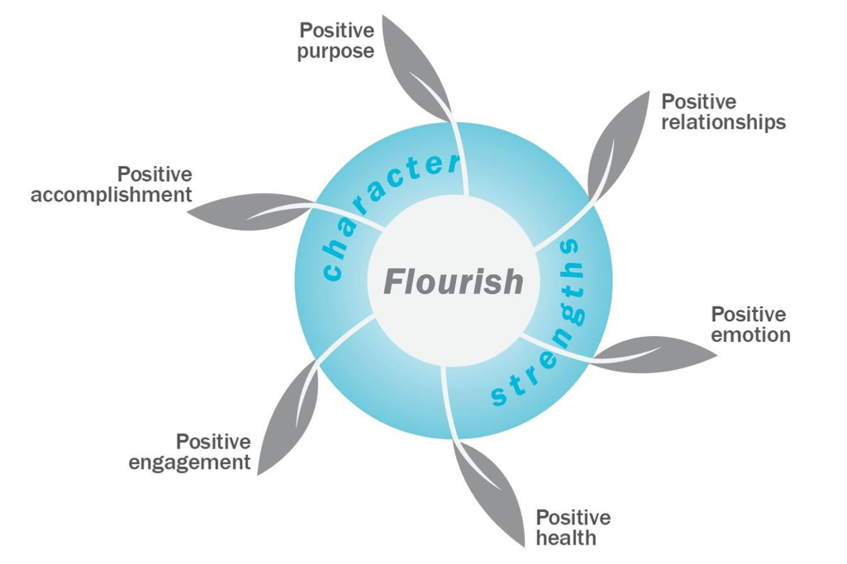

GEELONG GRAMMAR SCHOOL PROJECT
A WHOLE SCHOOL APPROACH
TO POSITIVE PSYCHOLOGY IN SCHOOLS
Introduced into Geelong Grammar School by Martin Seligman’s team in 2008
Aims to enable school communities to flourish by fostering positive health and the five elements of Seligman’s PERMA theory

Slide 52
GEELONG GRAMMAR SCHOOL PROJECT
A WHOLE SCHOOL APPROACH
TO POSITIVE PSYCHOLOGY IN SCHOOLS
All Geelong staff were trained in a wide range of PPIs
Staff were coached in how to teach these skills to students in stand-alone courses
Staff were coached in how to embed a positive psychology ethos in the way that they taught all academic subjects, extra-curricular activities, and sports. For example, identifying signature strengths of characters in English literature
The positive ethos of the school has been maintained by four strategies:
  Learn it
  Live it
  Teach it
  Embed it

Slide 53
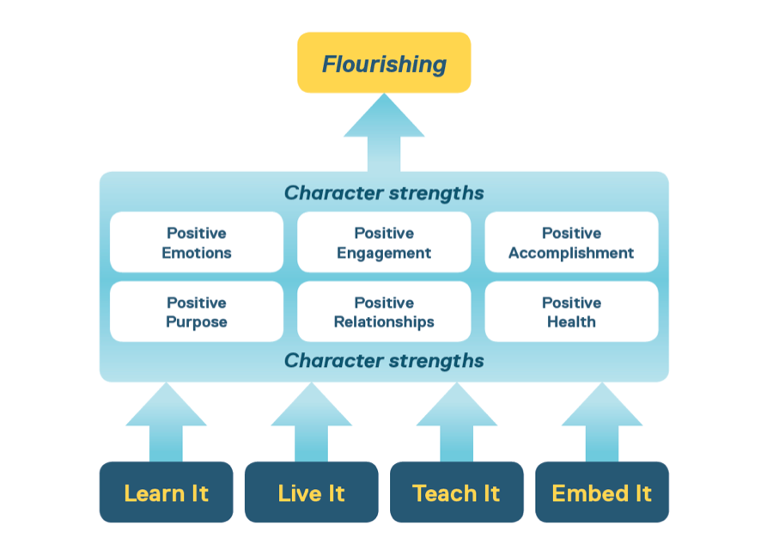
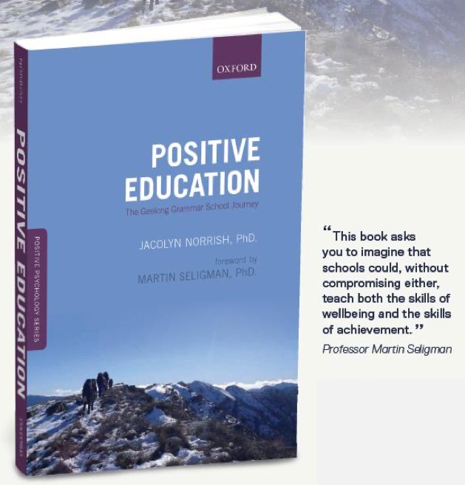
GEELONG GRAMMAR SCHOOL PROJECT
A WHOLE SCHOOL APPROACH
TO POSITIVE PSYCHOLOGY IN SCHOOLS

Slide 54
POSITIVE PSYCHOLOGY
IN ORGANIZATIONS

Slide 55
POSITIVE PSYCHOLOGY IN ORGANIZATIONS
Organizational performance may be enhanced by PPIs that increase positive leadership styles; employee empowerment and engagement; and psychological capital within the organization.
Positive leadership styles. These are styles that communicate a clear vision of the organizational goals, inspire motivation, encourage autonomy, role model effective and ethical organizational behaviour, take account of employees’ strengths and limitations, and communicate openly, supportively and positively
Empowerment and engagement. This is achieved by giving employees jobs that are perceived ‘make a difference’ with a variety of skills, autonomy, feedback, training in job skills and positive psychology skills, and social support
Psychological capital. Psychological capital includes self-efficacy (belief in personal effectiveness), optimism, hope, & resilience (capacity to bounce-back from setbacks)

Slide 56
POSITIVE PSYCHOLOGY IN ORGANIZATIONS
PPIs have been introduced into work organizations in a variety of ways ranging from offering employees training in specific PPIs, to broader organizational development interventions that target work teams, departments or whole organizations
Employee PPI skills training. Training may be in a group format or in a one-to-one coaching context. Skills training may cover leadership, teamwork, using signature strengths, resilience, self-efficacy, optimism, hope, resilience, gratitude, kindness, mindfulness etc
Organizational development approach. Appreciative enquiry is an example of a positive psychology organizational development approach which focuses on organizational strengths rather than problems

Slide 57
POSITIVE PSYCHOLOGY IN ORGANIZATIONS
POSITIVE PSYCHOLOGY COACHING
van Zyl and a team of international colleagues found that positive psychology coaching involves five phases and three continuous processes diagrammed on the next slide. A range of PPIs may be incorporated into coaching
The five phases are
  Establishing a positive working relationship
  Helping the client identify their strengths and providing feedback
  Facilitating the development of a vision of their ideal career and life trajectory
  Facilitating realistic goal setting, strategizing, and execution with a focus on strengths
  Concluding or re-contracting
Positive psychology coaching involves three processes that occur within all five phases:
  Facilitating transfer of learning from one situation to others
  Tracking progress towards goals and continuous evaluation
  Empowering clients through positive reframing (especially of management of setbacks), and positive reinforcement of constructive goal-oriented activities

Slide 58
POSITIVE PSYCHOLOGY COACHING
Note: Reproduced with permission from van Zyl, L. E., Roll, L. C., Stander, M. W., & Richter, S. (2020). Positive Psychological Coaching Definitions and models: a systematic literature review. Frontiers in Psychology, 11, 793. https://doi.org/10.3389/fpsyg.2020.00793. This is an open access publication.

Slide 59
POSITIVE PSYCHOLOGY IN ORGANIZATIONS
APPRECIATIVE ENQUIREY
The aim of Appreciative inquiry (developed by Cooperrider) is to identify and amplify positive organizational features, rather than to assess problems that need to be fixed
A 4-D cycle is used to identify and amplify these positive aspects of the organization. The 4-D cycle refers to discovery, dream, design and destiny phases shown on the next slide
Discovery. In the discovery phase, the most positive features of the organization are identified and appreciated
Dream. The findings from the discovery phase provide a platform in the dream phase for envisioning what the organization would be like if that positive process always occurred. The discovery and dream phases provide a vision or goal to work towards
Design. In the design phase, organizational members identify the way the organization would need to be to move towards their positive vision or goal
Destiny. In the destiny phase, organizational members make concrete plans and commit to carrying them out so as to achieve their goal and make their vision of their positive organization a reality

Slide 60
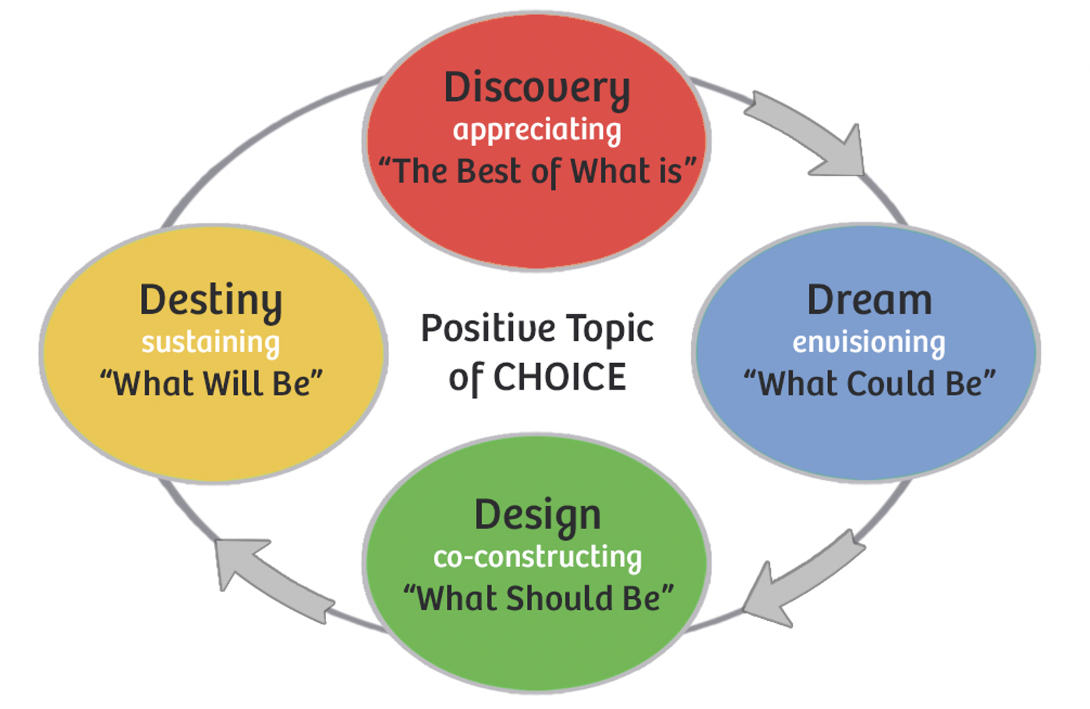
APPRECIATIVE ENQUIRY
4-D CYCLE

Slide 61
POSITIVE PSYCHOLOGY IN ORGANIZATIONS
APPRECIATIVE ENQUIRY
This 4-D cycle may be implemented with teams, key organizational members (for example members of a department), or entire organizations
The cycle may be repeated as required to facilitate the ongoing development of the organization

