Slide 1
New Module Requests
Guide for Schools & Colleges
This guide provides information for staff/faculty using the Curriculum Management System (CMS) to request new modules. School/ College-level access to the CMS is required for this task.
Further information and support on how to use the Curriculum Management System is available on the Curriculum Team website.
Version: February 2024
Updated to reflect revised Academic Regulations 2024/25

Slide 2
CONTENTS
Introduction 3
Creating a New Module Request 4
New Module Request Required Fields 5
Trimesters Explained 6
My Requests and My School Requests 7
When are New Module Codes Required? 8
Useful Links & Reporting 9
UCD Registry l February 2024

Slide 3
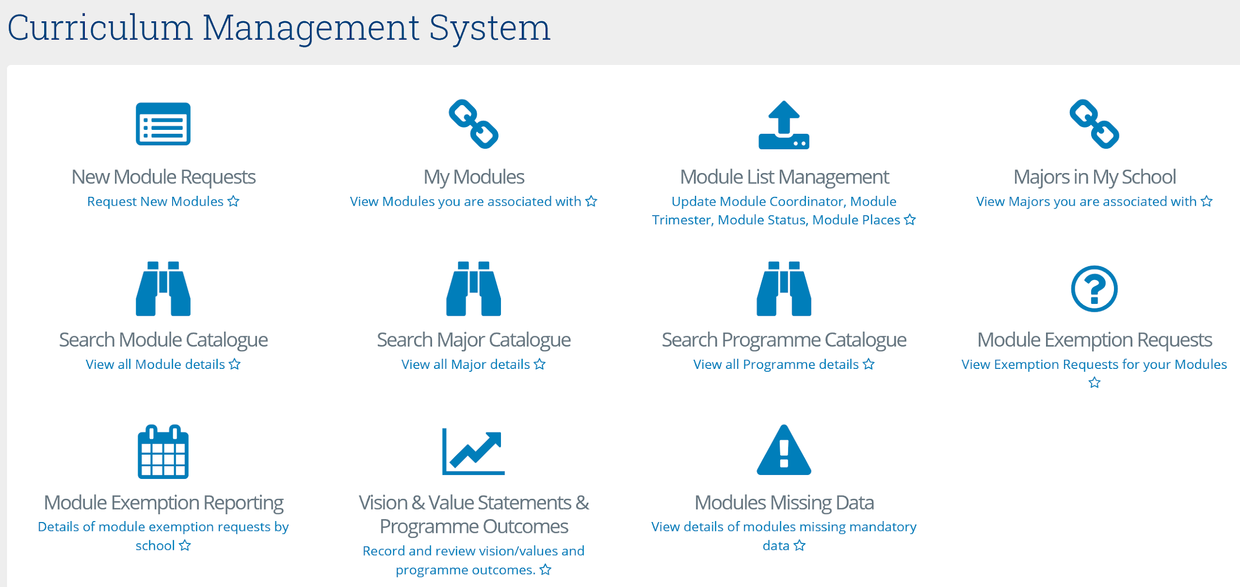
Introduction
New modules are requested on the New Module Requests menu of the Curriculum Management System (CMS).
This menu is available to staff and faculty with School/College-level access to the system, e.g., Head of School, School Head of Teaching & Learning, School/Unit Administrator, etc.
Individual Module Coordinators cannot request new modules directly. This is to avoid duplication of effort and to facilitate Schools/Units in managing their module lists.
A UCD InfoHub report, Curriculum Management Access Roles, shows people with different levels of access to the CMS within each School or Unit. Additional staff can be granted access on request to your Curriculum College Liaison.
To access the New Module Requests menu on the Curriculum Management System:
Log into InfoHub and click on the Students menu
Select Curriculum, Module Capacity & Timetables, then Curriculum Management System
Click on the New Module Requests menu
<< Back to Contents
3

Slide 4
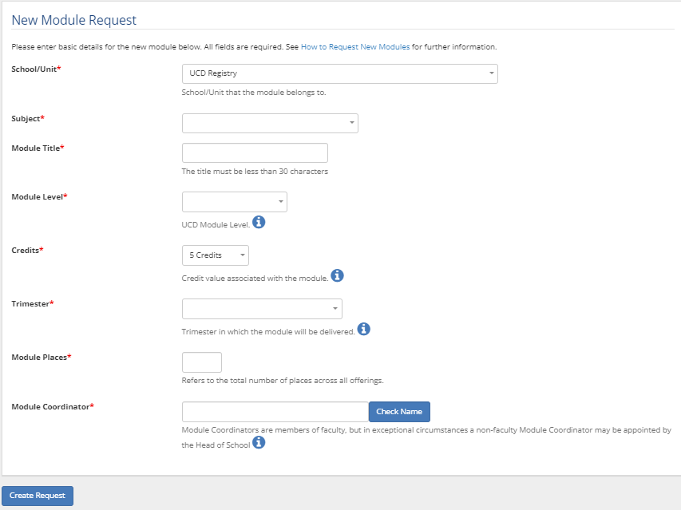
Creating a New Module Request
To request a new module, click Add New Module Request
Complete all fields and click Create Request to send your module request to the Curriculum Team for assignment of a module code.
<< Back to Contents
4

Slide 5
New Module Request: Required Fields
The following basic module details are required to set up a new module as per the Academic Regulations (section 3.18):
Field | Details
School/Unit | The School/Unit to which the module belongs
Subject | The subject associated with the module request
Module Title | Short title of the module (30 characters or less, including spaces). The long title can be edited via the module descriptor as long as the status is ‘Pending’
Module Level | The UCD level of the module, e.g. Introductory (1), Degree (3)
Credits | Credits associated with the module. Permissible credit values are described in the Academic Regulations [link] (3.18 (f))
Trimester | Trimester(s) in which module will be delivered (see explanation overleaf)
Module Places | The total number of places available on the module
Module Coordinator | Module Coordinators are members of faculty, but in exceptional circumstances a Head of School may appoint a non-faculty Module Coordinator, as outlined in section 3.16 of the Academic Regulations
<< Back to Contents
5

Slide 6
Trimesters Explained
Note: A module must be completed during a single trimester, unless it meets one of the criteria outlined in section 3.5 of the Academic Regulations
Trimester | Description
Autumn | The module is offered in the Autumn Trimester only
Spring | The module is offered in the Spring Trimester only
Summer | The module is offered in the Summer Trimester only
Two Trimesters (Autumn – Spring) | The module spans the Autumn and Spring Trimesters continuously (September to May)
Year long (12 months) | The module spans a full 12 months (3 continuous trimesters from the start of a student’s intake term)
Two Trimesters (Spring-Summer) | The module spans the Spring and Summer Trimesters continuously (January to August)
Autumn & Spring | The module is offered at least once in Autumn and at least once in Spring
Autumn & Summer | The module is offered at least once in Autumn and at least once in Summer
Spring & Summer | The module is offered at least once in Spring and at least once in Summer
Autumn & Spring & Summer | The module is offered at least once in each of the three trimesters - Autumn, Spring and Summer
<< Back to Contents
6

Slide 7
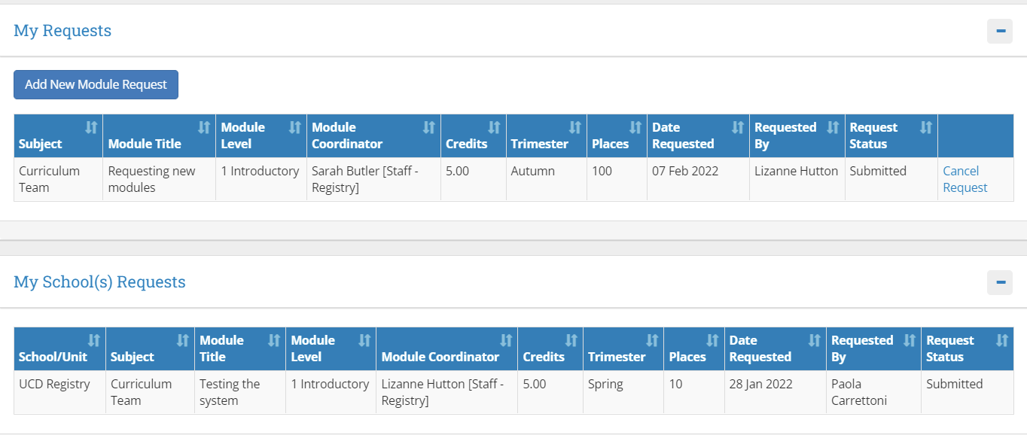
My Requests and My School Requests
The My Requests section displays new modules you have requested with statuses of:
Submitted: request has been sent to the Curriculum Team for coding
Reviewed: a code has been assigned to the request
Queried: there is a query on the new module request – please contact your Curriculum College Liaison if they have not already been in touch
If you wish to remove a request before a code has been assigned, click on Cancel request in the
right-hand column
All new module requests for your School/Unit are listed under My School Requests
Once a code has been assigned, the module is ready to be edited and will appear on the My Modules menu for the individual Module Coordinator and for those with a School/Unit Management role. It will also appear on the Search Module Catalogue menu
Note: the turnaround time for assigning codes to new modules is approximately two working days. There may be delays at peak times
<< Back to Contents
7

Slide 8
When are New Module Codes Required?
New module codes are needed when:
A module is brand new
There is a change to the credit value of an existing module
The module level changes
The learning outcomes or overall content of an existing module changes significantly
The title of an existing module changes significantly
Schools amalgamate and need new subjects to reflect the change
A new subject code is required (approved on the subject register or created for administrative purposes)
A new module code is not required when:
The Module Coordinator, or trimester in which a module is delivered, changes
Assessment strategy or module capacity is amended
A minor edit to a module title is required
Further detail needs to be added to a module descriptor
<< Back to Contents
8

Slide 9
Useful Links and Reporting
System Access and Training: contact your Curriculum College Liaison or email curriculum@ucd.ie
Curriculum Management System guides and checklists
Academic Regulations
InfoHub Reporting: key reports listed in the table below; see the Curriculum Management Reports Checklist for more comprehensive details
I want to: | InfoHub Report
Check CMS access for staff and faculty in my School | Curriculum Management Access Roles
See modules in my School for current and previous Academic Years | Curriculum Management - School Module Summary
Do a wildcard search of entire module catalogue for current or previous Academic Years across all Schools/Units | Curriculum Management - School Module Summary – Keyword Search
View details of modules missing mandatory data or with anomalies to be addressed | Modules Missing Data
View details of all modules for which I am currently the Module Coordinator and who else has access | Manage My Modules – Who has Access?
View core and option modules on a major/stage | Structures by Major
Review inactive modules on stages, majors/stages with no associated modules, option rules with no associated modules | Structures Check - Majors Missing Data
<< Back to Contents
9

Slide 10
UCD Registry
Clárlann UCD
The Curriculum Team | An Fhoireann Curaclam
Customer and Curriculum Operations | Oibríochtaí Custaiméirí agus Curaclaim
UCD Registry | Clárlann UCD
Tierney Building | Áras Uí Thiarnaigh
Belfield | Belfield
Dublin 4 | Baile Átha Cliath 4 D04 V1W8
W: https://www.ucd.ie/registry/staff/registryservices/curriculum/ E:curriculum@ucd.ie
Last updated February 2024

