Slide 1
[Unit Name]
Athena SWAN
UCD Schools Toolkit

Slide 2
Resources
For examples of successful applications, guidance documents, template action plan, survey and graph templates, go to UCD Athena SWAN Schools webpage .
Marcellina Fogarty
Equality, Diversity and Inclusion (EDI) Manager
E: Marcellina.Fogarty@ucd.ie
T: +353 (1) 7164947
Eimear O’Reilly
Equality, Diversity and Inclusion (EDI) Officer
E: eioreilly@ucd.ie
T: +353 (1) 7164979
UCD’s EDI Unit offers guidance for Schools applying for the Athena SWAN. Get in touch with your EDI contact if you have any questions about the process or to invite them to attend a Self Assessment Team (SAT) meeting.
Please also see the Athena SWAN website.
[Unit Name]

Slide 3

Before starting…
Useful things to know….
University College Dublin was awarded the Athena SWAN Bronze Institutional Award in March 2017.
UCD will have to reapply to the Equality Challenge Unit to renew its bronze award in 2020.
As part of Athena SWAN’s Bronze Award requirements, UCD has an institution level gender equality action plan (GEAP).
Please ensure consistency and support your application by reviewing UCD’s GEAP. A number of EDI developments are underway in 2017/2018 that will be available for you to implement at School level and support your application.
See GEAP on UCD Athena SWAN Schools webpage .
Equality, Diversity and Inclusion Unit

Slide 4
Content
Introduction
Why Apply to Athena SWAN?
The Awards
Athena SWAN Deadlines
Process Overview
Est. a self assessment team (SAT)
2. Data Collection
2.1 Methods?
2.2 Presenting Your Data
2.3 Storytelling with Data
2.4 Discussing your Data
2.5 What does the SAT do with the data?
2.6 Focus Groups
2.7 Benchmarking
3. Developing a Draft Submission and Organising Reviews
3.1 Application Overview
3.2 Tips
3.3 Resources for SAT Members
4. Final Sign-Off and Submission
Equality, Diversity and Inclusion Unit

Slide 5
Introduction
Athena SWAN Award recognises the advancement of gender equality and inclusion: representation, progression and success for all.
ECU’s Athena SWAN Charter was established in 2005 to encourage and recognise commitment to advancing the careers of women in science, technology, engineering, maths and medicine (STEMM) employment in higher education and research. In 2015, the charter was extended to encompass Arts, Humanities, Social Science, Business and Law (AHSSBL), professional and support staff, trans staff and students.
Equality, Diversity and Inclusion Unit

Slide 6
Why apply?
Benefits of applying to Athena SWAN
Mitigate against implicit/explicit barriers to women’s careers and discrimination
Create a dialogue and enhances trust
Attract and retain diverse talent
Enhance performance
Demonstrate commitment to creating a culture of fairness, inclusivity and transparency
Ensure the university is aligning itself to international best practice
Meeting the University Strategic Objectives
Meeting the recommendations of the HEA Gender Equality Audit
Research funding
HEAs and research councils are recognising the benefits of equality, diversity and inclusion (EDI) more and more in higher education. Some funders are positively demonstrating this commitment by ensuring grant recipients have embedded EDI best practice in their workplace and research practices.
Equality, Diversity and Inclusion Unit

Slide 7
The Awards
Bronze award
Analyse employee and student data to identify gender gaps, leaks in the pipeline and key areas of attrition.
Based on your data analysis, identify key plans to address issues.
Create an action plan for the next three years.
In addition to implementing institution-wide policies, the School is working to promote gender equality and to identify and address challenges particular to the School and discipline.
N.B. To attain Bronze the data must be reflective of the current situation in your School.
Be honest and acknowledge challenges within your School. Give an honest assessment of your School’s starting point.
Be critical, identify weaknesses and gaps to get a clear picture of your School.
Give evidence of how you’ve identified obvious areas for action and how you plan to tackle them.
Show commitment to bring about positive change by implementing the action plan. Identify quick wins and implement immediately.
Equality, Diversity and Inclusion Unit

Slide 8
The Awards cont.
Silver Award
Based on your action plan, the School needs to show significant activity, deliverables, impact and achievement.
Give evidence of how the implemented actions have shifted the culture and benefit employees at all levels.
Show ambitious plans for further actions and achievement.
Gold Award
Evidence of considerable action and impact.
Evidence that you support other Schools by sharing your best practice and ‘beacon’ activities.
Equality, Diversity and Inclusion Unit

Slide 9
Athena SWAN Deadline
Timescale (+/- deadline) | Action required
-2 months before submission | Applicants should inform ECU’s Equality Charters team of their intention to submit. Sign up to mailing list AthenaSWAN@jiscmail.ac.uk for email reminders and key contacts.
Last working day April/November. Deadline 5pm | Submissions are accepted either in April or November. Submissions should be sent in PDF format to as-submissions@ecu.ac.uk. Late submissions that are not already agreed with ECU will not be considered.
 | Schools should send ten hard copies in colour of their submissions to arrive within 5 working days of the deadline.
+2 months | Award panel takes place. Supplementary information may be requested.
+3 months | Results are sent to applicants. Feedback is sent to unsuccessful applicants. Applicants that receive awards should publish their submission on their website and inform Athena SWAN of the associated web address. Any personal or confidential information may be removed from the submission prior to publication.
+4 months | Feedback is sent for applications which received a lower level of award than applied for. Feedback is sent to applicants which were successful at the level applied for.
Equality, Diversity and Inclusion Unit

Slide 10
6 months
SAT created
Gather Data &Consultation
2 months
Submission Drafted
UCD Athena SWAN Process Overview
Mock Panel
Assessment
Changes Made
Changes Made
GEAG Review
2
weeks
Sign off by SAT
Sign off by
College Principal and GEAG
1
week
Submit Application

Slide 11
1. Est. Self-Assessment Team (SAT)
Equality, Diversity and Inclusion Unit

Slide 12
1. Est. Self-Assessment Team (SAT)
Identify a senior male/female Chair of the Self-Assessment Team (SAT) and lead for the application.
Create the SAT (identify, invite, put out call). Go to UCD Athena SWAN Schools webpage for more details.
Identify leads from the SAT to be responsible for managing and populating the application sections (max 2 leads per application section).
E.g. Section leads for: Data analysis, focus groups , internal and external consultation, identifying areas of good practice and areas requiring further development.
SAT responsibility:
Analysis of the employee and student data.
Carry out consultation.
Identify gaps, Agreeing actions and initiatives in response to the analysis.
Recommend quick wins to implement immediately;
Putting together the Athena SWAN application and action plan.
Equality, Diversity and Inclusion Unit

Slide 13
1. Est. Self-Assessment Team (SAT) -Roles
Chair of SAT
Ensure that everyone has a voice and hierarchy do not overpower discussions and decisions
That all members of the SAT take responsibility for completing tasks and the charter mark process
That SAT members are given proportionate responsibility
How many meetings will you have, when and where will they be, and for how long?
See Setting Up-SAT and Meeting and Agenda Timeline on UCD Athena SWAN School webpage.
Head of School
Submission cover letter: see SWAN Handbook, UCD Athena SWAN Schools webpage
Supporting the SAT with resources
Monitoring workload of SAT Chair etc.
EDI Units role
The EDI Unit is available to attend the initial introductory meeting and at key junctures if needed.
Provide templates, guidance, good examples of successful School applications available on the UCD Athena SWAN Schools webpage.
Will organise the GEAG to organising mock panels and provision of advice
Equality, Diversity and Inclusion Unit

Slide 14
2. Data Collection
Equality, Diversity and Inclusion Unit

Slide 15
2.1 Data Collection - Methods
There are four elements to data collection for Athena SWAN
Collect your individual school data
Examples of data to collect include:
Employee numbers (incl. grade, contract type, full/part time, clinical/non-clinical), % of staff availing of Maternity, Adoption, Paternity Leave, Parental leave etc.
Develop and undertake a school level employee and student survey
Present and discuss your qualitative data throughout the application – not just in the ‘any other comments’ section.
Survey must cover all employees and students in your School.
Qualitative and survey data can be effective in showing impact. It’s a good idea to complement your survey with data and analysis drawing on the UCD’s Culture and Engagement Survey (2016). Contact your Head of School for information on the survey.
Run focus groups in response to survey and data analysis
Focus groups and staff surveys will give you a strong sense of how people experience your Schools culture.
Identify areas of good practice and areas requiring further development.
Benchmark your staff and student data: click here for guidance
Benchmark against 1) HEA 2) HESA (UK) 3) similar disciplines and institutions throughout your application.
Templates and guidance can be found on UCD Athena SWAN Schools webpage
Equality, Diversity and Inclusion Unit

Slide 16
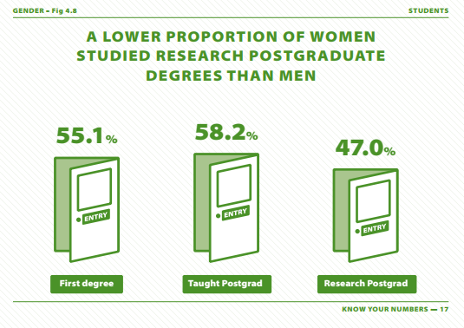
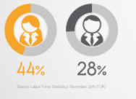
2.2 Presenting your Data
Make sure your data is easy to interpret and discuss.
Data should cover at least three years preceding the submission. (Five years for renewals & Gold submissions)
Display the data with clearly labelled graphs, charts, illustrations and infographics. (Avoid large tables of data)
Reasons should be explained where data is unavailable, and, in most cases, a relevant action included.
Make reference to percentages and raw numbers in the graphs and/or the narrative.
Data graphs should be embedded in the body of the document together with narrative responses. (Appendices are not allowed)
Please refer to the UCD Athena SWAN graph templates
See examples of other successful School submissions:
UCD Athena SWAN Schools webpage.
Reduce length of your narrative by capturing data with infographics.
Equality, Diversity and Inclusion Unit

Slide 17
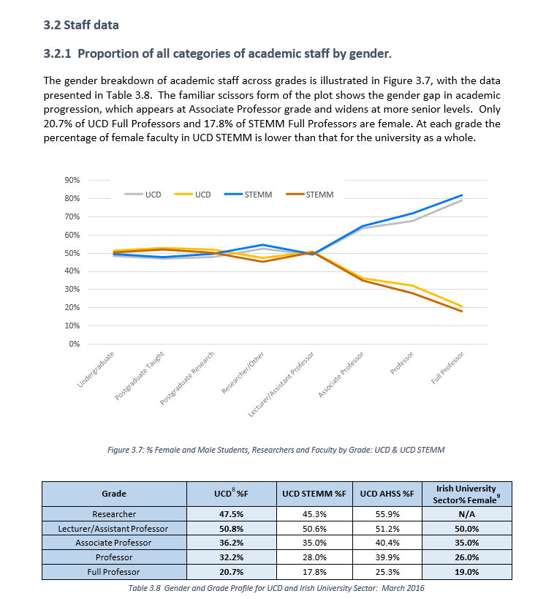
2.3 Storytelling with Data
The sample graphs in this section are reference points for your Athena SWAN applications.
How you present your data visually may vary depending on what data types you wish to display and what you are investigating.
Keep charts simple and don’t try to capture too many variables in a single chart.
Scissors chart is useful to show % increases and the closing/widening of the gap.
Excel table from which the above chart is derived.
Equality, Diversity and Inclusion Unit

Slide 18
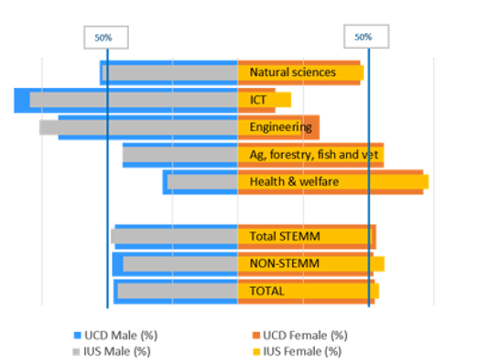
2.3 Storytelling with Data cont.
Benchmark your School data against national average. E.g. HEA data.
Equality, Diversity and Inclusion Unit

Slide 19
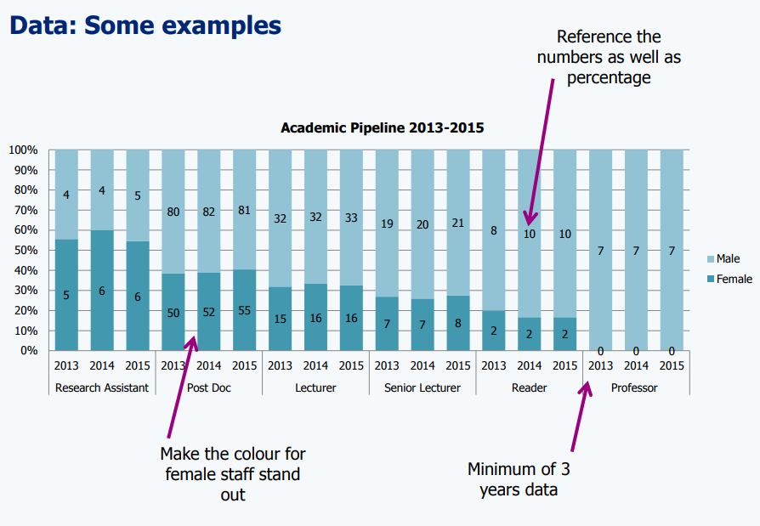
2.3 Storytelling with Data cont.
Example from University College London
Equality, Diversity and Inclusion Unit

Slide 20
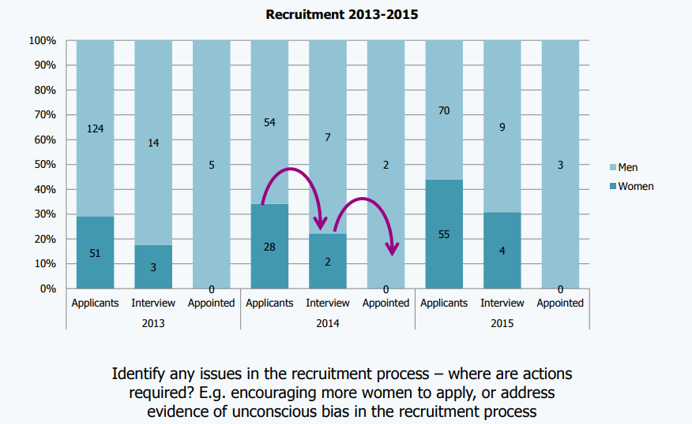
2.3 Storytelling with Data cont.
Example from University College London
Equality, Diversity and Inclusion Unit

Slide 21
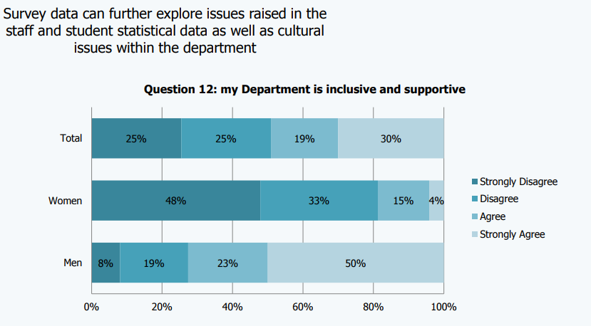
2.3 Storytelling with Data cont.
Example from University College London
Equality, Diversity and Inclusion Unit

Slide 22
2.4 Discussing your Data
Use data to inform your analysis
Consider what the data could mean and outline this
Hypothesise why trends might happen in your School
Highlight issues/areas for action throughout submission and connect them to specific actions in your action plan
Describe good practice/actions you have taken and its impact
Assume that the panel will not know anything about your School, it’s structures, policies or gender make-up. Make sure you describe processes and practices. E.g. how HR policies are implemented at school level
Please note: Describing data is not sufficient; you need to reflect on the data
E.g. stating that there are very few females in senior position is not good enough.
Follow this up with a statement saying:
“we plan to address this by doing (xyz action/s).”
Equality, Diversity and Inclusion Unit

Slide 23
2.4 Discussing your Data cont.
Things to avoid:
“The data is not statistically significant so no conclusions can be drawn and no action is planned.”
Consider qualitative data:
Having small numbers of staff is probably going to lead to stats not being significant – this doesn’t mean there isn't a trend or a leaky pipeline. Qualitative data can also help to identify issues that should be addressed.
“whilst our survey identified areas where staff were unhappy or felt unsupported, there was no gender differences in the results. Therefore we have no actions planned to address these issues.”
These issues should still be addressed:
In your application you can show that all staff have benefited, but highlight the impact for women in the School.
“…our recruitment data illustrate no clear gender bias at the point of invitation to interview or appointment, therefore no action is planned.”
Consider the following:
This may be the case but is there a large enough pool of women applying? What can you do to encourage women to apply for positions? How can you sustain increasing the pool of female candidates?
Equality, Diversity and Inclusion Unit

Slide 24
2.5 Data Collection
-What does the SAT do with the Data? cont.
Reflect on the data and develop appropriate actions to address the issues identified.
Quantitative Data: Describe and explain changes or trends identified over the three-year period.
Trends: The SAT must establish quantitative trends on gender. For example:
  How many women are employed at different levels?
  How many women and men take maternity/paternity/parental leave and return to work?
  The take up of flexible work arrangements amongst male and female members of academic, professional and technical staff?
  Induction, training and outcomes e.g. if women undertake leadership courses, do they secure promotions or other benefits such as committee membership as a result?
  Gender representation in school committees and in work undertaken beyond the school/institution?
  Workload allocation and recognition of teaching, research, administration and other roles?
  Gender bias in promotions and in other processes?
  Among students, gendered patterns in recruitment, subject choice, retention, progression, achievement and graduate destinations?
Equality, Diversity and Inclusion Unit

Slide 25
2.5 Data Collection
Survey–What does the SAT do with the Data? cont.
Surveys and Focus Groups
Qualitative Data: Complement quantitative data with qualitative information
  Use surveys and focus groups to generate qualitative data.
  Running a survey will give you a sense of how staff/students experience your School’s culture, development opportunities and any issues that may need resolving. This is an Athena SWAN requirement.
  Give the school an opportunity to share what they think it means, too.
  Reflect on what you think the data means and report back to your school.
  Follow up with a focus group/consultation
  Consult with staff and students to understand the data and to identify and plan actions to tackle issues.
  Ensure both quantitative and qualitative data are incorporated throughout the submission.

Slide 26
2.5 Data Collections
Survey- What does the SAT do with the Data? cont.
Aim to get a response rate of no less than 70%-80%.
Ask HoS to send out survey, include opportunity to win a gift voucher, line-up a number of communications to promote survey, ask team leads/line managers to ask their teams to complete survey.
Include an introduction to your survey outlining its purpose and benefits, how the data will be used, by whom.
State that the survey will be anonymous and optional.
Ensure the wording of questions produce data that can support development of your action plan.
Include an about section at the end of the survey so you can analyse data by gender, career stage, contract type, full-time/part-time/flexible working etc.
Don’t ask unnecessary questions.
Have multiple choice questions and some open ended questions.
The data you share with respondents/focus group etc. should not make anyone identifiable. See Data Protection checklist to ensure you are compliant.
Have engaging questions to gain respondents opinions.
Follow up with consultation/focus group session.
Equality, Diversity and Inclusion Unit

Slide 27
2.5 Data Collection
Focus Groups -What does the SAT do with the Data? cont.
After completing your survey hold focus groups in response to survey results.
Focus groups will give you a strong sense of how people experience your Schools culture.
Identify areas of good practice and areas requiring further development
Conduct focus groups with employees and students groups
You can organise 1 or 2 big focus groups or a number of smaller focus groups
Hold focus groups following survey as themes will emerge from survey analysis that need to be followed up on in greater details
Carrying out Focus Groups - guidance on undertaking focus group can be found on UCD Athena SWAN Schools webpage .

Slide 28
2.7 Data Collection – Benchmarking What does the SAT do with the Data? cont.
Benchmarking
2.1.3) Putting your data into context
  Benchmarking provides context and comparison in your sector. It highlights good practice to inform actions.
  Benchmark data against 1) HEA 2) HESA (UK) 3) similar disciplines and institutions throughout your application.
  For ideas on how to benchmark, see Sample application
  Consider how your gender representation compares to different national benchmarks, and how these relate to your own discipline focus, and what this could mean in terms of setting targets and aspirations.
  For example, when looking at recruitment, you can seek to benchmark the proportion of applications against the expected poll of applicants. Through this, you may more readily identify whether your recruitment outcomes are supporting your gender equality ambitions, and whether your targets are appropriate.

Slide 29
3. Develop Draft Submission & Schedule Reviews
Discuss findings with SAT members.
SAT lead is responsible for managing the collation of the various sections into a draft submission.
Circulate draft submission to all members and seek their views.
Identify potential action points to address areas requiring further development, i.e. signposting of the promotion criteria.
Compile an action plan with SMART objectives. This must be submitted as part of your application. Please see:
1. UCD’s Institution level Gender Equality Action Plan (GEAP) to ensure consistency and support your application.
2. Template GEAP
3. Use UCD’s Athena SWAN School Checklist.
Above documents are available on UCD Athena SWAN Schools webpage .
Once the SAT have signed off on the draft application submit to mock panel for initial review.
N.B. Contact EDI Unit 2 months in advance of initial review to organise a mock panel and an executive panel to review your application.
Discuss feedback and incorporate any relevant changes from mock panel.
Resubmit draft submission to the Gender Equality Action Group.
Discuss feedback and incorporate any relevant changes.
Equality, Diversity and Inclusion Unit

Slide 30
3.1 Application Overview
School application | Bronze | Silver
Word limit | 10,500 | 12,000
Recommended word count
1. Letter of endorsement | 500 | 500
2. Description of the School | 500 | 500
3. Self-assessment process | 1000 | 1000
4. Picture of the School | 2000 | 2000
5. Supporting and advancing women’s careers | 6000 | 6500
6. Case studies | n/a | 1000
7. Further information | 500 | 500
8. Develop Action Plan
For detailed guidance on section requirements see Athena SWAN Handbook.
Equality, Diversity and Inclusion Unit

Slide 31
3.2 Tips
Download: Athena SWAN Application Form
Keep Athena SWAN principles in mind. Indicate how your application engages with them wherever possible.
Keep approach analytical, reflective, and action-oriented.
Present quantitative and qualitative data.
Give evidence of good practice and recent innovations.
Be honest about actions that have not worked or need further refinement. Be action oriented about refinement.
Use the data to engage assessor about how your school is making advances on gender inclusion. Use quotes from the surveys/focus groups and images.
Word length is limited! Use data visualisations and visuals (e.g. photos, infographics) to tell your story.
Take every opportunity to link reflection to action.
Always fill in Section 7:‘Further Information’ (See Athena SWAN Handbook for details).
As well as an emailed application, submit 10 printed colour copies. Colours in graphs should be distinguishable when printed. (Avoid pink and blue)
Equality, Diversity and Inclusion Unit

Slide 32
3.3 Resources for SAT Members
Email Athena SWAN and join the JISK mailing list: AthenaSWAN@jiscmail.ac.uk for Athena SWAN, events and institutions working on Athena SWAN awards updates here.
Volunteer to become an observer of an Athena SWAN assessment panel.
Get valuable tips on the application process, application expectations and assessment.
Get in touch with UCD’s EDI unit if you would like to reach out to UCD’s GEAG
Use the Equality Challenge Unit and the manager for Ireland: Sarah Fink Athena SWAN Programme Manager Ireland
T: +44 (0)20 7269 6541 E: sarah.fink@ecu.ac.uk
Find templates, handbooks and successful applications from other universities here.
Check out FAQs to see if your query has been answered.
Please refer to the UCD Athena SWAN Schools website and Athena SWAN School Handbook
Equality, Diversity and Inclusion Unit

Slide 33
3.3 Resources for SAT Members contd.
There are a number of training courses available to UCD employees that you can promote/organise within your School to support gender equality and your application.
Training
Unconscious Bias E-Training (available from December 2017) All staff should undergo this online training.
Professional Development
Coaching
Mentoring
Networks
WITS: Women in the Sciences
UCD are a member of 30% club
Equality, Diversity and Inclusion Unit

Slide 34
4 Final Sign Off and Submission
Complete UCD’s Athena SWAN School Checklist. Available on UCD Athena SWAN Schools webpage.
Submissions should be emailed in one pdf and 10 x hard copies printed in colour sent by post.
Send to your Athena SWAN Programme Manager, Sarah Fink.
Email: as-submissions@ecu.ac.uk.
Address:
Sarah Fink,
Athena SWAN Charter, Equality Challenge Unit, 7th Floor, Queens House, 55/56 Lincoln’s Inn Fields,
London WC2A 3LJ,
England.
Equality, Diversity and Inclusion Unit

Slide 35
References
I wish to acknowledge the ECU, UCL, Newcastle University, University of Surrey whose graphs I have referenced and which provided a background from which this toolkit was customised:
Equality Challenge Unit
http://www.ecu.ac.uk/equality-charters/athena-SWAN/athena-SWAN-ireland/
Newcastle University
http://www.ncl.ac.uk/media/wwwnclacuk/abouttheuniversity/files/Athena%20SWAN%20Toolkit.pdf
University College London
http://www.ucl.ac.uk/hr/equalities/gender/1.%20UCL%20SWAN%20Toolkit-%202015.pdf
University of Surrey
https://www.surrey.ac.uk/equalityanddiversity/about/groups/gender/athena_SWAN/Athena%20SWAN%20Guidance%20Documentation%20February%202015.pdf
Equality, Diversity and Inclusion Unit

Slide 36
Equality, Diversity and Inclusion Unit
Thank You!
Go raibh maith agat!

