Slide 1
Welcome to
the Engineering Programme Briefing (DN150)
7th September, 2016

Slide 2
Engineering Programme Briefing
Dr Neal Murphy (Programme Coordinator)
9.40 am B005 Health Science Centre
neal.murphy@ucd.ie

Slide 3
Other Important Programme Contacts:
Dean of Engineering – Prof David FitzPatrick
Programme Manager – Mary Bushe
Programme Office Director – Sue Philpot
Student Advisor – Colleen Doyle
(All contact details in your “Guide to First Year” booklet
and Online)

Slide 4
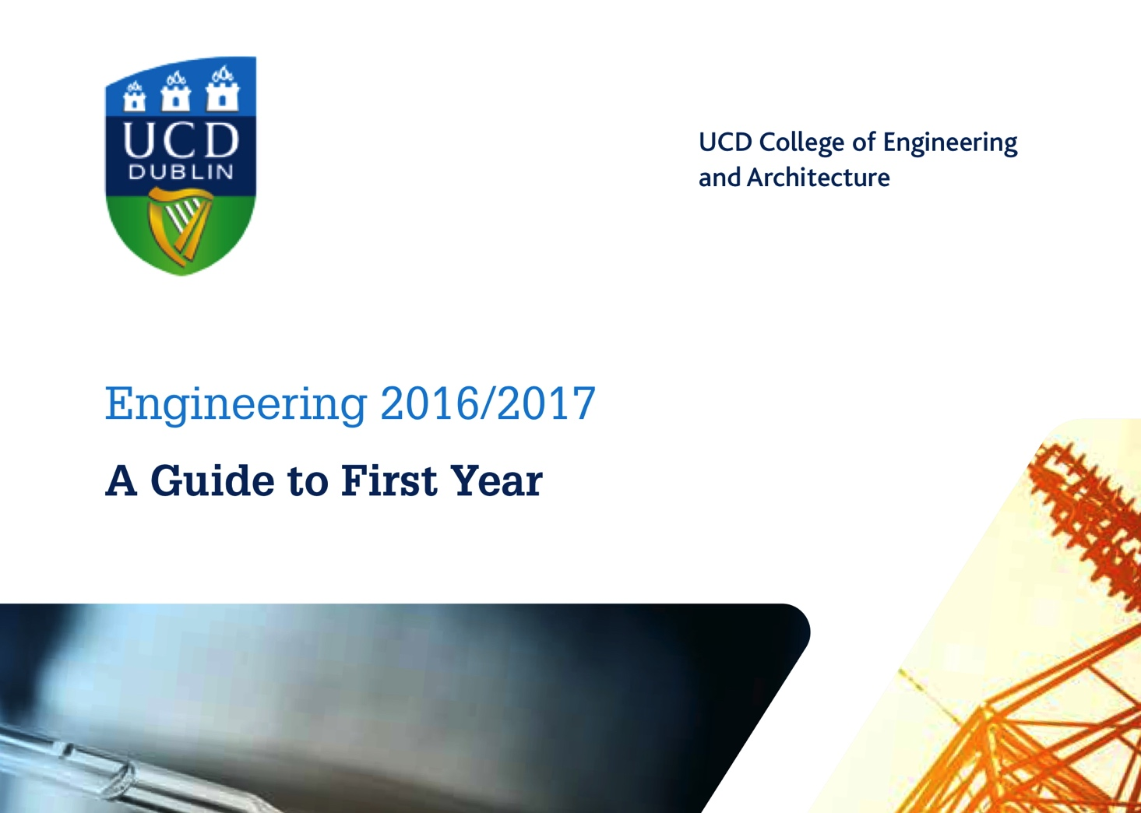

Slide 5

Stage 1 Semester 1 Engineering DN150
2016-17 Academic Year
Semester 1
Physics for Engineers I
Chemistry for Engineers
Intro Calculus for Engineers
Creativity in Design
Mechanics for Engineers
Electronic and Electrical Engineering I
NO ELECTIVES IN SEMESTER 1
Practicals / Tutorials: You need to register to the associated practical/tutorial sessions to suit your timetable.

Slide 6
ENGINEERING at UCD (2016-17)
Stage One , Semester One
(6 core modules)
  Lectures (~14 per week x 12 weeks in 6 Modules)
  Practicals (~9 contact hours per week)
  (Physics, Chemistry, Design, Electronic Engineering, Mechanics)
  Tutorials (~2 contact hours per week)
    (Mathematics, Physics, Design, Mechanics)
  (Average Semester One contact time = 25.6 hours per week for 12 weeks)

Slide 7
ENGINEERING at UCD (2016/17) CONTACT HOURS
Stage One, Semester One

Slide 8
Example – Stage 1 Semester 2 Engineering DN150 2016-17 academic year
Semester 2
Physics for Engineers II
Energy Engineering
Linear Algebra for Engineers
One Option from list of 3;
Chemical Engineering Process Principles
Computer Science for Engineers I
Design and Materials
Two free Electives (taken from within or outside Engineering).
Remember!
In-Programme Electives
eg. “Energy Challenges”
Practicals / Tutorials: You need to register to the associated practical/tutorial sessions to suit your timetable.
Refer to “A Guide to First Year” for more information.

Slide 9
MODULE LEVELS
LEVEL SUMMARY DESCRIPTION
        0 Foundation/Access
        1 Introductory (e.g. MEEN10050)
        2 Intermediate
        3 Degree
        4 Masters
        5 Doctoral

Slide 10
CREDITS & WORKLOAD
The CREDIT is a unit of currency, part of the European Credit Transfer System (ECTS), which is designed to allow movement of students between European Universities.
Each 5-credit module corresponds to about 100-125 hours of student effort (including attendance at lectures, tutorials, practical work, and time spent on assignments, study, examinations, etc.)
Taking six 5-credit modules over a 15 week semester implies an average of 40 to 50 hours per week – of overall student effort.

Slide 11
Essential Advice
Attend Lectures.
Take all the help you can get (Attend Tutorials).
Aim for an ‘A’ in Lab Reports & Assignments.
Be Organized – have a plan & stick to it.
Download Last Year’s Exam Papers
& use these as a study guide.

Slide 12
Selecting Option Modules
If You Wish to Study | You are Recommended to Take
Chemical & Bioprocess | CHEN 10010 Chemical Eng. Process Principles
Civil, Mechanical or Biomedical | MEEN 10060 Design & Materials
Electrical, Electronic, Electronic and Computer, Electrical Energy, Energy Systems | COMP 10060 Computer Science for Engineers I

Slide 13
In-Programme Electives
Chemical Engineering Process Principles
Computer Science for Engineers I
Design & Materials
Biosystems Engineering Design Challenge
Energy Challenges
Biopharmaceuticals Industry in Ireland
Introduction to Civil & Environmental Engineering
Robotics Design Project

Slide 15
STRONG RECOMMENDATION;
DO NOT REGISTER FOR AN ELECTIVE IN SEMESTER ONE!
(7 Modules in one Semester is too many)

Slide 16
Remember …
You MUST PASS every module
There is no escape …
Usually Resit Exam at Christmas or Summer

Slide 17
Good Tip…
Final 2 hr Exam usually worth 60%
Coursework typically worth 40%
Well worth the effort to do as well as possible in your Coursework
(Lab reports, homework assignments, class tests)

Slide 18
Important Dates - Reminder
Module registration closes 23 September 2016. Any semester one modules dropped after that date will be subject to fees and will appear on your academic record.
Allocation of provisional electives takes place on the afternoon of Friday, 9 September and Saturday, 10 September. Check your UCD Connect email on Saturday, 10 September to see if you were successful in getting a place on your chosen module.
More general elective places can become available, consult
http://www.ucd.ie/students/moduleplaces.html
In-programme electives are allocated on first-come first-served basis.
Monday 12 September 2016 - Lectures start at 9.00 am.

Slide 19
ASSESSMENT
Continuous Assessment:
Takes place in all modules over the Semester,
eg. MCQ’s; in-class tests/quizzes; lab practicals
Exams at end of Semester 1:
Most modules use 2-hour examinations
Revision week: 3rd to 9th December 2016
Exams take place 10th to 22nd December 2016
Exams at end of Semester 2:
Fieldwork/Study period: 13th March to 26th March
Revision week: 29th April to Sunday 7th May 2016
Exams take place 8th to 19th May 2017

Slide 20
Grade | Grade Point | Description
A+ | 4.2 | Excellent
A | 4.0
A- | 3.8
B+ | 3.6 | Very Good
B | 3.4
B- | 3.2
C+ | 3.0 | Good
C | 2.8
C- | 2.6
D+ | 2.4 | Pass
D | 2.2
D- | 2.0
E | 1.6 | Marginal fail
F | 1.0 | Unacceptable
G | 0 | Wholly unacceptable

Slide 21
Typical Mechanics Results

Slide 22
GRADE POINT AVERAGE (GPA)
At the end of a Stage, all the grade points are averaged to get a Grade Point Average.
"Honours" Grades for a Degree
Degree "Honours" classification is based on weighted calculation:
Weighted by a factor of 7 for the final Stage and weighted by a factor of 3 for the penultimate Stage.
However, your performance in all Stages is important for progression and your overall degree GPA!

Slide 23
"Honours" Grades for a Degree
GPA | AWARD
> 3.68 | First Class honours
3.08 to 3.67 | Second Class Honours, Grade 1
2.48 to 3.07 | Second Class Honours, Grade 2
2.00 to 2.47 | Pass

Slide 24
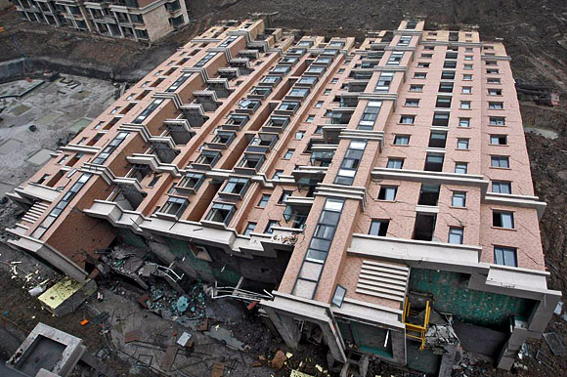
At 5:30am on June 27, 2009, an unoccupied building still under construction in Shanghai city toppled over.

Slide 25
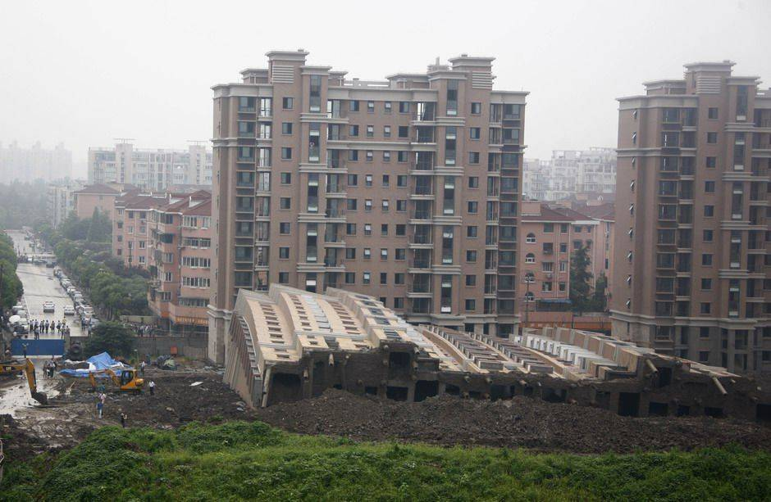
At 5:30am on June 27, 2009, an unoccupied building still under construction in Shanghai city toppled over.

Slide 26
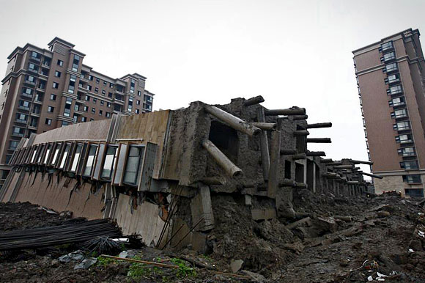
At 5:30am on June 27, 2009, an unoccupied building still under construction in Shanghai city toppled over.

Slide 27
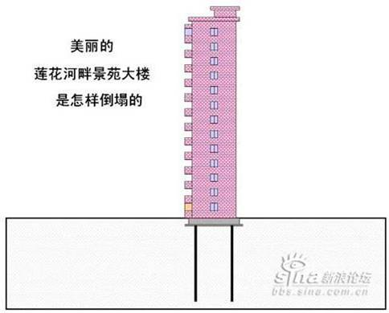

Slide 28
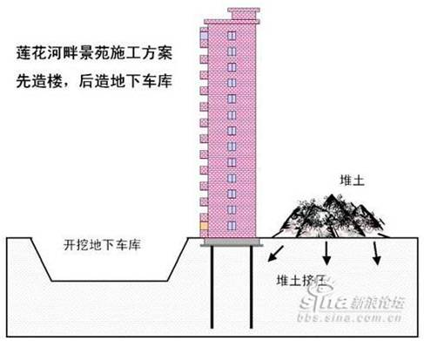

Slide 29
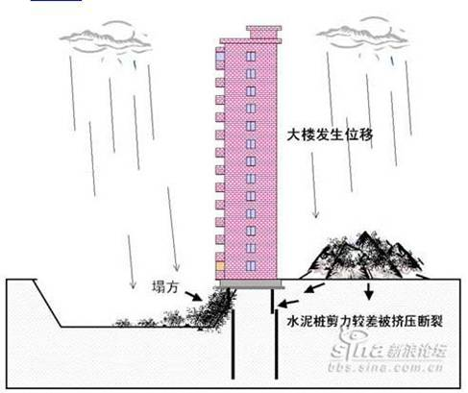

Slide 30
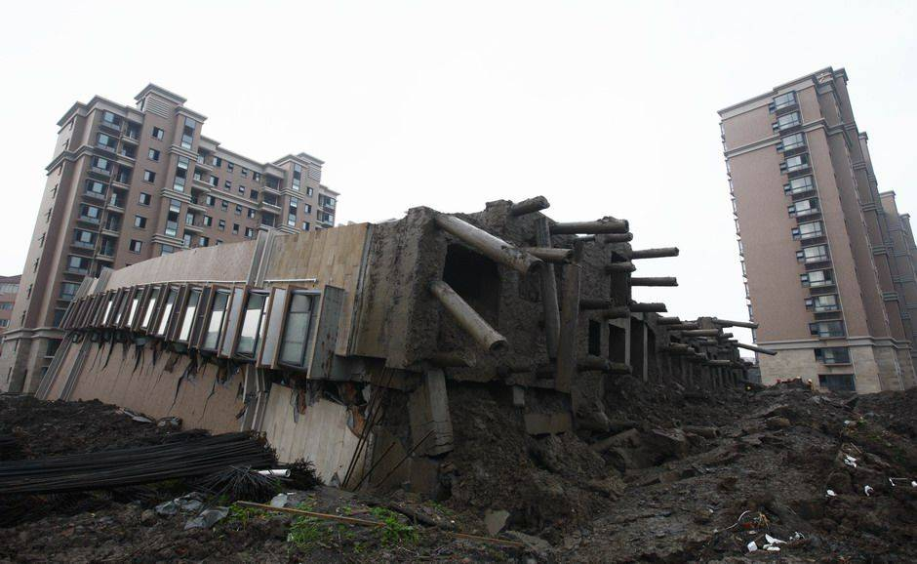
Buyers are clamouring to get their money back. Authorities are making efforts to reassure them.

Slide 31
Becoming a Chartered Engineer
(C.Eng)
Complete a degree programme which is accredited by Engineers Ireland*, and
Have a minimum of four years postgraduate training and engineering experience.
* Graduates of accredited programmes are recognised in 29 European countries and are accepted as equivalent by professional bodies in Australia, Canada, Hong Kong, Japan, New Zealand, South Africa, UK and USA.

Slide 32
Chartered Engineers of the Future
The registered professional title of Chartered Engineer is recognised internationally.
“Engineers Ireland” regulations:
Engineers graduating from 2013 onwards
will need a 5-year accredited
Master degree (or equivalent).

Slide 33
UCD Engineering Degree Programmes
4-Year BE Degree
5-Year BSc + ME Degrees (with specialisations)
  Graduate with BSc (Engineering Science) + ME (Master of Engineering) degrees.
  Accredited professional engineering qualification.
5-Year BSc + ME (Structural Engineering with Architecture)
  Graduate with BSc (SEwA) + ME (Master of Engineering) degrees.
  Accredited Professional Engineering qualification.

Slide 34
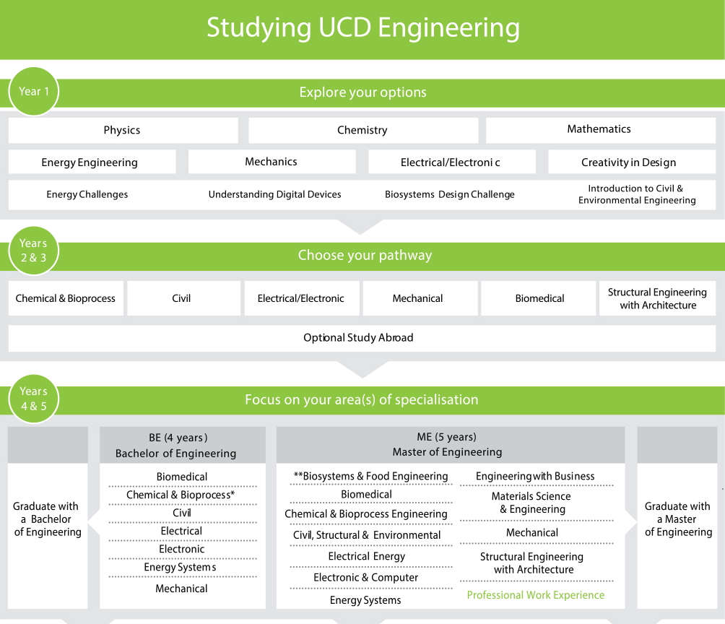

Slide 35
BE Degrees Available
(for 2016 entrants)
Biomedical Engineering
Chemical and Bioprocess Engineering
Civil Engineering
Electrical Engineering
Electronic Engineering
Energy Systems
Mechanical Engineering

Slide 36
ME Degrees Available (for 2016 entrants)
Biomedical Engineering
Biosystems Engineering
Civil Engineering
Electronic and Computer
Engineering
Energy Systems
Engineering
Electrical Energy
Engineering
Materials Science Engineering
Mechanical Engineering
Engineering with
Business
Civil, Structural & Environmental Engineering
Structural Engineering with Architecture

Slide 37
Which Discipline Should I Choose?
We will Run Lunchtime Information Sessions Later in the Semester
Introduction to the Disciplines and Course overviews
Speakers (UCD Engineering Graduates) will Describe their Careers
Tea & Coffee afterwards to meet speakers & find out more
More sessions Next Semester - More details about the courses & You will Meet a Selection of Students to tell you the Real Story!

Slide 38




Introduction to UCD Library:
…OR…how the Library can help you with your studies!
UCD Library
An Leabharlann UCD
Notes:
I’m going to start with the introductions: to the Library and to the Librarians who are here to help you.
This presentation is designed to give students an overview of what the Library can offer them as they begin their studies at UCD. The bits on findit may be left out if irrelevant at this stage, for say 1st years.

Slide 39
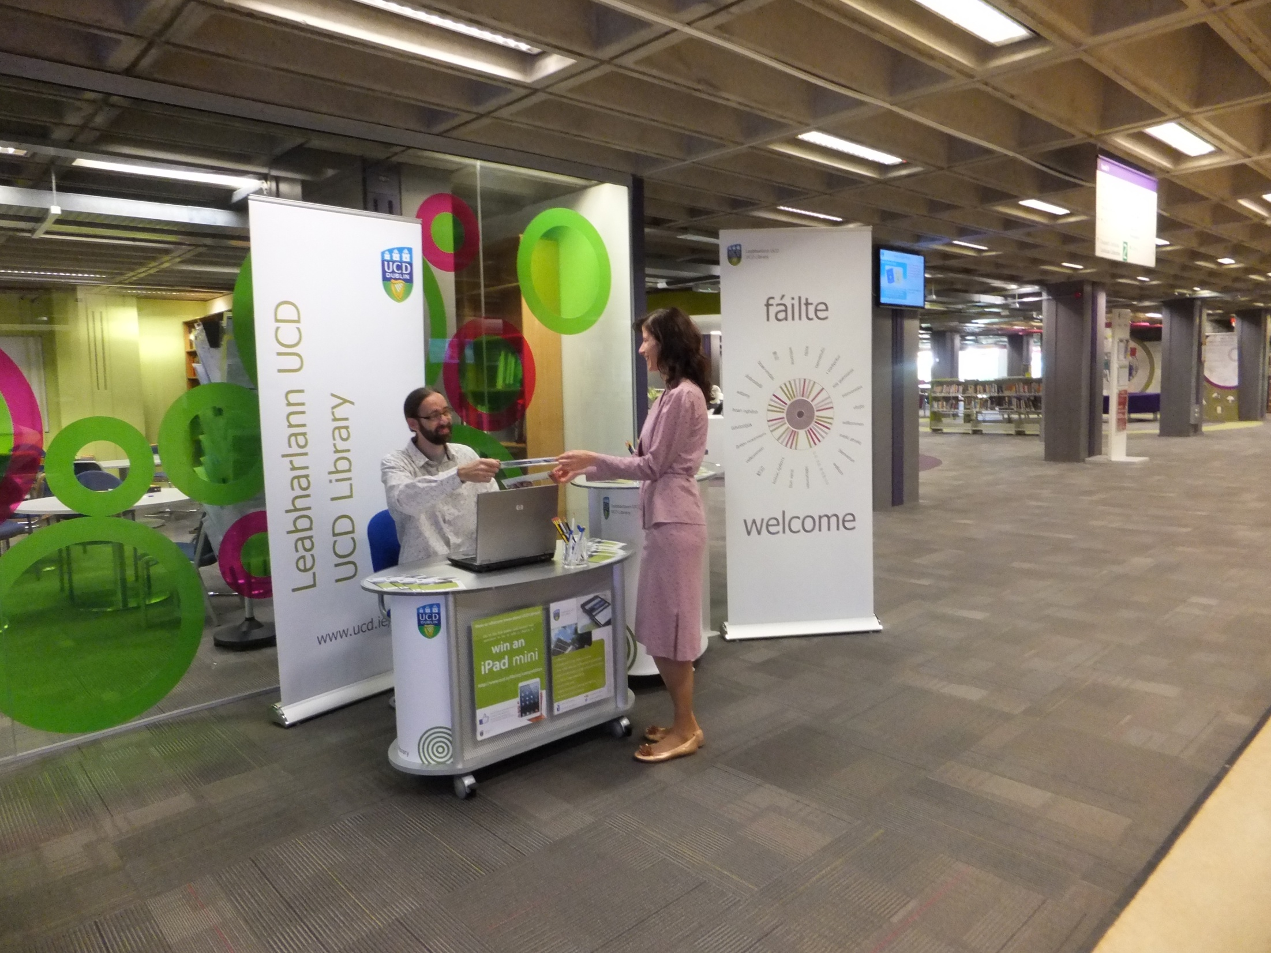
Information Desk

Slide 40

Students
Information Desk
Level 1, James Joyce Library
Advice & assistance with Library services, resources and information
James Joyce Tours daily. Last for half an hour
Notes:
JJL New Students Information Desk – optional slide

Slide 41
SEMESTER ONE CORE MODULE
CVEN 10040 CREATIVITY IN DESIGN
Need to acquire some equipment for sketching and model making
SU Shop (Library Building):
Drawing Pad – A3 Cartridge (approx 115 g/m² but not less than 100g/m²)
A5 Sketch Book (approx 100g/m²)
Pencils – B, 2B
Pencil Sharpener
Eraser
Set square - 30⁰/60º 30cm side with mm gradation measurement
1 non-permanent marker (medium Black)
Small object (corkscrew, pepper mill, hand tool)
Cost approx €8
Details of Group requirements will be posted on Blackboard and in the Student Handbook for this module and discussed at the first lecture. Group Pack costs €44 divided between 4 to 5 students

Slide 42
Important Announcement
Some changes may have been made to the locations of your lectures.
If you printed out your personalized timetables last week please reprint them to get up to date information

Slide 43
Communications
UCD Connect email is the primary channel for official UCD communications.
You will have received information regarding your computer and email account when offered your place in UCD.
It is the responsibility of each student to regularly
check their UCD Connect email account.
Please Set Up Your Mail Accounts so that You
Automatically Pick Up Your UCDconnect Mail.
Please CHANGE YOUR PASSWORD TO SOMETHING MORE SECURE.

Slide 44
Thank You for Your Attention
Contact Details:
Dr Neal Murphy (Programme Coordinator)
Office: Room 313 Eng & Materials Science Centre
Email: Neal.Murphy@ucd.ie

